Slide 1
SPRING MVC
MODEL-VIEW-CONTROLLER

Slide 2
Introduction to mvc
MVC is abbreviated as Model View Controller is a design pattern created for developing applications specifically web applications. As the name suggests, it has three major parts. The traditional software design pattern works in an "Input - Process - Output" pattern whereas MVC works as "Controller -Model - View" approach. With the emergence of the MVC model, creation of application takes different aspects individually into consideration. These aspects of the application are:
UI Logic
Input logic
Business Logic
But there is a loose coupling between these aspects or elements. According to this model, each element needs to exist in an application but not tightly connected or interlinked. The UI logic deals with the view or front end of the application. The Input logic deals with the controller. Lastly, business logic deals with the model of an application. This loosely coupled element helps developers handle development complication when building any application. It helps users' enables in focus on one specific element of the implementation at a time. Take a scenario where you are working with business; you can specifically deal with that and focus on the business logic building without depending on the view logic.

Slide 3
Main components of mvc
MODEL : The Model encloses the clean application related data. But the model does not deal with any logic about how to present the data.
VIEW : The View element is used for presenting the data of the model to the user. This element deals with how to link up with the model's data but doesn't provide any logic regarding what this data all about or how users can use these data.
CONTROLLER : The Controller is in between the model and the view element. It listens to all the incident and actions triggered in the view and performs an appropriate response back to the events.

Slide 4
HTTP REQUEST
PRESENTATION
1
MODEL
5
CONTROLLER
6
VIEW
2
RESPONSE
4
INTERACTION WITH DATABASE
3
DATABASE

Slide 5
Spring mvc
A Spring MVC is a Java framework which is used to build web applications. It follows the Model-View-Controller design pattern. It implements all the basic features of a core spring framework like Inversion of Control, Dependency Injection.
A Spring MVC provides an elegant solution to use MVC in spring framework by the help of DispatcherServlet. Here, DispatcherServlet is a class that receives the incoming request and maps it to the right resource such as controllers, models, and views.

Slide 6
Front controller(dispatcher servlet)
In Spring Web MVC, the Dispatcher Servlet class works as the front controller. It is responsible to manage the flow of the Spring MVC application.
Every request from the clint is sent to front controller and the front controller will decide which controller should be called for that request.
We no need to create front controller spring mvc will provide us.
All the requests from web.xml are sent to front controller.

Slide 7
Handler mapping
Handler Mapping works as helper for Dispatcher servlet. It helps to identify appropriate controller bean to Dispatcher servlet.
It identified controller bean with URL. It matches the name in URL with controller bean.
If it matches it will return back it to dispatcher servlet. finally the servlet executes the business method of controller and returns ModelAndView object back to dispatcher servlet.
By default the dispatcher servlet uses the BeanNameUrlHandlerMapping to map the incoming request.

Slide 8
Controller
Any class specified with @Controller annotation serves the role of controller.
Controller acts as an interface between view and model.
Dispatcher servlet sends the request to the controller and controller returns the model and view.

Slide 9
View resolver
After getting the model and view from controller the dispatcher servlet takes the help of view resolver for which view we have to send as response to the request.

Slide 10
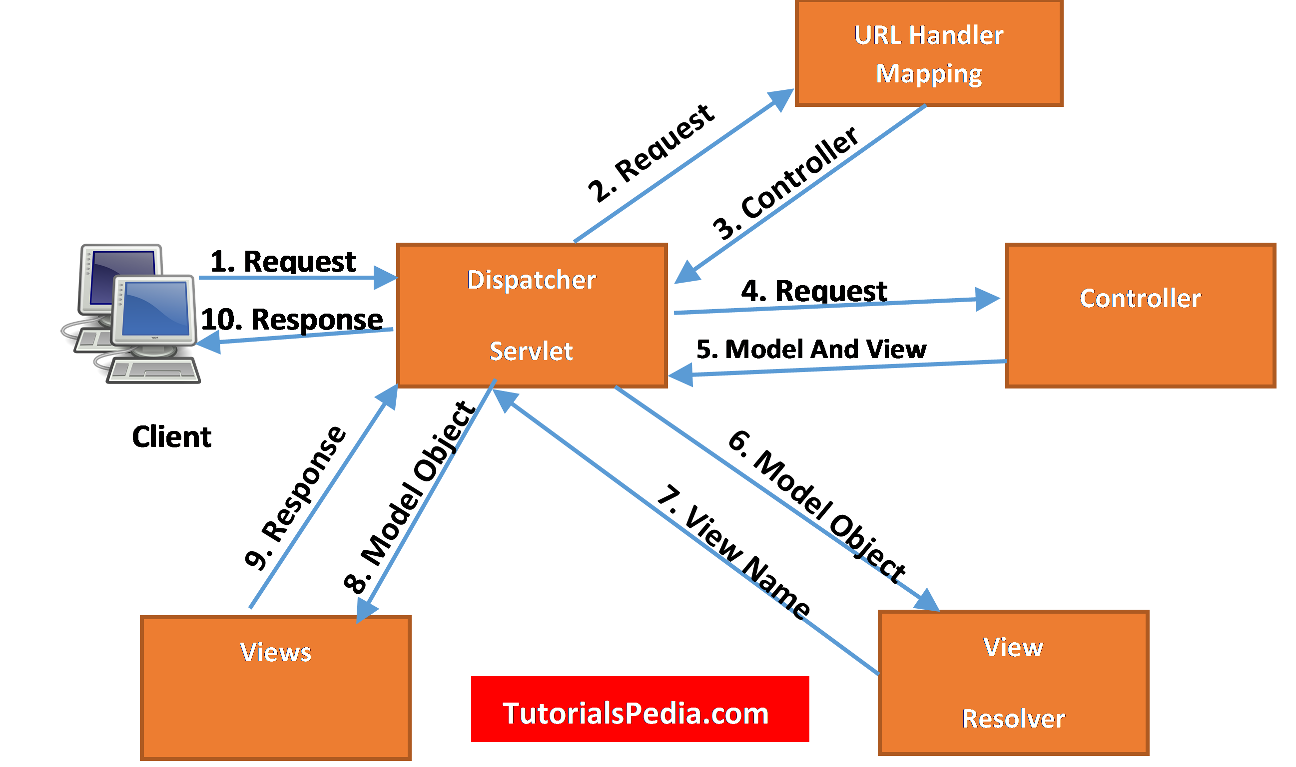
WORK FLOW OF SPRING MVC
WORK FLOW

Slide 11
MODEL IN SPRING MVC
In spring mvc, the model works as a container that contains the data of the application. Here, the data can be in any form such as objects, strings, information from the databse,etc.
It is required to place the Model interface in the controller part of the application. The information provided by the user can be passed to Model interface and view page can easily accesses the data from the model part.

Slide 12
Model and view
ModelAndView is a holder for both Model and View in the web MVC framework. These two classes are distinct; ModelAndView merely holds both to make it possible for a controller to return both model and view in a single return value. The view is resolved by a ViewResolver object; the model is data stored in a Map .

Slide 13
Annotation | Description
@Controller | The @Controller annotation indicates that a particular class serves the role of a controller
@RequestMapping | One of the most important annotations in spring is the @RequestMapping Annotation which is used to map HTTP requests to handler methods of MVC and REST controllers. In Spring MVC applications, the DispatcherServlet (Front Controller) is responsible for routing incoming HTTP requests to handler methods of controllers.
@ModelAttribute | The @ModelAttribute annotation binds a method parameter or method return value to a named model attribute and then exposes it to a web view.
@PathVariable | @PathVariable annotation is used to extract the value from the URI. It is most suitable for the RESTful web service where the URL contains some value.

Slide 14
Annotation | Description
@Configuration | @Configuration annotation which indicates that the class has @Bean definition methods. So Spring container can process the class and generate Spring Beans to be used in the application. This annotation is part of the spring core framework.
@ComponentScan | @ComponentScan annotation along with the @Configuration annotation to specify the packages that we want to be scanned. @ComponentScan without arguments tells Spring to scan the current package and all of its sub-packages.

