Slide 1
Financial Sales Dashboard
Data Analyst Internship – Task 4
Prepared By: Sumit Suman
Tool Used: Power BI
Dataset: Financial Sample Dataset

Slide 2
Project Overview
Objective: Design an interactive dashboard for business stakeholders.
Tools Used:
• Power BI
• Excel Dataset
Features:
• KPI Cards
• Sales Trend Analysis
• Product Performance Analysis
• Segment Analysis
• Interactive Filters

Slide 3
Dashboard Components
KPIs:
• Total Sales: 18.25M
• Total Profit: 2.31M
• Units Sold: 162.42K
• Gross Sales: 19.83M
Visualizations:
• Line Chart
• Donut Chart
• Bar Chart
• Slicers

Slide 4
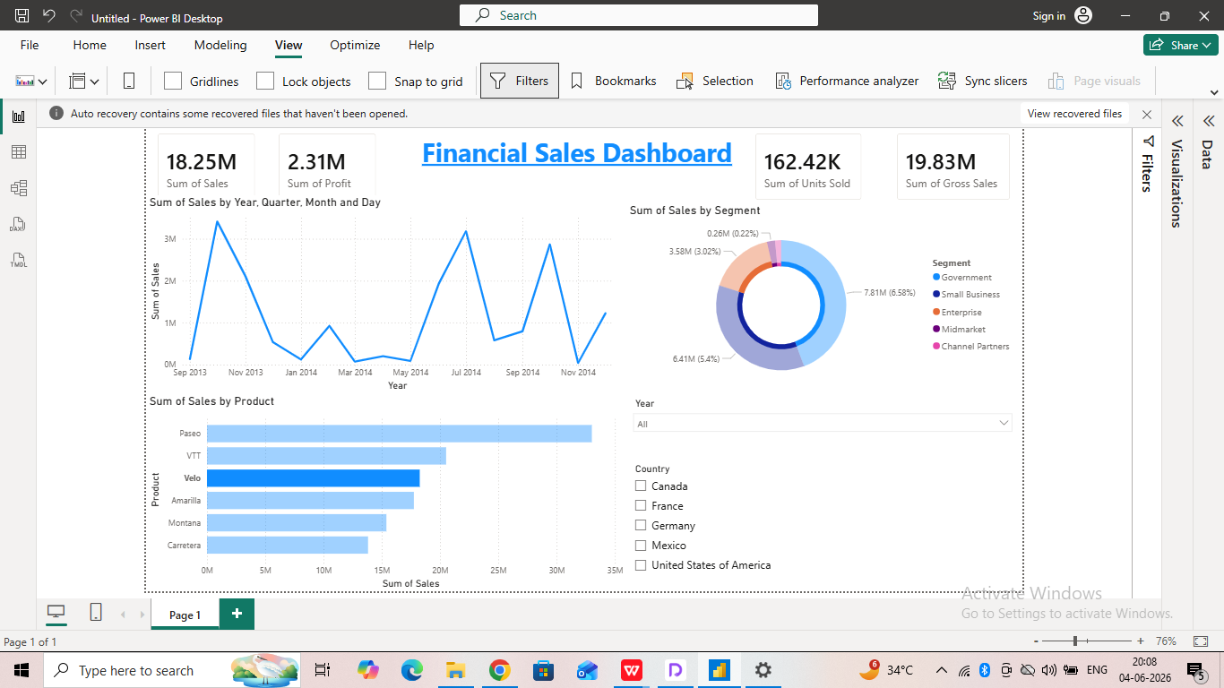
Dashboard

Slide 5
Key Insights
• Sales fluctuated across months.
• Peak sales observed during 2014.
• Paseo generated the highest sales.
• Government segment contributed the largest share of sales.
• Filters allow analysis by Year and Country.

Slide 6
Conclusion
• Dashboard provides a clear overview of business performance.
• Interactive filters support decision-making.
• Visualizations help identify trends.
Future Improvements:
• Growth analysis
• Regional analysis
• Forecasting

