Slide 1
Machine Failure Prediction Using Sensor Data
Sumit Dey
About Dataset :-
Dataset Overview This dataset contains sensor data collected from various machines, with the aim of predicting machine failures in advance. It includes a variety of sensor readings as well as recorded machine failures.
Columns Description :-
Footfall: The number of people or objects passing by the machine.
Temp Mode: The temperature mode or setting of the machine.
AQ: Air quality index near the machine.
USS: Ultrasonic sensor data, indicating proximity measurements.
CS: Current sensor readings indicate the machine's electrical current usage.
VOC: Volatile organic compounds level detected near the machine.
RP: The machine parts' rotational position or RPM (revolutions per minute).
IP: Input pressure to the machine.
Temperature: The operating temperature of the machine.
Fail: Binary indicator of machine failure (1 for failure, 0 for no failure).

Slide 2
Business Objective :-
- Predict machine failures in advance using sensor data from my project dataset.
- Help reduce unexpected breakdowns, cut downtime, and save maintenance costs.
- Focus on key factors like VOC and air quality that strongly impact failures.
- Make it easier to schedule timely maintenance and keep machines running longer.
- Aim to build a simple, effective tool that highlights which machines are at higher risk.
- Use this model to learn how different sensor readings relate to failures, so I can apply these insights in future projects.

Slide 3
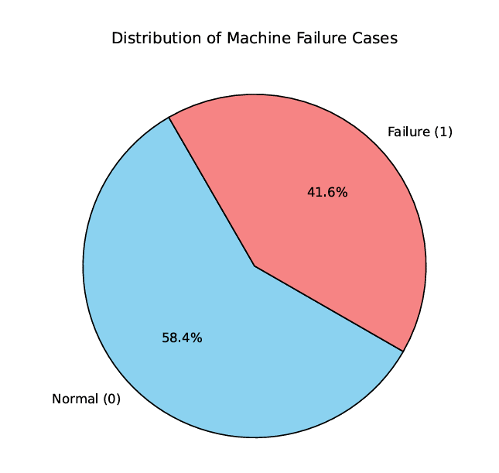
Dataset & Features :-
- Collected data from 944 machine observations with 9 sensor readings.
- Key metrics include footfall near the machine, air quality, current usage (CS), VOC levels, RPM, input pressure, and temperature.
- Target variable fail indicates whether the machine failed.
📊 Pie chart idea :
About 42% of records indicate machine failures, giving us a balanced dataset and shaping how we assess model risk.

Slide 4
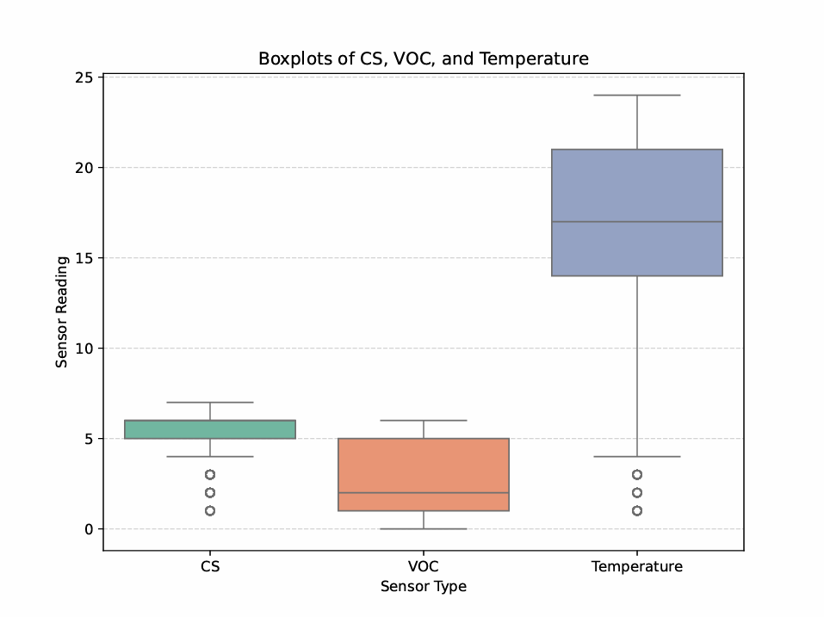
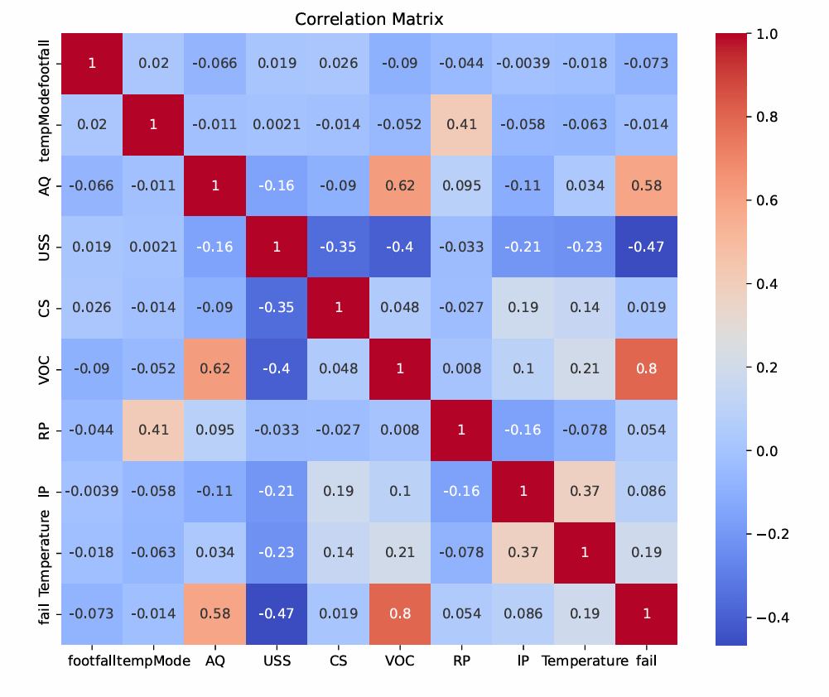
Data Cleaning & Exploration :-
- No missing data; ensured integrity with type checks and summary stats.
- Identified outliers in CS, VOC, and Temperature through boxplots.
- Correlation matrix revealed CS, VOC, and Temperature most linked with failures.
📊 Visuals to include :
- Boxplots of CS, VOC, Temperature.
- Correlation heatmap showing strongest links.

Slide 5
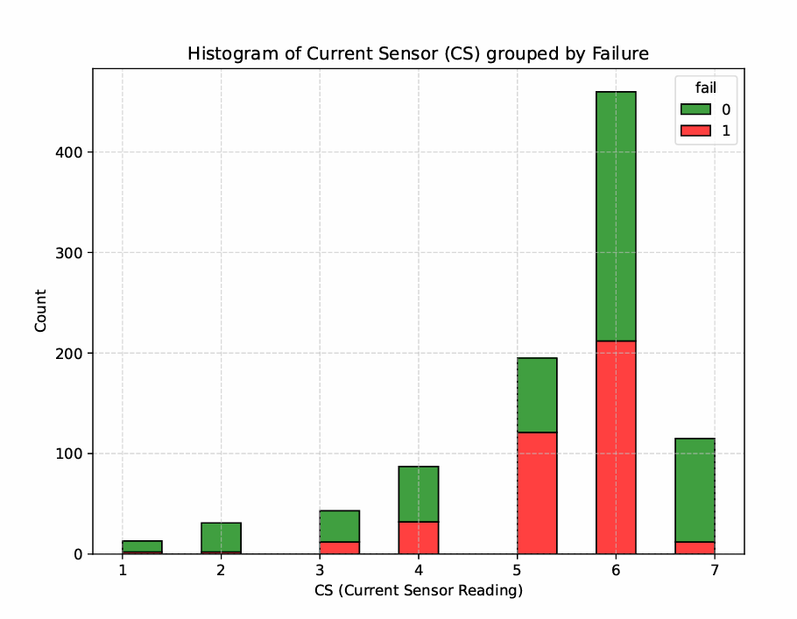
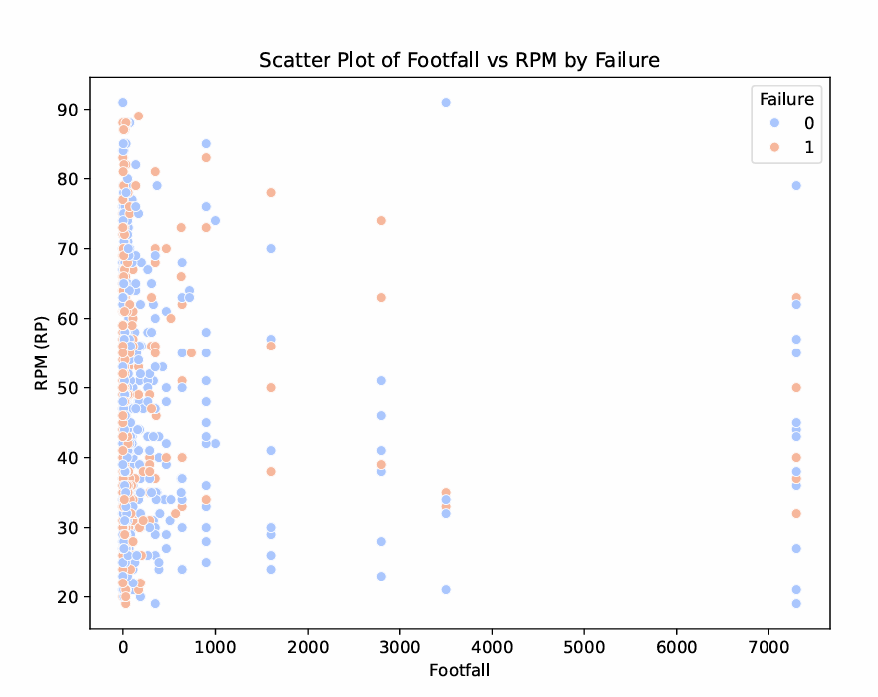
Key Visual Insights :-
- Failures frequently occurred at higher CS values (above 6 amps), indicating electrical overload risks.
- A histogram of CS grouped by failure status clearly shows machines that failed often operated at higher current levels.
- Additionally, failures clustered when footfall exceeded 400 and RPM over 50, highlighting stress from simultaneous high usage and speed.
📈 Visuals on this slide :
- Histogram of CS colored by fail.
- Scatter plot of footfall vs RPM, colored by fail.

Slide 6
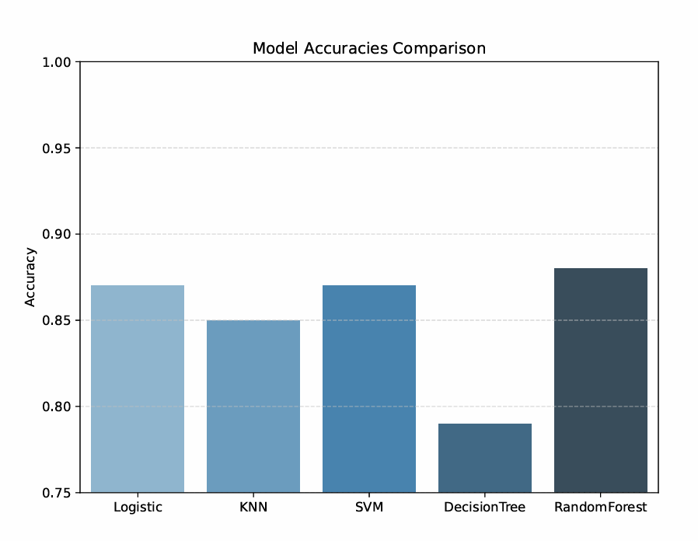
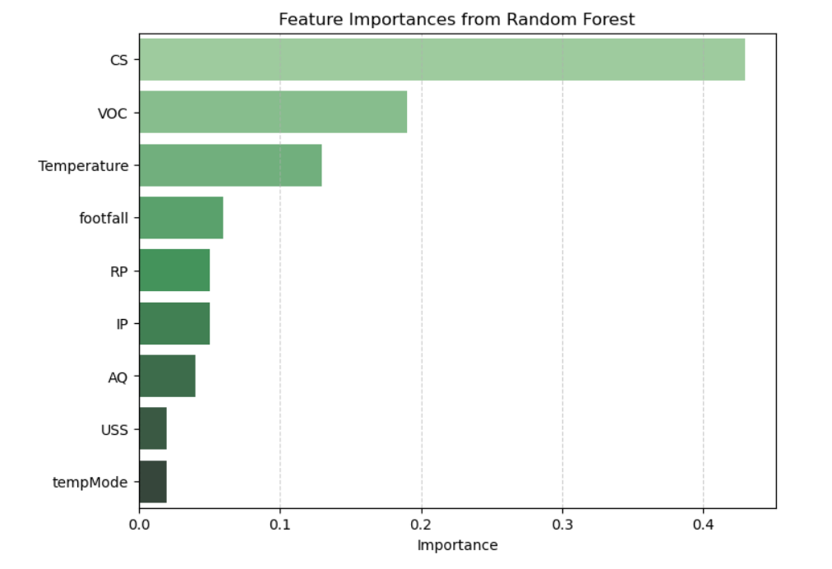
Modeling Approach & Results :-
- Used 80/20 train-test split and tried multiple models :
- Logistic Regression, KNN, SVM, Decision Tree, Random Forest.
- Random Forest achieved best performance with ~88 % accuracy, precision 0.90, recall 0.88.
- Top predictors : CS, VOC, Temperature.
📊 Charts :
- Bar chart of model accuracies.
- Feature importance bar plot.

Slide 7
Conclusion & Recommendations :-
We developed a robust machine learning model that predicts machine failures in advance with ~88% accuracy, leveraging sensor data such as VOC, air quality, and ultrasonic proximity. The analysis revealed VOC and AQ as the most critical indicators of failure, underscoring the importance of environmental monitoring alongside traditional machine metrics. This solution enables proactive maintenance, helping reduce unexpected downtime and extend asset life.
Executive summary -
- Built a predictive model achieving ~88% accuracy, driven primarily by VOC, AQ, and USS sensor data.
- Found environmental conditions are key predictors, beyond typical machine load metrics.
- Supports data-driven maintenance scheduling, reducing unplanned failures and costs.
- Next phase: consider time-series analysis to model sensor behavior over time for even better forecasting.

Slide 8
THANK YOU
Sumit dey | sumitdey9354@gmail.com

