Slide 1

CREDIT EDA CASE STUDY
Prepared By:-
Name:-Sumit Kumar
Mail I’d:-sumit.singh34@yahoo.com

Slide 2
“Without data you’re just another person with an opinion”
Edwards Deming, Statistician

Slide 3
Contents
Introduction ………………………………………………………………….....................................................…04 & 05
Finding outliers ………………………………………………………………………………………………...06 & 07
Checking Type of Client & Data is Balanced or not……………………………………………………08
Univariate Analysis of Categorical and Numerical Data ……………………………………….. 09 t0 20
Top 10 Correlation Columns of Data Frame……………………………………………………………………….………………………………………….…21
Bivariate Analysis of Numerical Variables……………………………………………………………………….…………………………………..……22
Previous application Data dataset for analysis-------------------------------------------------23
Univariate Analysis of Previous application -----------------------------------------------24 & 25
Bivariate Analysis on Numerical Columns------------------------------------------------------26
Merging the Files and Analysing the Data------------------------------------------------------27
Relation Between Own Car-Non Car Client vs Loan Status-----------------------------------28
Relation Between Gender Client vs Loan Status-----------------------------------------------29
Relation Between Payments Difficulty and Non Difficulty vs Loan Status------------------30
Conclusions----------------------------------------------------------------------------------------31
Inferences-------------------------------------------------------------------------------------------32
…………………………………………….Thank You……………………………………………………….………….

Slide 4
Introduction This case study aims to give you an idea of applying EDA in a real business scenario. In this case study, apart from applying the techniques that you have learnt in the EDA module, you will also develop a basic understanding of risk analytics in banking and financial services and understand how data is used to minimise the risk of losing money while lending to customers. Business Understanding The loan providing companies find it hard to give loans to the people due to their insufficient or non-existent credit history. Because of that, some consumers use it as their advantage by becoming a defaulter. Suppose you work for a consumer finance company which specialises in lending various types of loans to urban customers. You have to use EDA to analyse the patterns present in the data. This will ensure that the applicants capable of repaying the loan are not rejected. When the company receives a loan application, the company has to decide for loan approval based on the applicant’s profile. Two types of risks are associated with the bank’s decision: If the applicant is likely to repay the loan, then not approving the loan results in a loss of business to the company If the applicant is not likely to repay the loan, i.e. he/she is likely to default, then approving the loan may lead to a financial loss for the company. The data given below contains the information about the loan application at the time of applying for the loan. It contains two types of scenarios: The client with payment difficulties: he/she had late payment more than X days on at least one of the first Y instalments of the loan in our sample, All other cases: All other cases when the payment is paid on time. When a client applies for a loan, there are four types of decisions that could be taken by the client/company): Approved: The Company has approved loan Application Cancelled: The client cancelled the application sometime during approval. Either the client changed her/his mind about the loan or in some cases due to a higher risk of the client he received worse pricing which he did not want. Refused: The company had rejected the loan (because the client does not meet their requirements etc.). Unused offer: Loan has been cancelled by the client but on different stages of the process. In this case study, you will use EDA to understand how consumer attributes and loan attributes influence the tendency of default. Business Objectives This case study aims to identify patterns which indicate if a client has difficulty paying their instalments which may be used for taking actions such as denying the loan, reducing the amount of loan, lending (to risky applicants) at a higher interest rate, etc. This will ensure that the consumers capable of repaying the loan are not rejected. Identification of such applicants using EDA is the aim of this case study. In other words, the company wants to understand the driving factors (or driver variables) behind loan default, i.e. the variables which are strong indicators of default. The company can utilise this knowledge for its portfolio and risk assessment. To develop your understanding of the domain, you are advised to independently research a little about risk analytics - understanding the types of variables and their significance should be enough). This dataset has 2 files as explained below: 'application_data.csv' contains all the information of the client at the time of application. The data is about whether a client has payment difficulties. 'previous_application.csv' contains information about the client’s previous loan data. It contains the data whether the previous application had been Approved, Cancelled, Refused or Unused offer.

Slide 5
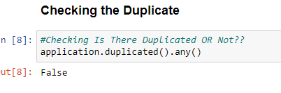

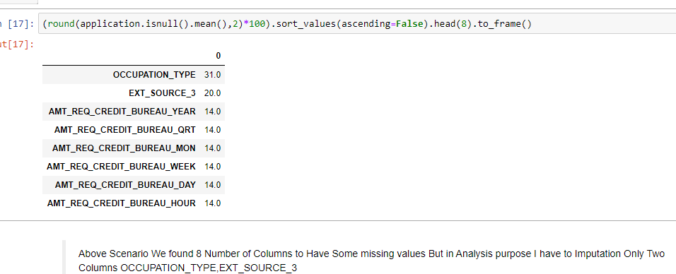
INTRODUCTION
For the purpose of this case study, two data sets were provided, namely:
Application Data
Previous Application Data
First, we took the Application Data dataset for analysis.
Data Cleaning:-was done before analysis. Following were the steps followed:
1. Found out the % of missing values in each column so as to determine which value to delete.
2. Removed columns with more than 40% NaN values
3. Post these actions, we decided on imputing values on few columns to further make the data set usable.
As you can see from above screenshots, we have decide to impute Mode values to the OCCUPATION_TYPE.
And EXT_SOURCE_3 to impute Mean Values.

Slide 6
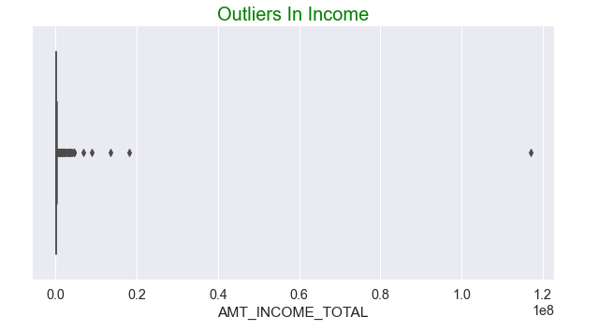
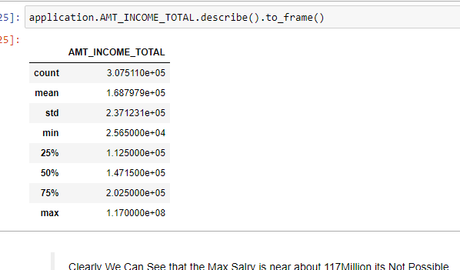
Finding outliers in the given Dataset
Spot outliers in the columns and find reasons for this outlier value presence. Here are some of the values we could spot as outliers with the help of plots:-

Slide 7
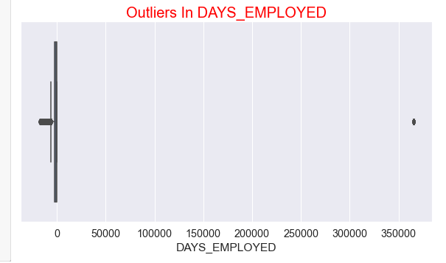
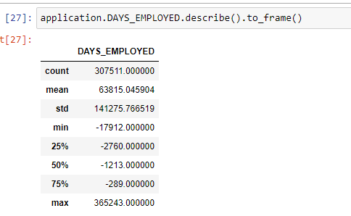
In the DAYS_EMPLOYED there is a value present at 36k range, this won’t be possible. This error could have occurred during data entry
In the plot AMT_INCOME_TOTAL, we can visually see that the MAX amount is way larger than the other statistical data [Mean, (25,50,75) percentiles]
Now that we have identified the ouliers, we have removed them and plotted them again to observe the difference.
Further more we have done some modification of values in oreder to make the analysis of data easier.
Converted Date of birth to age and also did binning of salaries into High, Medium and Moderate Levels.
ANALYSIS OF APPLICATION DATA
Then we proceeded with the analysis of data.
Divided data into two separate dataframes with defaulter and good clients.
Target value 0 indicates that the client is not a Payment Not Difficulties thus a good client.
Target value 1 indicates client with Payment Difficulties : he/she had late payment more than X days on at least one of the first Y installments of the loan in our sample.

Slide 8
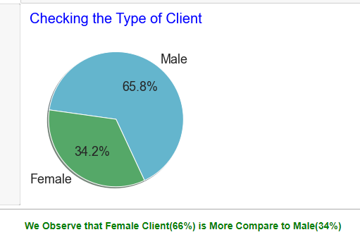
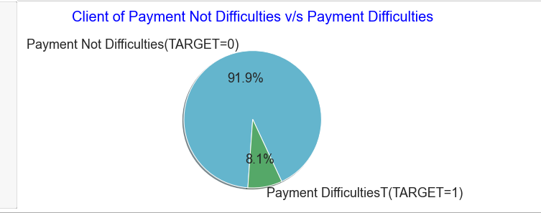

Client Type
Checking Imbalanced Data in
Column Target
Here the data is imbalanced 0 is payment Not difficulties 92% of client that have no issues of payments similarly 1 is payment difficulties that have only 8% of client.

Slide 9
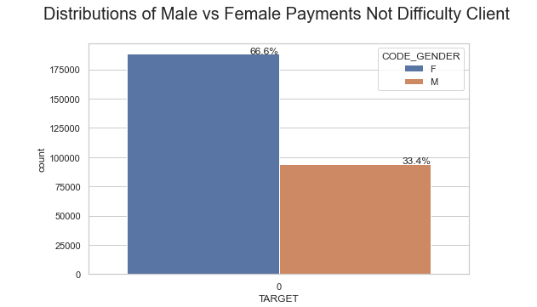
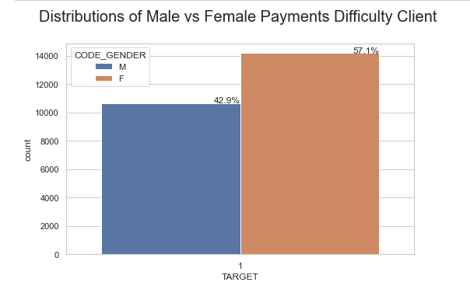
Univariate Analysis of Categorical and Numerical Data
Checked for clients that are likely to be defaulters/ unlikely to pay back the loan by analysing various columns in the data frame.
Based on CODE_GENDER (Gender of client)
We can see that Female contribute 67% to the non-defaulters while 57% to the defaulters. We can conclude that We see more female applying for loans than males and hence the more number of female defaulters as well. But the rate of defaulting of FEMALE is much lower compared to their MALE counterparts.

Slide 10
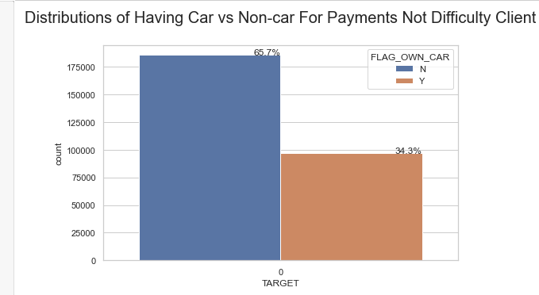
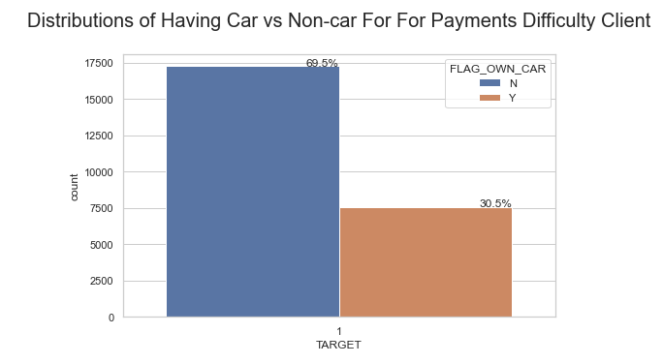
Analysing the FLAG_OWN_CAR Column (client Have Owns Car or Not)
We can see that people with cars contribute 65.7% to the non-defaulters while 69.5% to the defaulters. We can conclude that While people who have car default more often, the reason could be there are simply more people without cars Looking at the percentages in both the charts, we can conclude that the rate of default of people having car is low compared to people who don't.

Slide 11
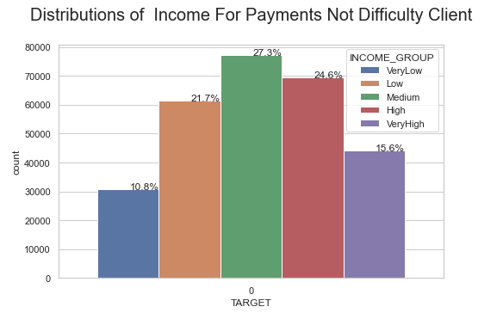
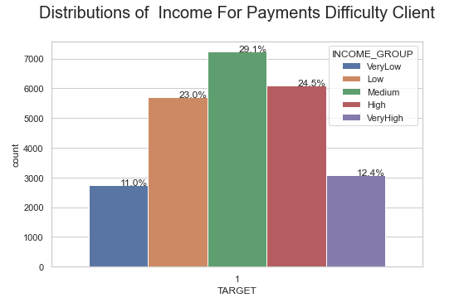
Analysing the INCOME_GROUP column.
We can see that the Medium, High, Very High and low range of salary have no issue with payments Medium salary client holds more loan compare to others and they have lots of issue in payments

Slide 12
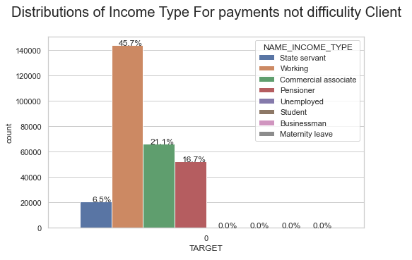
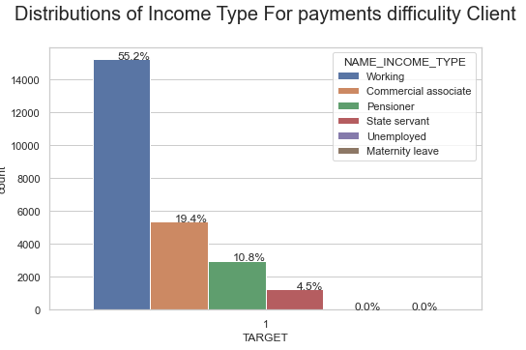
Analysing on NAME_INCOME_TYPE(Those Client
Who Have Working on Different Departments
Here We Can see that the Working client have not the payment issues as working client have more payments difficulty compared to others

Slide 13
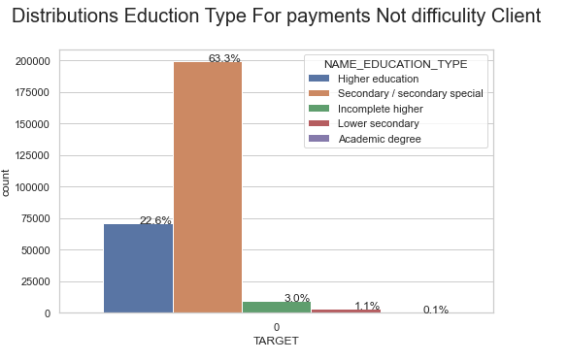
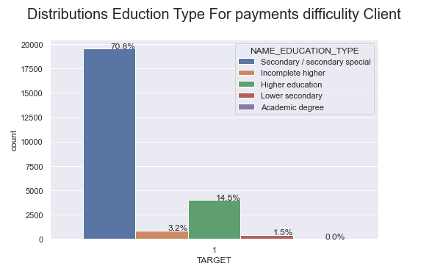
Analysing NAME_EDUCATION_TYPE column (Level of highest education the Client achieved)
Secondary Passing client has no issue in payment it has highest as compared to others here near about 70% of lower level of educations have payment issues.

Slide 14
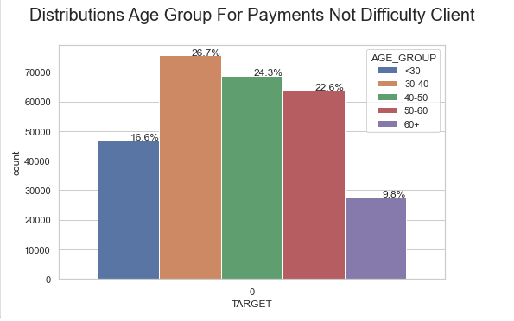
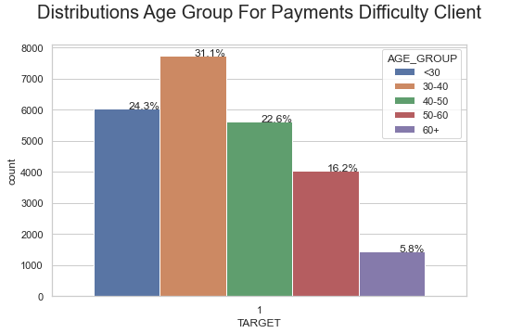
Analysing AGE_GROUP column (Age of Client)
As we can the range of age <30,30-40,40-50 and 50-60 age having no issue in payments The age group of <30,30-40 and 40-50 they have lots have issues in payments

Slide 15
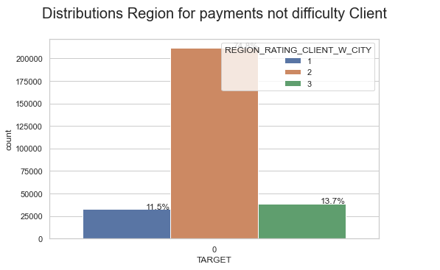
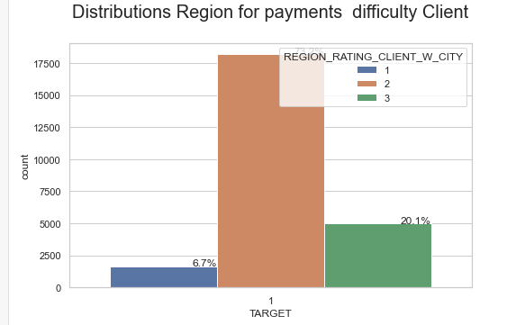
Analysing the REGION_RATING_CLIENT_W_CITY(Our Rating of the Region where client lives (1,2,3))
Most of the client came from region 2 Payments Difficulty of Region 2 client and very low client is came from region 1.

Slide 16
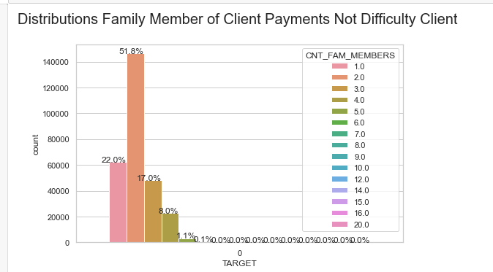
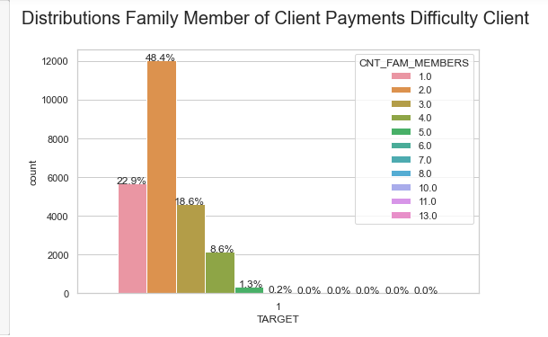
Analyses On CNT_FAM_MEMBERS column(How many family members does client have)
After Visualizations In Both Graph We can see that Client Family Member has Most of 2 members both cases 52% and 48%

Slide 17
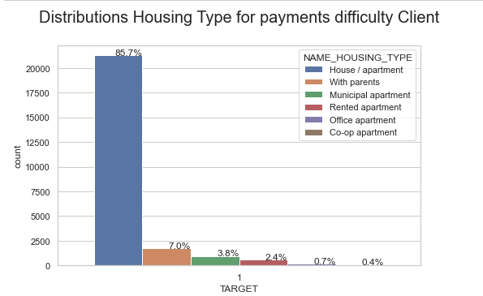
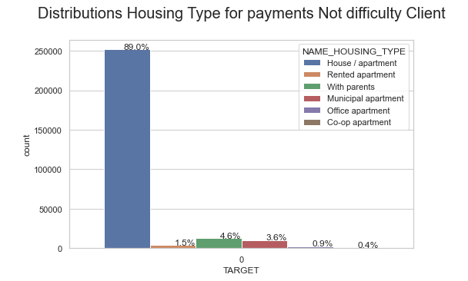
Analysing the NAME_HOUSING_TYPE (What is the housing situation of the client (renting, living with parents, ...))
It is clear from the graph that people who have House/Apartment, tend to apply for more loans. People living with parents tend to default more often when compared with others. The reason could be their living expenses are more due to their parents living with them.

Slide 18
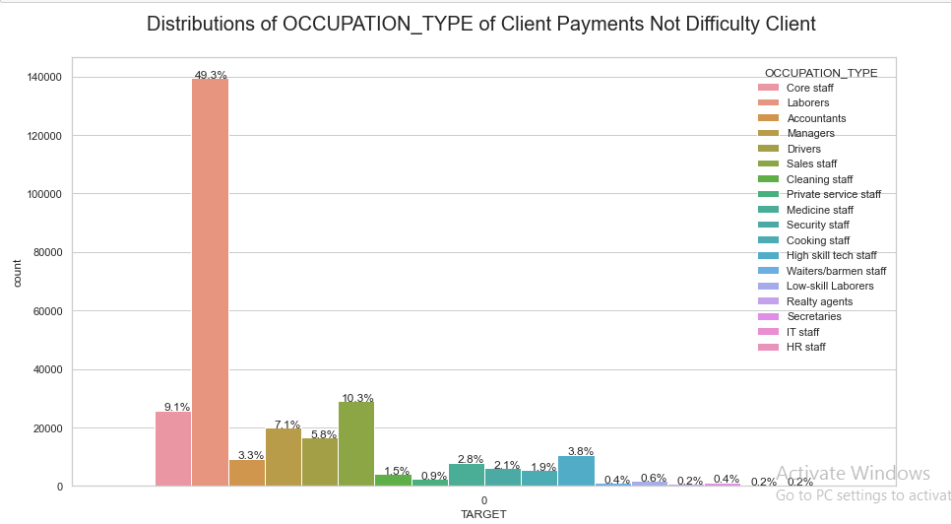
Analysing the OCCUPATION_TYPE (Client Occupations))

Slide 19
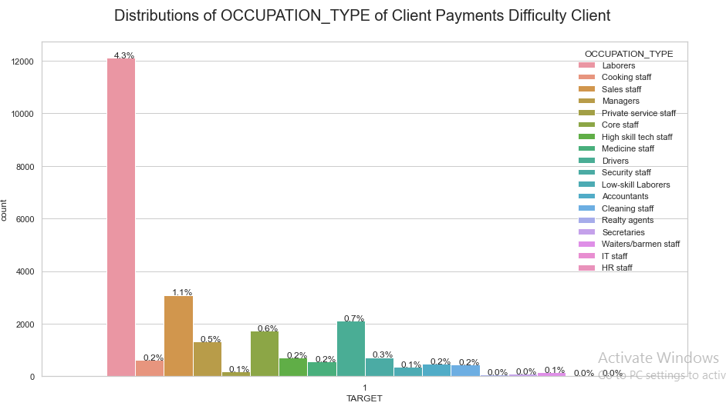
In Above Visualizations We have Seen the Labours client have 49% have not issue with payments as also you can see that as increasing the occupation type so its is decreasing the percentage rate of payment issue. only 4.3% have payment related issue on labours client.

Slide 20
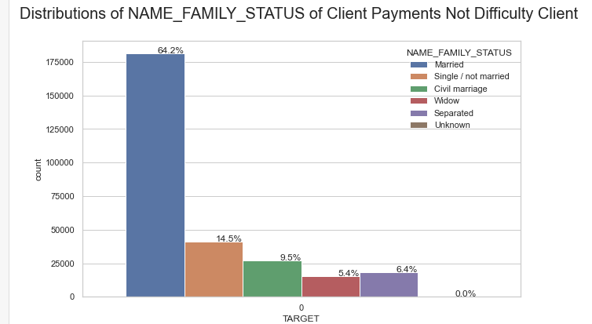
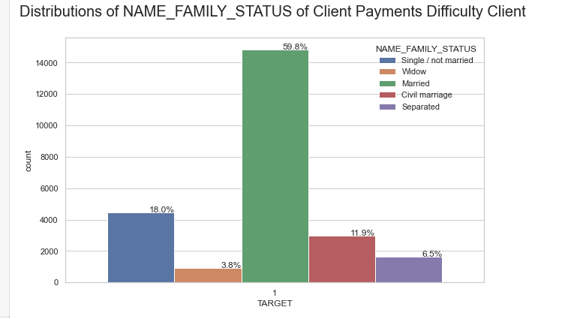
Analysing the NAME_FAMILY_STATUS(Client Status)
We can see that Number of married client near by 64% is not issues with payments as compared to others but single/not married client have 18% with have payment issues.

Slide 21
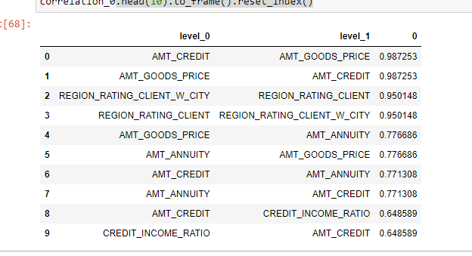
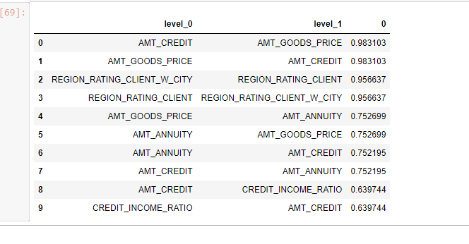
Top 10 Correlation Columns of new1 Dataset
Top 10 Correlation Columns of new2 Dataset
There is showing all are in positive values so they are in Strong Relationship between the data

Slide 22
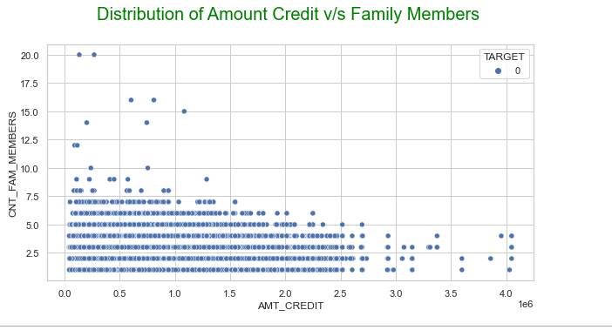
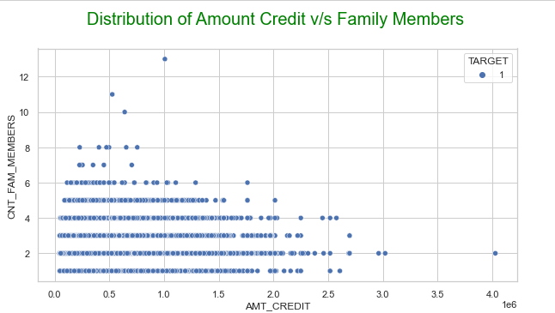
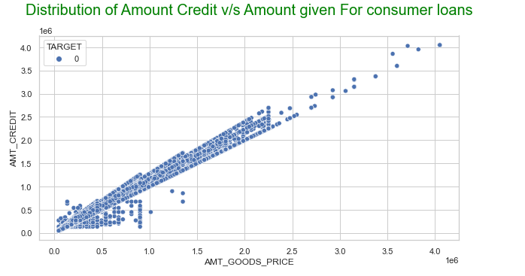
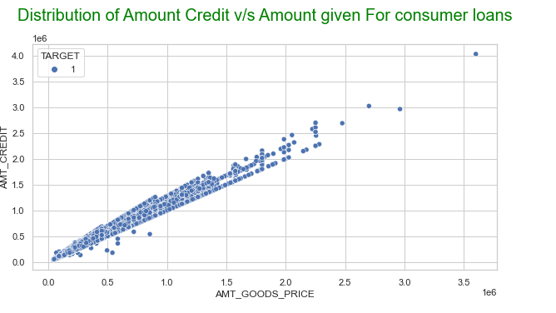
Bivariate Analysis of Numerical Variables
Using(Scatterplot) column:-AMT_CREDIT & CNT_FAM_MEMBERS
We can see that the density in the lower left corner is similar in both the case, so the people are equally likely to default if the family is small and the AMT_CREDIT is low. We can observe that larger families and people with larger AMT_CREDIT default less often
Bivariate Analysis of Numerical Variables
Using(Scatterplot) column:-AMT_GOODS_PRICE & AMT_CREDIT

Slide 23
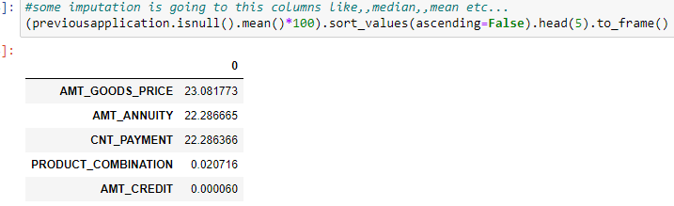
Analyse In both visualizations there is Strong Relationships between them.
Now, we took the Previous application Data dataset for analysis.
Data cleaning was done before analysis. Following were the steps followed:
1. Found out the % of missing values in each column so as to determine which value to delete.
2. Removed columns with more than 40% NaN values
3. Post these actions, we decided on imputing values on few columns to further make the data set usable.

Slide 24
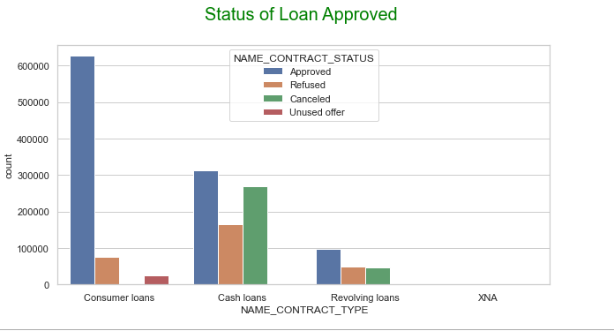
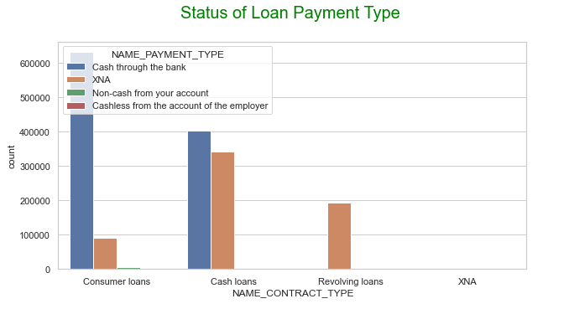
Univariate Analysis on Column
NAME_CONTRACT_TYPE & NAME_CONTRACT_STATUS
Here We can Analysis the In Which Contract Type Has Approved the Loans
Here we can see that the consumer loans has been approved more than the others in cash loans the loan has refused and also cancelled in large quantity.
Univariate Analysis on Column
NAME_CONTRACT_TYPE & NAME_PAYMENT_TYPE

Slide 25
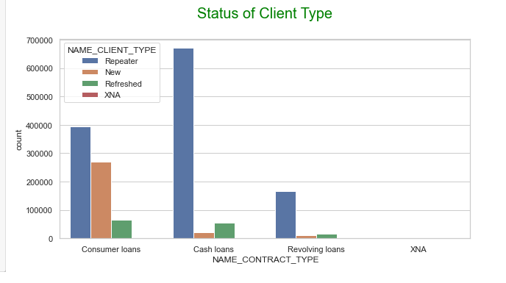
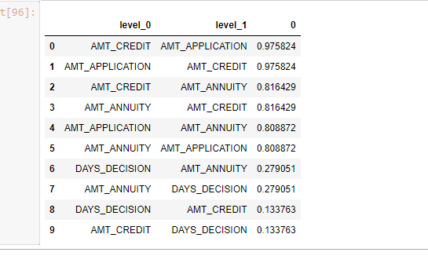
Here we can see that the loan amount payment is done from mostly in cash.. in business purpose look into the cashless segment
Univariate Analysis on Column
NAME_CONTRACT_TYPE & NAME_CLIENT_TYPE
In Cash Segment Repeater client(means those client who have already a loan) is more New client is also came in consumer loans
Finding Top 10 correlation of Previous Application Dataset

Slide 26
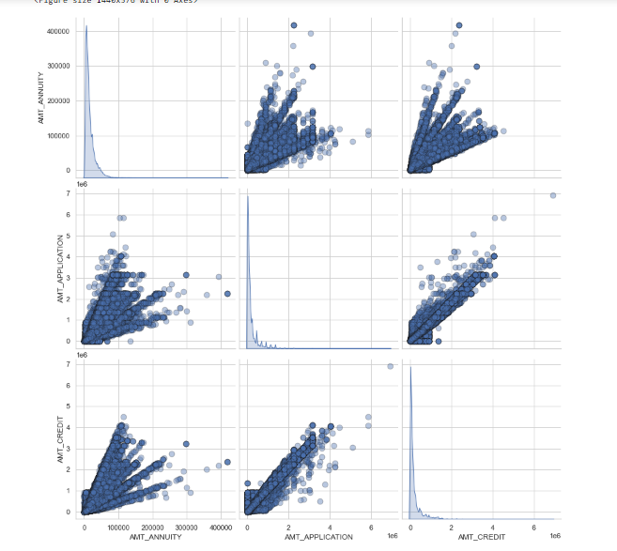
Using Pair plot to Perform Bivariate Analysis on Numerical Columns
Columns Are:-'AMT_ANNUITY','AMT_APPLICATION','AMT_CREDIT','AMT_GOODS_PRICE','NAME_CONTRACT_STATUS'
Plotting the relation between correlated highly correlated numeric variables
Annuity of previous application has a very high and positive influence over: (Increase of annuity increases below factors) (1) How much credit did client asked on the previous application (2)Final credit amount on the previous application that was approved by the bank (3) Goods price of good that client asked for on the previous application.
For how much credit did client ask on the previous application is highly influenced by the Goods price of good that client has asked for on the previous application
Final credit amount disbursed to the customer previously, after approval is highly influence by the application amount and also the goods price of good that client asked for on the previous application.

Slide 27
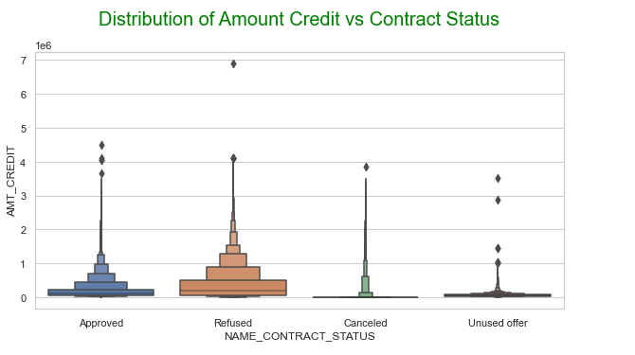
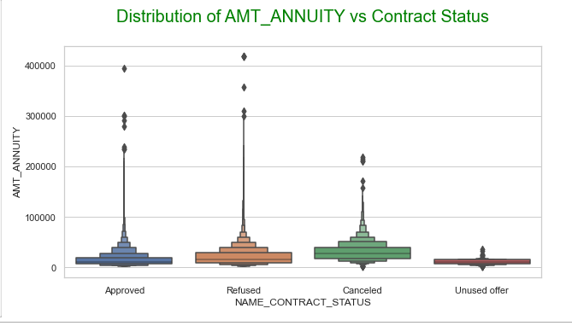
Bivariate Analysis Using Boxplot on Categorical vs Numeric columns
Columns Are:-NAME_CONTRACT_STATUS,
AMT_CREDIT
We can infer that when the AMT_CREDIT is too low, it get's cancelled/unused most of the time.
Columns Are:-NAME_CONTRACT_STATUS,
AMT_ANNUITY

Slide 28
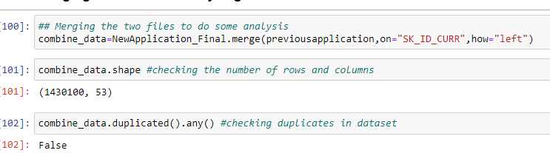
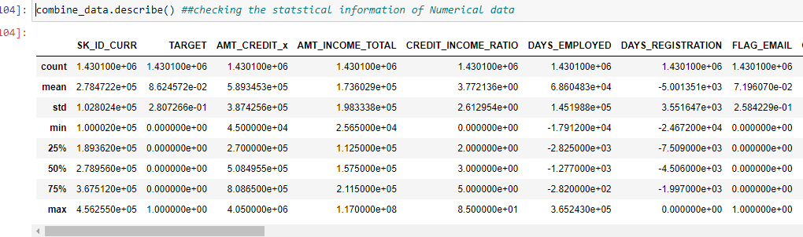
Approve Loan on based on criteria but also refused a lot of loan applications and cancelled also
Merging the Files and Analysing the Data
Checking the statistical information of Numerical data

Slide 29
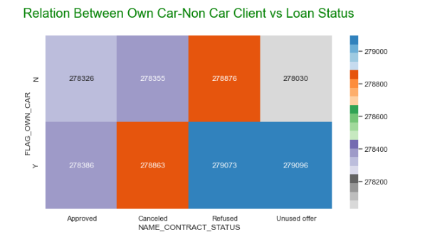
Relation Between Own Car-Non Car Client vs Loan Status
We see that car ownership doesn't have any effect on application approval or rejection. But we saw earlier that the people who has a car has lesser chances of default. The bank can add more weightage to car ownership while approving a loan amount

Slide 30
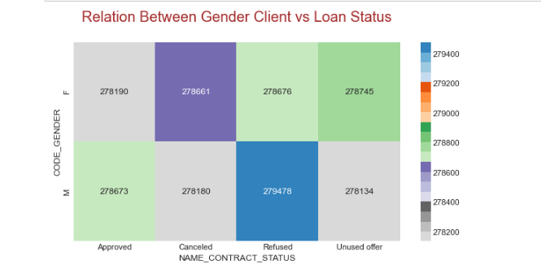
Relation Between Gender Client vs Loan Status
We see that code gender doesn't have any effect on application approval or rejection. But we saw earlier that female have lesser chances of default compared to males. The bank can add more weightage to female while approving a loan amount.

Slide 31
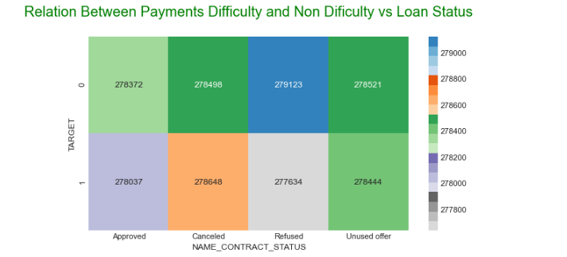
Relation Between Payments Difficulty and Non Difficulty vs Loan Status
We can see that the people who were approved for a loan earlier, defaulted less often where as people who were refused a loan earlier have higher chances of defaulting.
Target variable (0 - Payments Not Difficulty 1 -Payments Difficulty )

Slide 32
Conclusion
In this Project, We have Analysed the Data Between Multiple Features of Loan/Client to Establish Each’s Relationship with the other and Impute the Missing Fields within the Dataset.
We have successfully imputed all missing values with appropriate metrics.
While doing so, we have uncovered several insights from the data which we present in the subsequent slide.

Slide 33
INFERENCES
Focused on Business Some Point Are:----
Female Client.
Person Have Medium Range of Salary Income.
Focused on Married Client.
Working Person(Occupation— Labours )
Higher Education Client—Businessman & Higher Secondary School.
Age Group from 30 to 60 Year.
Person Who Have Come From Region 2 .
Person Who Have House member 2.
Person Focused On Consumer Loans and Cash Loans.

Slide 34
Thank You

