Slide 1
CSE303 Project Presentation
BY: Md navidul islam
Tiasha Swarnaker
Abdullah al-noman
sumiya afrin
Sabrina Yasmin
Md. Faysal chowdhury

Slide 2
Introduction
The Student Performance Monitoring System focuses on performance monitoring of student’s continuous assessment(tests) and examination scores.
The main idea of this project is to evaluate the COs achieved and mapped PLOs achieved by each student in each of the enrolled courses as that would be necessary for monitoring the student performance.
This Student Performance Monitoring System would provide an insight about how learning might improve in a given program - whether it be online or in a classroom.

Slide 3
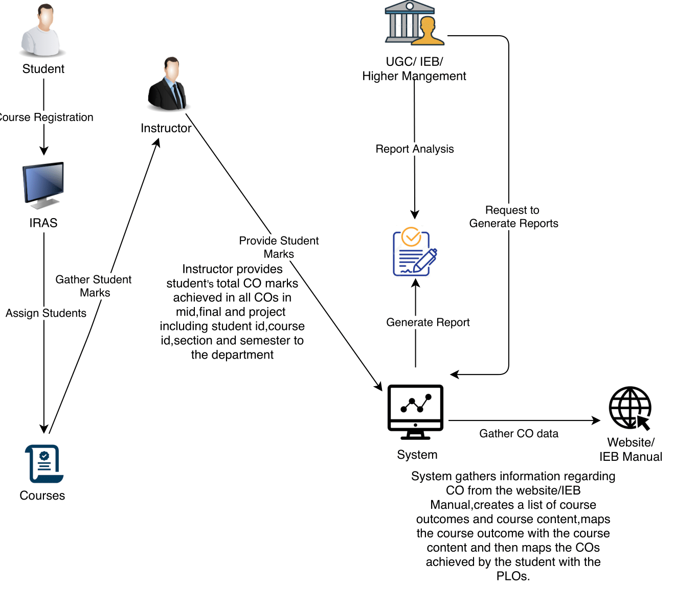
Student Performance Monitoring System Rich Picture

Slide 4
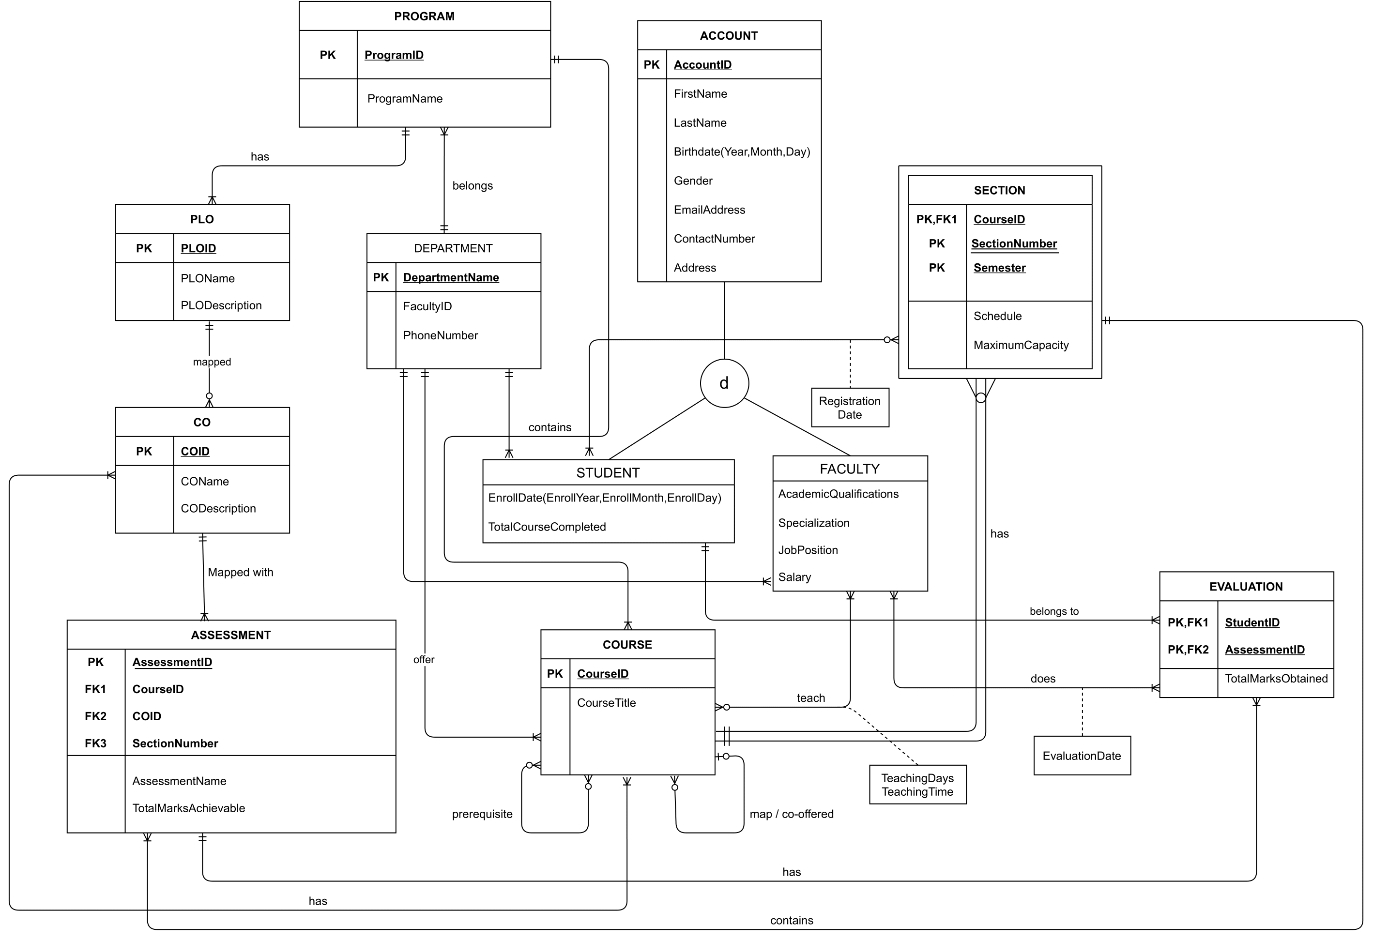
Enhanced Entity Relationship Diagram

Slide 5
Input Forms
Add User
Add Program and PLO
Add Course with CO
Add Individual Marks
Add Mass Marks

Slide 6
Output Reports
Higher Management Dashboard
PLO Achievement View
Student Progress View
Student Result

Slide 7
Conclusion
The system that we have created can automatically store and retrieve data that were previously done manually.
It is more effective and user friendly as gathering and collecting data manually was a tiresome task.
Primarily we have focused on IUB as the organization for which we have done this project but the project has the potential of being useful to other universities as well.

Slide 8
Thank you

