Slide 1

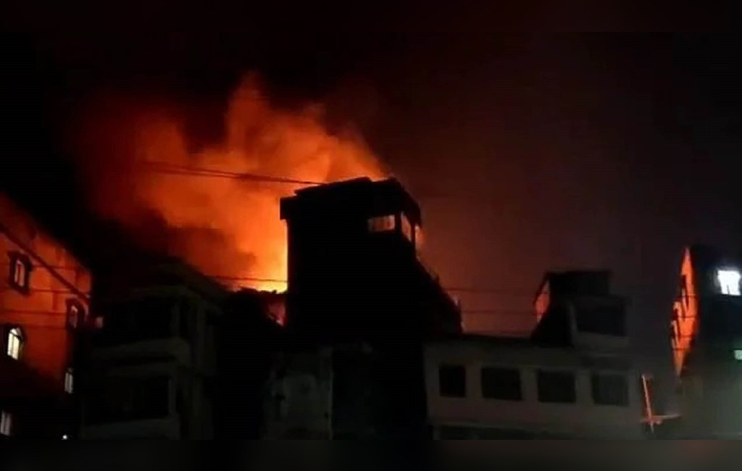

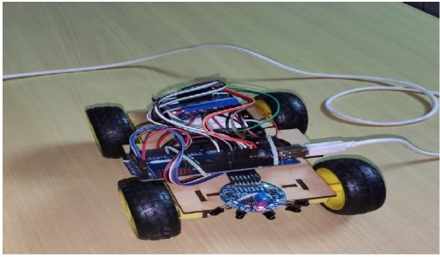
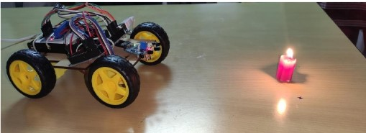
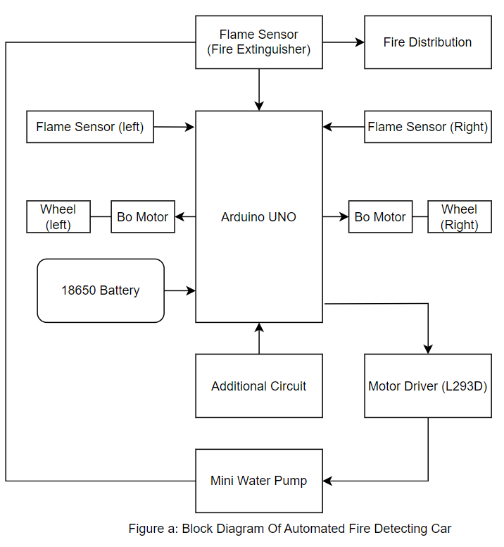
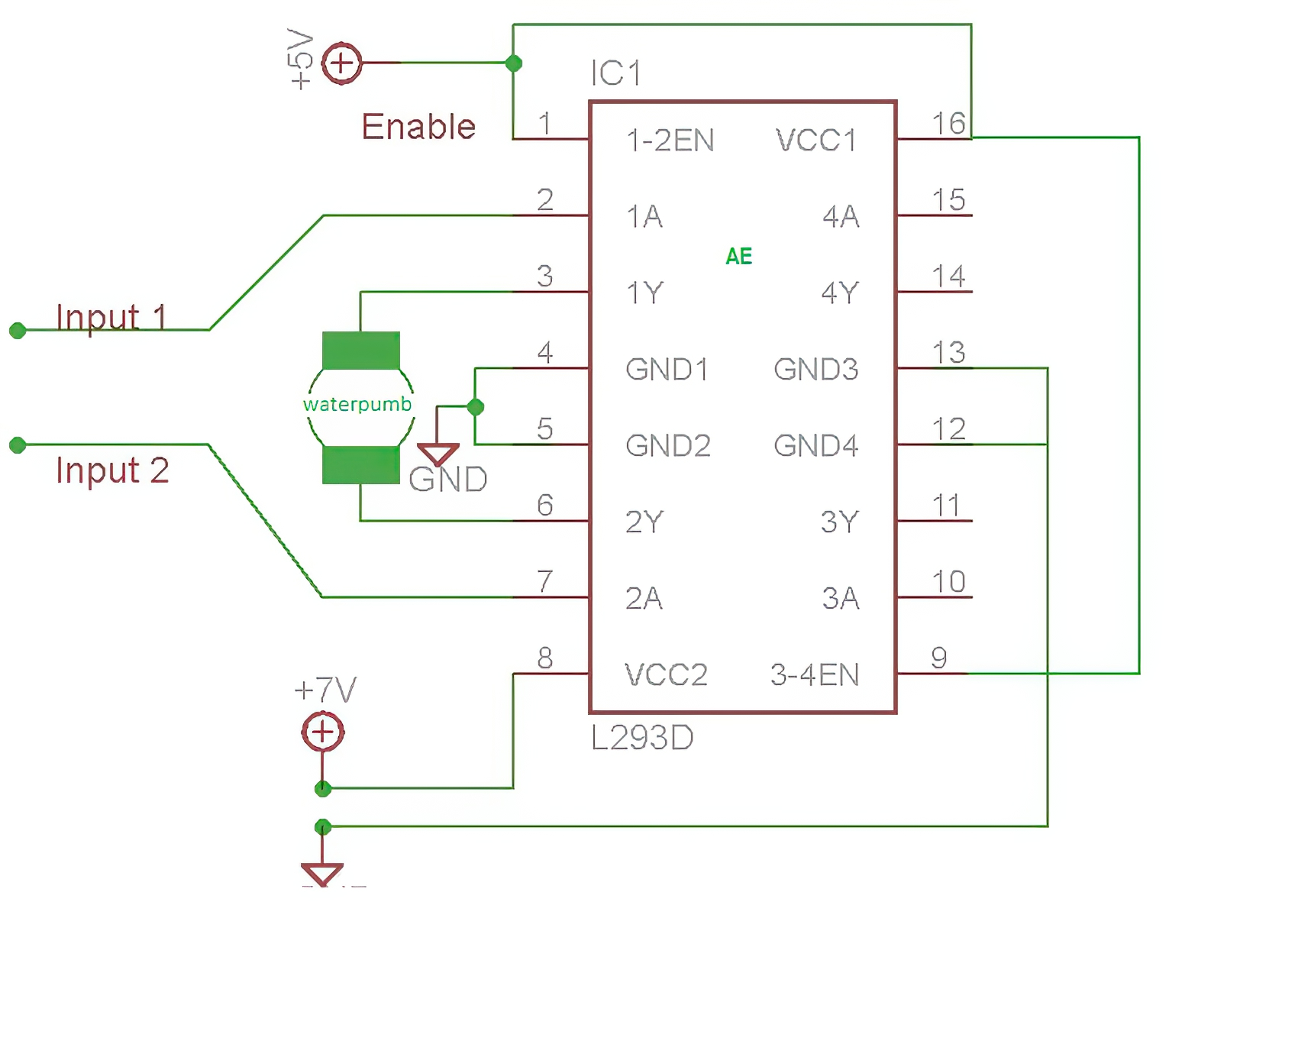
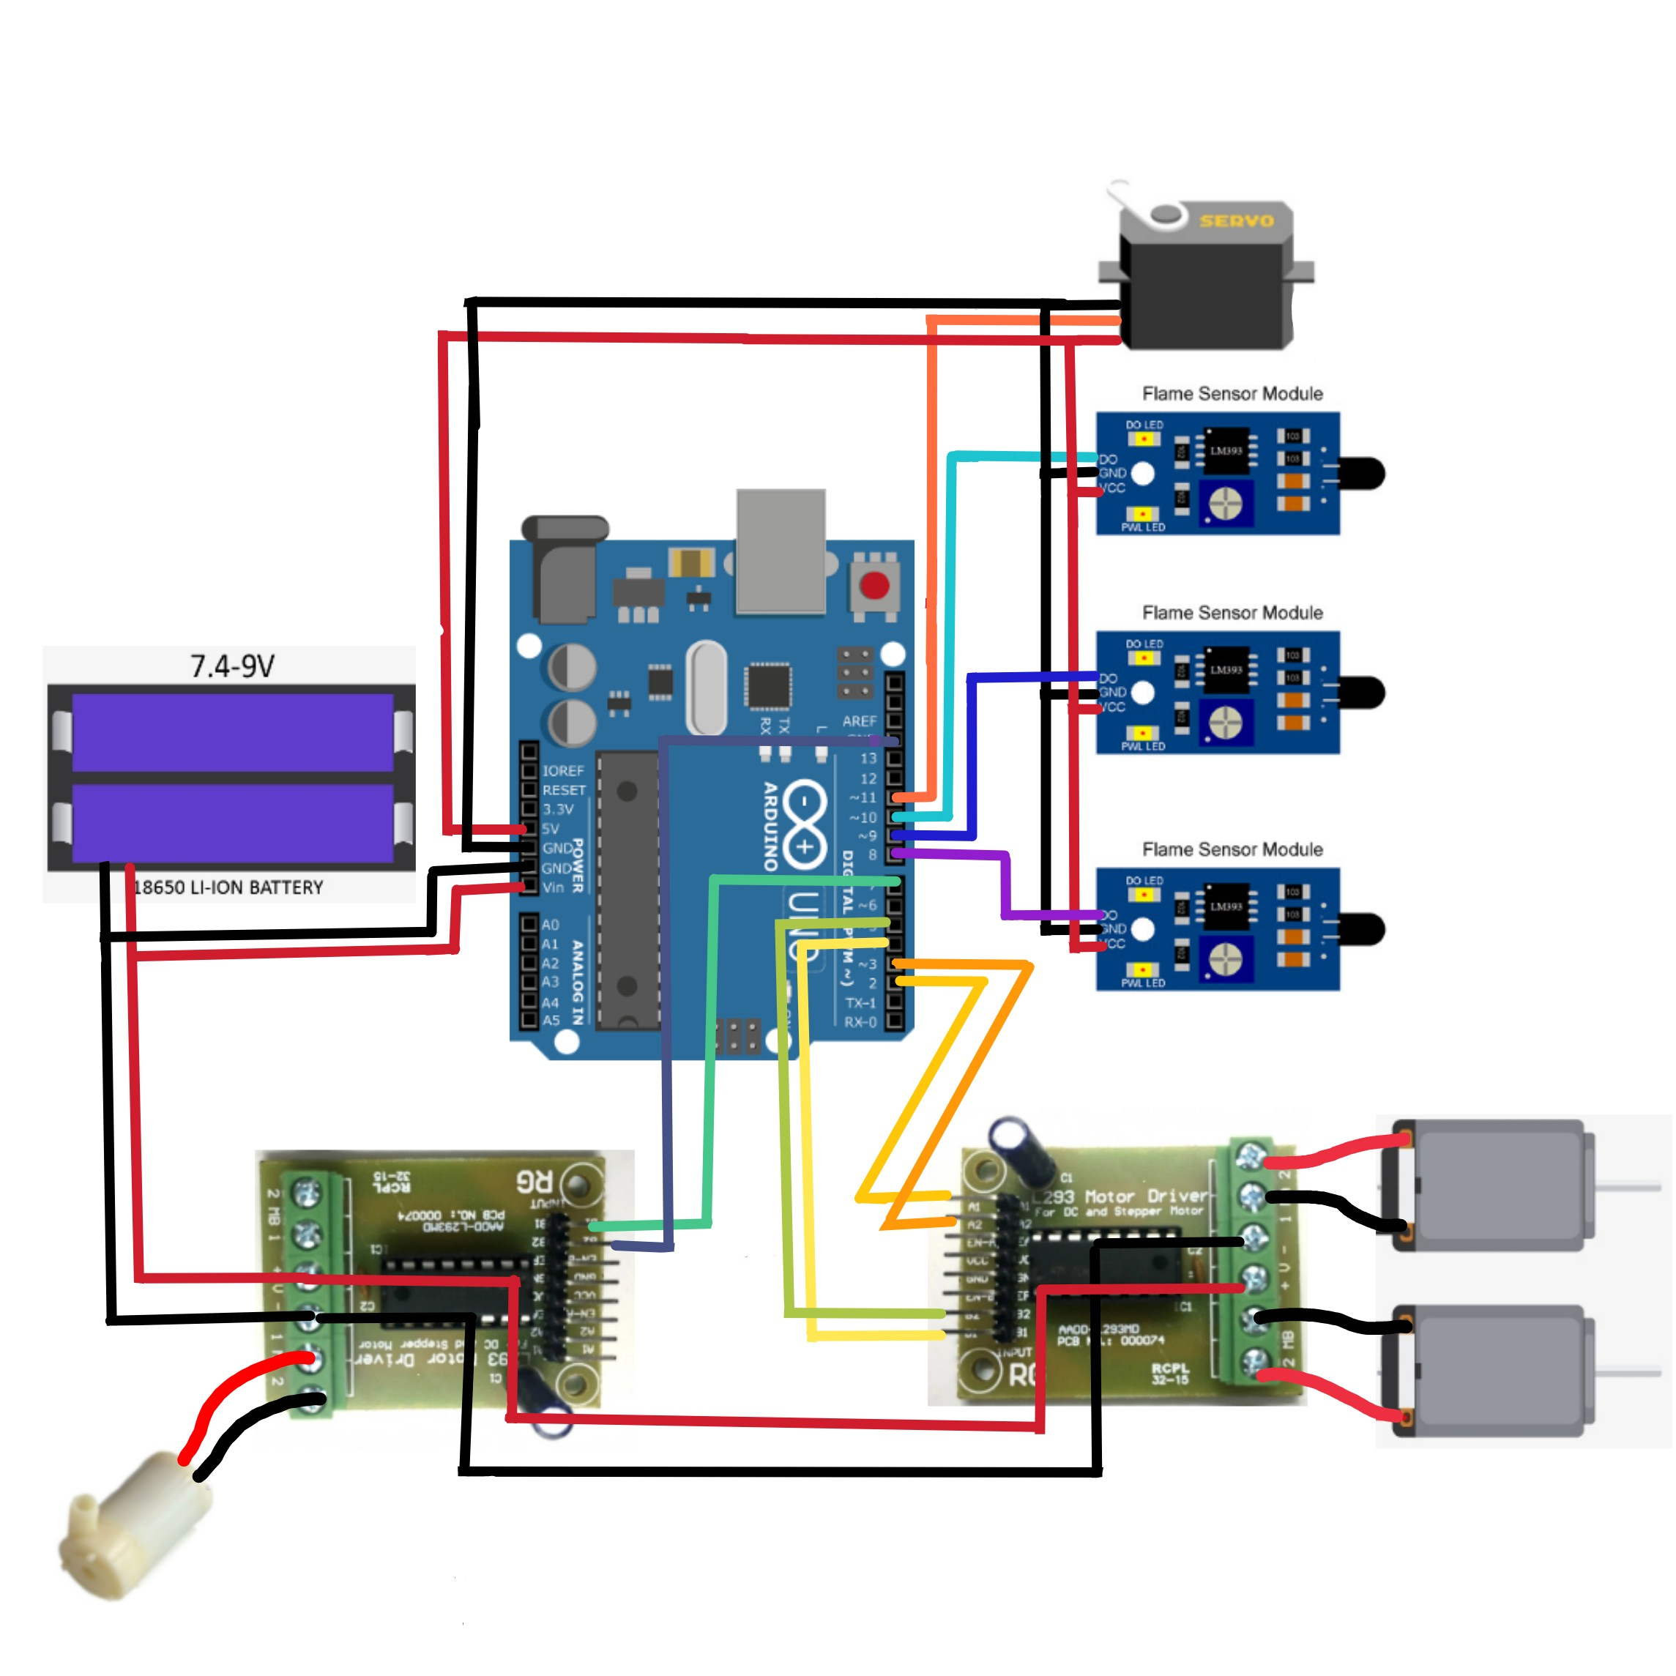
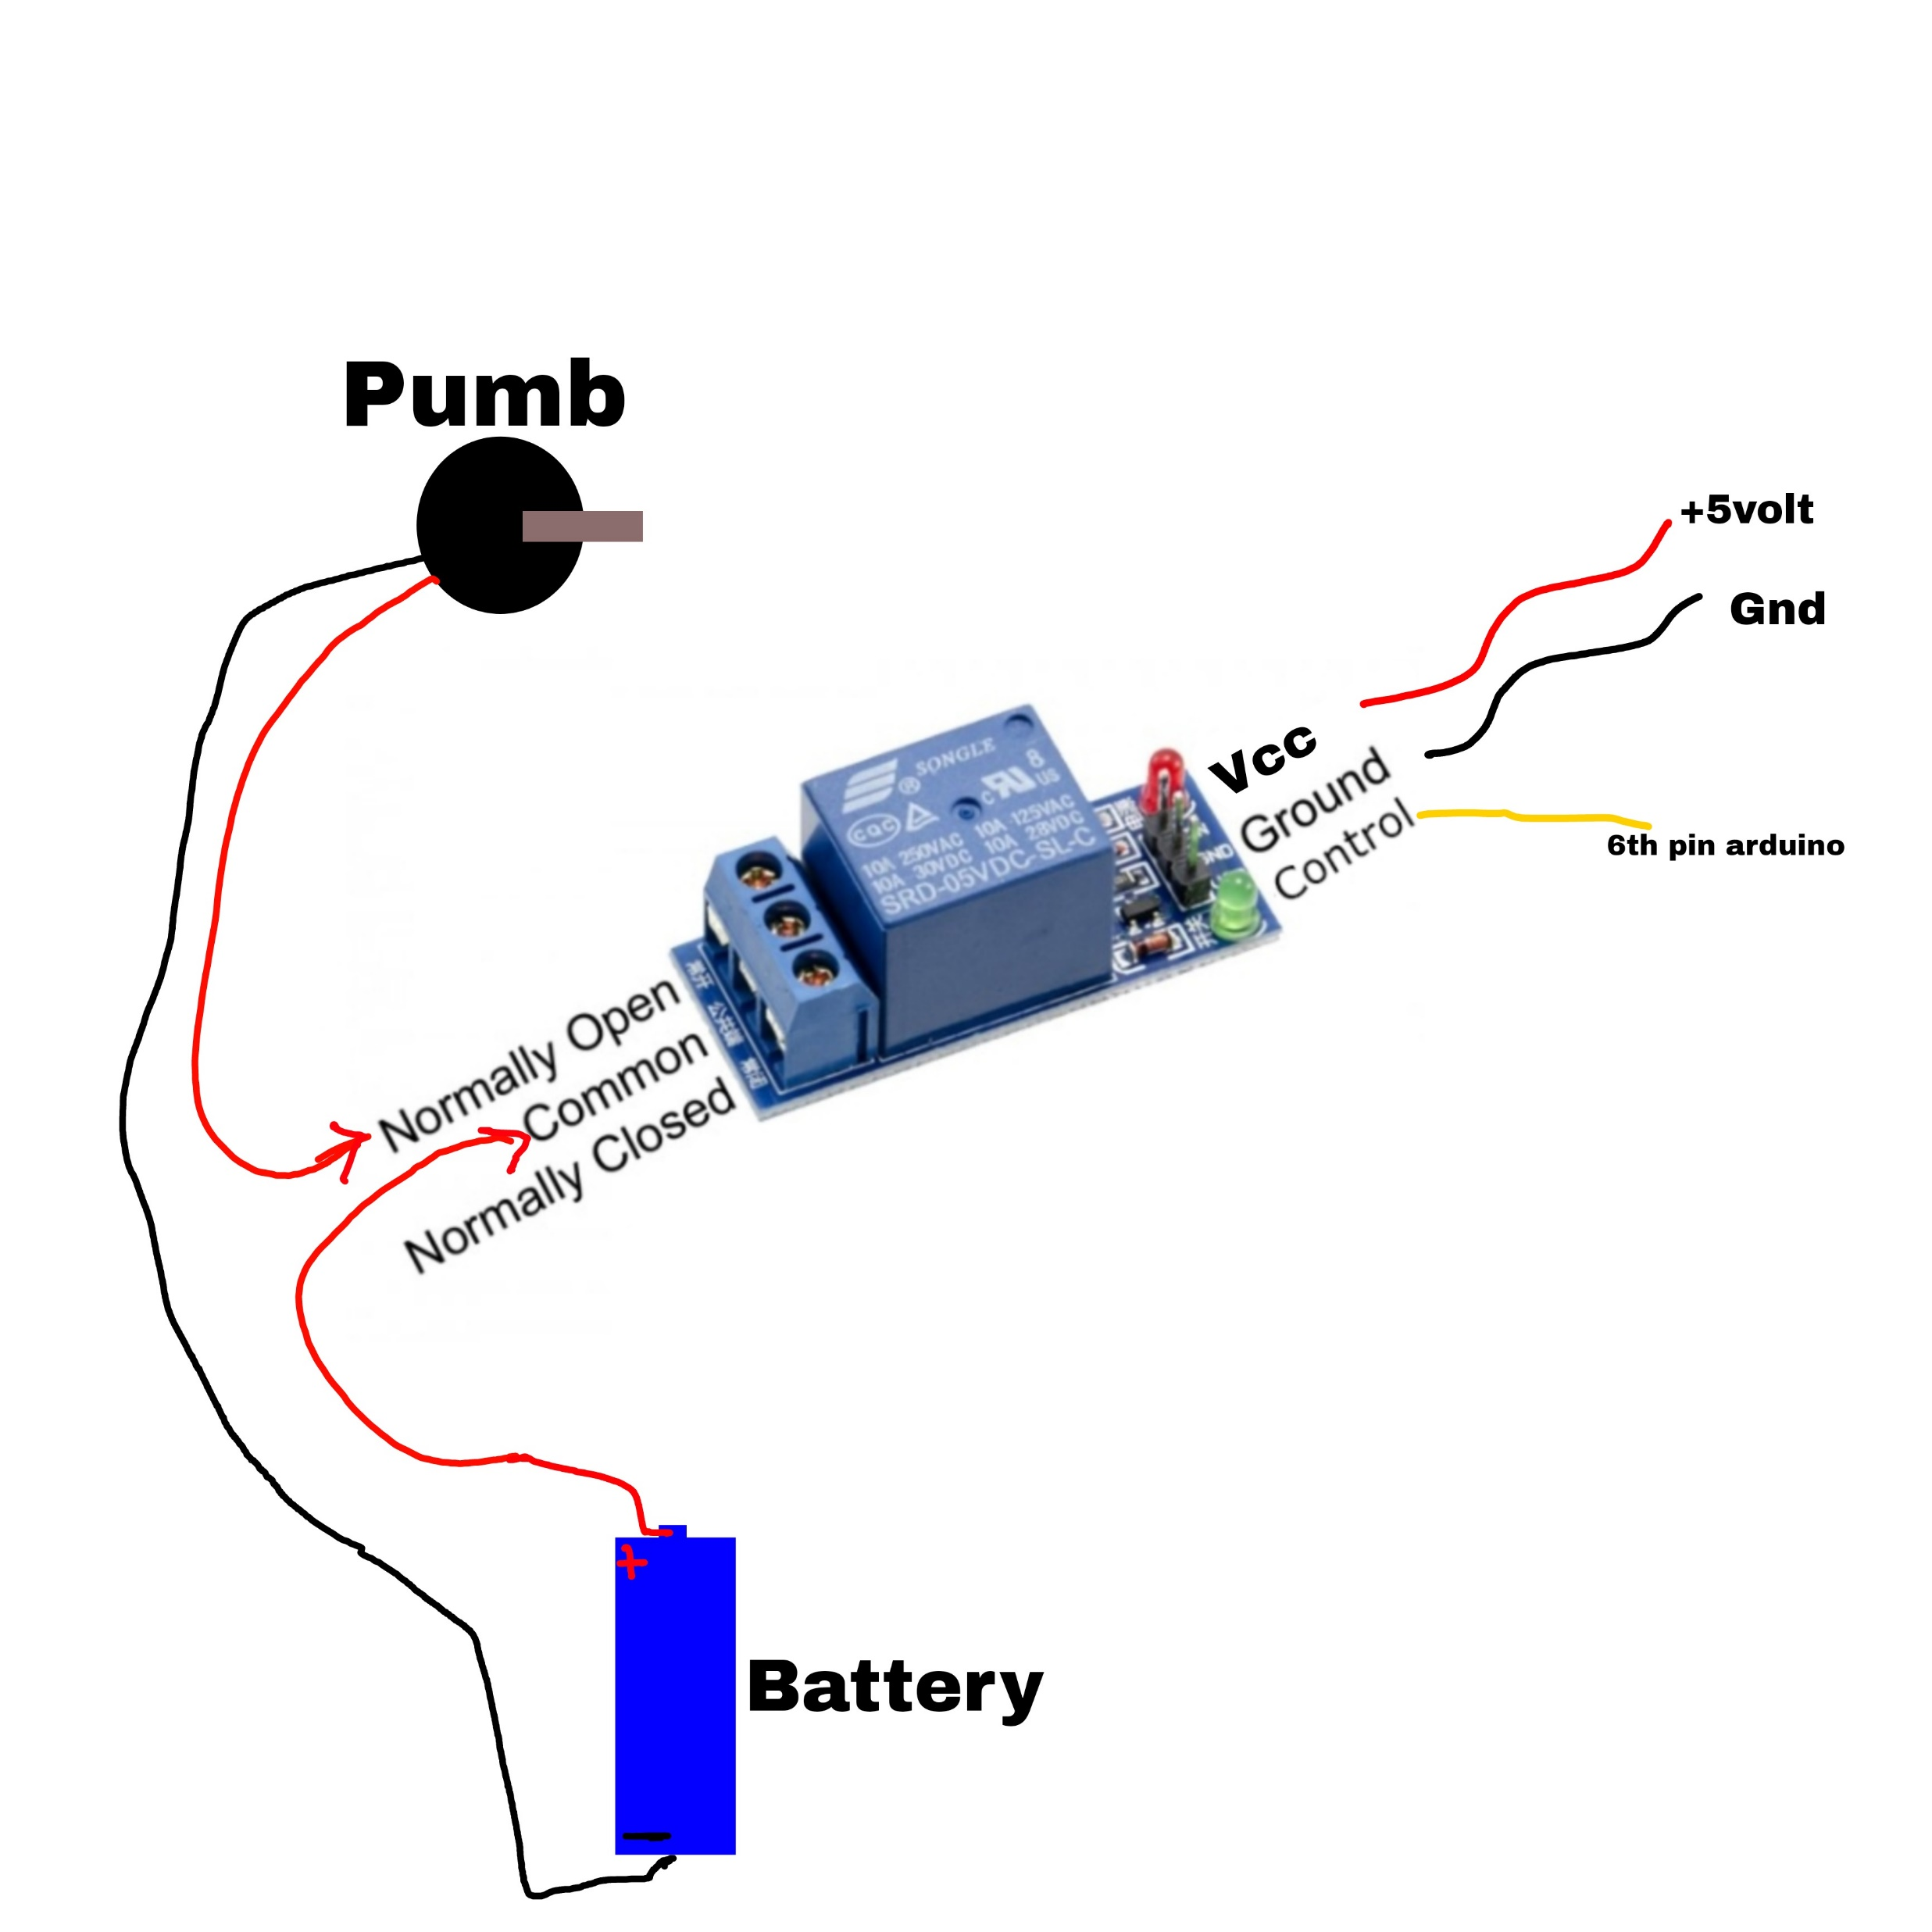
AUTOMATED FIRE DETECTING AND EXTINGUISHING CAR
Group-05
Mst. Sumiya Siddika (Roll-1975)
Md.Shakil Ahmed (Roll-2013)
Md.Masud Rana (Roll-2015)
Amit Azim Amit (Roll-2090)
Abstract
Related Works
A firefighter’s work entails detecting and extinguishing fires. In this rapidly evolving technological age, the world is gradually moving toward automated systems. Firefighters, on the other hand, are often in danger of losing their lives. As a result, in order to resolve these issues, our system was developed. In our system, there is no need for a human being to put out the fire.
Optical sensors: Researchers have used optical sensors such as infrared cameras and thermal imaging devices to detect fires in cars. These sensors can quickly detect temperature changes and the presence of smoke, allowing the fire suppression system to be activated in a timely manner.
Fire suppression agents: Different fire suppression agents have been studied and tested, including water, foam, and gases such as carbon dioxide and halon. The choice of fire suppression agent depends on the type of fire, the location of the fire, and the safety of the occupants of the car.
Introduction
The project that is being presented is focused on a firefighting car. This system is capable of performing tasks in a more efficient, cost-effective, and accurate manner than humans. The firefighting car is programmed to detect and extinguish fires in affected areas. The robotic vehicle is equipped with water tanks and a pump that is operated automatically. As a result of a fire outbreak (or) fire explosion, we are demanding that we use human resources that are not secure to put out the fire. It is very much possible to replace human work in putting out a fire in a dangerous environment by using higher technology, specifically robotics. This strategy would free firefighters from dangerous tasks, increase their efficiency, and reduce the number of fires. we'll create an Arduino-based firefighting car that will detect the fire and it will begin to pump water into the fire-detected area using a sprinkler.
Experimentation
Initialization of Robot:
Detection of fire by robot:
Figure: Initialization
Figure : A random Fire incident and percentage of fire incidents from year 2004 to 2018.
Objectives
The main objective of our project is-
i. Safety: The system should be designed to be safe for the occupants of the car, and not cause harm or injury.
ii. Rapid response: The system should act quickly to extinguish the fire, using the appropriate fire suppression agent.
iii. Minimal human intervention: The system should be designed to operate with minimal human intervention, as people may not be able to respond quickly enough in an emergency.
Fig: Fire Detection
Future work
Design
In Future, we will work with high-performance flame sensor which shows well performance on sunlight.
Automated water sprinkler can be added to this system.
Some of interfacing applications which can be made are controlling home appliances, robotics movements, Speech Assisted technologies etc.
By making it GPS enabled, robot can be controlled from remote station also.
It can be further expanded with voice interactive system facility.
Limitations
In sunlight flame sensor can not provide well performance.
This system will work only in a limited area.
Figure b : L293 Water pump Connection
Conclusion
This project describes about the real time firefighting car which moves in a constant speed, identify the fire and then extinguish it with the help of pumping mechanism. It has advantageous features such as ability to detect location of fire automatically in a certain range besides having a compact body and lightweight structure. The car can be used at a place that has a small entrance or in small spaces because it has a compact structure. The system can potentially be useful to accompany fire fighters and prevent an outbreak. From the experimental results, the robot can sense fire accurately in a short time.
Figure c Circuit Diagram
Figure d : Relay Connection
References
Figure (a) shows the block diagram for Automated Fire Detecting Car. This block diagram shows how an Autonomous fire Detecting Car implements. Sensors use as input and this input control by Arduino UNO and additional circuit. With this input, the main board set the references and uses this data to apply it to the output where the output is a brushless motor, will go to object and sprinkles water.
Figure (b) shows the circuit diagram of L293 Water pump connection.
Figure (c) shows the circuit diagram of the Automated Fire Detecting Car.
Figure (d) shows the Relay connection.
[1] Daniel J. Pack; Robert Avanzato; David J. Ahlgren; Igor M. Verner; “Fire-Fighting Mobile Robotics and Interdisciplinary Design-Comparative Perspectives”, IEEE Transactions on Education, 3 August, 2004, Volume 47, No. 3
[2] Khalid, W., Sattar, A., Qureshi, M. A., Amin, A., Malik, M. A., & HUSSAIN, K. (2019). A smart wireless sensor network node for fire detection. Turkish Journal of Electrical Engineering & Computer Sciences, 27(4), 2541-2556.
[3] Ryder, N. (2019). Use of Sensors for Fire Detection and Monitoring.

