Slide 1
Vishwakarma Institute of Information Technology. Kondhwa, Pune – 411048 Dept. of Computer Engineering Man-In-Middle Attack.
Presented by:
Sumit R. Dube. 21820103-322068
Darshan Bhangare 21820097-322016
Sagar Majgude 21820181-322066
Vaishnavi Suslade 21820059-322001

Slide 2
Man-In-Middle Attack.

Slide 3
Outline
ABSTRACT
INTRODUCTION
DEFINITION
EXAMPLES
PREVENTION
CONCLUSION
REFERENCES

Slide 4
Abstract :
MIMA is computer security term related to eavesdropping of data.
The attack consist of stealing information by third party.
Sender and receiver are unaware of intruder.
Attacker takes charge of the communication path between sender and receiver and manipulates communication

Slide 5
Introduction :
Man-in-the-middle project written in Python using sockets, threading, and object-oriented programming in order to illustrate the concept of covertly intercepting and modifying messages between two parties in a client-server architecture.

Slide 6
Definition :
A man in the middle (MITM) attack is a general term for when a perpetrator positions himself in a conversation between a user and an application—either to eavesdrop or to impersonate one of the parties, making it appear as if a normal exchange of information is underway.

Slide 7
How it actually works?
The communication is running initially among client and server.
The attacker accesses the the port address and host address of client.
The request from client can now be accessible by the attacker also.
The response can also be sent to the server by attacker as well.
The messages are now visible to attacker.
Attacker can change the contents of messages as well.
The server and client both will remain unaware of the attacker.
The process continues till attacker willingly exits or the communication ends.

Slide 8
Components in MIMA :
Client : The request provider.
Server : The service provider.
Host address : IP address of computer which is unique in current network.
Port address : The address of virtual connection port through which communication occurs.
In LAN, the host address of server is known to all and, the port address for communication is common to server and client.
Attacker can access both by getting port and host address of client.

Slide 9
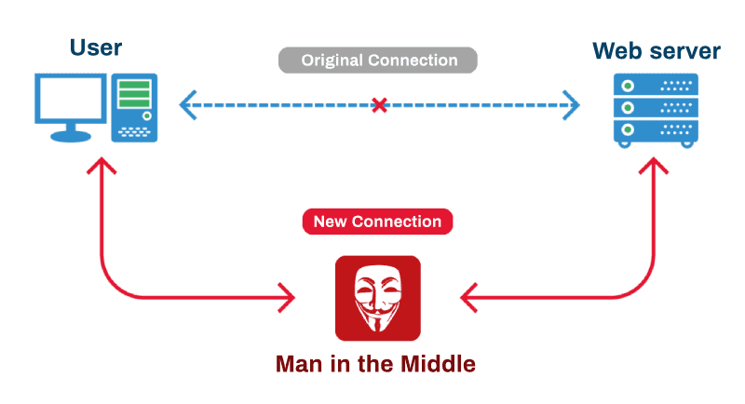
Overview :
Fig : The overview of man-in-middle.

Slide 10
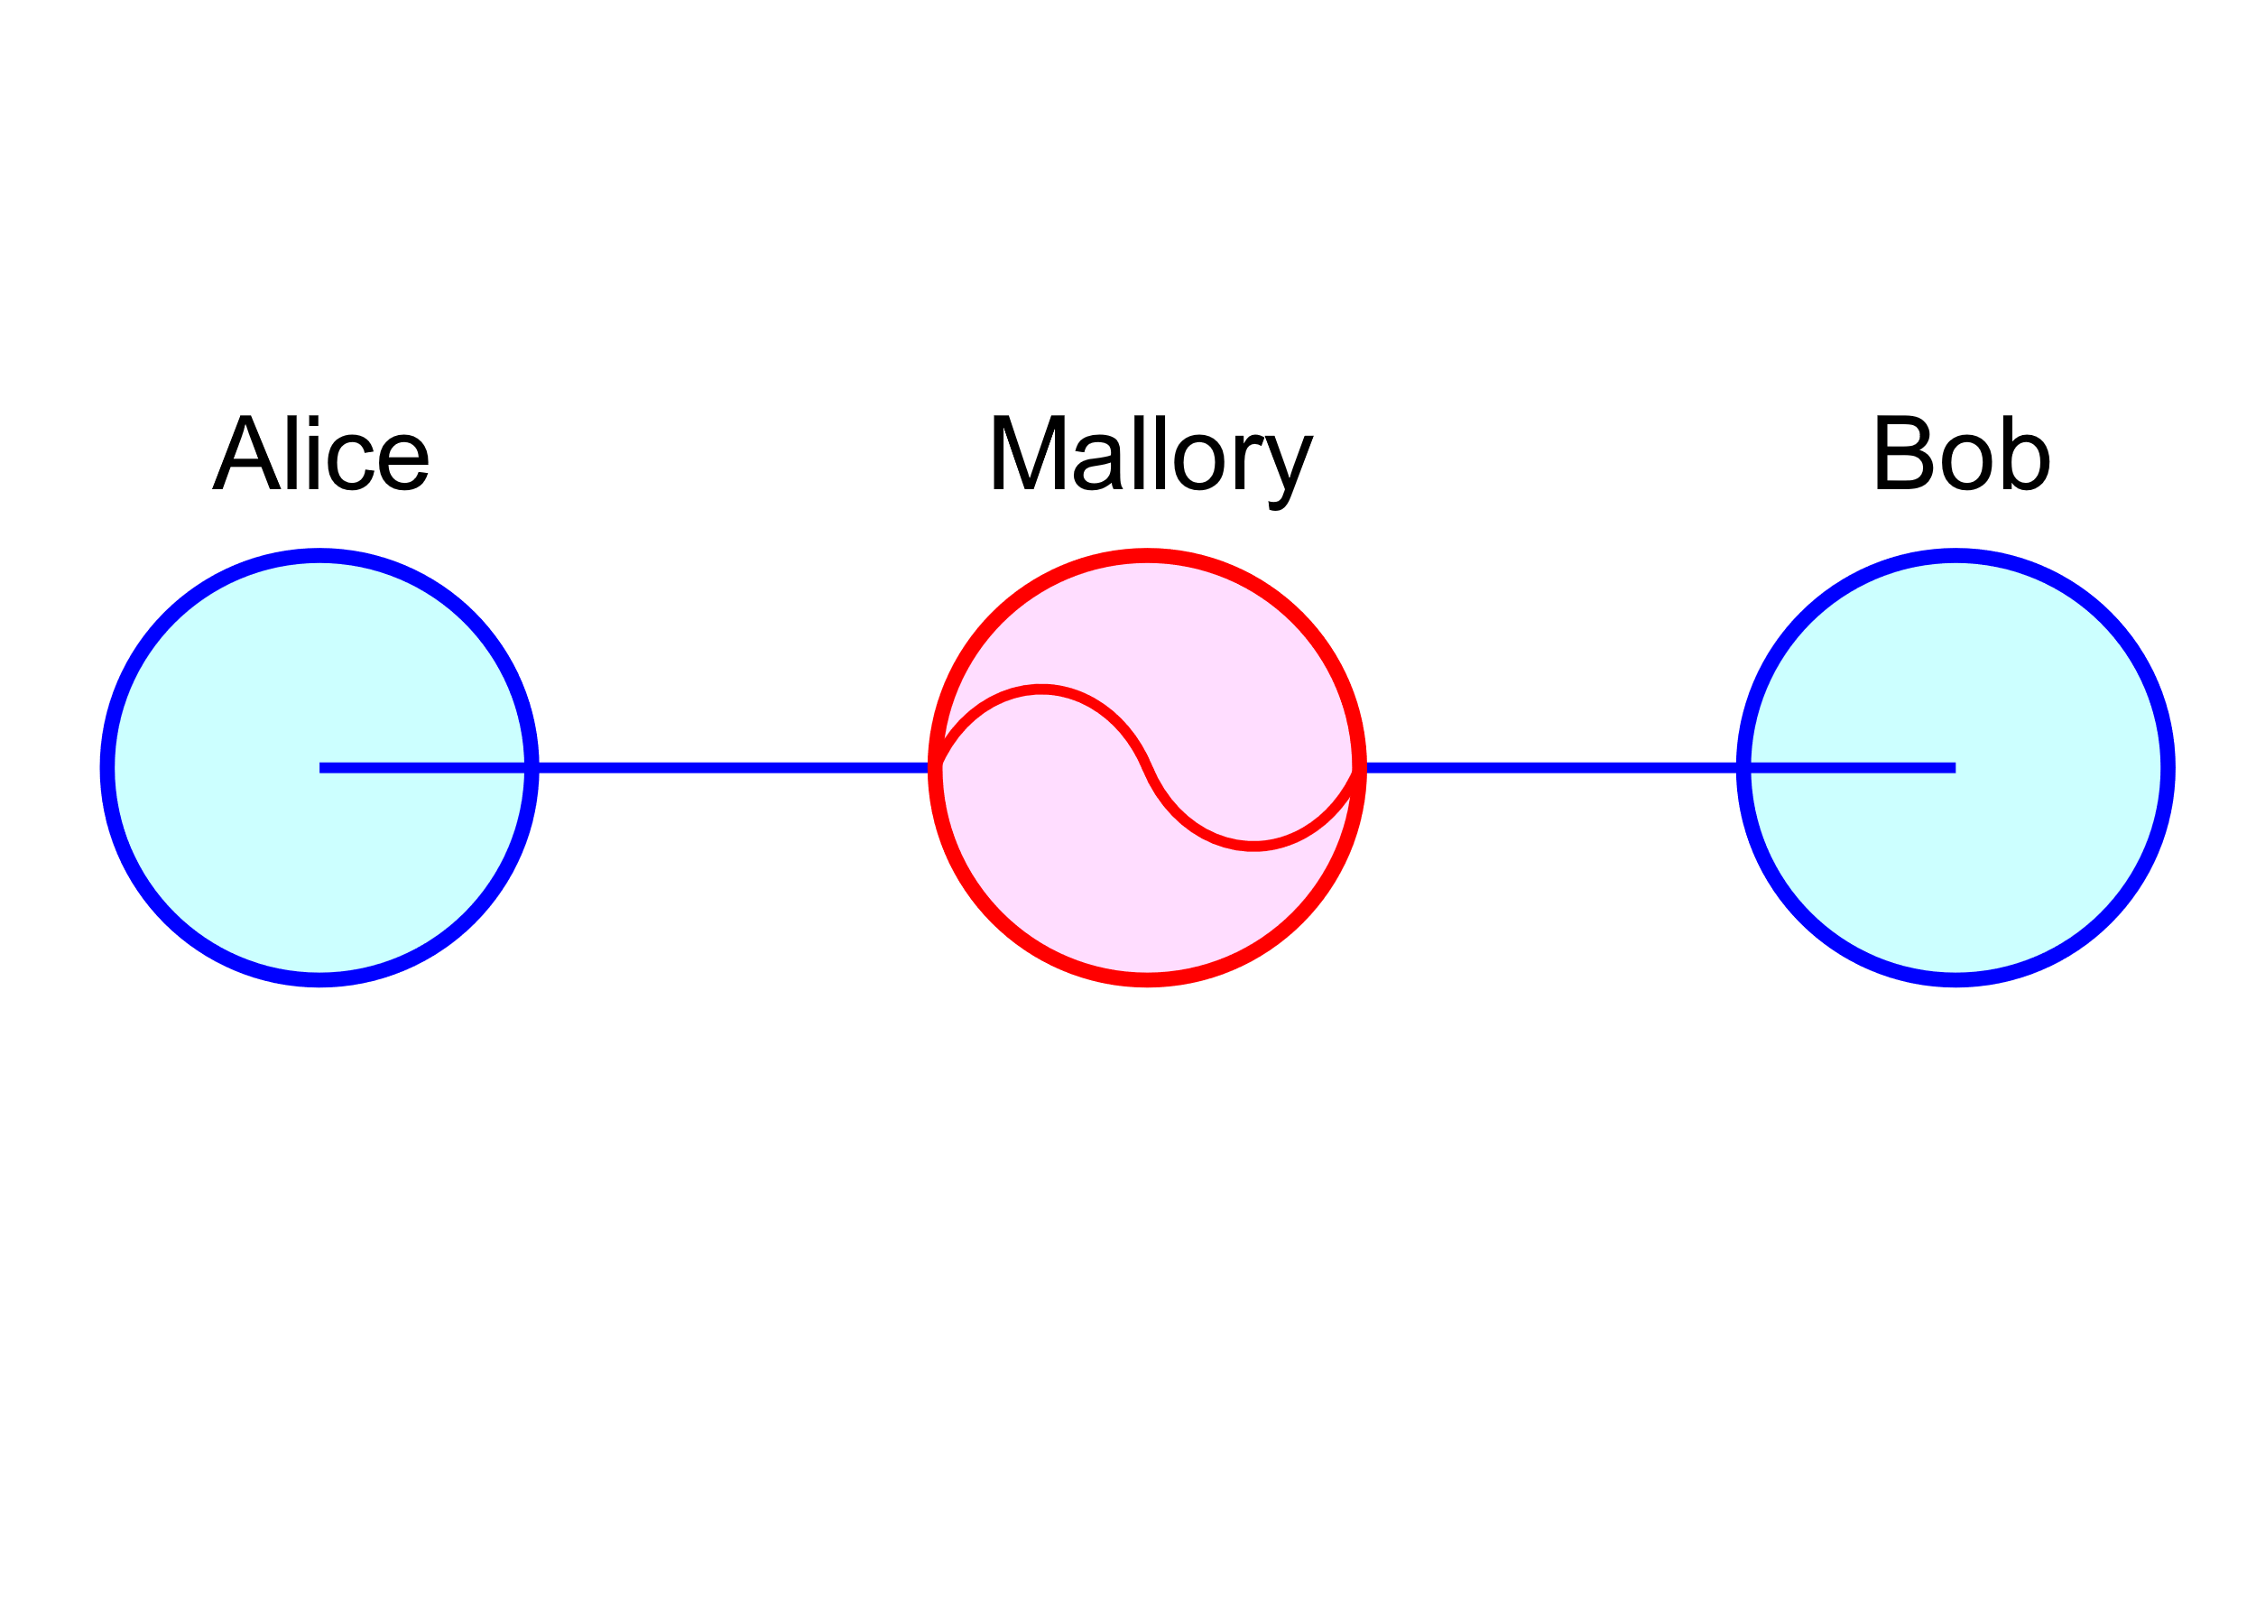
Examples :
(sender)
(attacker)
(reciever)
Fig. : Example for MIMA

Slide 11
Alice sends a message to Bob, which is intercepted by Mallory
Mallory relays this message to Bob; Bob cannot tell it is not really from Alice:
Bob responds with his encryption key
Mallory replaces Bob's key with her own, and relays this to Alice, claiming that it is Bob's key
Alice encrypts a message with what she believes to be Bob's key, thinking that only Bob can read it:
However, because it was actually encrypted with Mallory's key, Mallory can decrypt it, read it, modify it (if desired), re-encrypt with Bob's key, and forward it to Bob:
Bob thinks that this message is a secure communication from Alice.

Slide 12
Prevention
Use a Virtual Private Network (VPN) to encrypt your web traffic.
Secure your network with an intrusion detection system.
Your network should have strong firewalls and protocols to prevent unauthorized access.
Use third-party penetration testing tools,softwares and HTTPS encryption to help detect and block spoofing attempts.
Install active virus and malware protection that includes a scanner that runs on your system at boot.
End-to-End Encryption is the best defense to protect against intercepted communication.

Slide 13
Conclusion :
Man-In-Middle Attack is well knowned attack in which loss of data privacy,
Identity spoofing, session hijacking occurs which leads to a fatal lose
Thus, to be aware about such attacks and taking better preventions is a key to
avoid such attacks.

Slide 14
References :
Wikipedia
Imperva
veracode

