Slide 1
Project 1
Deliverable 3
LING 575: Summarization
Team 2
Notes:
Josh

Slide 2
Team 2
Ben Cote
Mohamed Elkamhawy
Karl Haraldsson
Alyssa Vecht
Josh Warzecha
Notes:
Josh

Slide 3
Project 1 Overview
Multi-document summarization
News articles
Various categories and topics
End-to-end system
Document ingestion
Content selection
Information ordering
Content realization
Evaluation of output summaries

Slide 4
D3: Initial System
Notes:
Alyssa

Slide 5
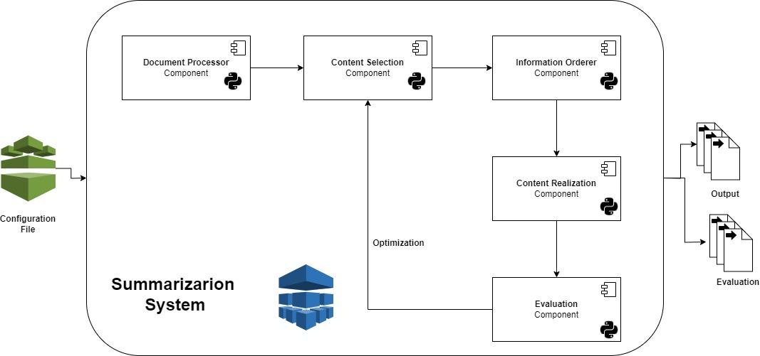
System Overview
Notes:
Mohamed

Slide 6
Content Selection Methods
TF-IDF
Identifies important phrases based on their frequency across documents relative to their frequency within a single document, prioritizing content that is both common across and unique to the document set.
Goal:
Identify the most salient sentences for inclusion in the summary.
TextRank
Utilizes a graph-based ranking model to evaluate the importance of sentences within the text, based on the strength of the relationships between and across other sentences.
Notes:
Mohamed & Ben

Slide 7
Initial Information Ordering Method
Goal:
improve the coherence and readability of summaries by determining an optimal sequence for the selected content.
Implementation:
Inspired by the Traveling Salesperson Problem (TSP) to sequence sentences, using the MASI distance to measure similarity between sentences and applying a two-opt algorithm for optimization.
Sentences are treated as nodes and the goal is to find the shortest path that visits all sentences once, ensuring a logically coherent flow.
The method seeks to arrange sentences in a manner that maximizes topical continuity, enhancing the narrative structure of the summary.
Notes:
Alyssa

Slide 8
Naive Content Realization Method
Goal:
Compose selected and ordered content into a coherent summary that retains the integrity of the underlying sentences.
Implementation:
Utilizes a basic concatenation of sentences, prioritizing the evaluation of content selection and ordering strategies.
Truncates sentences that would force the summary to exceed 100 word tokens.
Notes:
Karl

Slide 9
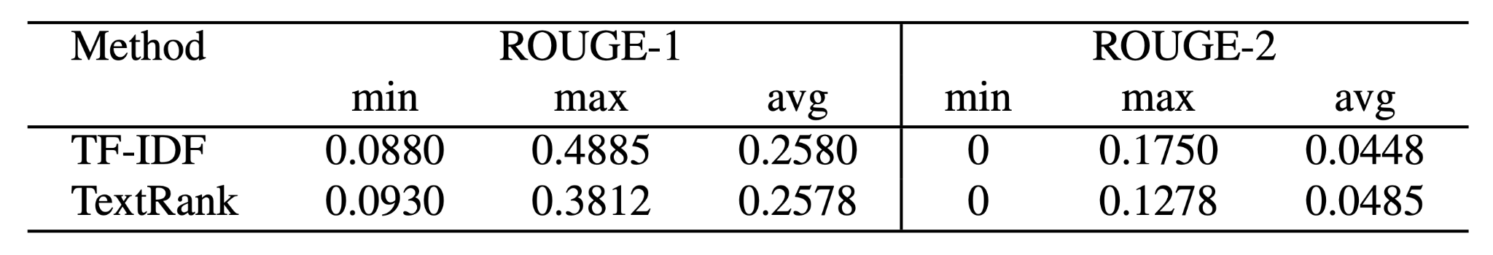
Issues & Successes
Notes:
Josh
Relatively low ROUGE scores, with TextRank achieving slightly higher ROUGE-2 overall.
Some amount of overlap is expected, as stop words and other common words were not excluded from evaluation, potentially inflating ROUGE-1 scores.
The ROUGE-2 scores are slightly more illustrative, as they rely on bigram overlap.

Slide 10
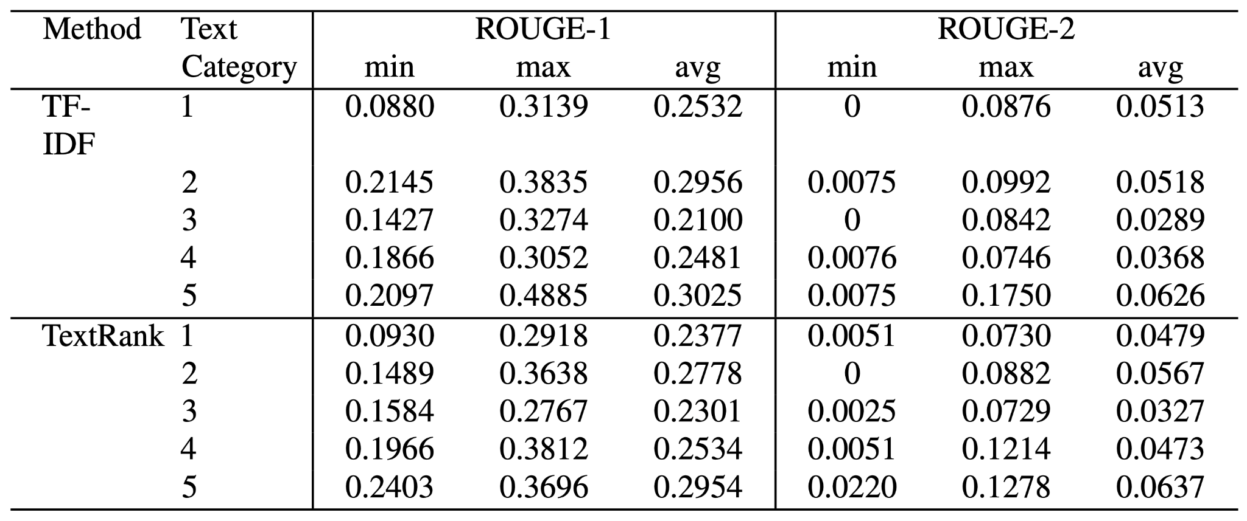
Issues & Successes
Notes:
Josh
Varying performance across text categories.
Our system generally summarized texts in categories 2 (attacks) and 5 (investigations and trials) better than those in categories 1 (accidents and natural disasters), 3 (health and safety), and 4 (endangered resources).
System summaries generated for document sets with topics around health and safety (category 3) were consistently worse than those for any other category.
Category 3 is more general and less targeted than categories 2 or 5.
We can postulate a spectrum of category “abstractness” within these document sets, ranging from least abstract (i.e., categories 2 and 5) to somewhat abstract (i.e., categories 1 and 4) to most abstract (i.e., category 3).
It could be useful in refining the content selection methods to first measure the topic variability within a document set and use this information when selecting content to ensure that the most salient sentences are extracted.
Content realization currently a blunt object, often leading to the truncation of sentences with useful information. Could also assess topic variability within document set to determine how best to select content.

Slide 11
Next Steps

Slide 12
Initial Plans for Future Versions
Content Selection
LDA/Topic modeling with Gensim
Supervised model(s)
Enhance TF-IDF through:
Term Weighting Adjustments
Incorporate Semantic Similarity
Graph-based Ranking
Information Ordering
Naive implementations planned for initial system iteration.
Literature review in progress to guide more refined implementations.
Content Realization
Sentence compression methods
Notes:
Mohamed

