Slide 1
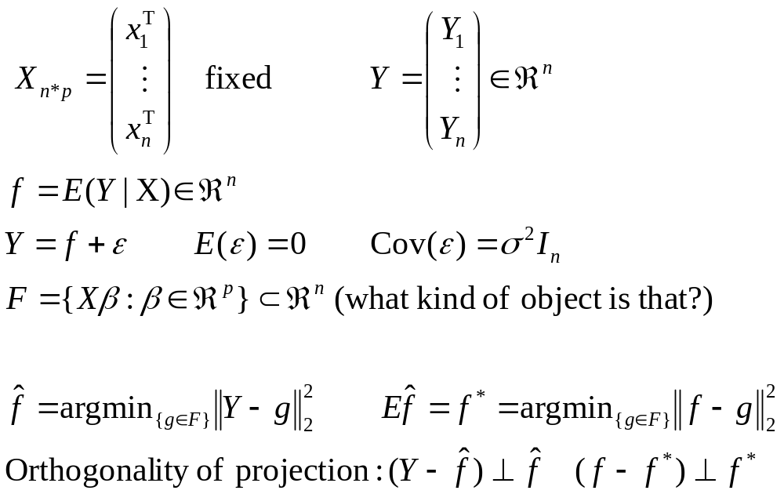
Setup for linear regression model

Slide 2
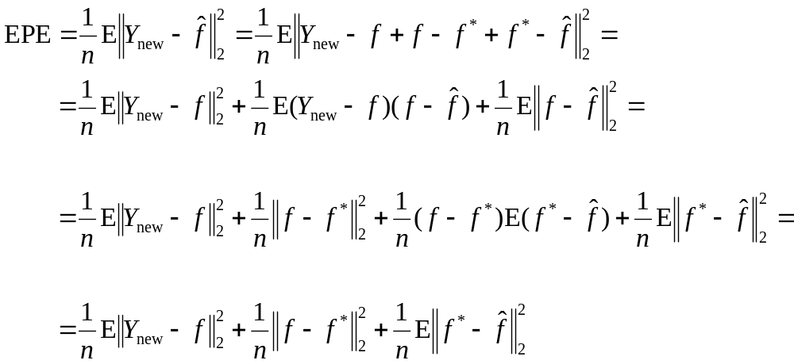
Analyzing “EPE” (fixed X)
0 (independence)
0
=σ² (irreducible)
bias²
variance (= σ²p/n)

Slide 3


Graphical picture of linear model
F
Data variance
y
Variance
ƒ
Bias
Irreducible error
y_{new}

Slide 4
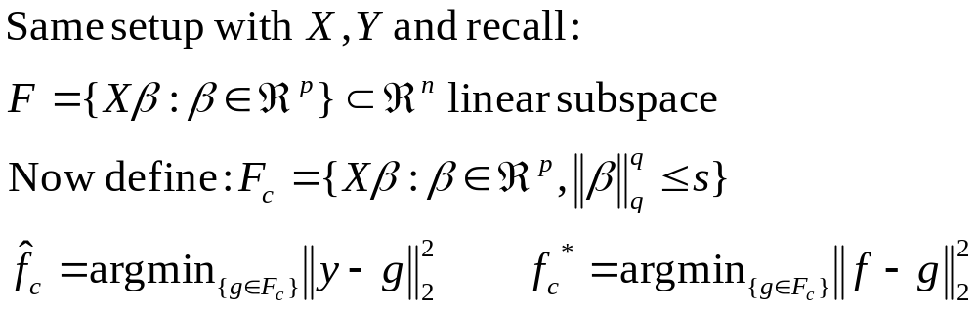
Regularization in linear regression
Questions:
  What happens to our bias?
  What happens to our variance?
  What happens to our calculations (still orthogonal projections?)

Slide 5


Graphical picture of linear model + regularization
F
F
Data variance
Model variance
F_{c}
y
Variance
ƒ
Bias
Irreducible error
y_{new}

