Slide 1
VTank
Vermont Technical College

Slide 2
What is VTank?
Online multi-player 3D game written in .NET
Customizable tanks
Product of Summer of Software Engineering (SoSE) program

Slide 3
Summer of Software Engineering
Students develop software in professional environment
Focuses on best practice development
Running since 2006

Slide 4
How VTank Started
Rob Fredricksen offered $50.00 for online multi-player version of old Atari game
Cross-platform using C++ and OpenGL
Almost everything written from scratch

Slide 5
The New VTank
Microsoft XNA Framework
Internet Communications Engine (Ice) for network infrastructure
Exclusive to Windows
Much easier to develop

Slide 6
Gameplay
An action/arcade-style tank game
Typical first-person shooter controls
Change to a new map every 20 minutes
Various game modes (e.g. Deathmatch, Capture the Flag)

Slide 7
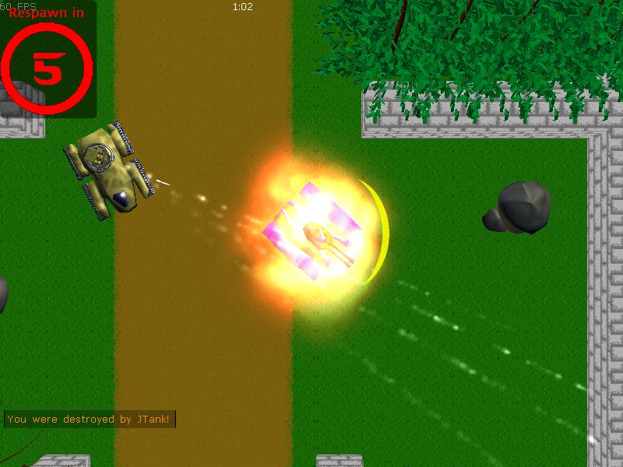
Screenshot (Top Down)

Slide 8
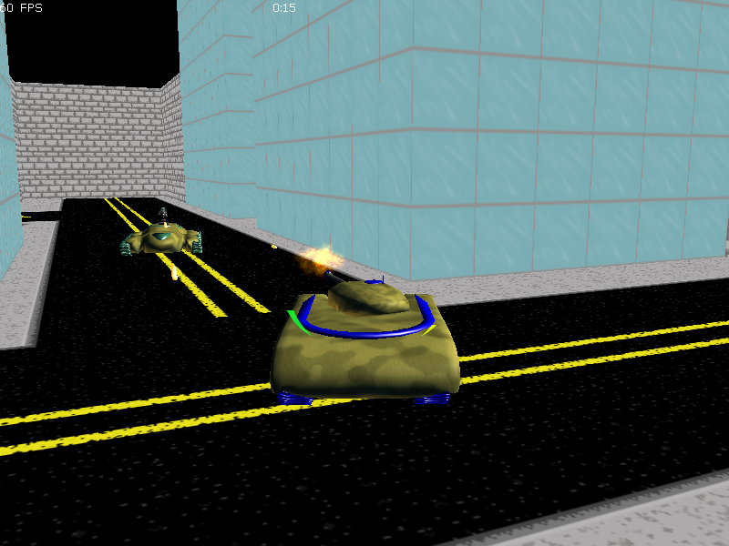

Slide 9
Internet Communications Engine (Ice)
Cross-platform middleware
Object-oriented design
Design protocol in ‘Slice’ definition files
Compile to any supported language
Created & maintained by ZeroC
URL: http://zeroc.com

Slide 10
Slice (Example)
Slice definition (MyFile.ice):
module MyModule {
interface MyInterface {
string ToUpper(string str);
};
};
Server implementation (Example in C#):
class MyInterfaceServant : MyModule.MyInterface { public string ToUpper(string str)
{
return str.ToUpper();
}
}
Client usage (Example in Python):
print serverObj.ToUpper(“hi”);
Output:
HI

Slide 11
Why Ice?
Ice met the requirements perfectly:
Free, open-source, licensed under GPL
Built to meet the requirements for a MMO game
Need to host servers on Windows and Linux
Supports all languages we use

Slide 12

Architecture

Slide 13
Main Server
Master server – manages all types of clients
Including game servers
External database for account and tank data
Acts as middle-man to database
Written in Python

Slide 14
The Database
Using MySQL instance
Reason: Easily deployable, scalable
InnoDB table engine
MyISAM has no integrity checks
Completely blocked off from the public

Slide 15
Glacier2
Firewall traversal service
Callback utility – clients don’t modify firewall
Acts as proxy between server(s) and client(s)
Sits on edge of server firewall
Provides extra security

Slide 16
Game Server
Each instance runs simulation
Game servers/processes don’t affect each other
Can be any number of game servers
Written in C++

Slide 17
VTank (client)
Manage tanks, play the game
Login with account created at the website
Written in .NET (C#)
Microsoft XNA Framework for graphics API
Neoforce Controls for the GUI

Slide 18
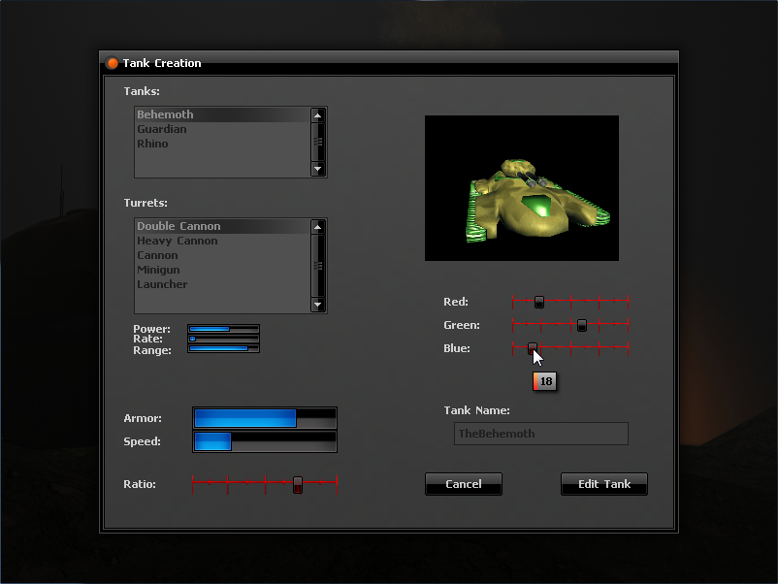

Slide 19
Patcher
Searches for and downloads updates
Interacts with IcePatch2 server
Interface for game options, starting the game
Written in C++

Slide 20
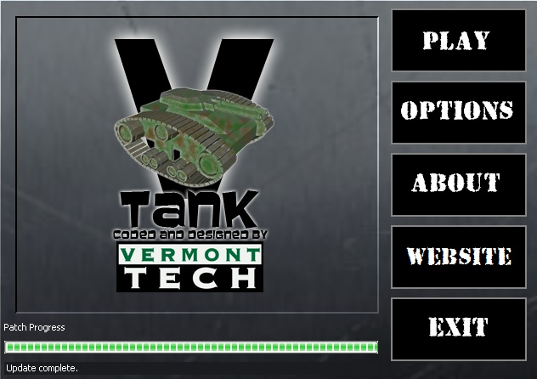
Patcher (Screenshot)

Slide 21
Map Editor
Preserved from last year’s SoSE
Create and upload playable maps
Meant for developers, guests can use it too
Only developers can upload maps
Written in C++

Slide 22
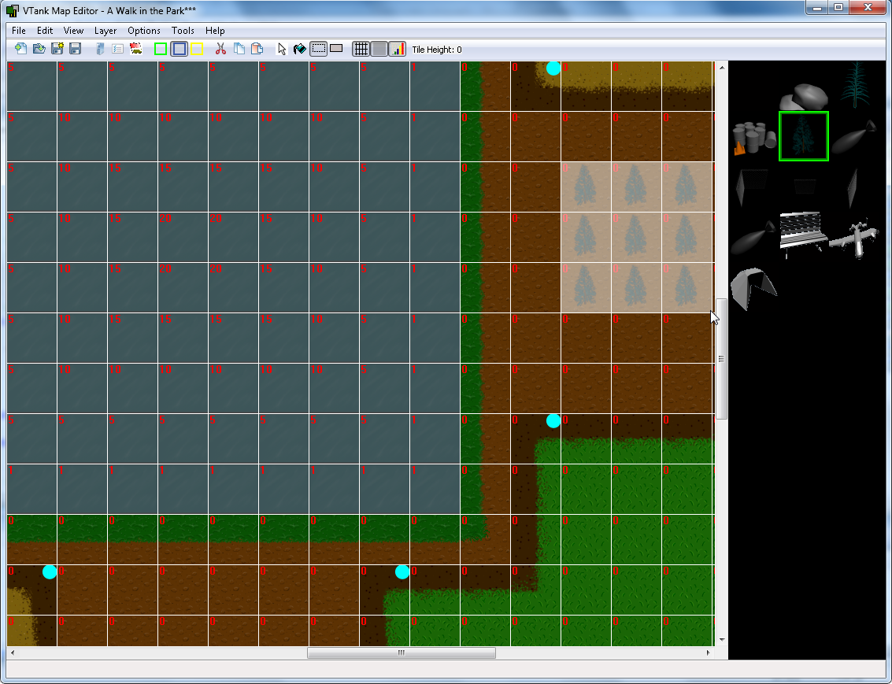

Slide 23
Captain VTank
Interface for administration, in-depth statistics
Requires highest possible privileges
It can do anything
Not very mature – only about a week of work
Written in Java

Slide 24
Janitor
Interface for game data modification
Requires ‘developer’ privileges
Meant to abstract the difficulties of working with database directly – anyone can use it
Doesn’t quite exist yet

Slide 25
Website
Backend in Python using Django framework
Forum for community interaction
Interface for account registration
URL: http://vtank.cis.vtc.edu

Slide 26
Distribution
Installer installs Patcher, not the client
Patcher will do a full download on first run
Rationale: Only one installer ever
Until it gets huge…

Slide 27
The Patching Process
Build server compiles new client version
A script runs to update ‘live’ patch directory
IcePatch2 server is restarted
New patch is not released if the build breaks

Slide 28
The Future of VTank
Statistics and player ranking
In-game power-ups
Enhanced map editor

Slide 29
The Website
http://vtank.cis.vtc.edu/

Slide 30
Demonstration

