Slide 1
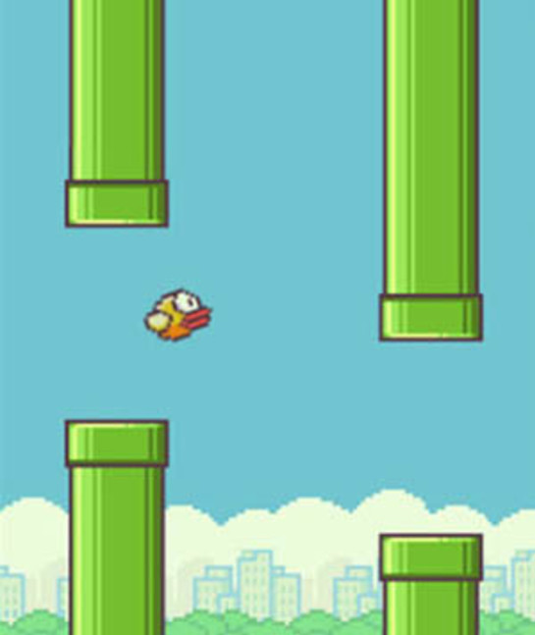
Flappy Bird
Deep Q Learning

Slide 2
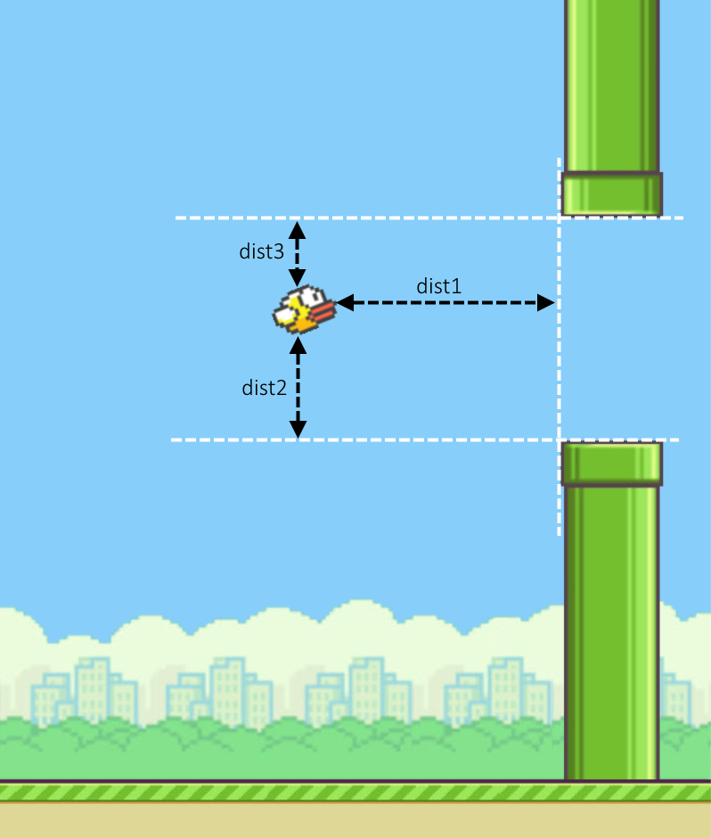
Problem
Understanding deep q learning
Applying experience replay to train agent learn playing “flappy bird”
Study which experience replay method is the best (by altering variables)
Presented by Siyuan,Tang

Slide 3
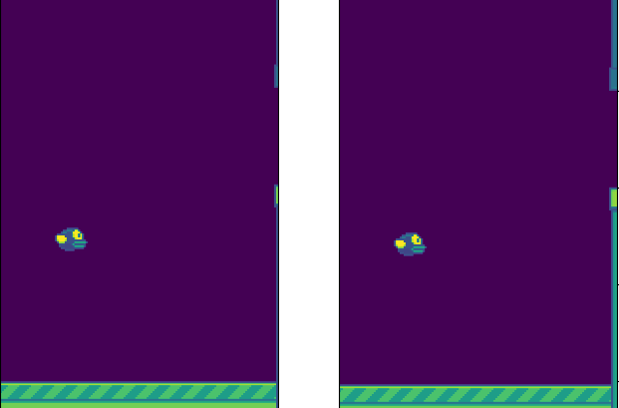
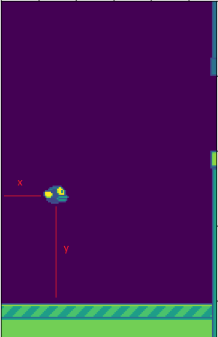
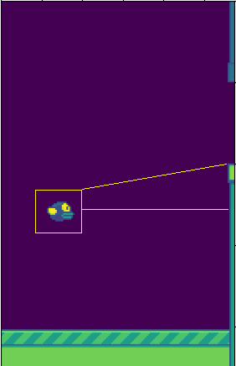
Data Sources
Image frame
Bird Position
Pipe position
Gap position
Presented by Siyuan,Tang

Slide 4
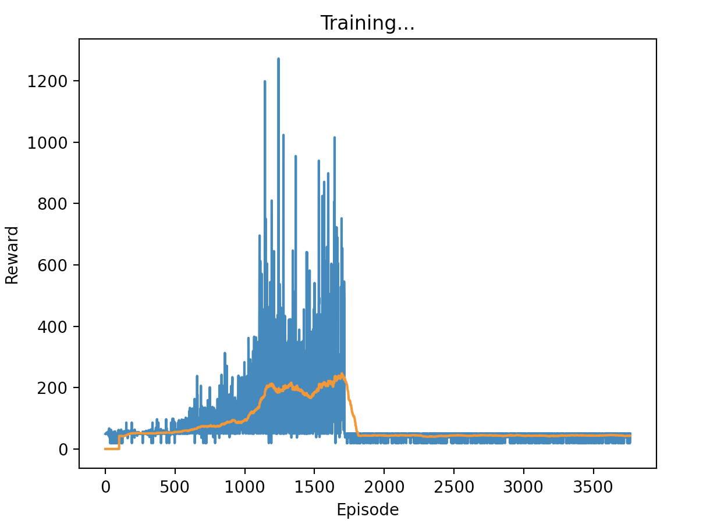
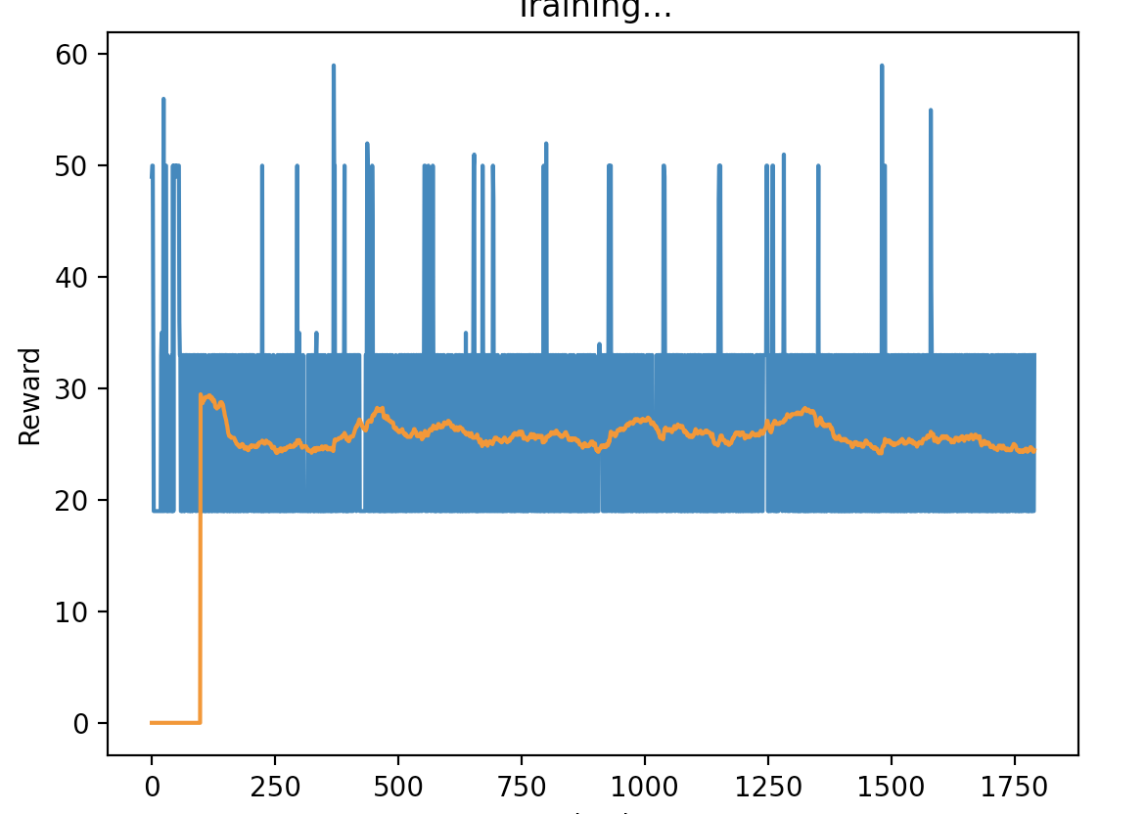
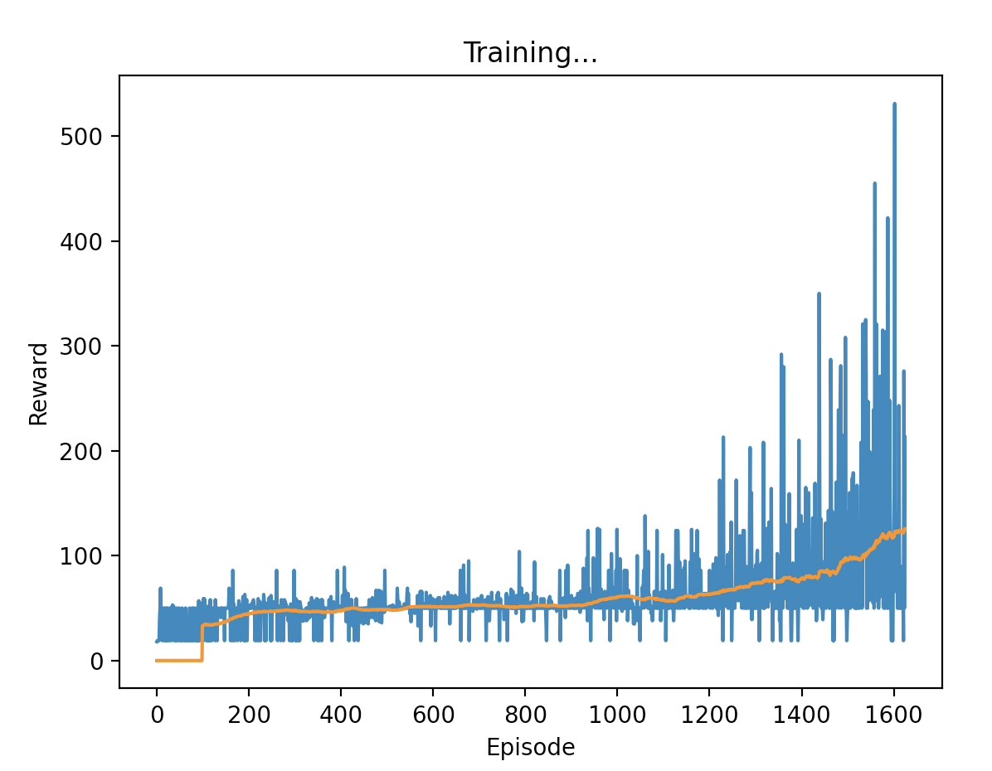
Methodology -- 1
Different Model Comparison
Experience Replay
Q – Learning Model
3-layer DQN with experience replay Model
Double Q-Learning Model

Slide 5

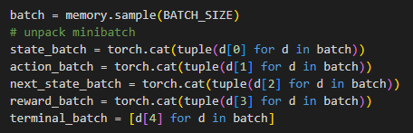
Methodology -- 1
Experience Replay
Epsilon Greedy Algorithm
Storing gameplay
Taking samples from memory

Slide 6
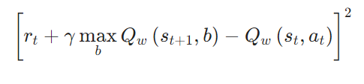
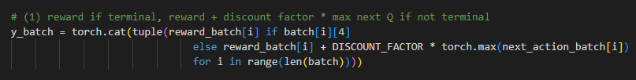

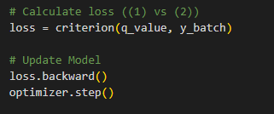
Methodology -- 2
Experience Replay

Slide 7

Methodology -- 3
Experience Replay
Changing Hyperparameters
Initial Epsilon
Learning Rate
Batch Size

Slide 8
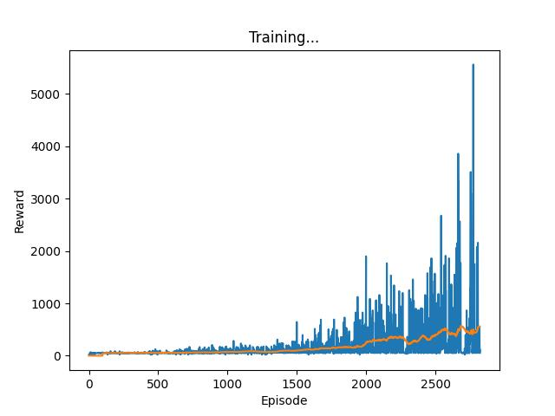
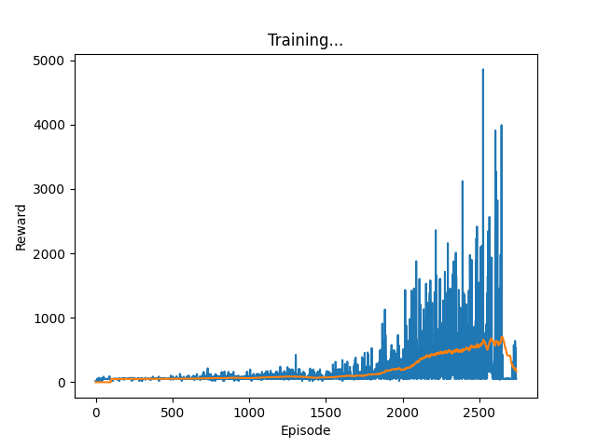
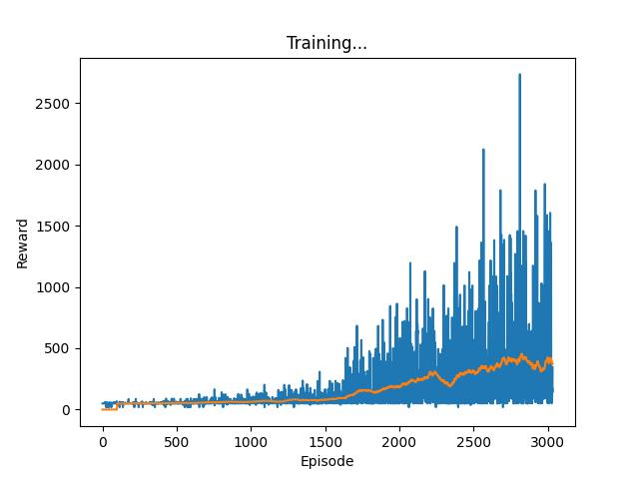
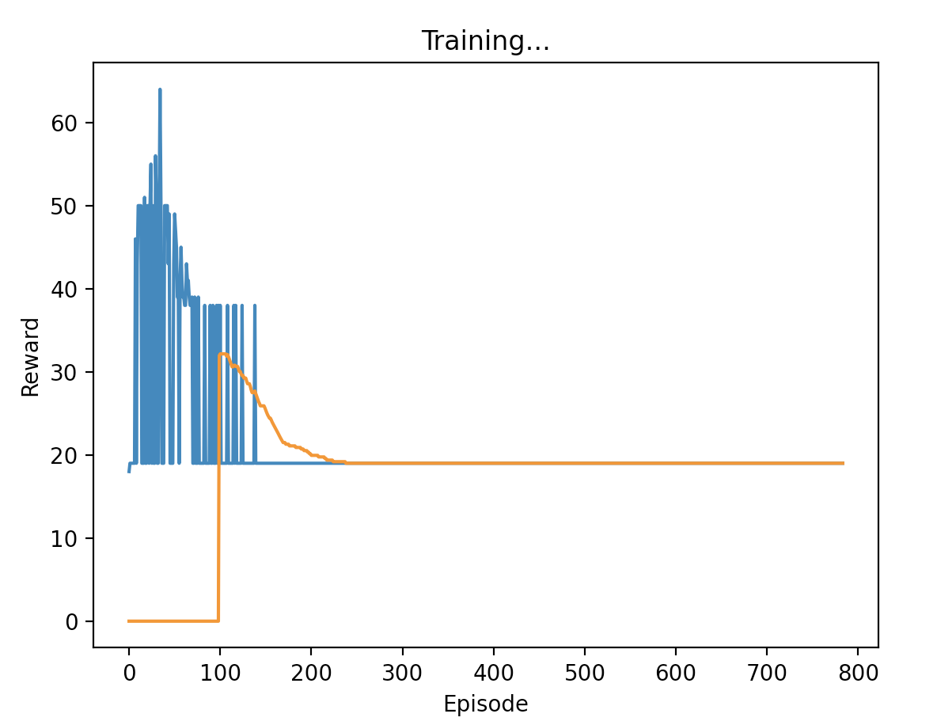
Result
Initial Epsilon | 0.2
Learning Rate | 1e-5
Memory Size | 50
Sample Size | 30
Initial Epsilon | 0.2
Learning Rate | 5e-6
Memory Size | 50
Sample Size | 30
Initial Epsilon | 0.2
Learning Rate | 1e-5
Memory Size | 100
Sample Size | 85
Initial Epsilon | 0.6
Learning Rate | 1e-5
Memory Size | 50
Sample Size | 30
Time Taken: 4 hours 48 mins
Time Taken: 5 hours 7 mins
Time Taken: 7 hours 34 mins
Presented by Siyuan, Tang

Slide 9
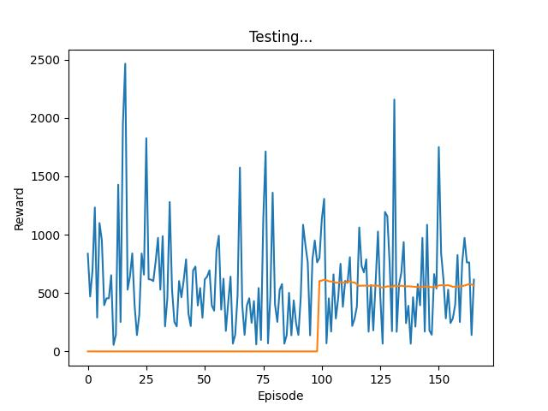
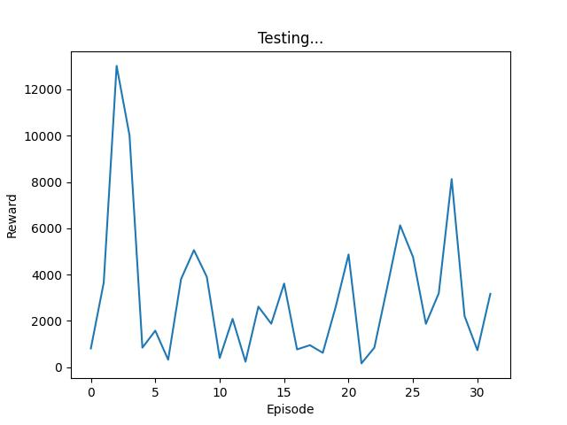
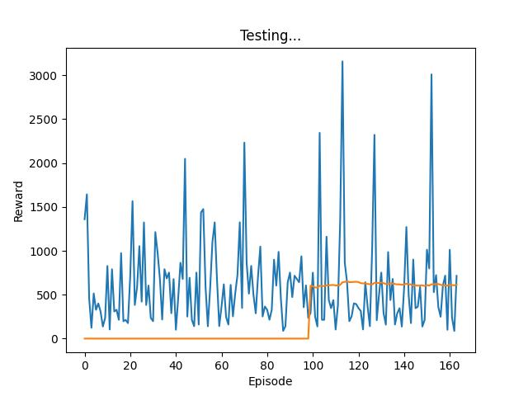
Model Testing
Initial Epsilon | 0.2
Learning Rate | 1e-5
Memory Size | 50
Sample Size | 30
Initial Epsilon | 0.2
Learning Rate | 5e-6
Memory Size | 50
Sample Size | 30
Initial Epsilon | 0.2
Learning Rate | 1e-5
Memory Size | 100
Sample Size | 85
Initial Epsilon | 0.6
Learning Rate | 1e-5
Memory Size | 50
Sample Size | 30
Presented by Siyuan, Tang

Slide 10
Conclusion
Experience Replay generally is a good approach in training the agent to learn the environment and achieve desired outcome
Increasing memory and batch size does not improve learning outcome of agent, rather the time taken is increased
Decreasing learning rate improves agent learning speed dramatically
Increasing initial epsilon prevents agent from learning

