Slide 1
Analyzing U.S. County-Level
Health Outcomes
The Role of Lifestyle, Environment, and Access to Care
Summer Almansour | DSCI 510 – Spring 2026 | USC Viterbi

Slide 2
Introduction
Why do some counties have far worse health outcomes than others?
Motivation
Research Questions
Premature death rates vary by 4x across U.S. counties
Lifestyle factors like inactivity and smoking are modifiable
Access to care and insurance coverage differ dramatically by region
Understanding these patterns can inform public health policy
Which behavioral and environmental factors most strongly correlate with premature death rates?
Do counties cluster into distinct health risk profiles?
Which states have the best and worst health outcomes?
Dataset: 2,843 U.S. counties | Source: County Health Rankings 2025 (countyhealthrankings.org)

Slide 3
Data Sources
Three datasets merged on county FIPS codes
# | Dataset | Source / Type | Key Fields | Size
1 | County Health Rankings 2025 | countyhealthrankings.org / CSV File | Premature death, diabetes, physical inactivity, uninsured rate, obesity, smoking | ~3,200 counties
2 | CDC PLACES API | data.cdc.gov / API (JSON) | Chronic disease measures by county — obesity, smoking, checkup rates | 500+ measures, 3,100+ counties
3 | EPA Air Quality Annual Summary | aqs.epa.gov / CSV File | Median AQI, days good/unhealthy, max AQI per county | ~1,000+ counties
All datasets joined on 5-digit county FIPS codes. Final analysis dataset: 2,843 counties after removing missing values.

Slide 4
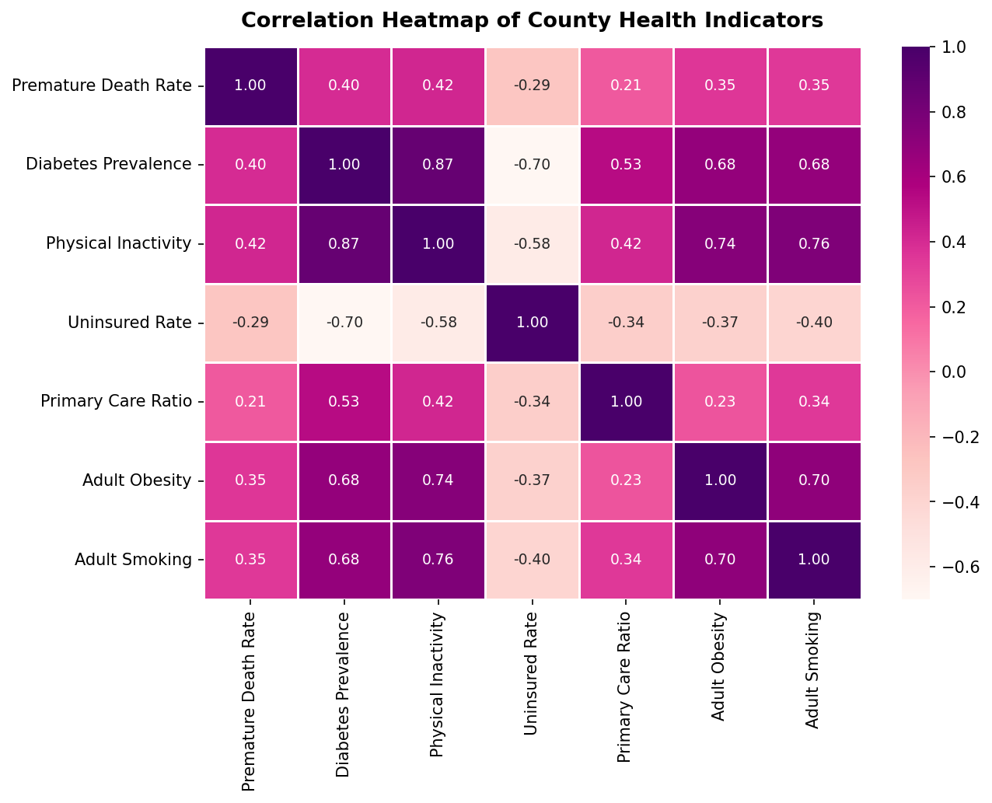
Results: Correlation Analysis
Which factors most strongly predict premature death rates?
Correlation with
Premature Death Rate
Physical Inactivity
r = 0.42
Diabetes Prevalence
r = 0.40
Adult Obesity
r = 0.35
Adult Smoking
r = 0.35
Uninsured Rate
r = 0.29
All correlations statistically significant (p < 0.001)

Slide 5
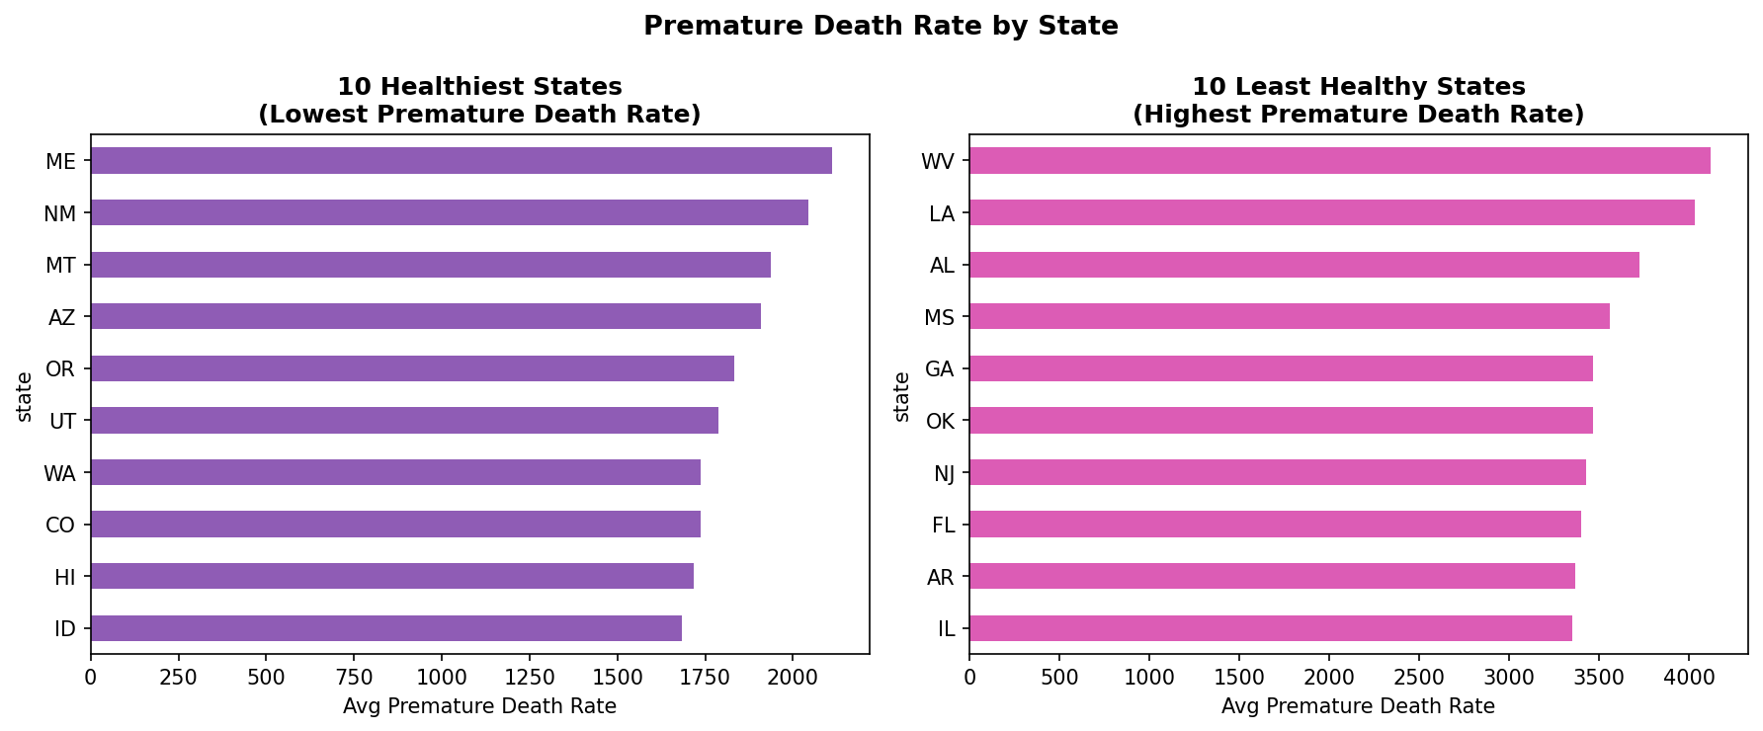
Results: State-Level Patterns
Healthiest vs. least healthy states by average premature death rate
Healthiest: ID, HI, CO, WA, UT — lower inactivity, higher access to care
Least healthy: WV, LA, AL, MS, GA — higher poverty, inactivity, uninsured

Slide 6
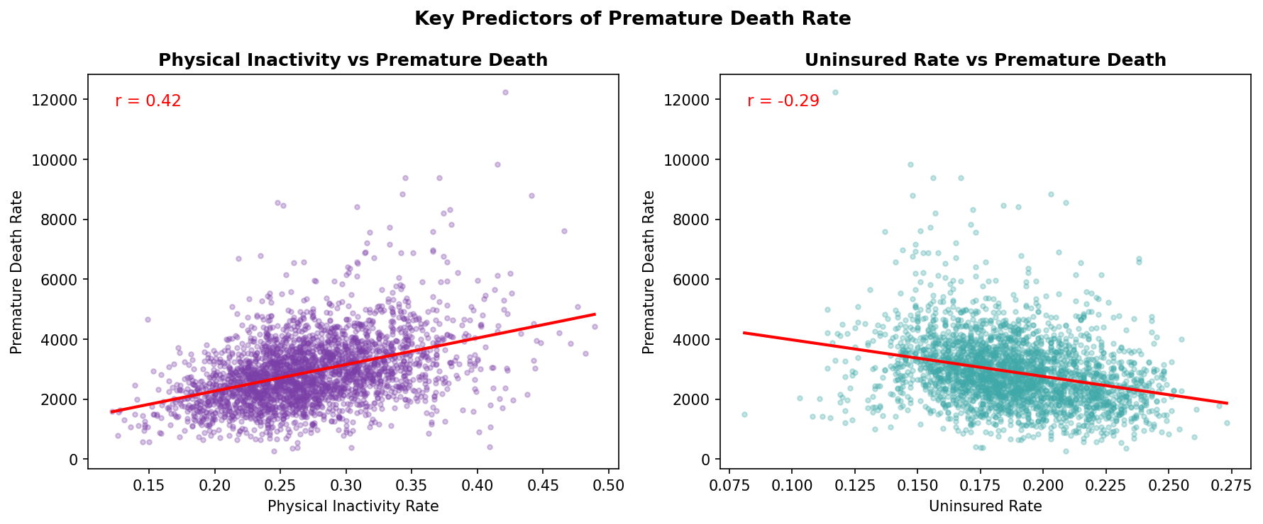
Results: Key Predictors
Physical inactivity and uninsured rates as predictors of premature death
Physical inactivity (r=0.42): Counties where more residents are physically inactive show consistently higher premature death rates.
Uninsured rate (r=0.29): Higher uninsured rates correlate with worse outcomes, reflecting reduced access to preventive care.

Slide 7
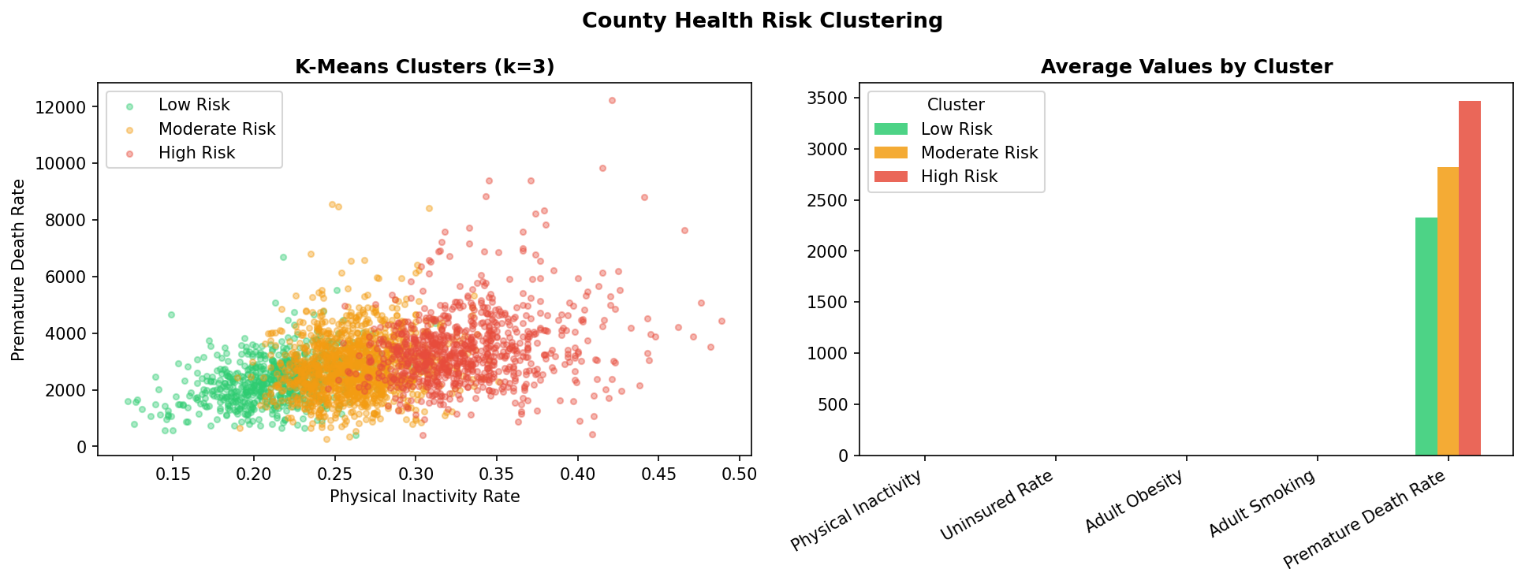
Results: K-Means Clustering (k=3)
Counties group into distinct health risk profiles
Low Risk
640 counties | Avg death rate: 2,327
Lower inactivity, lower smoking, better access to care
Moderate Risk
1,344 counties | Avg death rate: 2,823
Average across all risk factors
High Risk
859 counties | Avg death rate: 3,468
Higher inactivity, obesity, smoking, uninsured rates
Features used for clustering: Physical Inactivity, Uninsured Rate, Adult Obesity, Adult Smoking

Slide 8
Challenges
Difficulties encountered during the project
FIPS Code Formatting
Incomplete AQI Coverage
Each dataset used different county identifier formats — integers vs. zero-padded 5-character strings. Required standardization before merging.
EPA air quality data only covers counties with active monitoring stations (~1,000 of 3,100+), leaving most counties without AQI values. Treated as optional feature.
CDC API Access Restrictions
Missing Data Handling
The CDC PLACES API required pagination and rate-limiting logic to retrieve all county-level records in JSON format without errors.
Some smaller/rural counties lacked values for several measures. Chose to drop rows with missing key variables rather than impute, reducing dataset from 3,152 to 2,843 counties.

