Slide 1
Project 7: Variant Warehouse
Summer Elasady, Denise Mauldin, Joe Slagel and Brady Bernard
11-19-2015

Slide 2
Connect!
GitHub tutorials and PowerPoint:
git clone https://github.com/summerela/impala_training/

Slide 3
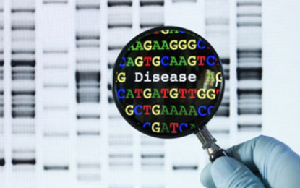
Agenda
Overview of Impala Ecosystem
Use Cases
What is Cloudera Impala?
What’s available?
Connecting to Impala
Hue Web Interface
Impala Shell
R
Python
Breakout Sessions:
Query Creation
Pipelines
Where to Find Help

Slide 4
Section 1: Overview of Impala Ecosystem

Slide 5
Use cases
Why do we need Impala?

Slide 6
The reality
Tens of thousands of genomes, billions of variants, petabytes of data
Incremental updates necessary for ongoing analyses by multiple researchers and groups
Tab delimited files of multi-sample genomic data representations are not scalable
Example ITMI projects:
Families with full and preterm births
Longitudinal study – first 1000 days of life
Congenital anomalies

Slide 7
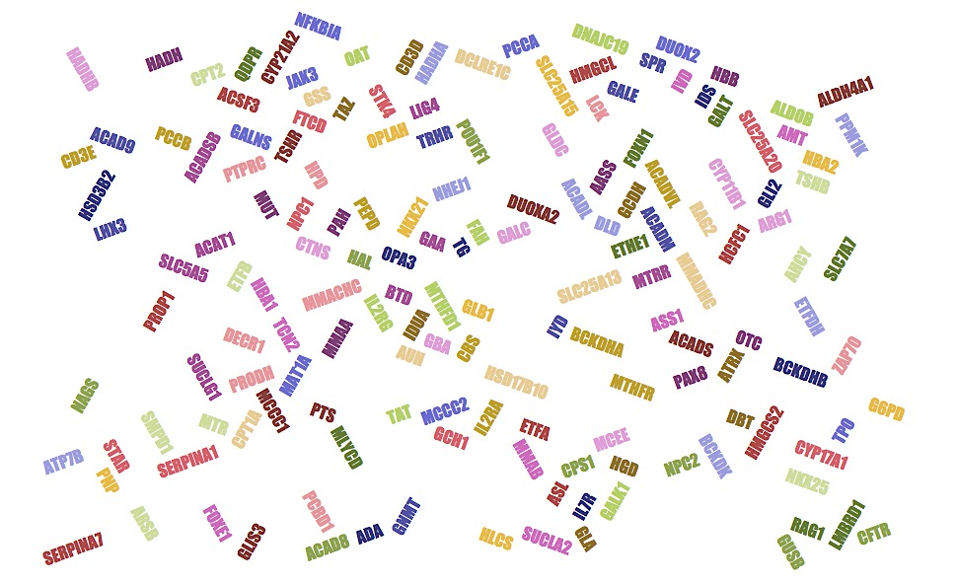
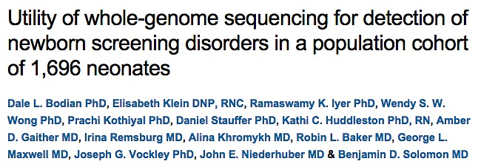
Newborn Screening Genes
ITMI Genetics In Medicine paper
Variants in NBS regions

Slide 8
NBS Genes: Traditional Approach
Sequence trios
Extract variants found in NBS regions
Annotate with ClinVar
Left shift and normalize with GATK
Functional annotation with Annovar
Examine method of inheritance

Slide 9
NBS Genes: Impala Solution
Select sample set
Filter using global variants table
Examine method of inheritance

Slide 10
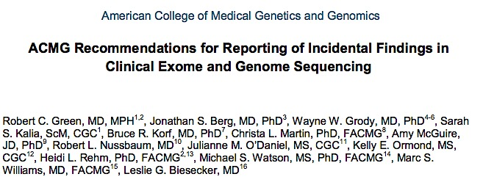

ACMG Actionable Genes

Slide 11
ACMG Genes: Impala Solution
Select sample set
Filter using global variants table
Examine method of inheritance

Slide 12

Clarity Challenge: Undiagnosed
8 families
Undiagnosed disease
Documentary “Undiagnosed”
http://www.childrenshospital.org/clarity-undiagnosed

Slide 13
Clarity Challenge: Impala Solution
Select sample set
Filter using global variants table
Examine method of inheritance

Slide 14
Clarity Challenge: Impala Solution
Select sample set
Filter using global variants table
Examine method of inheritance
BRCA1 Mutation

Slide 15
Cloudera impala
Big Data and the Hadoop Ecosystem

Slide 16
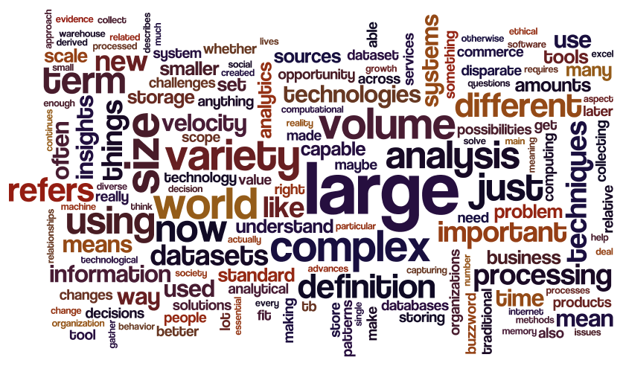
Big Data
"Any amount of data that's too big to be handled by one computer." John Rauser, AWS Data Scientist
"The joke is that big data is data that breaks Excel..." Brian Witt, Senior Data Scientist at Jawbone

Slide 17
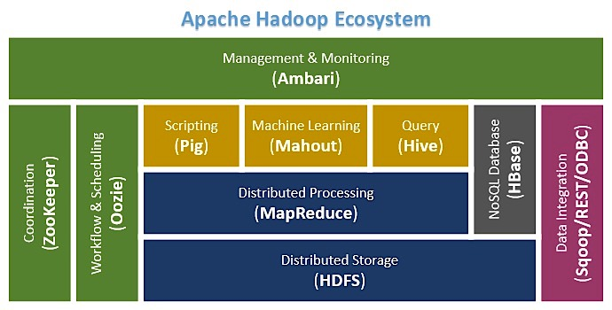
Hadoop
First major big-data solution
Based on map-reduce
Requires java and/or custom languages
Slow when querying large data sets

Slide 18
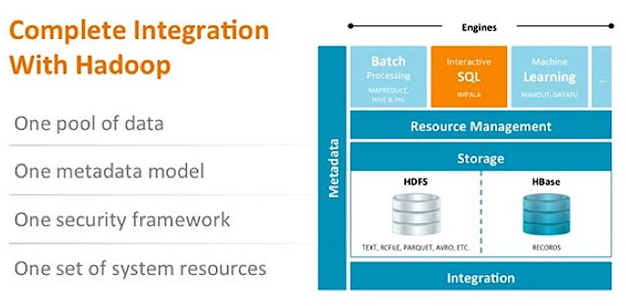
Cloudera Impala vs Hadoop
Hadoop-based system
Access data and run map-reduce jobs without java
Access data directly from HDFS
Native SQL Syntax
Faster than Hive

Slide 19
What is impala?
System Structure

Slide 20
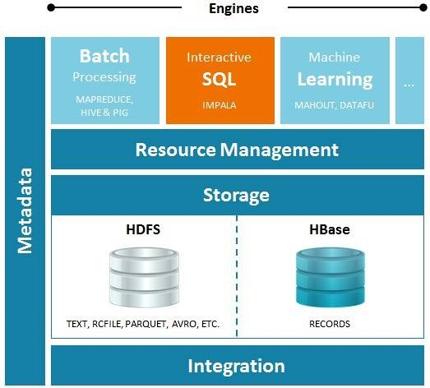
What exactly is impala?

Slide 21
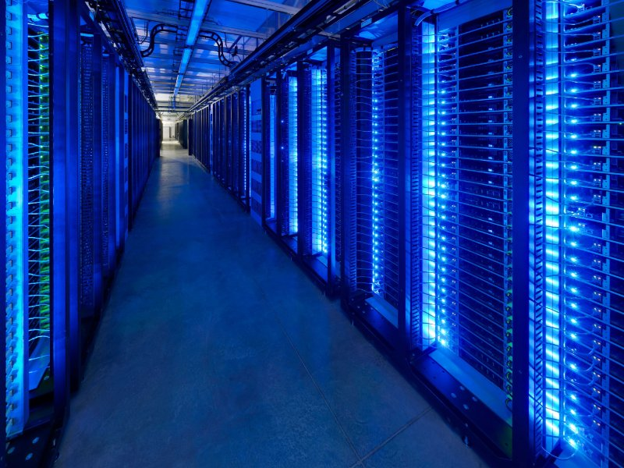
Data Warehousing and Analysis Solution

Slide 22
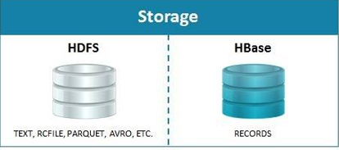
HDFS: File Storage

Slide 23
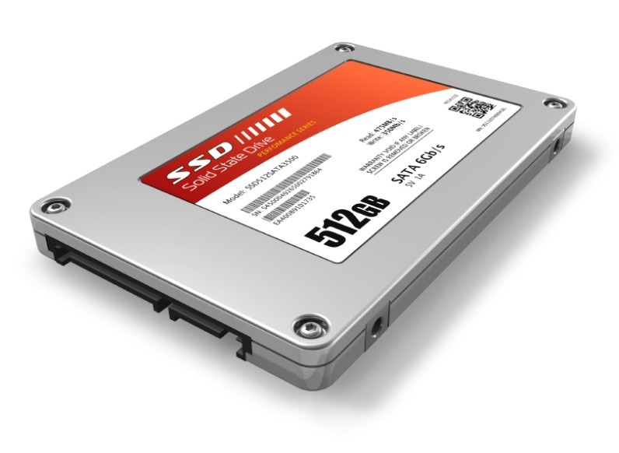
HDFS: File Storage
Store Files:
Variants
Reference DB’s
Analysis results

Slide 24
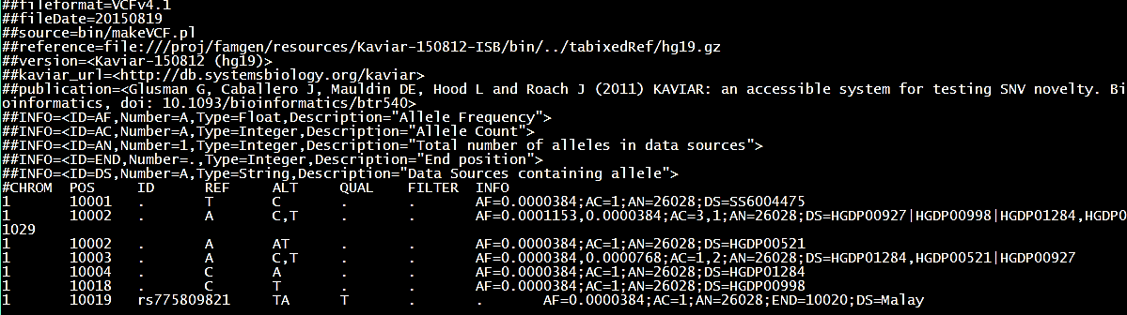
Transform Raw Data
Raw VCF file transformed and uploaded to HDFS:

Slide 25
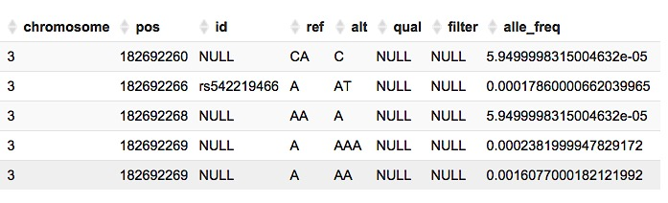
Impala Table
Read as a table by impala:

Slide 26
What exactly is impala?

Slide 27
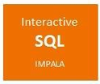
Access Data

Slide 28

Access Data

Slide 29
Structured Query Language (SQL)
Basic SQL Syntax
SELECT column_name(s)
FROM database_name.table_name
WHERE conditions
LIMIT number of rows to return
Example
SELECT *
FROM p7_ref_grch37.ucsc_genes
WHERE chrom = '1'
LIMIT 5

Slide 30
Cloudera vs. Traditional RDBMS
No transactional operations:
DELETE
UPDATE
COMMIT/ROLLBACK
Flexible schemas
No indexing
Primary key not required
Replication of data not a concern
Optimized by partitioning
Data distributed on clusters

Slide 31
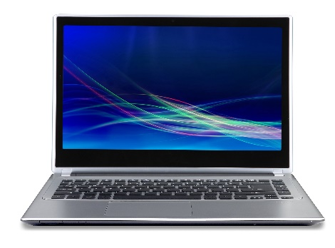
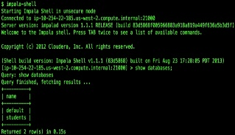





Connect to Impala
ODBC

Slide 32
What is impala?
Data Model

Slide 33
Schema
Platform
Variants
Methylation Data
RNAseq
Illumina
CGI
Custom Sets
Position Based
Region Based
Gene Based
Reference
Product
Metadata
ITMI
File
Subject
ETL log
Reference Build

Slide 34
Infrastructure goal and requirements Enabling speed and reproducibility
Incremental updates
add more genomes and re-analyze
update annotations and re-analyze
Accessible from high performance computing environment
Provenance and versioning ➝ reproducible research
Central to analysis, reports, research, interactive exploration, and clinical integration

Slide 35
Data Standards
Convention
Normalized Data
1-based coordinates
Universal Column Names
Chrom
Pos
Ref
Alt
Each database based on a specific build

Slide 36
Benefits
Speed
Quickly run queries across thousands of genomes
Scalability
Just add more nodes as the data grows
Dynamically cohort creation
Create cohorts (mother, study, condition..)

Slide 37
What is impala?
Variant Normalization and RCF Format

Slide 38
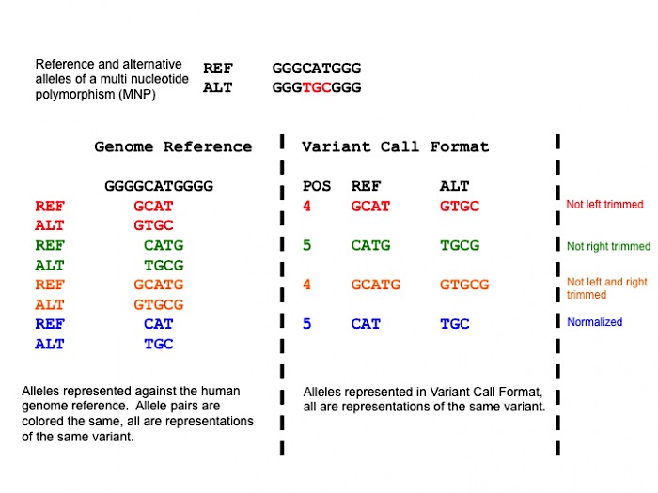
Variant Normalization: Parsimony
Tan A, Abecasis G, Kang HM. Unified representation of genetic variants. Bioinformatics 2015

Slide 39
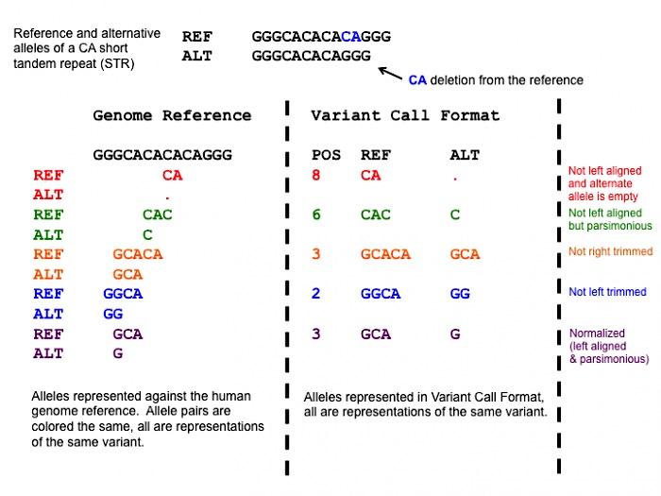
Variant Normalization: Left Alignment
A variant is normalized if and only if it is parsimonious and left aligned.
Software: vt http://genome.sph.umich.edu/wiki/Vt
https://github.com/atks/vt.git
Tan A, Abecasis G, Kang HM. Unified representation of genetic variants. Bioinformatics 2015

Slide 40
Genome sequencing data model Range Call Format
VCF format extension - adds end position column
Compact and general - homozygous reference inferred
Contains no-call information
Compatible with bedtools
Illumina gVCF
vt
normalize*
Normalized VCF
Normalized RCF
transform
CGI
vcfBeta
parsimony &
left alignment
CGI:
Exclude CGA_CNVWIN
Add PASS to lines (other than CGA_NOCALL or AN=0)
cgatools
Illumina:
FILTER other than PASS to nc
Exclude reference (filter == PASS && GT = 0.0)
Remove leading reference base
CGI masterVar

Slide 41
What is impala?
Available Resources

Slide 42


What’s Available: Variants

Slide 43
What’s Available: Variants
101
102
103

Slide 44
Reference Sources
Regional Annotations:
ACMG actionable genes
Cytoband regions
ESP exomes
GO
miRBase
NBS genes
RepeatMasker
Segmental Duplications
Position Based Annotations:
CADD
ClinVar
DANN
dbSNP
dbNSFP
ESP exomes
Kaviar
Gene/Protein Annotations:
Ensembl
RefSeq
UCSC
Uniprot
Custom Annotations:
Global Distinct Variants
Coding consequence predictions
For additional annotations email:
Summer.Elasady@systemsbiology.org
Descriptions of each reference:
https://github.com/summerela/external-reference-data-catalog
Notes:
What is a table versus a file? Screenshot of VCF vs screenshot of variants table?
What is SQL?
More applied examples will be shown during demonstration later or see Supplemental Slides

Slide 45
When to use impala
Locate, filter and annotate variants based on:
Pathogenicity rating (ClinVar, CADD, etc.)
Gene region
Allele frequency (ESP, Kaviar)
Big Data
Files are too large to work with on your computer

Slide 46
Section 2: Connecting to Impala
Notes:
https://github.com/summerela/impala_scripts/blob/master/training/connecting.pptx

Slide 47
Section 3: Queries and Pipelines
Notes:
Queries:
https://github.com/summerela/impala_scripts/blob/master/training/Building%20Queries.pptx
Pipelines:
https://github.com/summerela/impala_scripts/blob/master/training/Pipelines.pptx

Slide 48
Breakout Groups
Group 1: Building Queries
New to SQL
SQL Syntax Basics
Group 2: Running Pipelines
Already familiar with SQL
Run custom pipelines

Slide 49
Getting help
Resources - Questions

Slide 50
Resources
Project 7:
Summer: selasady@systemsbiology.org
Joe: Joseph.Slagel@systemsbiology.org
Denise: Denise.Mauldin@systemsbiology.org
Impala:
Impala SQL Language Reference
Impala Google Group
SQL:
SQL Tutorial
Code Academy: Learn SQL
Documentation:
Pandas
Impyla
Ibis
RODBC

Slide 51


Acknowledgements
Ilya Shmulevich
Brady Bernard
Joe Slagel
Denise Mauldin
Gustavo Glusman
Theo Knijnenburg
Michael Miller
Jared Roach
Roger Kramer
Nyasha Chambwe
David Gibbs
Crystal Humphries
Max Robinson
Terry Farrah
Aaron Black
Greg Eley
Igor Karbovsky
Prachi Kothiyal
Mehul Shah
Ben Solomon
Daniel Stauffer
Quang Tran
Joe Vockley
John Niederhuber
Stuart Young
… And Team

Slide 52
Supplementary Definitions and Materials

Slide 53
Impala SQL Support
JOIN, AGGREGATE, DISTINCT, UNION ALL, ORDER BY, LIMIT, and (uncorrelated) subquery in the FROM clause. Subqueries with WHERE, GROUP BY, HAVING. Impala also supports INSERT INTO and INSERT OVERWRITE. One DISTINCT clause per query.
Left, right, semi, full, outer, and cross joins.
Datatypes: string, TINYINT, SMALLINT, INT, BIGINT, FLOAT, DOUBLE, BOOLEAN, STRING, TIMESTAMP
NO DELETE. NO COMMIT. NO INTERSECT. Subqueries in FROM, not WHERE. NO EXISTS.
ALTER TABLE, ALTER VIEW, COMPUTE STATS, CREATE/DROP DATABASE, CREATE/DROP FUNCTION, CREATE/DROP ROLE, CREATE/DROP TABLE, CREATE/DROP VIEW, DESCRIBE, EXPLAIN, GRANT, INSERT, INVALIDATE, LOAD DATA, REFRESH, REVOKE, SELECT, SET, SHOW, USE
abs, acos, asin, atan, bin, ceil, conv, cos, degrees, e, exp, floor, fmod, fnv_hash, greatest, hex, is_inf, is_nan, least, ln, log, log10, log2, max_int, min_int, mod, negative, pi, pmod, positive, pow, precision, quotient, radians, rand, round, scale, sign, sin, sqrt, tan, unhex
Cast, month/day mathematical functions, datediff, current_timestamp, extract, trunc, case, coalesce, decode, if, ifnull, isfalse, isnotfalse, isnottrue, isnull, istrue, notnullvalue, nullif, nullifzero, nullvalue, nvl, zeroifnull, current_database, effective_user, pid, user, version
Ascii, char_length, concat, find_in_set, group_concat, instr, length, locate, lower, lpad, ltrim, parse_url, regexp_extract, regexp_replace, repeat, reverse, rpad, rtrim, space, strleft, strright, substr, translate, trim, upper, avg, count, group_concat, max, min, ndv, stddev, stddev_samp, stddev_pop, sum, variance, over, dense_rank, first_value, lag, last_value, lead, rank, row_number
Impala does not support natural joins or anti-joins, and requires the CROSS JOIN operator for Cartesian products result set to eliminate duplicate values

Slide 54
ODBC Driver
Official Definition:
An ODBC driver uses the Open Database Connectivity (ODBC) interface by Microsoft that allows applications to access data in database management systems (DBMS) using SQL as a standard for accessing the data. ODBC permits maximum interoperability, which means a single application can access different DBMS.
Summary:
Driver that allows you to use SQL to access a database

