Slide 1
Project 7: Variant Warehouse
Summer Elasady and Denise Mauldin
11-19-2015

Slide 2
Connect!
GitHub tutorials and PowerPoint:
git clone https://github.com/summerela/impala_training/

Slide 3
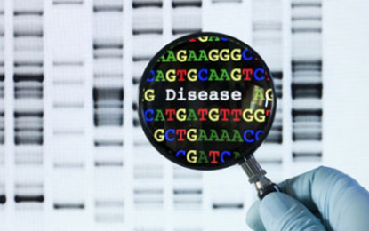
Agenda
Overview of Impala Ecosystem
Use Cases
What is Cloudera Impala?
What’s available?
Connecting to Impala
Hue Web Interface
Impala Shell
R
Python
Breakout Sessions:
Query Creation
Pipelines
Where to Find Help

Slide 4
Section 1: Overview of Impala Ecosystem

Slide 5
Use cases
Impala in the real world

Slide 6
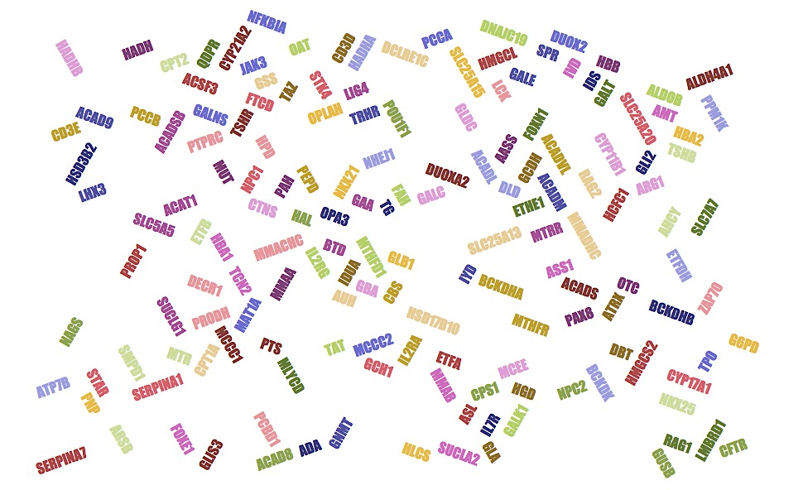
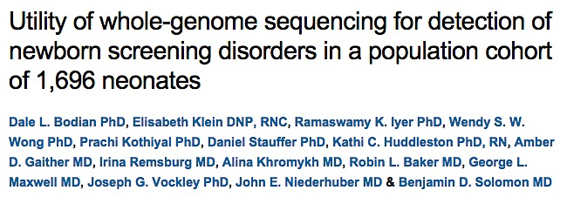
Newborn Screening Genes
ITMI Genetics In Medicine paper
Variants in NBS regions

Slide 7
NBS Genes: Traditional Approach
Sequence trios
Extract variants found in NBS regions
Annotate with ClinVar
Left shift and normalize with GATK
Functional annotation with Annovar
Examine method of inheritance

Slide 8
NBS Genes: Impala Solution
Select sample set
Filter using global variants table
Examine method of inheritance

Slide 9
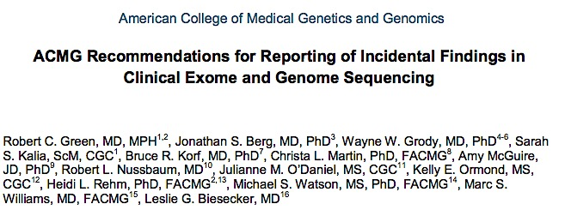

ACMG Actionable Genes

Slide 10
ACMG Genes: Impala Solution
Select sample set
Filter using global variants table
Examine method of inheritance

Slide 11

Clarity Challenge: Undiagnosed
8 families
Undiagnosed disease
Documentary “Undiagnosed”
http://www.childrenshospital.org/clarity-undiagnosed

Slide 12
Clarity Challenge: Impala Solution
Select sample set
Filter using global variants table
Examine method of inheritance

Slide 13
Clarity Challenge: Impala Solution
Select sample set
Filter using global variants table
Examine method of inheritance
BRCA1 Mutation

Slide 14
Cloudera impala
Big Data and the Hadoop Ecosystem

Slide 15
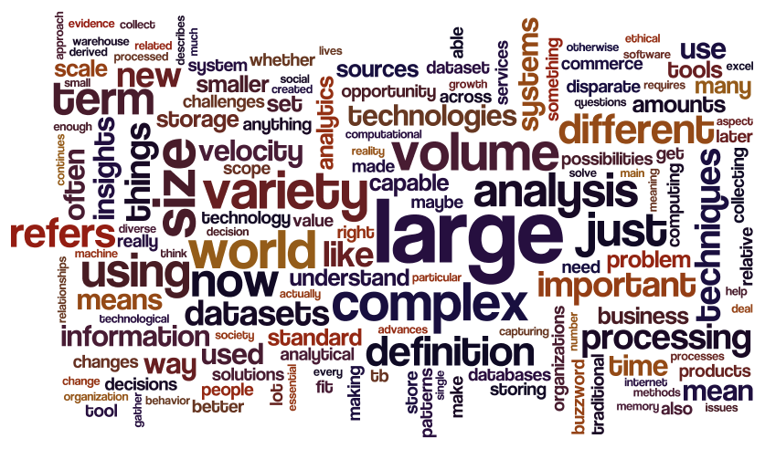
Big Data
"Any amount of data that's too big to be handled by one computer." John Rauser, AWS Data Scientist
"The joke is that big data is data that breaks Excel..." Brian Witt, Senior Data Scientist at Jawbone

Slide 16
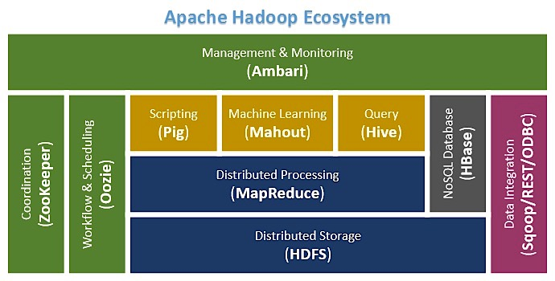
Hadoop
First major big-data solution
Based on map-reduce
Requires java and/or custom languages
Slow when querying large data sets

Slide 17
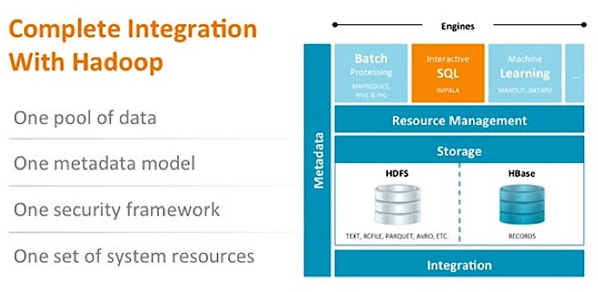
Cloudera Impala vs Hadoop
Hadoop-based system
Access data and run map-reduce jobs without java
Access data directly from HDFS
Native SQL Syntax
Faster than Hive

Slide 18
What is impala?
System Structure

Slide 19
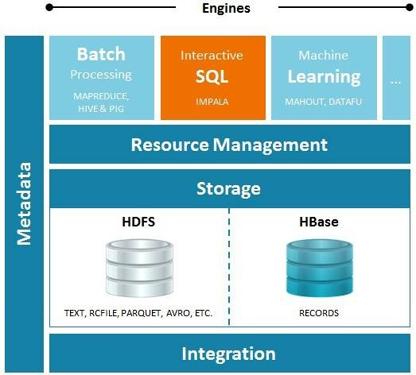
What exactly is impala?

Slide 20
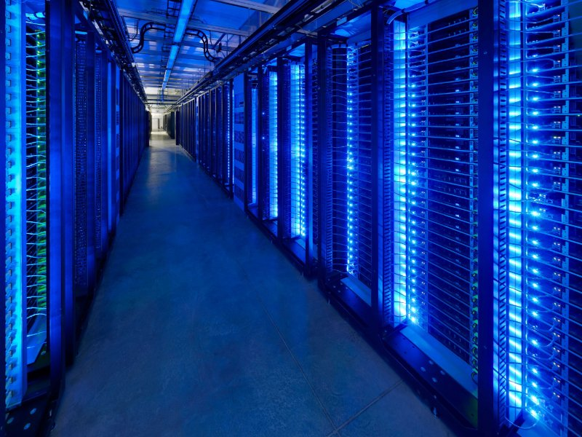
Data Warehousing and Analysis Solution

Slide 21
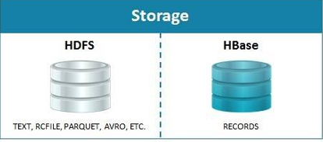
HDFS: File Storage

Slide 22
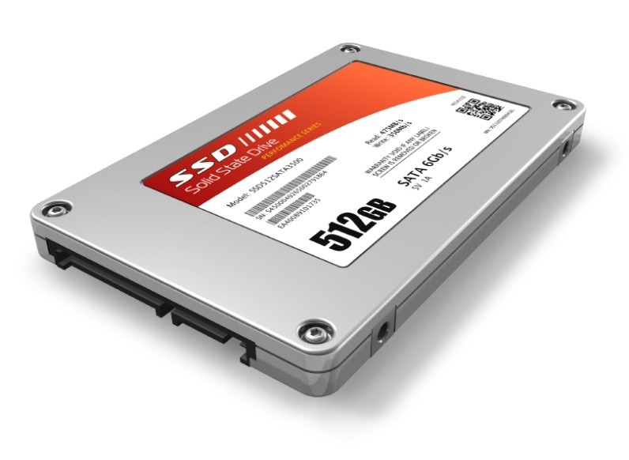
HDFS: File Storage
Store Files:
Variants
Reference DB’s
Analysis results

Slide 23
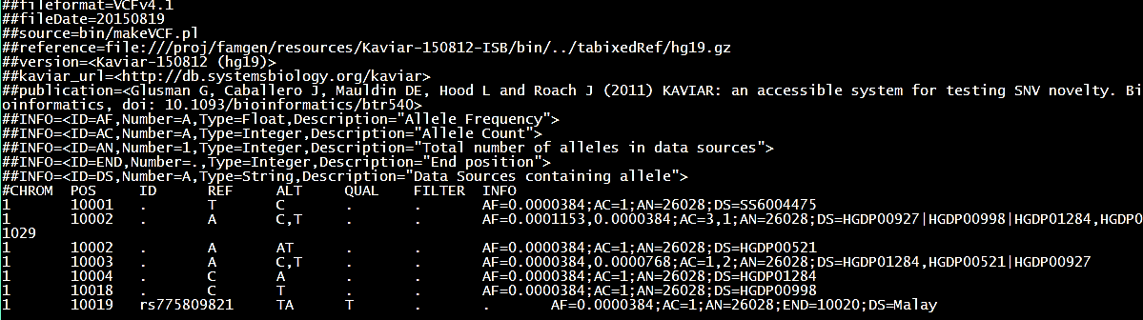
Transform Raw Data
Raw VCF file transformed and uploaded to HDFS:

Slide 24
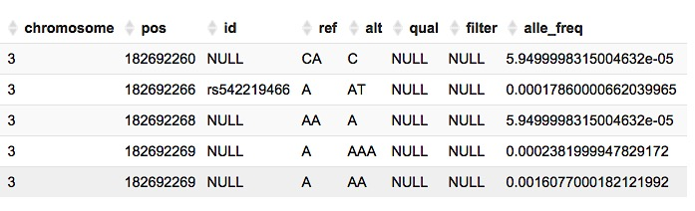
Impala Table
Read as a table by impala:

Slide 25
What exactly is impala?

Slide 26
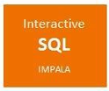
Access Data

Slide 27

Access Data

Slide 28
Structured Query Language (SQL)
Basic SQL Syntax
SELECT column_name(s)
FROM database.table
WHERE conditions
LIMIT number of rows to return
Example
SELECT *
FROM p7_ref_grch37.ucsc_genes
WHERE chrom = '1'
LIMIT 5

Slide 29
Cloudera vs. Traditional RDBMS
No transactional operations:
DELETE
UPDATE
COMMIT/ROLLBACK
Flexible schemas
No indexing
Primary key not required
Replication of data not a concern
Optimized by partitioning
Data distributed on clusters

Slide 30
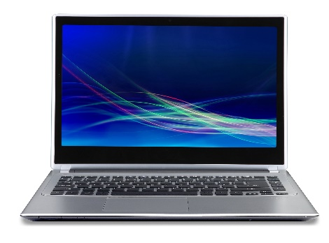
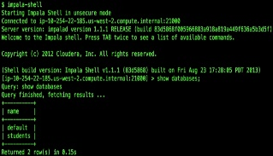





Connect
ODBC

Slide 31
What is impala?
Data Model

Slide 32
Data Schema
Platform
Variants
Methylation Data
RNAseq
Illumina
CGI
Custom Sets
Position Based
Region Based
Gene Based
Reference
Product
Metadata
ITMI
File
Subject
ETL log
Reference Build

Slide 33
Data Standards
Convention
Normalized Data
1-based coordinates
Universal Column Names
Chrom
Pos
Ref
Alt
Each database based on a specific build

Slide 34
Benefits
Speed
Quickly run queries across thousands of genomes
Scalability
Just add more nodes as the data grows
Dynamically cohort creation
Create cohorts (mother, study, condition..)

Slide 35
What is impala?
Variant Normalization and RCF Format

Slide 36
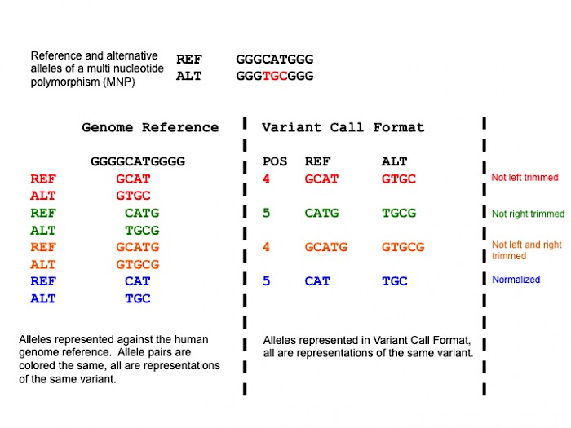
Variant Normalization: Parsimony
Tan A, Abecasis G, Kang HM. Unified representation of genetic variants. Bioinformatics 2015

Slide 37
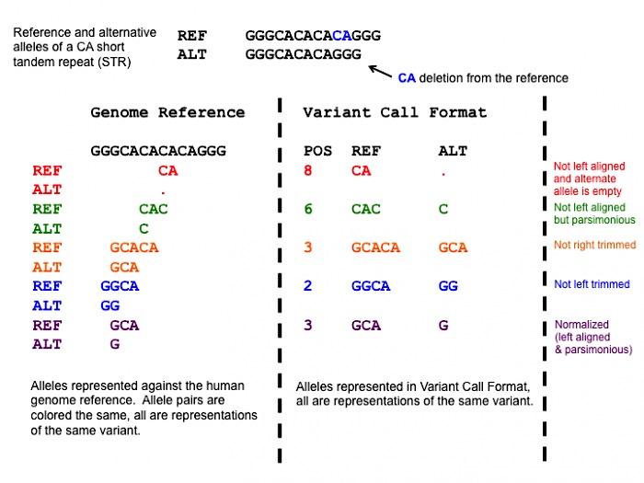
Variant Normalization: Left Alignment
A variant is normalized if and only if it is parsimonious and left aligned.
Software: vt http://genome.sph.umich.edu/wiki/Vt
https://github.com/atks/vt.git
Tan A, Abecasis G, Kang HM. Unified representation of genetic variants. Bioinformatics 2015

Slide 38
Range Call Format (RCF) Overview
What is RCF?
VCF format + end position column
BED-like format 0-based start and 1-based end
Benefits:
Compact
Cross platform
Includes no-call information
Compatible with bedtools
To be implemented:
Comparable cross-platform quality scores
Illumina gVCF
Sorted, Normalized RCF
CGI
vcfBeta
* https://github.com/atks/vt implementing http://genome.sph.umich.edu/wiki/Variant_Normalization

Slide 39
RCF Illumina Pipeline
Illumina gVCF
vt
normalize*
Normalized VCF
Normalized RCF
FamGen Genotype.pl
parsimony &
left alignment
vcf-sort
Illumina:
FILTER != PASS > nc
Exclude reference (filter == PASS && GT = 0/0)
Remove leading reference base
Sorted, Normalized RCF
* https://github.com/atks/vt implementing http://genome.sph.umich.edu/wiki/Variant_Normalization

Slide 40
RCF Complete Genomics Pipeline
CGI:
Exclude CGA_CNVWIN
Add PASS to lines (other than CGA_NOCALL or AN=0)
vt
normalize*
Normalized VCF
Normalized RCF
FamGen Genotype.pl
CGI
vcfBeta
parsimony &
left alignment
vcf-sort
cgatools
Sorted, Normalized RCF
CGI masterVar
* https://github.com/atks/vt implementing http://genome.sph.umich.edu/wiki/Variant_Normalization

Slide 41
What is impala?
Available Resources

Slide 42


What’s Available: Variants

Slide 43
What’s Available: Variants
101
102
103

Slide 44
Reference Sources
Regional Annotations:
ACMG actionable genes
Cytoband regions
ESP exomes
GO
miRBase
NBS genes
RepeatMasker
Segmental Duplications
Position Based Annotations:
CADD
ClinVar
DANN
dbSNP
dbNSFP
ESP exomes
Kaviar
Gene/Protein Annotations:
Ensembl
RefSeq
UCSC
Uniprot
Custom Annotations:
Global Distinct Variants
Coding consequence predictions
For additional annotations email:
Summer.Elasady@systemsbiology.org
Descriptions of each reference:
https://github.com/summerela/external-reference-data-catalog
Notes:
What is a table versus a file? Screenshot of VCF vs screenshot of variants table?
What is SQL?
More applied examples will be shown during demonstration later or see Supplemental Slides

Slide 45
When to use impala
Locate, filter and annotate variants based on:
Pathogenicity rating (ClinVar, CADD, etc.)
Gene region
Allele frequency (ESP, Kaviar)
Big Data
Files are too large to work with on your computer

Slide 46
Section 2: Connecting to Impala

Slide 47
Section 3: Queries and Pipelines

Slide 48
Breakout Groups
Group 1: Building Queries
New to SQL
SQL Syntax Basics
Group 2: Running Pipelines
Already familiar with SQL
Run custom pipelines

Slide 49
Getting help
Resources - Questions

Slide 51
Acknowledgements
Thank you:
ISB | ITMI
Brady Bernard | Aaron Black
Terry Farrah | Dale Godian
Gustavo Glusman | Prachi Kothiyal
Russel Ingram | Ben Solomon
Denise Maulden
Jared Roach
Ilya Shmulevich
Joe Slagel
You!

Slide 52
Supplementary Definitions and Materials

Slide 53
Impala SQL Support
JOIN, AGGREGATE, DISTINCT, UNION ALL, ORDER BY, LIMIT, and (uncorrelated) subquery in the FROM clause. Subqueries with WHERE, GROUP BY, HAVING. Impala also supports INSERT INTO and INSERT OVERWRITE. One DISTINCT clause per query.
Left, right, semi, full, outer, and cross joins.
Datatypes: string, TINYINT, SMALLINT, INT, BIGINT, FLOAT, DOUBLE, BOOLEAN, STRING, TIMESTAMP
NO DELETE. NO COMMIT. NO INTERSECT. Subqueries in FROM, not WHERE. NO EXISTS.
ALTER TABLE, ALTER VIEW, COMPUTE STATS, CREATE/DROP DATABASE, CREATE/DROP FUNCTION, CREATE/DROP ROLE, CREATE/DROP TABLE, CREATE/DROP VIEW, DESCRIBE, EXPLAIN, GRANT, INSERT, INVALIDATE, LOAD DATA, REFRESH, REVOKE, SELECT, SET, SHOW, USE
abs, acos, asin, atan, bin, ceil, conv, cos, degrees, e, exp, floor, fmod, fnv_hash, greatest, hex, is_inf, is_nan, least, ln, log, log10, log2, max_int, min_int, mod, negative, pi, pmod, positive, pow, precision, quotient, radians, rand, round, scale, sign, sin, sqrt, tan, unhex
Cast, month/day mathematical functions, datediff, current_timestamp, extract, trunc, case, coalesce, decode, if, ifnull, isfalse, isnotfalse, isnottrue, isnull, istrue, notnullvalue, nullif, nullifzero, nullvalue, nvl, zeroifnull, current_database, effective_user, pid, user, version
Ascii, char_length, concat, find_in_set, group_concat, instr, length, locate, lower, lpad, ltrim, parse_url, regexp_extract, regexp_replace, repeat, reverse, rpad, rtrim, space, strleft, strright, substr, translate, trim, upper, avg, count, group_concat, max, min, ndv, stddev, stddev_samp, stddev_pop, sum, variance, over, dense_rank, first_value, lag, last_value, lead, rank, row_number
Impala does not support natural joins or anti-joins, and requires the CROSS JOIN operator for Cartesian products result set to eliminate duplicate values

Slide 54
ODBC Driver
Official Definition:
An ODBC driver uses the Open Database Connectivity (ODBC) interface by Microsoft that allows applications to access data in database management systems (DBMS) using SQL as a standard for accessing the data. ODBC permits maximum interoperability, which means a single application can access different DBMS.
Summary:
Driver that allows you to use SQL to access a database

