Slide 1
Connecting to Impala

Slide 2
Accessing impala
Hue Web Interface – Impala-shell – Python - R

Slide 3
The Plan
Show you how to connect
Pick your favorite connection method
Learn basic SQL queries
Practice
Run a pipeline

Slide 4

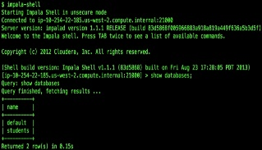





Connect
ODBC

Slide 5

Accessing Impala

Slide 6

Accessing Impala

Slide 7

Accessing Impala
Pros:
Easy, web based, quick
Easy to do query testing and EXPLAIN plan
Cons:
Cuts off results inconsistently at 100,000 rows
AJAX connection issues:
Connection drops
Canceling queries

Slide 8
Accessing Impala

Slide 9

Accessing Impala
Pros:
Fast
Efficient
Cons:
Less intuitive and friendly interface

Slide 10
Accessing Impala

Slide 11
Accessing Impala
ODBC
driver

Slide 12


Accessing Impala
ODBC
driver
Impyla
Ibis
RODBC

Slide 13
Accessing Impala

Slide 14
Accessing Impala
Use:
Graph results

Slide 15
Connecting on the web
Hue Web Interface

Slide 16
Hue Interface
ITMI Impala:
http://ec2-54-152-101-80.compute-1.amazonaws.com:8888/accounts/login/
Hue Tutorial:
https://github.com/summerela/impala_training/blob/master/using_hue.pdf
Notes:
Elasasu (lowercase)
Regular pass

Slide 17
Connecting with impala-shell
Tutorial:
https://github.com/summerela/impala_training/blob/master/impala_shell.ipynb
ssh ec2-user@ec2-54-86-98-154.compute-1.amazonaws.com
Notes:
alias ssh_itmi_impala='ssh -vv -q -oUserKnownHostsFile=/dev/null -oStrictHostKeyChecking=no -i /Users/selasady/Documents/HADOOPDIRECTOR.pem ec2-user@ec2-54-86-98-154.compute-1.amazonaws.com'

Slide 18
Connecting With Python
Python Interface

Slide 19

Connecting with Python: Overview
ODC
driver
Cursor Object
Iterate records in a set
Orders records and knows the current record
Same interface for each database
A database cursor is a control structure that enables traversal over the records in a database. Cursors facilitate processing in conjunction with the traversal, such as retrieval, addition, and removal of database records.

Slide 20



Connecting with Python: Overview
ODBC
driver
Cursor Object
fetchrow
fetchall

Slide 21
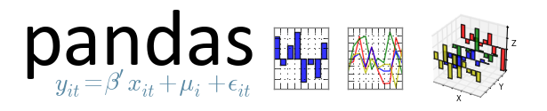
Connecting with Python: Pandas
Python package for working with tabular data:
SQL table or Excel spreadsheet
Ordered and unordered time series data
Arbitrary matrix data
Observational/statistical data sets
Way to do data frame analysis in Python

Slide 22
Connecting with Python
Tutorial on Github:
https://github.com/summerela/impala_training/blob/master/connect_python.ipynb
Script: impala_training/connect_python.ipynb
ITMI host name: http://ec2-54-152-101-80.compute-1.amazonaws.com/

Slide 23
Connecting With R
R Interface

Slide 24
Connecting with R
R:
Launch R:
https://glados47.systemsbiology.net/
Tutorial:
https://github.com/summerela/impala_training/blob/master/connect_with_R.md
Script: https://github.com/summerela/impala_training/blob/master/connect_R.R

