Slide 1
Using the Hue Web Interface
Summer Elasady and Denise Maulden

Slide 2
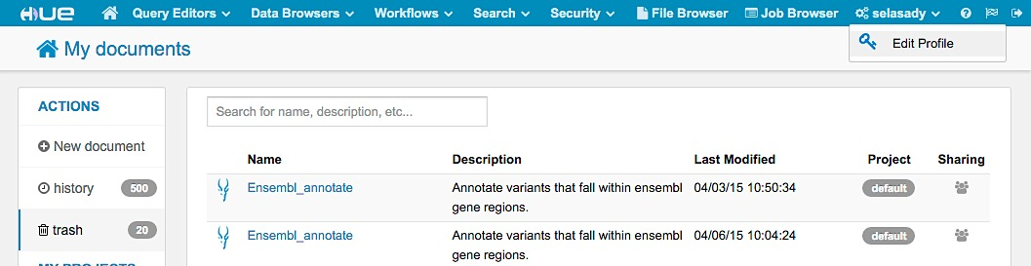
Updating Account Info
Click on your user name
Edit Profile
Follow the steps to update your password and info

Slide 3
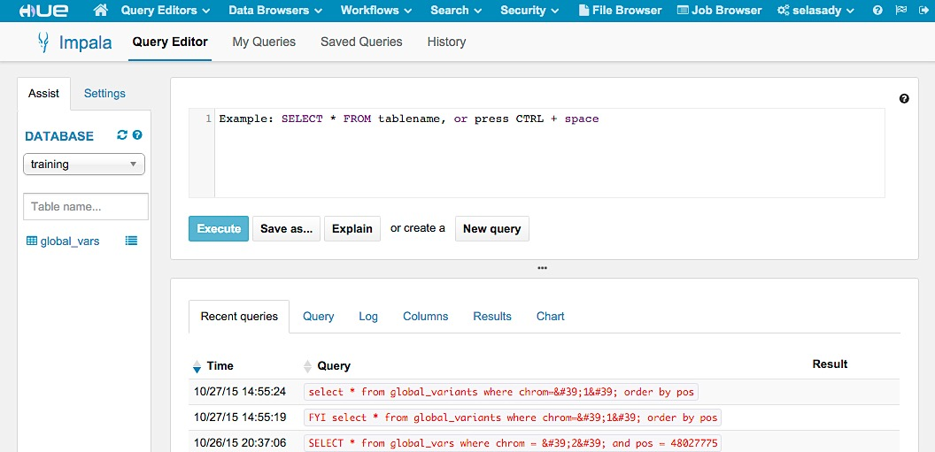
Query Editor- Impala
Click on Query Editor
Click on impala

Slide 4
Query Editor- Impala
Query window where you write and execute queries

Slide 5
Query Editor- Impala
View recent queries and query results

Slide 6
Selecting and Viewing Database
Click on the drop-down menu to view and select databases

Slide 7
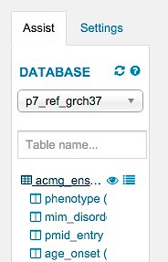
View Database Information
Click on the database icon to view column names and data types

Slide 8
View Database Information
Click on the eye to view information and a data sample in a new window
Click on the list icon to view this information in the same window

Slide 9
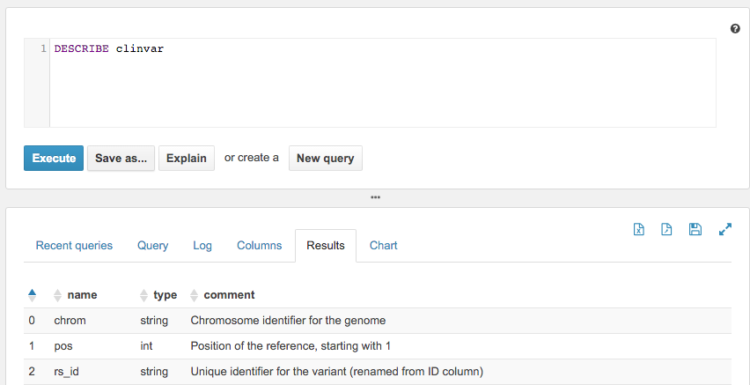
Describe Database Columns
Type DESECRIBE table_name and click on Execute
View descriptions of what is in each column

Slide 10
Run a Query
Select the p7_ref_grch37 database
Enter the query shown
Click on Explain
SELECT *
FROM clinvar
WHERE chrom = ‘1’
LIMIT 5

Slide 11
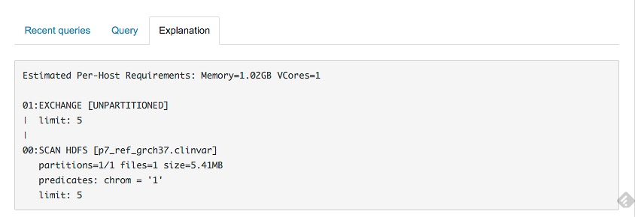
Explain Plan
Read in numerical order
Look for ways to optimize
Identify bottlenecks

Slide 12
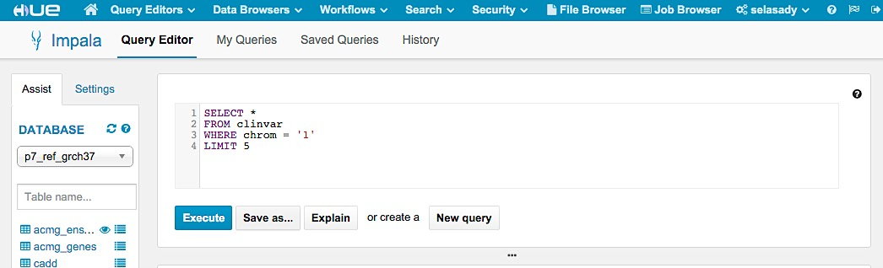
Save Queries
After executing a query click on Save as
Give the query a name and description

Slide 13
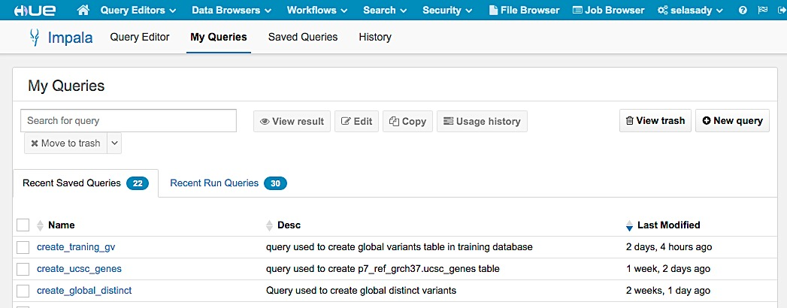
Run Saved Queries
Click on My Queries to view your saved queries
Click on the query name to run it in the impala query editor

Slide 14
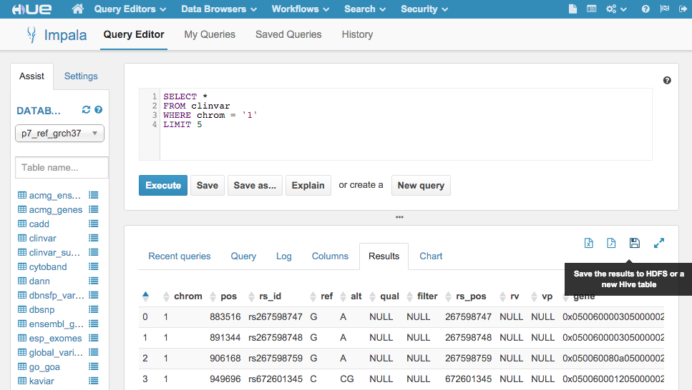
Save Results
Click on one of the icons shown in the red box to save your results as a table on impala, or to download as a csv or excel file

Slide 15
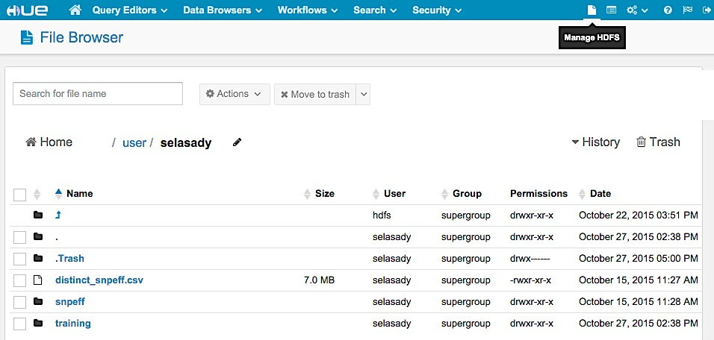
Working with HDFS
Click on the file icon
Click on manage HDFS

Slide 16
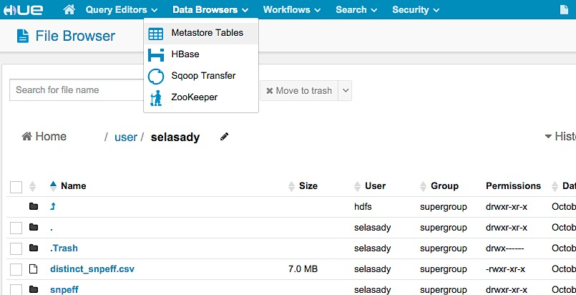
Create an impala table from HDFS
Once a file has been uploaded to HDFS, click on Data Browses
Click on Metastore Tables

Slide 17
Create an impala table from HDFS
Once a file has been uploaded to HDFS, click on Data Browses
Click on Metastore Tables

