Slide 1
Pre
Main
Post
Instructions
Instructions
Training 1
Training 2
Test
Instructions
Break
Break
Questions
10 mins
40 mins
10 mins

Slide 2
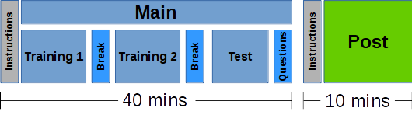
Pre
Instructions
10 mins

Slide 3
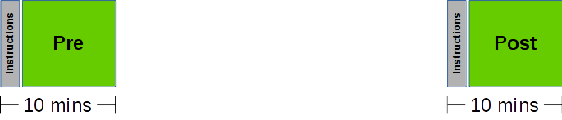
Main
Instructions
Training 1
Training 2
Test
Break
Break
Questions
40 mins

Slide 4
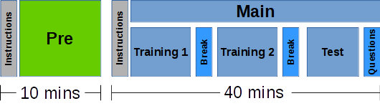
Post
Instructions
10 mins

