Slide 1





AI, Cognition and Society
1. The Laws of Thought
Prof. Christopher Summerfield
University of Oxford
funding gratefully acknowledged

Slide 2

Questions
1. What are the theoretical principles by which we should build a thinking machine?
2. Historically, what progress was made towards this goal before the LLM era?
Sample essay question:
Describe how AI research and cognitive science were shaped by the debate between symbolist and connectionist approaches. Have key controversies been resolved today?

Slide 3
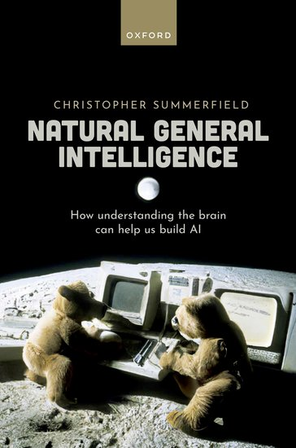
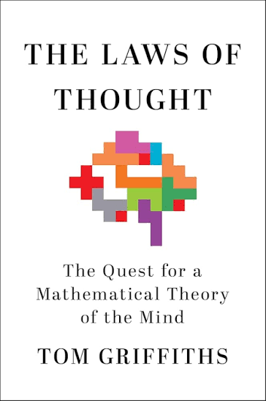
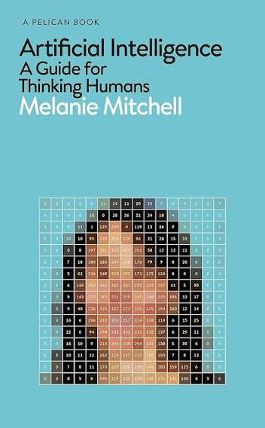
Suggested reading

Slide 4
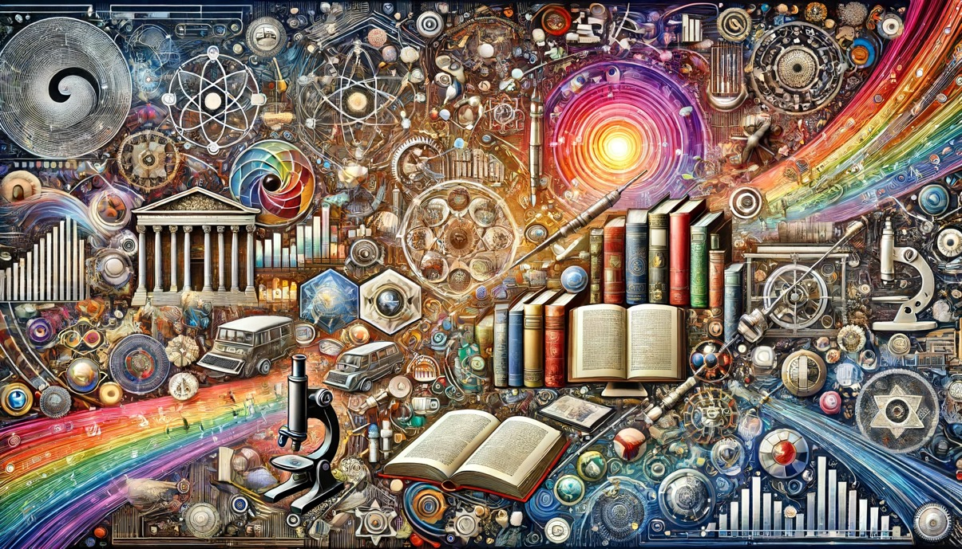

The incredible idea
the incredible idea that it might be possible to
automate the generation of
humans (~8 bn)
knowledge (lots)

Slide 5
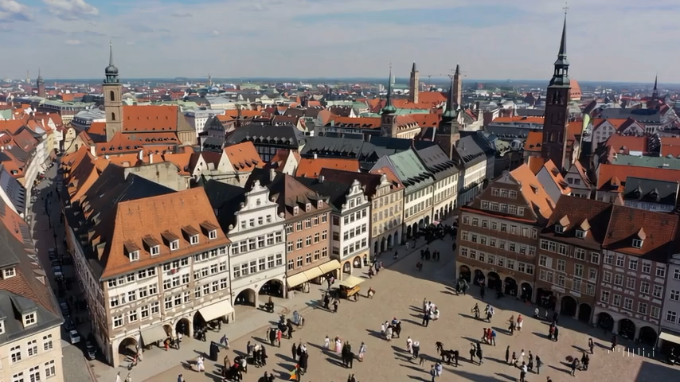
Where it all started
Leipzig, 1677
Notes:
This dream is not a new one. In its modern form, we can date it back at least to Leibniz. Leibniz realised that if we could encode thoughts and ideas in a formal language – like arithmetic or geometry – then we could potentially automate the whole process of reasoning. So just like the formal operations of arithmetic allow you to infer that 523 + 401 = 924 – a calculation that you’ve probably never carried out before – if we had a similar language for all forms of reasoning, then we could automate it in a machine.

Slide 6
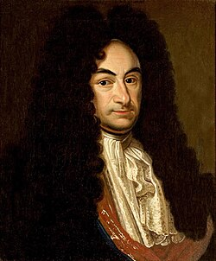
Leibniz’s dream
“[can we]… find characters or signs suited for expressing all our thoughts as clearly and as exactly as arithmetic expresses numbers or geometry expresses lines”
Leibniz wanted a
language of thought
Gottfried Wilhelm Leibniz
(1646-1716)
Notes:
This dream is not a new one. In its modern form, we can date it back at least to Leibniz. Leibniz realised that if we could encode thoughts and ideas in a formal language – like arithmetic or geometry – then we could potentially automate the whole process of reasoning. So just like the formal operations of arithmetic allow you to infer that 523 + 401 = 924 – a calculation that you’ve probably never carried out before – if we had a similar language for all forms of reasoning, then we could automate it in a machine.

Slide 7
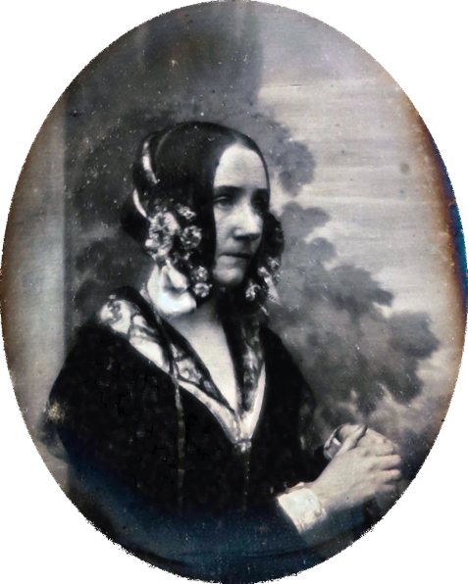
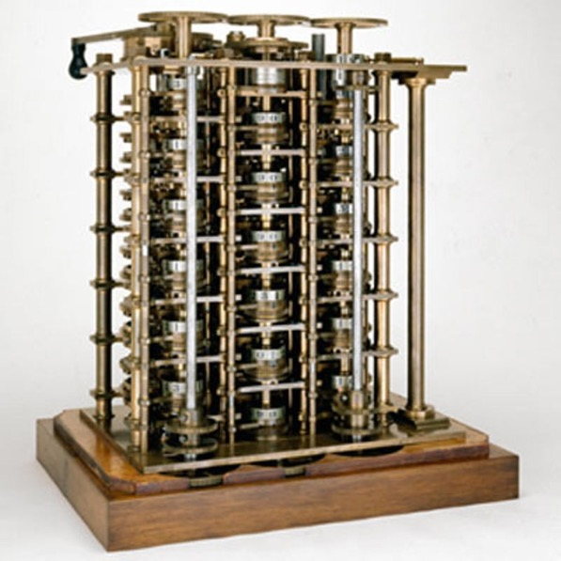
Lovelace’s dream
“[The Analytical Engine] might act upon other things besides number, were objects found whose mutual fundamental relations could be expressed by those of the abstract science of operations”
Analytical Engine
Lovelace dreamed of
general-purpose computation
Ada King, Countess of Lovelace 1815-1852
Ada Countess of Lovelace
(1815-1852)
Notes:
This dream is not a new one. In its modern form, we can date it back at least to Leibniz. Leibniz realised that if we could encode thoughts and ideas in a formal language – like arithmetic or geometry – then we could potentially automate the whole process of reasoning. So just like the formal operations of arithmetic allow you to infer that 523 + 401 = 924 – a calculation that you’ve probably never carried out before – if we had a similar language for all forms of reasoning, then we could automate it in a machine.

Slide 8

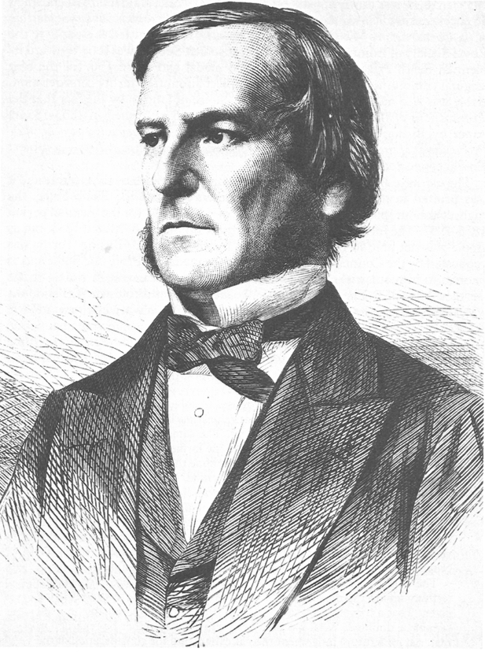
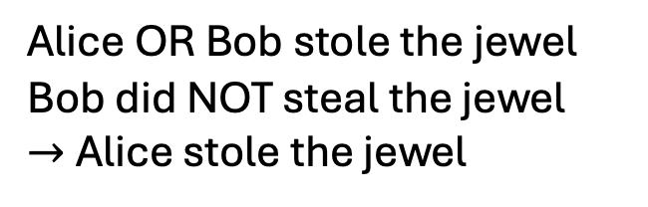
Boole’s idea
George Boole (1815-1864)
Reasoning is a generative process
AND
OR
Alice OR Bob stole the jewel
Bob did NOT steal the jewel
$→$Alice stole the jewel
NOT
Boole formalised the laws of reasoning
Notes:
This dream is not a new one. In its modern form, we can date it back at least to Leibniz. Leibniz realised that if we could encode thoughts and ideas in a formal language – like arithmetic or geometry – then we could potentially automate the whole process of reasoning. So just like the formal operations of arithmetic allow you to infer that 523 + 401 = 924 – a calculation that you’ve probably never carried out before – if we had a similar language for all forms of reasoning, then we could automate it in a machine.

Slide 9
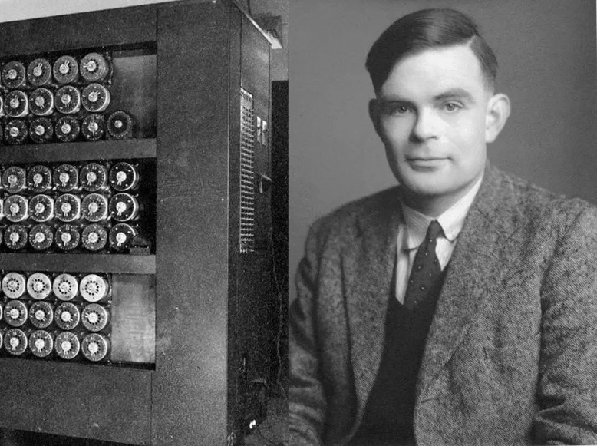
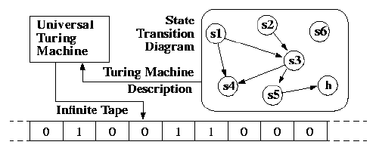
The birth of computing
The Turing Machine is a theory of computation (not a physical device)
Alan Turing (1912-1954)
Colossus
Laid the foundations for modern computer science
Notes:
But computers weren’t really up to the job until after the war, when electronic calculating devices were used for codebreaking and the calculation of missile trajectories.
In the 1930s, Alan Turing developed a theory which attempted to define what could (and could not) be computed in finite time. To illustrate his theory he conceived of a theoretical device in which read in from, and wrote to, and endless tape composed of ones and zeros, and which was able to compute everything that was computable. Turing realized that a computational device could receive instructions about how to write its own instructions

Slide 10
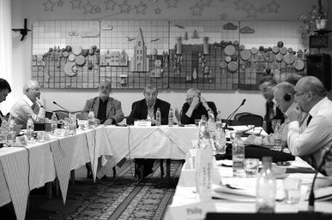
The Dartmouth Conference
August 31st 1955
“We propose that a 2-month, 10-man study of artificial intelligence be carried out in the summer of 1956 at Dartmouth College.
The study is to proceed based on the conjecture that every aspect of learning or any other feature of intelligence can in principle be so precisely described that a machine can be made to simulate it”
Notes:
This dream is not a new one. In its modern form, we can date it back at least to Leibniz. Leibniz realised that if we could encode thoughts and ideas in a formal language – like arithmetic or geometry – then we could potentially automate the whole process of reasoning. So just like the formal operations of arithmetic allow you to infer that 523 + 401 = 924 – a calculation that you’ve probably never carried out before – if we had a similar language for all forms of reasoning, then we could automate it in a machine.

Slide 11
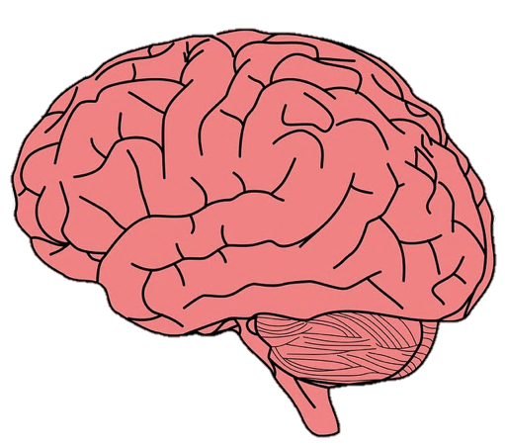
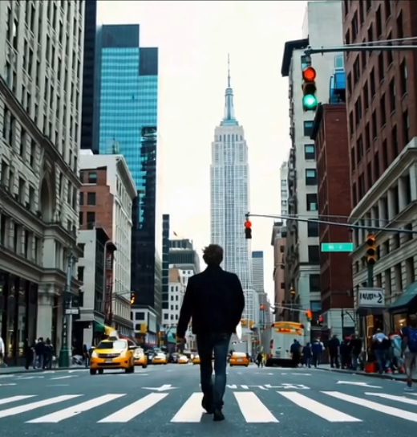
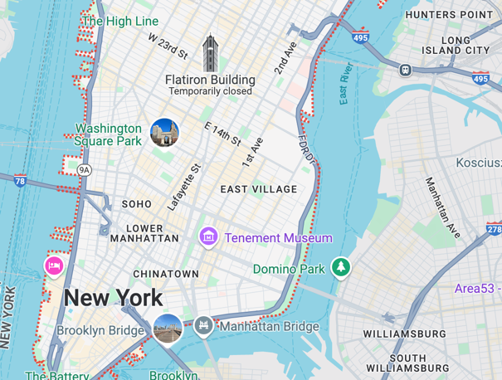
Generative models
acquire
generate

Slide 12
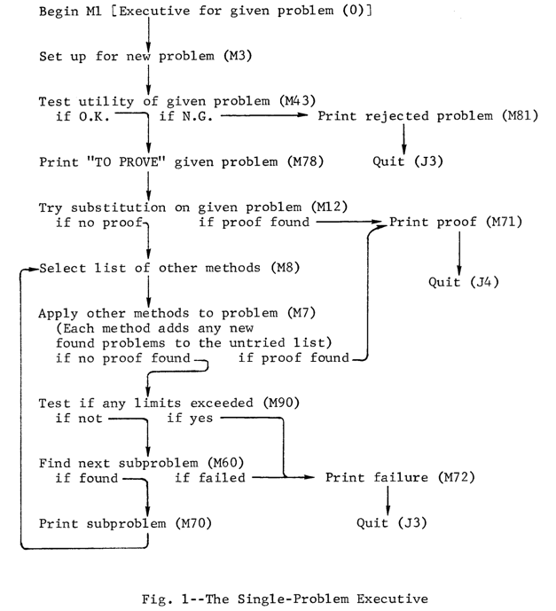




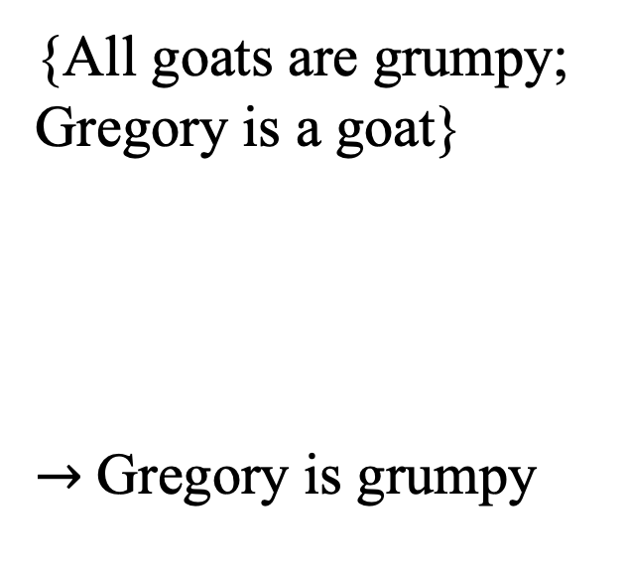

Symbolic systems
$x$
$y$
{All goats are grumpy;
Gregory is a goat}
$→$Gregory is grumpy
Logic theorist: the first superhuman AI system
Found 38/52 proofs in Russell’s Principia Mathematica
$a$
$x$
$a$
$y$
Symbolic systems allow new knowledge to be generated by following logical rules

Slide 13
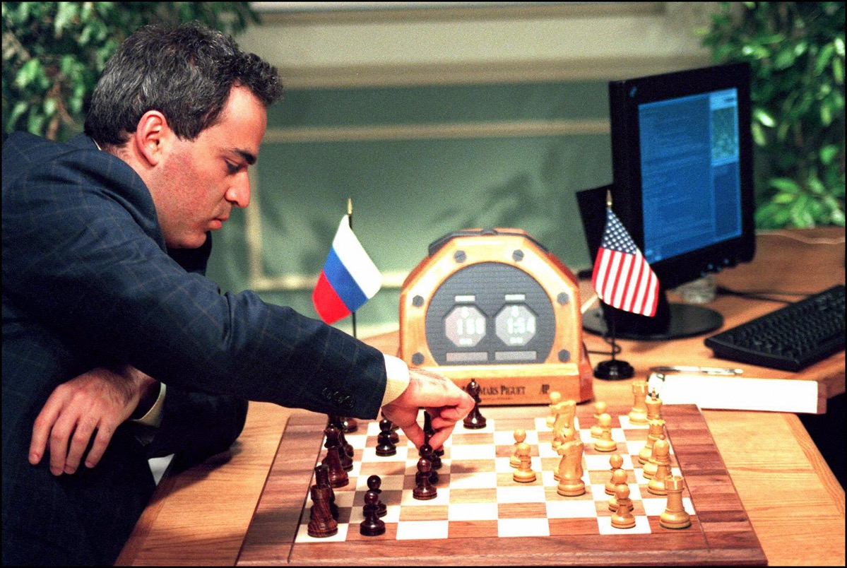
Kasparov’s demise
Kasparov loses 4-2 to Deep Blue at Chess
Complements earlier successes in Backgammon, Draughts, etc
Deep Blue
Gary Kasparov
World Chess Champion
1985-2000
Notes:
This dream is not a new one. In its modern form, we can date it back at least to Leibniz. Leibniz realised that if we could encode thoughts and ideas in a formal language – like arithmetic or geometry – then we could potentially automate the whole process of reasoning. So just like the formal operations of arithmetic allow you to infer that 523 + 401 = 924 – a calculation that you’ve probably never carried out before – if we had a similar language for all forms of reasoning, then we could automate it in a machine.

Slide 14
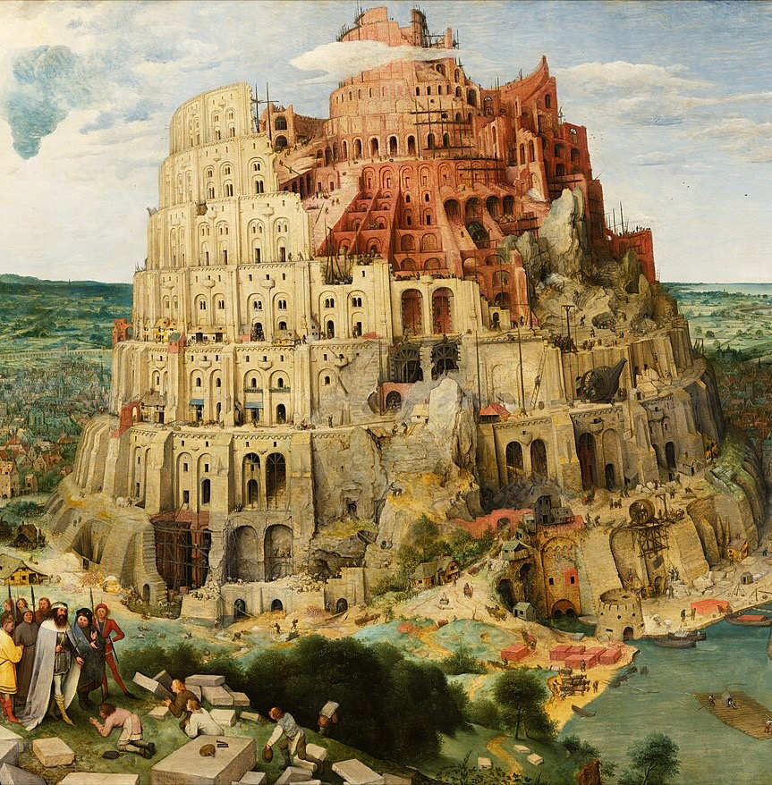
The ultimate knowledge production system
Bruegel
Language is the human superpower
Basis for cumulative culture and technological development
Other species communicate, but none has “language” (the ability to use combine syntax and semantics as a generative process)
Notes:
This dream is not a new one. In its modern form, we can date it back at least to Leibniz. Leibniz realised that if we could encode thoughts and ideas in a formal language – like arithmetic or geometry – then we could potentially automate the whole process of reasoning. So just like the formal operations of arithmetic allow you to infer that 523 + 401 = 924 – a calculation that you’ve probably never carried out before – if we had a similar language for all forms of reasoning, then we could automate it in a machine.

Slide 15
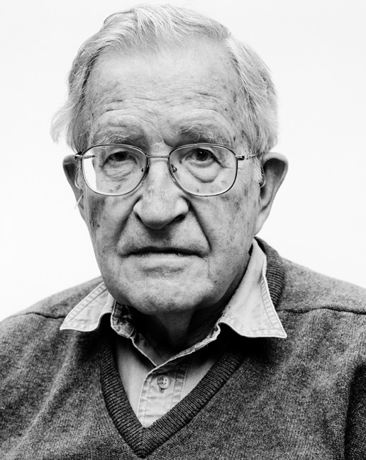
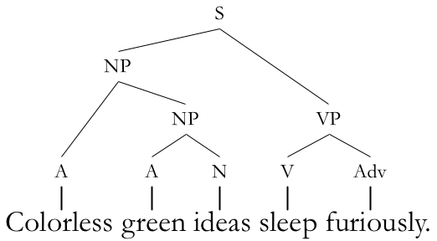
Generative grammar in linguistics
Operations for language = syntax
Noam Chomsky 1928-
Noam Chomsky 1928-
1. Noam loves ChatGPT
2. ChatGPT loves Noam
Even if this sentence is meaningless, you can detect that it is valid. Syntax rules!

Slide 16
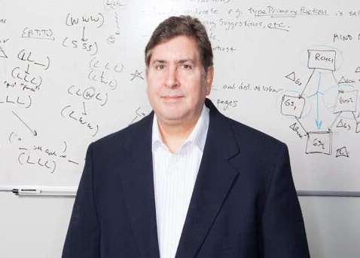
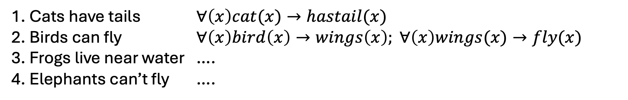
Expert systems
Doug Lenat, 1950-2023
Cyc – an AI project to encode the entirety of commonsense knowledge in predicate logic
(a “universal ontology”)
Back-of-the-envelope calculation: humans know about ~3 million pieces of knowledge – would need about ~2,000 person years to code up
1. Cats have tails $∀\left(x\right)cat(x)→hastail(x)$
2. Birds can fly $∀\left(x\right)bird\left(x\right)→wings\left(x\right); ∀\left(x\right)wings(x)→fly(x)$
3. Frogs live near water ….
4. Elephants can’t fly ….

Slide 17
Nature of reality
What is human knowledge like?
What is the nature of reality, i.e., what is the world like?

Slide 18



Of clocks and clouds
…a precision clock, intended to represent physical systems which are regular, orderly, and highly predictable in their behaviour.
…intelligence is about learning
…clouds are intended to represent physical. systems which, like gases, are highly irregular, disorderly, and more or less unpredictable
…intelligence is about reasoning
Popper, 1966
…intelligence is about learning

Slide 19
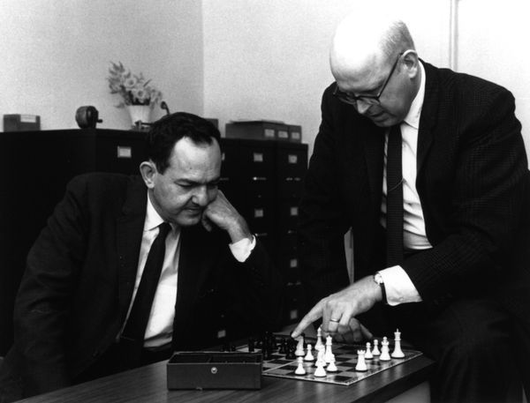
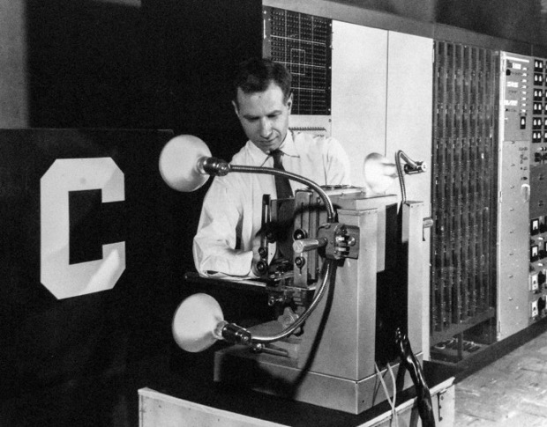
Of clocks and clouds
…intelligence is about learning
symbolic systems
neural networks
…intelligence is about reasoning
Popper, 1966
…intelligence is about learning

Slide 20
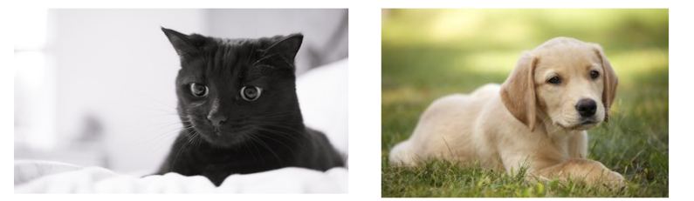



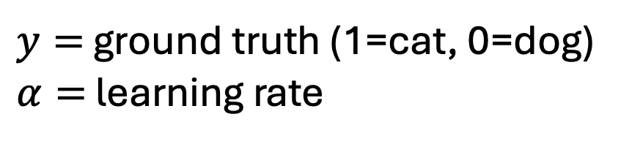



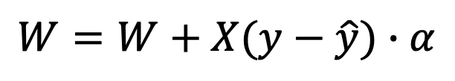

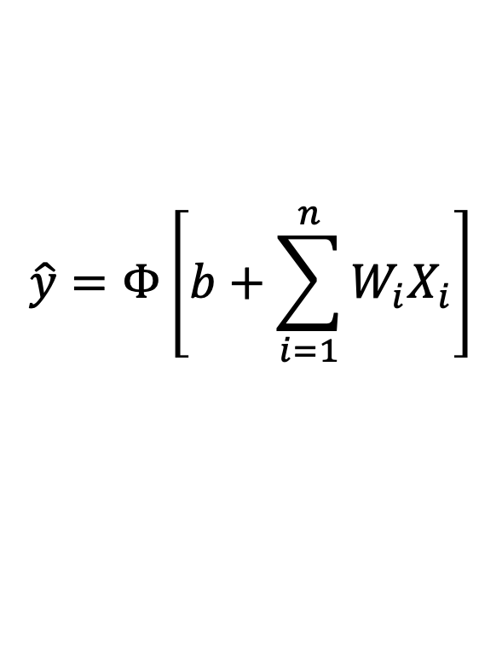

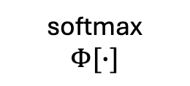



Perceptron
miaow
woof
inference:
$$\hat{y}=Φ\left[b+\sum_{i=1}^{n}{W_{i}X_{i}}\right]$$
$$b$$
$$x_{1}$$
$$1$$
$$w_{1}$$
learning:
$$x_{2}$$
$$x_{3}$$
⎰ $→$ $\hat{y}=p(cat)$
$$W=W+X(y−\hat{y})∙α$$
$$x_{4}$$
softmax
$$Φ[∙]$$
$$x_{5}$$
$y=$ ground truth (1=cat, 0=dog)
$α=$ learning rate
…
$$w_{n}$$
$$x_{n}$$
logistic regression
Rosenblatt, 1957

Slide 21
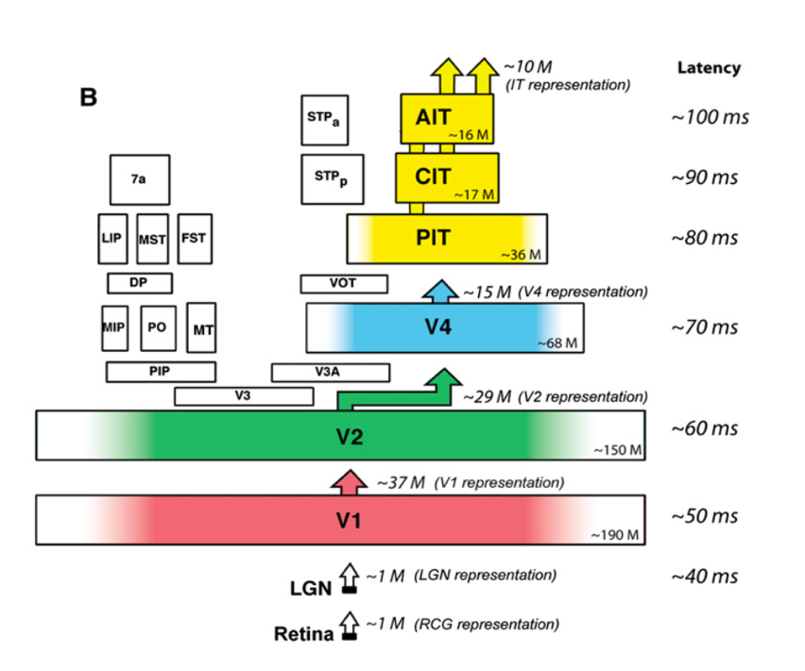
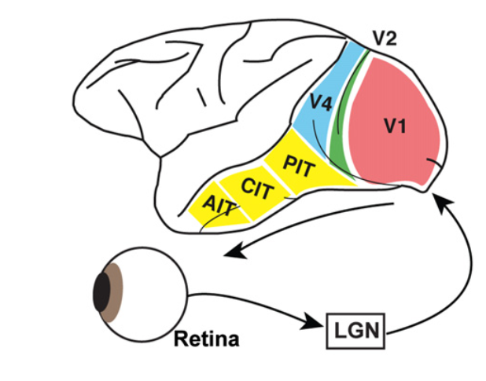
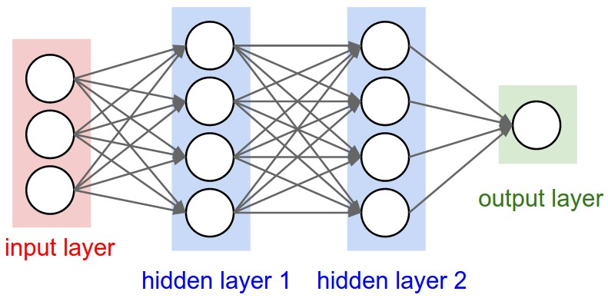
Hierarchical sensory systems
Sensory information is processed in a feedforward hierarchy of feature extractors
Multilayer neural networks with nonlinearities can learn to map between arbitrarily complex functions; structure is ‘emergent’
McClelland 2010
Notes:
This dream is not a new one. In its modern form, we can date it back at least to Leibniz. Leibniz realised that if we could encode thoughts and ideas in a formal language – like arithmetic or geometry – then we could potentially automate the whole process of reasoning. So just like the formal operations of arithmetic allow you to infer that 523 + 401 = 924 – a calculation that you’ve probably never carried out before – if we had a similar language for all forms of reasoning, then we could automate it in a machine.

Slide 22
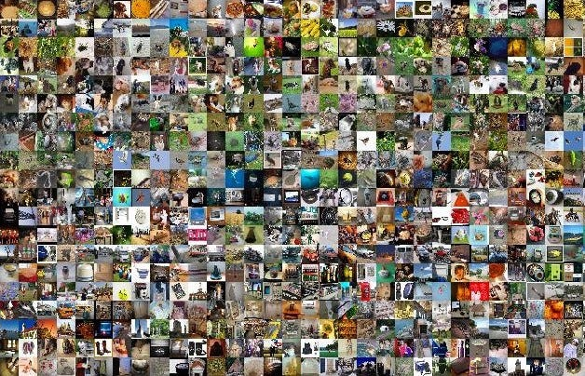
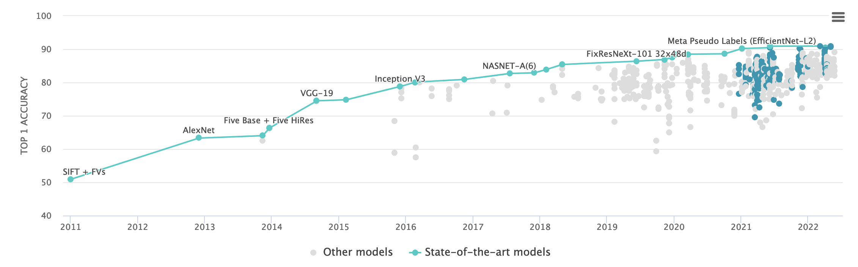
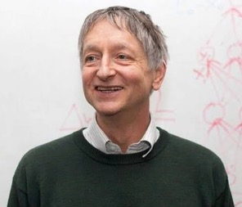

Neural networks
Fei-Fei
Li

Slide 23
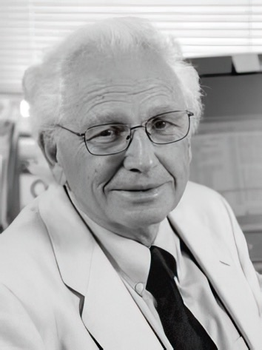
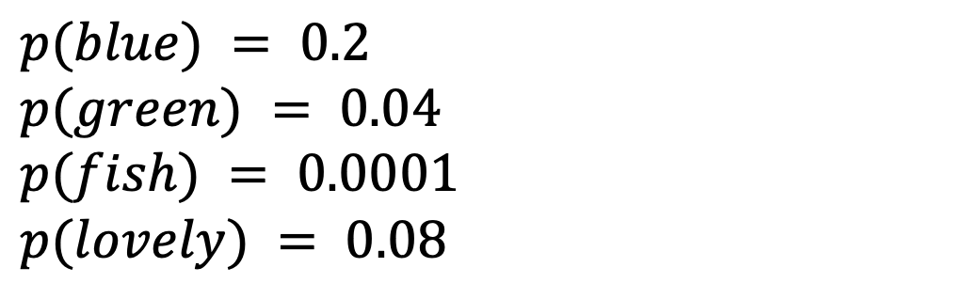
N-gram models
Fred Jelinek
Can we model natural language by its transition statistics alone?
blue
Roses are red, and violets are ______
$$p(blue) = 0.2$$
$$p(green) = 0.04$$
$$p(fish) = 0.0001$$
$$p(lovely) = 0.08$$
“You shall know a word by the company it keeps”

Slide 24
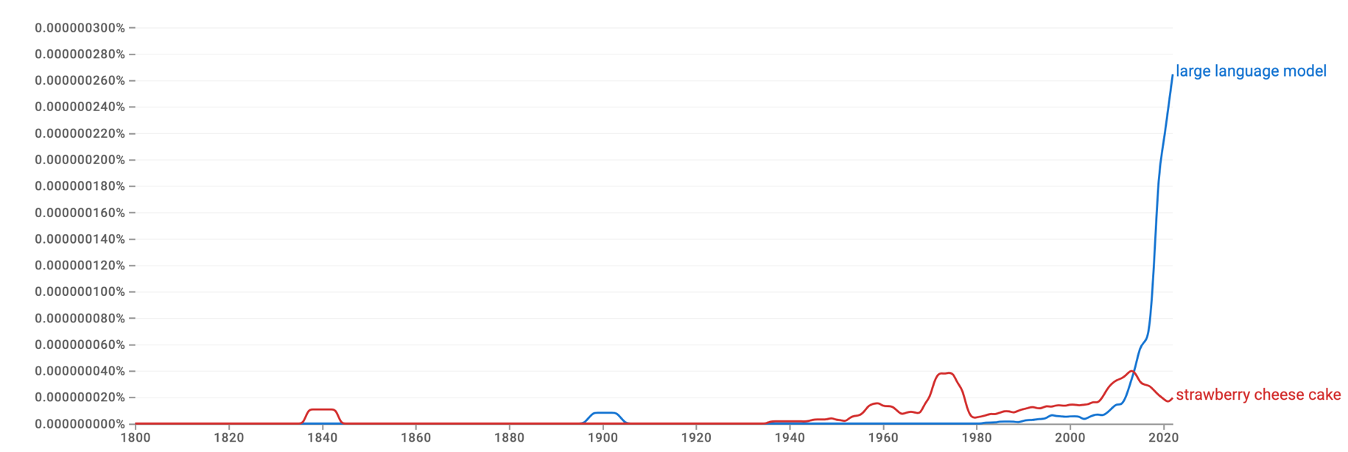
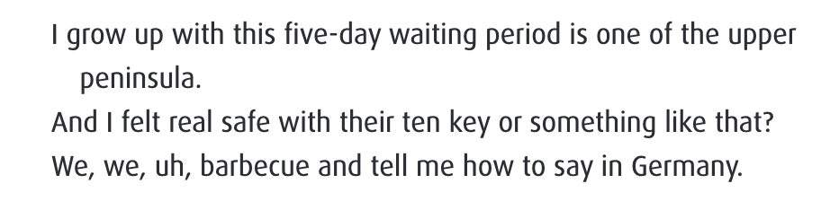
N-gram models
unigrams | Roses | are | red | and | violets | are | blue
bigrams | Roses are | are red | red and | and violets | violets are | are blue
trigrams | Roses are red | are red and | red and violets | and violets are | violets are blue
https://books.google.com/ngrams/

Slide 25
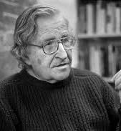
N-gram models
Can we model natural language by its transition statistics alone?
“the notion of ‘probability of a sentence’ is an entirely useless one, under any known interpretation of this term”
Chomsky
loves
ChatGPT
no structure?
Noam Chomsky

Slide 26
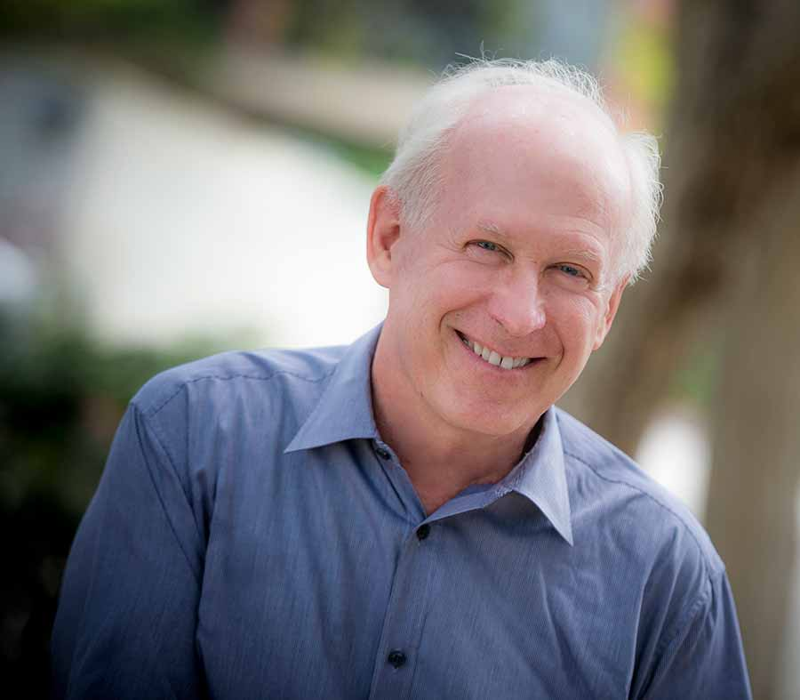
Neural networks for language
Starting from ~1990s, researchers began to use neural networks to model natural language
With the arrival of large text corpuses (~trillion words by 2006), this led to neural networks being applied to problems like machine translation and document classification
Jeff Elman 1948-2018
Elman 1990; Bengio 2003

Slide 27
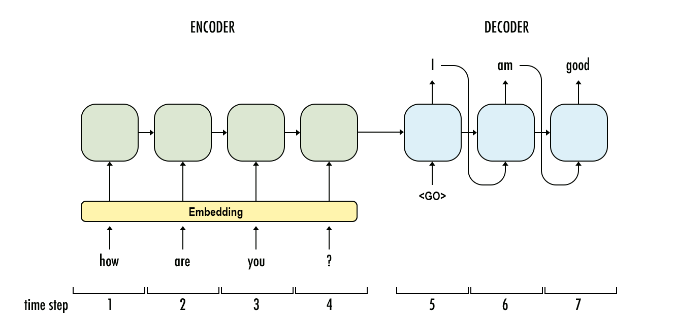
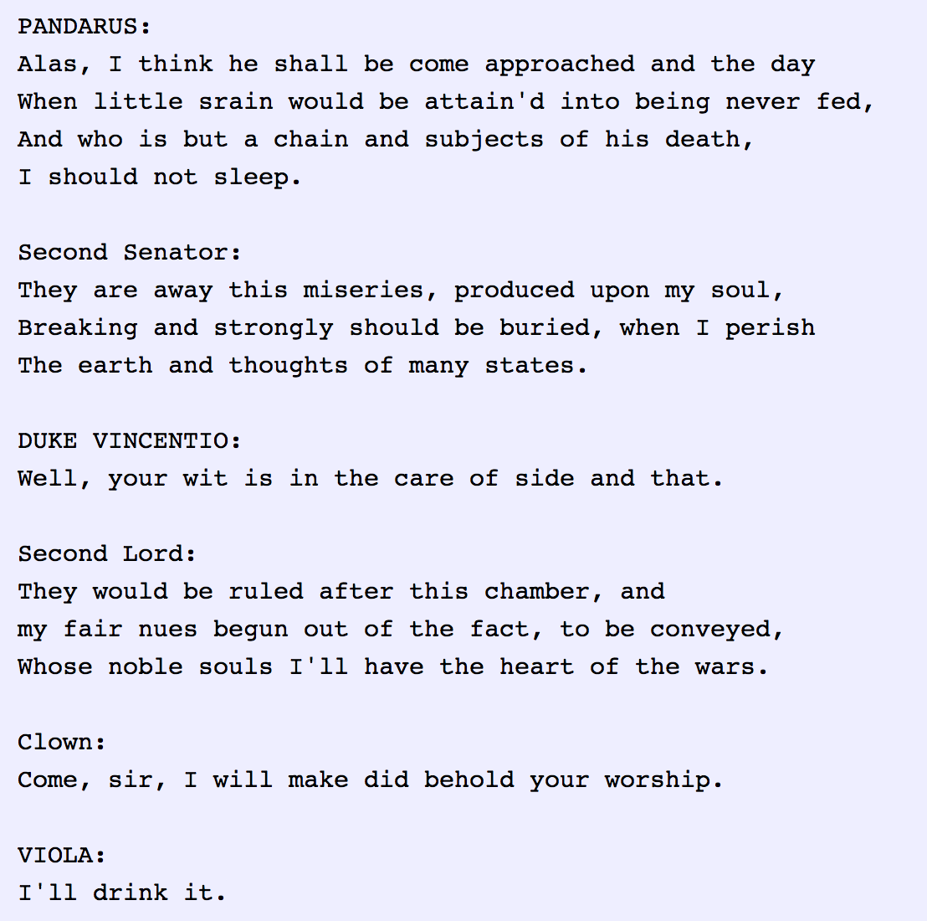
Neural networks for language
Sequence to sequence (RNN / LSTM) models began to come of age ~2015

Slide 28
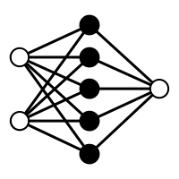
Neural machine translation
Japanese
Japanese
Google’s NMT was able to translate between pairs of languages on which it had never been trained (!!)
.. it must have learned the deep, shared structure of human communication
LSTM
English
English
Swahili
Swahili
…
…
German
German
training
test
Wu et al 2016

Slide 29
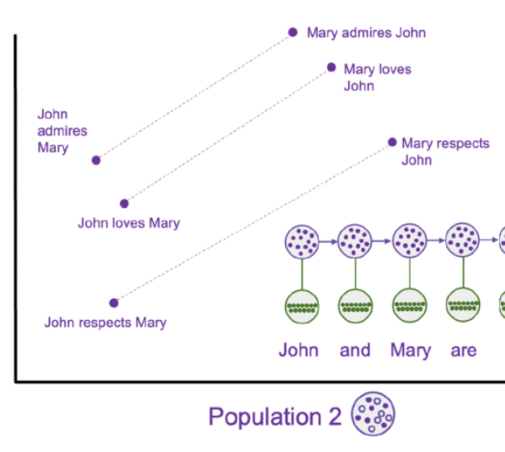
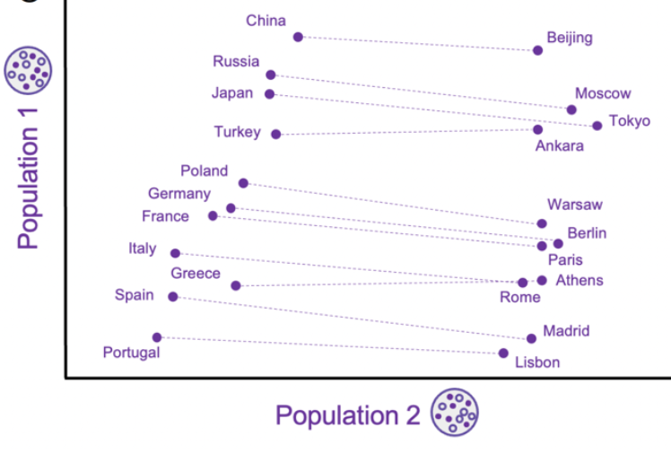
Structure in language
word embeddings from generative modelling of text
Language conveys (lots of) information about how the world is structured
Mikolov 2013

Slide 30
Of clocks and clouds
…intelligence is about learning
symbolic systems
neural networks
…intelligence is about reasoning
Popper, 1966

