Slide 1





AI, Cognition and Society
2. Ingredients of Intelligence
Prof. Christopher Summerfield
University of Oxford
funding gratefully acknowledged

Slide 2
Questions
1. What are the computational principles that underpin modern AI’s success?
2. To what extent do they draw upon ideas from natural intelligence?
Sample essay question:
In his essay “The Bitter Lesson” the AI pioneer Rich Sutton argues that general-purpose computation and big data are the key ingredients of intelligence. Do you agree?

Slide 3
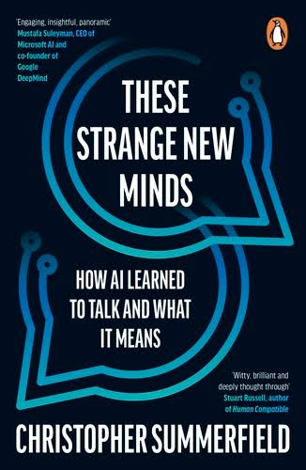
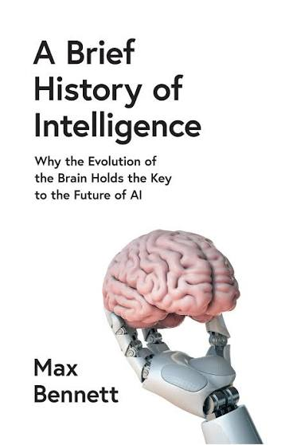
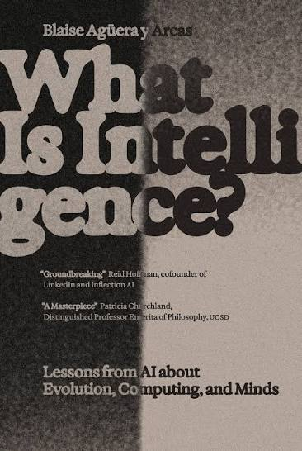
Suggested reading

Slide 4

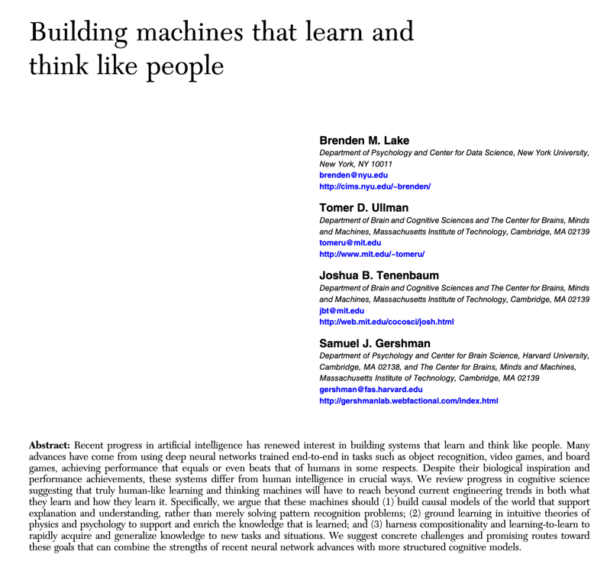
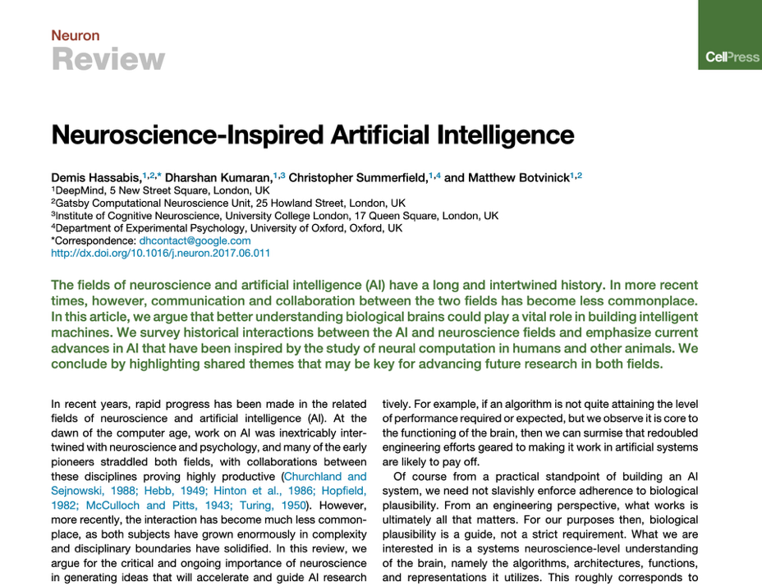
Back in 2016
Abstraction / generalization
Symbolic processing / compositionality
Planning and reasoning
Sample-efficient learning
Hassabis 2017
1. Abstraction / generalization
2. representation learning (from reward)
3. Integrated memory / attention systems
4. Planning and imagination
Lake 2016

Slide 5
Back in 2016
We should [. . . ] be mindful of what AI has achieved and what it has not. While the pace of progress has been impressive, natural intelligence is still by far the best example of intelligence”
Hassabis 2017
Building human-level
general AI [. . . ] is a daunting task, because the search space of possible solutions is vast
and likely only very sparsely populated”
Lake 2016

Slide 6
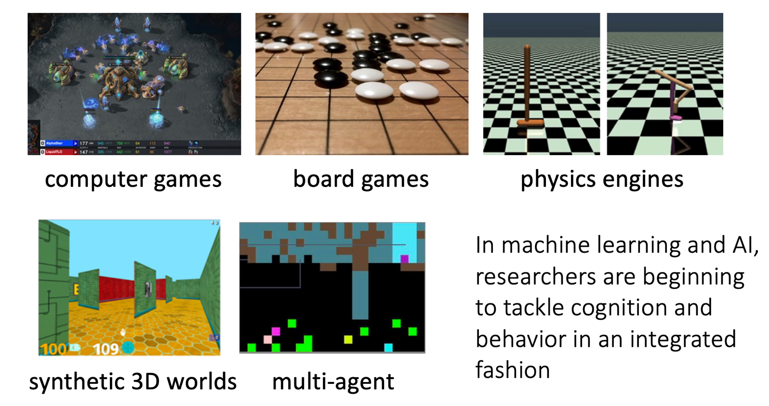
Slide from a 2019 talk

Slide 7
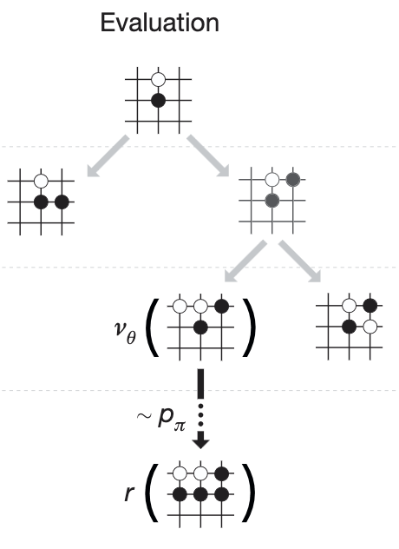
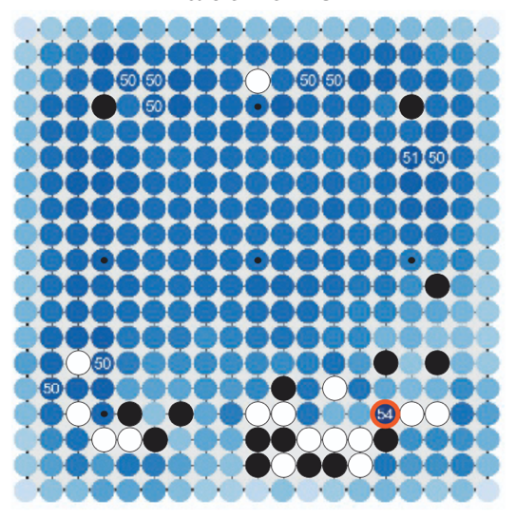
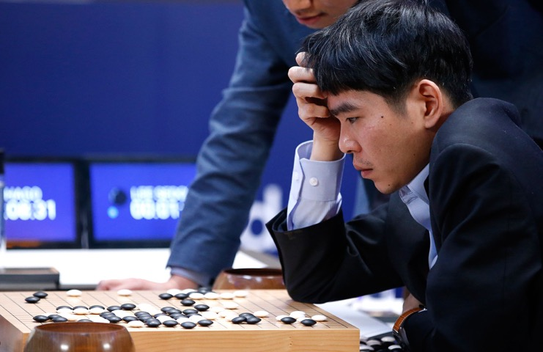
AlphaGo
Lee Sedol
2016
AlphaGo combines Deep RL and Monte-Carlo Tree Search (MCST)
Silver 2016

Slide 8

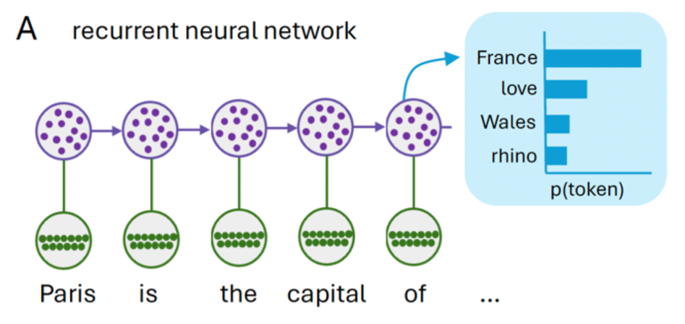
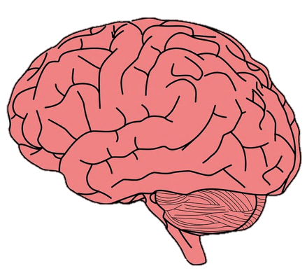
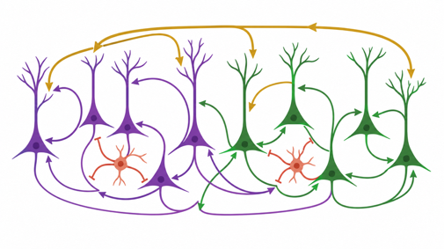
Recurrent memory
Recurrent neural circuits support working memory and decision-making
Inputs processed in a temporal chain
(each item connected to the next one in time)

Slide 9
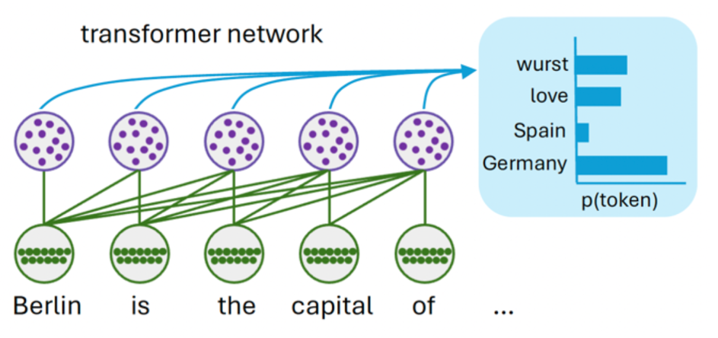
Memory structures
Inputs processed in a temporal chain
(each item connected to the next one in time)
Inputs processed in a computational graph
(everything connected to everything else)

Slide 10
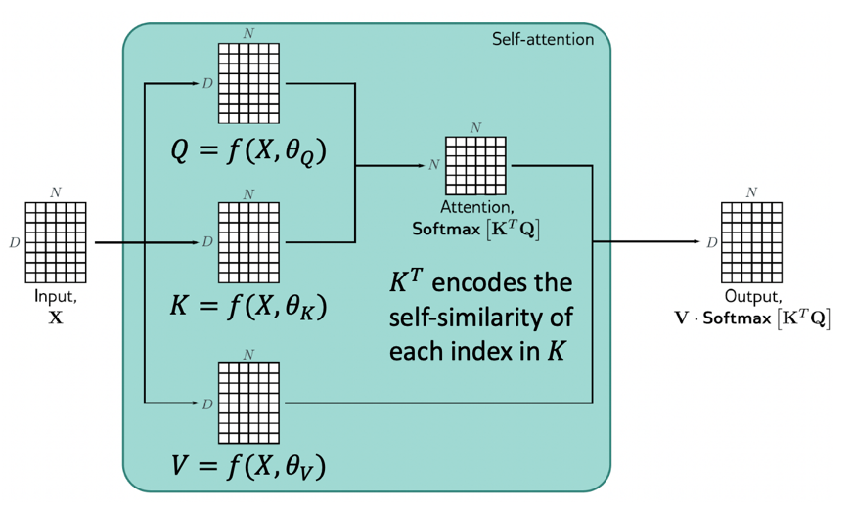
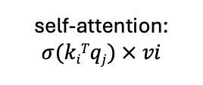
Transformer Networks
…
…
…
…
self-attention:
$$σ(kiTqj) × vi$$
updated
token j
key k_{i}
value v_{i}
query q_{j}
token i
token j
Paris
is
the
capital
...
The transformer learns to predict the next token conditional on how everything in its inputs is related to everything else

Slide 11
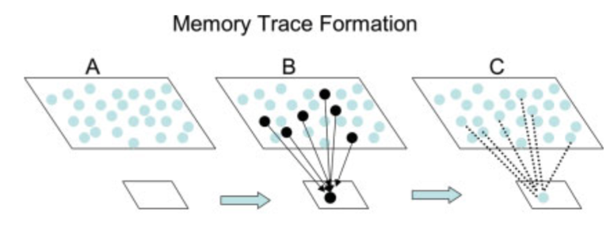
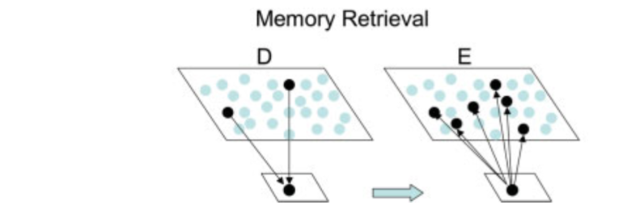
Transformer Networks
…
…
…
…
self-attention:
$$σ(kiTqj) × vi$$
updated
token j
key k_{i}
value v_{i}
query q_{j}
token i
token j
Paris
is
the
capital
...
This is generalized heteroassociation – a longstanding theory of hippocampal-dependent memory
Teyler & DiScenna, 1986

Slide 12
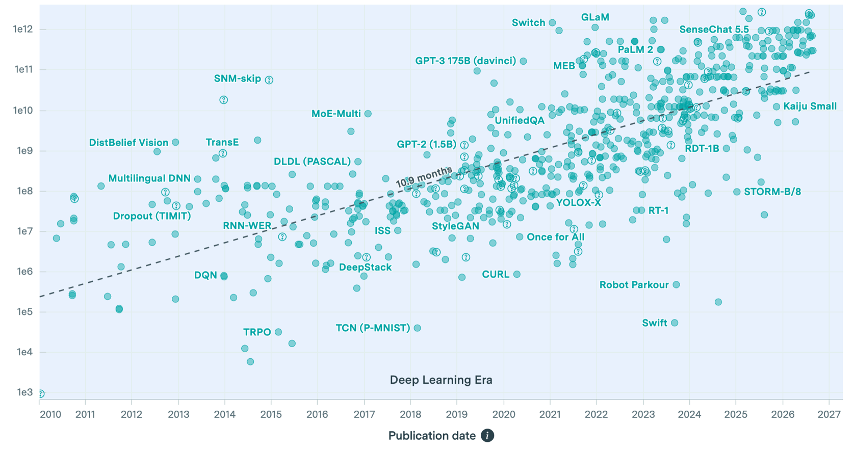
Combined with scale
trillion-parameter models
number of parameters

Slide 13
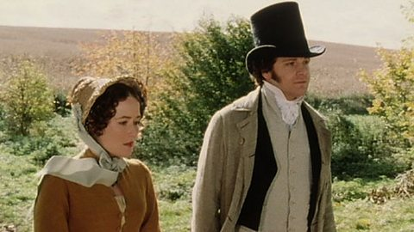
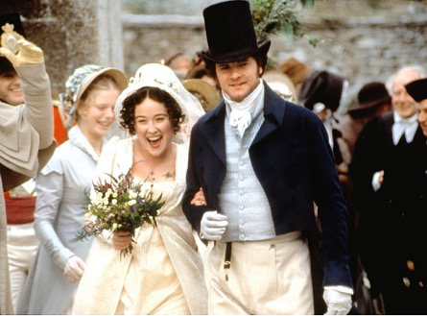
Scaling laws
It is a truth universally acknowledged, that a single man in possession of a good fortune must be in want of a wife.
Small model:
self-attention allows early words in a sentence to predict late ones
Large model:
self-attention allows events in early chapters to predict later ones

Slide 14

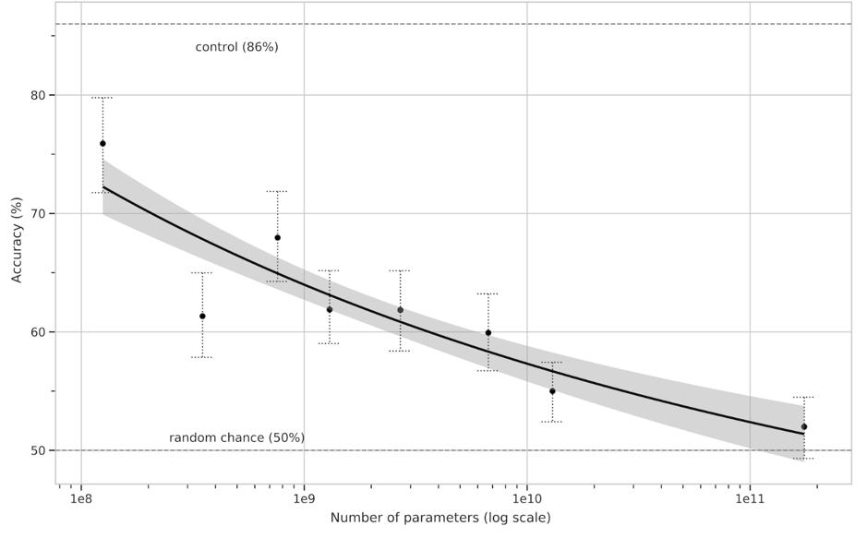
GPT-3
news articles
detectability
model scale
Meaning that GPT-3 could generate long, coherent passages of text…astonishing for the time
Brown 2020

Slide 15
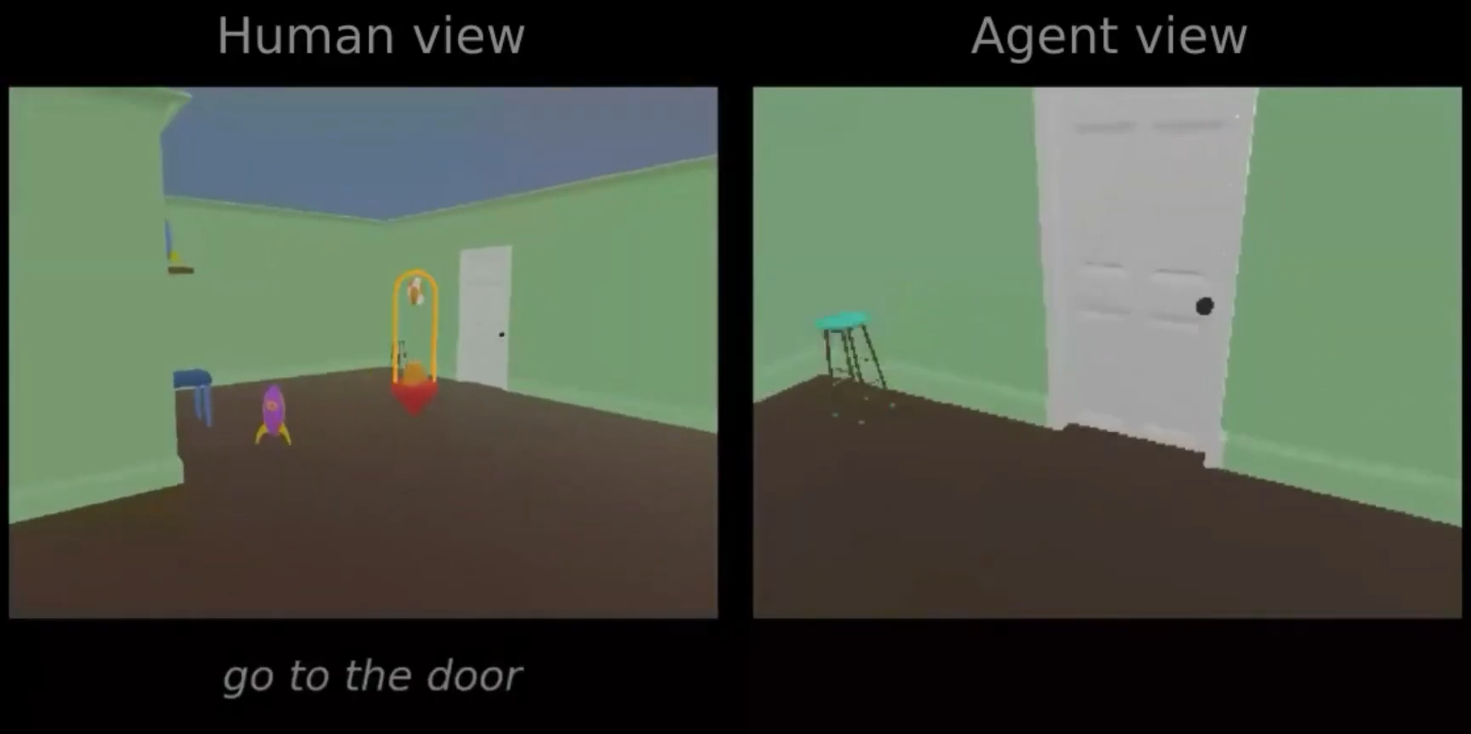
Grounding for language
Abramson 2020

Slide 16

Grounding for language
Lots of people are very keen to assert that LLMs cannot “understand” !!
Imagine an immense library in which all of the books are written in an unknown language.
Could you ever “understand” language just by reading all those books?
(obviously related to Searle’s Chinese Room thought experiment)
Bender & Koller 2020; but see also Piantadosi & Hill 2022; Mandelkern 2024
Abramson 2020

Slide 17

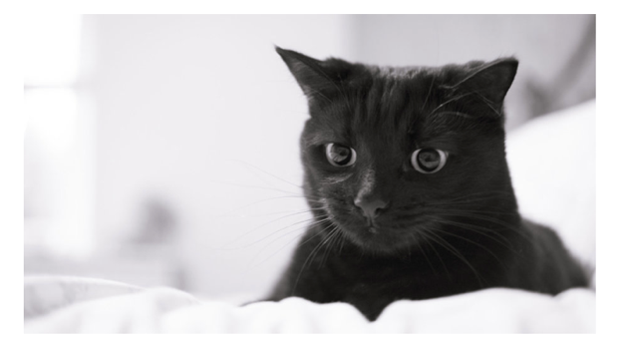
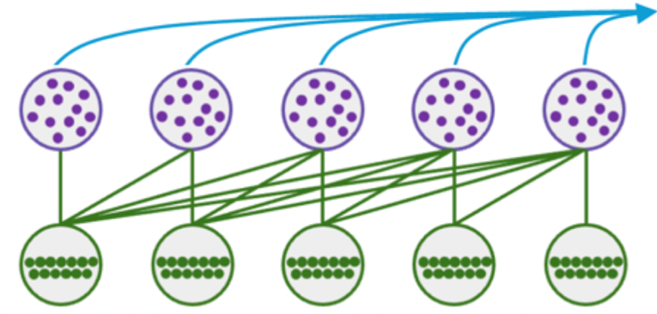


Vision language models
“This is my pet cat Gauss”
16 x 16 x 3 (flattened and embedded)
green
pig
riding
red
bicycle
my
pet
cat
Transformers can be adapted to process images, audio and video…these are called ‘multimodal’ models

Slide 18
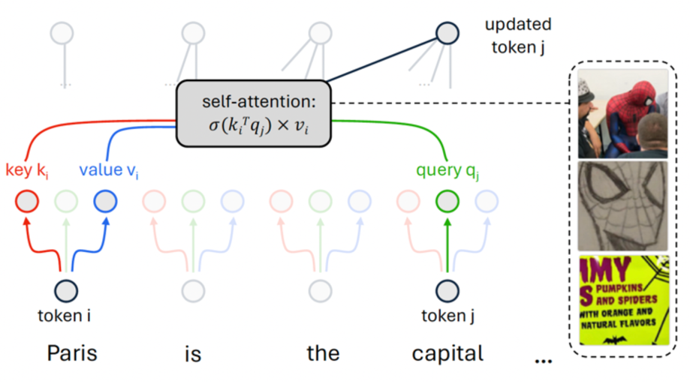
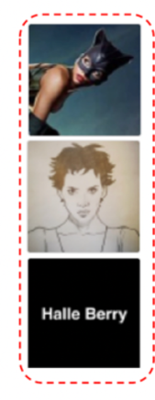
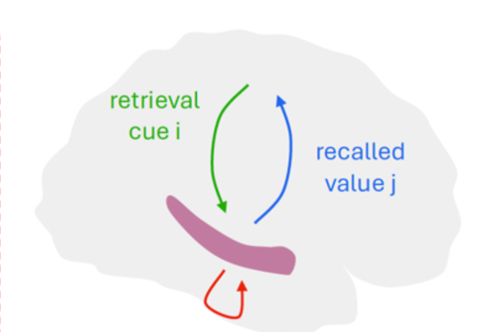
Fast associative memory
neocortex
hippocampus
indices for earlier memory j
“concept” neurons found in transformer-based VLMs
Just like similar cells found in human MTL
Goh 2021
Quan Quiroga 2005

Slide 19
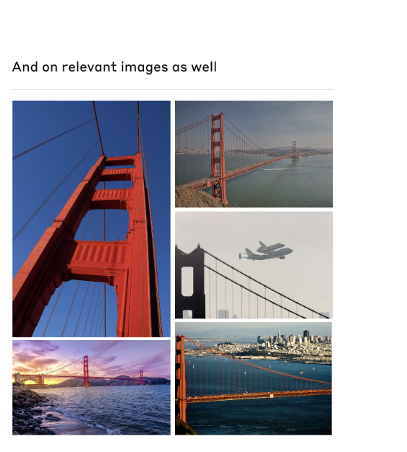
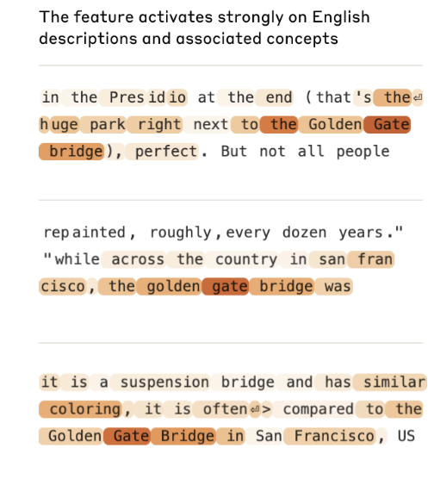
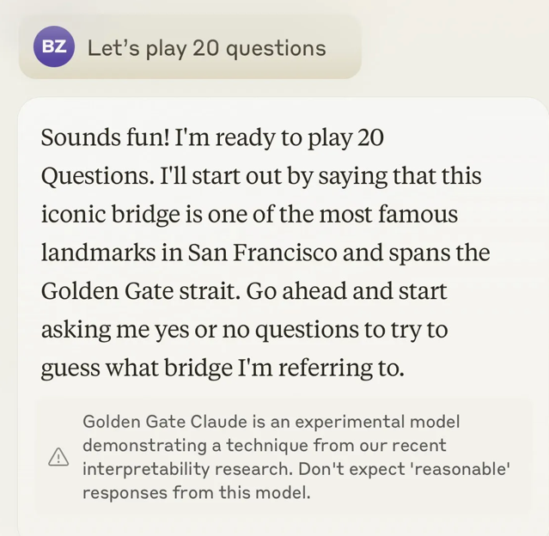
Golden Gate Claude
Individual concepts can be linearly augmented
Templeton et al 2024
Notes:
Note that it’s not that the network lacks the capacity to learn both tasks.
It’s easy to find a network paramaterisation that meets the objectives of both tasks A and B.
It can be found by training the network on an interleaved fashion, in which tasks A and B are mixed together.
However, life isn’t like that for humans. We usually perform tasks in an autocorrelated fashion. For example, I might play the violin in the morning and the piano in the afternoon, but rarely switch rapidly between them during a concert.

Slide 20
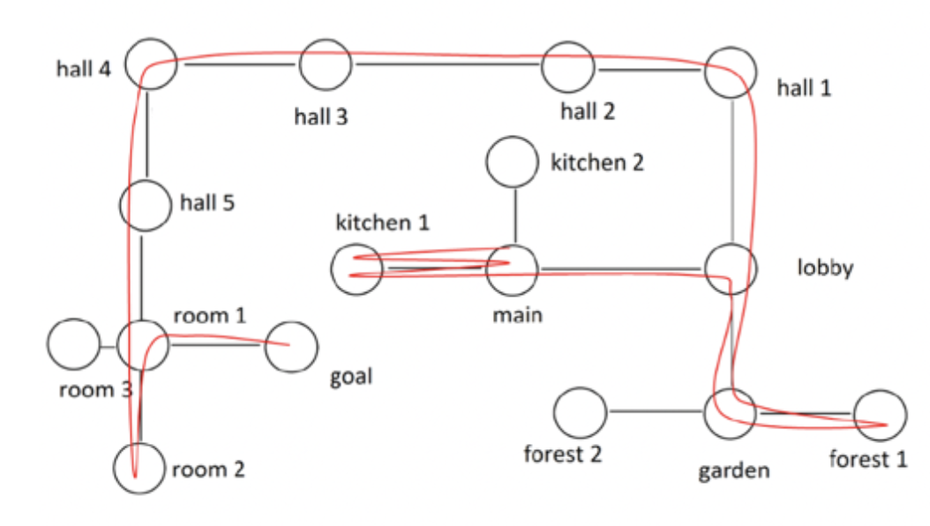
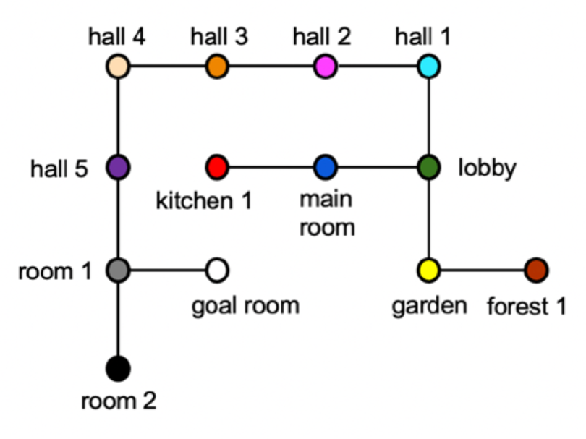
3. Symbols are (nearly) enough
Map described verbally
GPT4 can plot it in 2D
Bubeck, 2023

Slide 21
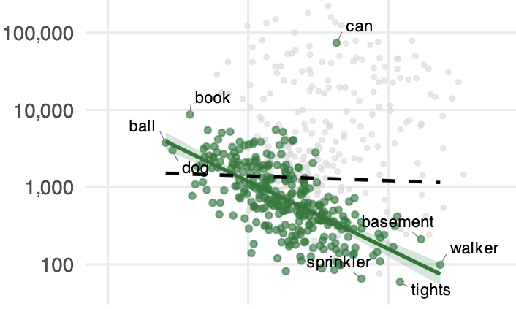
Sample efficiency
…”children may only need to see a few examples of the concepts hairbrush, pineapple or lightsaber before they largely ‘get it,’ grasping the boundary of the infinite set that defines each concept from the infinite set of all possible objects”.
cumulative exposures
Lake et al 2016
age (months) at which 50% proficiency achieved
Frank 2026

Slide 22

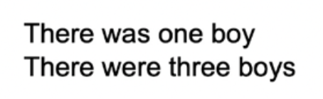


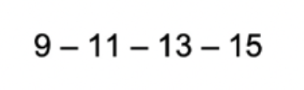
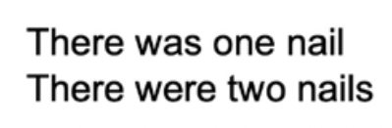
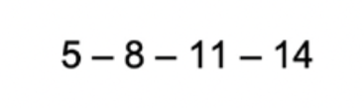
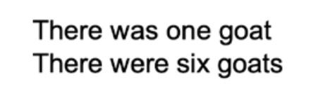



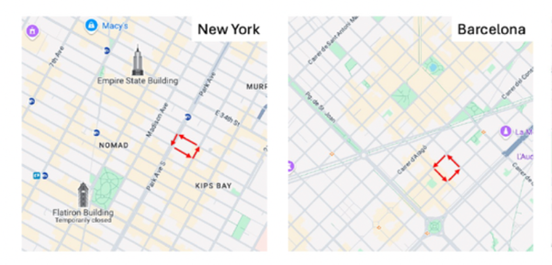
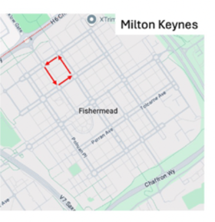


In context / in weight learning
In-weight learning
(e.g. parameters adjusted by gradient descent)
In-context learning
(predict based on relations among past examples)

Slide 23


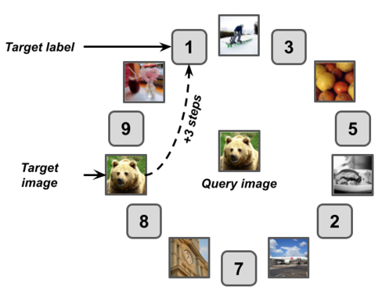

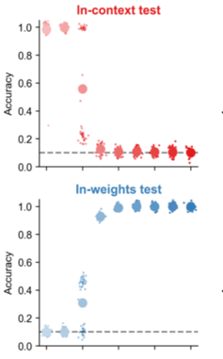
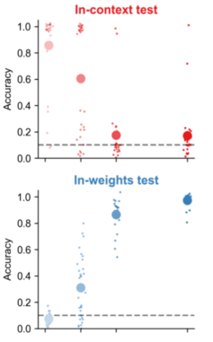
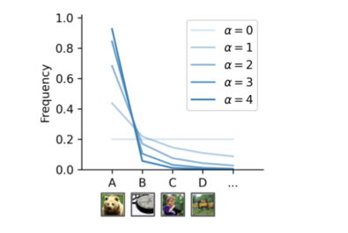
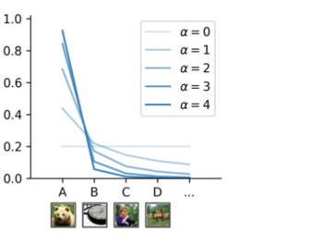
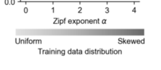
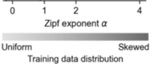
Data diet and in-context learning
transformer
human
uniform
and
/or
skewed (Zipf)
We can vary the parameters of the training distribution to understand what promotes in-context learning
Pesnot-Lerousseau 2025; see Chan 2022

Slide 24
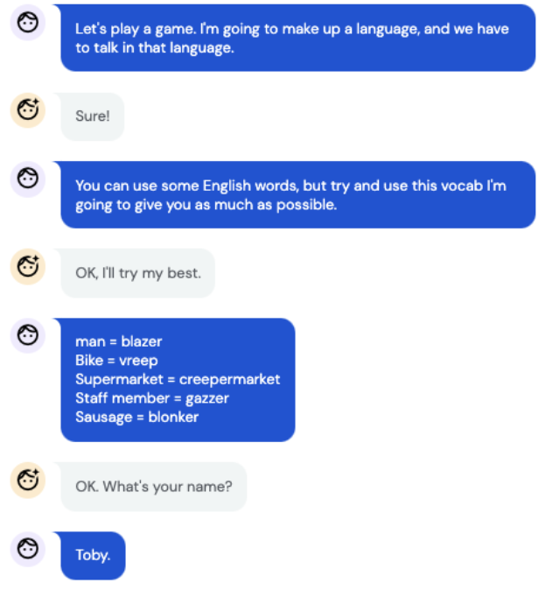
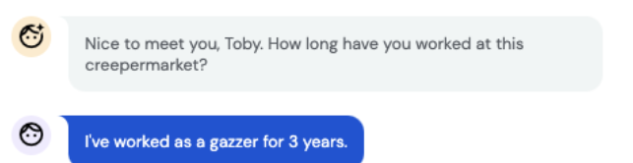
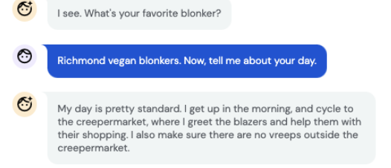
Meta-learning
New vocabulary acquired one shot, due to in-context learning
Toby Shevlane tweet, 2022

Slide 25




Key-value memory
To be effective, an index must be organized in someway! e.g. a book index is organized alphabetically
Query: “Is GPT-4 an LLM?”
Key: “LLM”
{LLM; GPT4}
{LLM; powerful}
{LLM; personalized}
Gershman 2024
Notes:
Note that it’s not that the network lacks the capacity to learn both tasks.
It’s easy to find a network paramaterisation that meets the objectives of both tasks A and B.
It can be found by training the network on an interleaved fashion, in which tasks A and B are mixed together.
However, life isn’t like that for humans. We usually perform tasks in an autocorrelated fashion. For example, I might play the violin in the morning and the piano in the afternoon, but rarely switch rapidly between them during a concert.

Slide 26

Neural scaffolding
Hippocampus
encodes conjunctions of experience + scaffold
Entorhinal Cortex
encodes the scaffold (for space)
Whittington 2024

Slide 27













Neural scaffolding
grid cells
band cells
PRC
(objects)
ERC
(space)
hippocampus
(conjuctive)
Toroidal topology in mERC
place cells
Gardner 2022
Whittington 2020

Slide 28




Neural scaffolding
grid cells
band cells
PRC
(objects)
ERC
(space)
(invariant)
hippocampus
(conjuctive)
Toroidal topology in mERC
place cells
(remap)
Gardner 2022
Whittington 2020

Slide 29
3. Symbols are (nearly) enough
Map described verbally
GPT4 can plot it in 2D
Bubeck, 2023

Slide 30





Multiple scaffolds
episodic
“Paris”
map-like
Paris
Berlin
Lille
Lyon
Paris
magnitude-like
associative
“Paris is the capital of France”
propositional
Notes:
Note that it’s not that the network lacks the capacity to learn both tasks.
It’s easy to find a network paramaterisation that meets the objectives of both tasks A and B.
It can be found by training the network on an interleaved fashion, in which tasks A and B are mixed together.
However, life isn’t like that for humans. We usually perform tasks in an autocorrelated fashion. For example, I might play the violin in the morning and the piano in the afternoon, but rarely switch rapidly between them during a concert.

Slide 31










The scaffold for all human knowledge
text
image
notation
foundation model
chat
code
audio
diagrams

Slide 32




What is the language of thought?
Gurnee 2026

Slide 33

What is the language of thought?
Gurnee 2026

Slide 34

Platonic Representation hypothesis
Is information encoded in large AI models converging to a shared model of reality?
Anna Karenina principle:
“All happy families are alike; each unhappy family is unhappy in its own way.”
Huh 2024; see Bosch 2026

