Slide 1





AI, Cognition and Society
3. How to build Frontier AI
Prof. Christopher Summerfield
University of Oxford
funding gratefully acknowledged

Slide 2
Questions
1. How does a modern frontier AI system work, and does it resemble the human brain?
2. What cognitive functionality has yet to be implemente in AI? What have we not solved yet?
3. Have modern AI systems reached human-level competence? If not, what is missing?

Slide 3

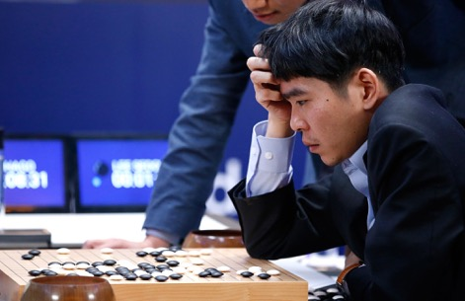
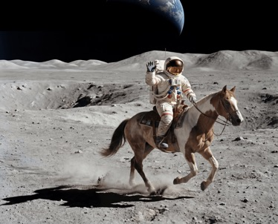
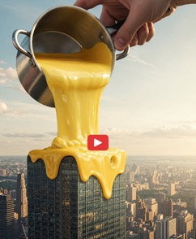

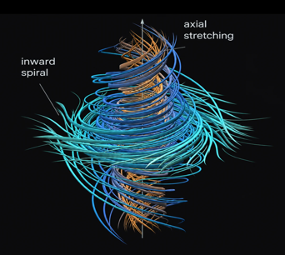
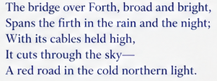


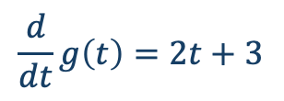
A potted history of now
Deep RL
VLMs
AI agents
AI video
2020
2021
2022
2023
2024
2025
2026
Prehistory
LLMs
Post-trained AI
Reasoning models
$$g\left(t\right)=t^{2}+3t+1$$
$$\frac{d}{dt}g\left(t\right)=2t+3$$
Superhuman AI

Slide 4
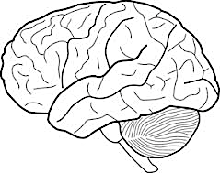
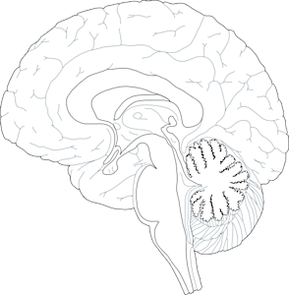
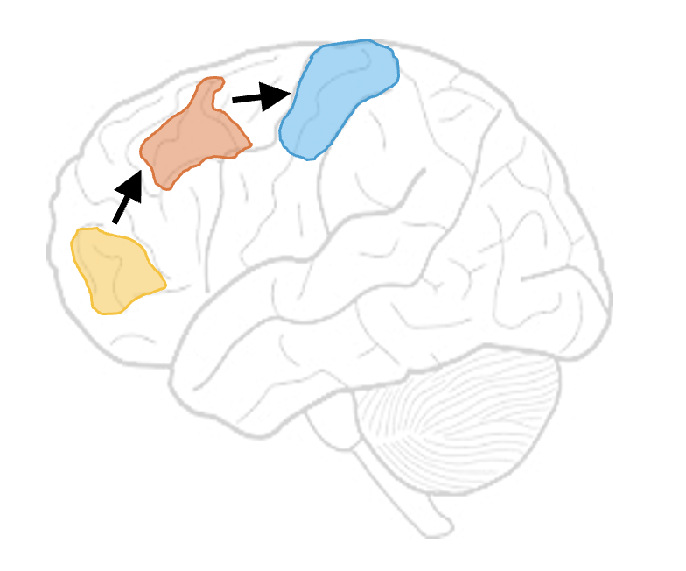
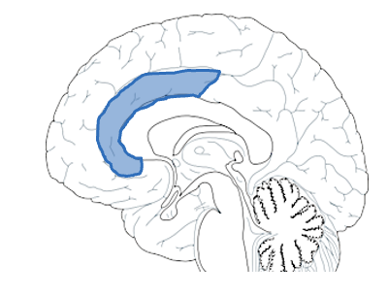
Structure
Scaling – making big AI models work
Memory – allowing the past to influence the present
Reasoning – using externalisation for search
Agents – moving from words to actions
What’s missing? – consolidation, metacognition, embodiment
?

Slide 5
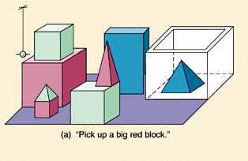
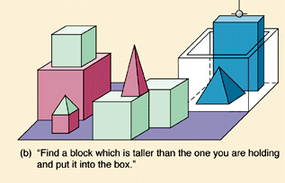
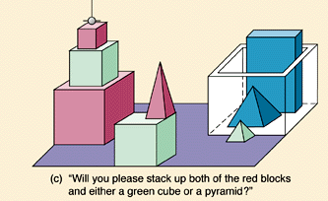
The bitter lesson
The biggest lesson that can be read from 70 years of AI research is that general methods that leverage computation are ultimately the most effective, and by a large margin.We have to learn the bitter lesson that building in how we think we think does not work in the long run.
The bitter lesson is based on the historical observations that 1) AI researchers have often tried to build knowledge into their agents, 2) this always helps in the short term, and is personally satisfying to the researcher, but 3) in the long run it plateaus and even inhibits further progress, and 4) breakthrough progress eventually arrives by an opposing approach based on scaling computation by search and learning. The eventual success is tinged with bitterness, and often incompletely digested, because it is success over a favored, human-centric approach.
Sutton 2019

Slide 6
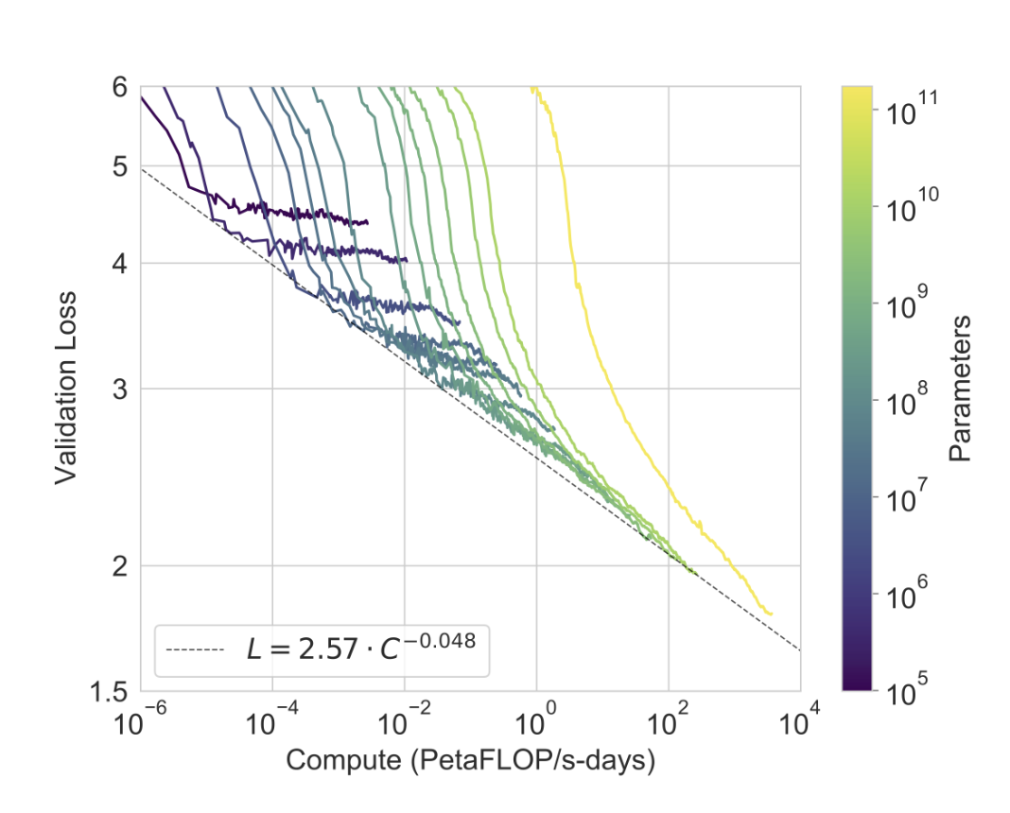
Scaling laws
Test loss (perplexity) declines predictably with compute (and data and parameters)
dashed line fit to lower envelope of curves
Kaplan et al 2020

Slide 7
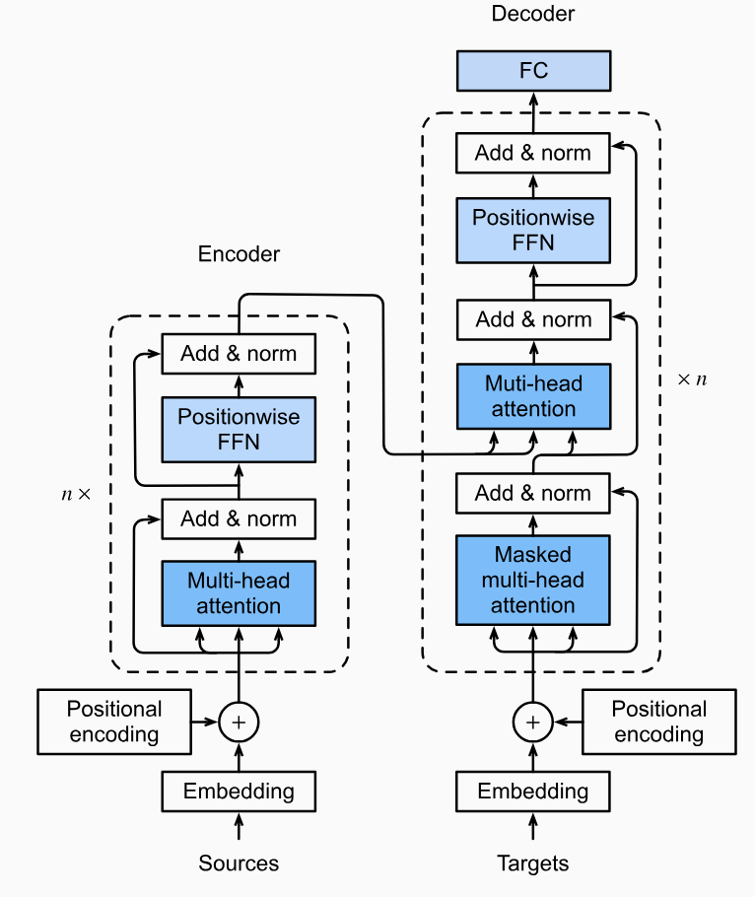
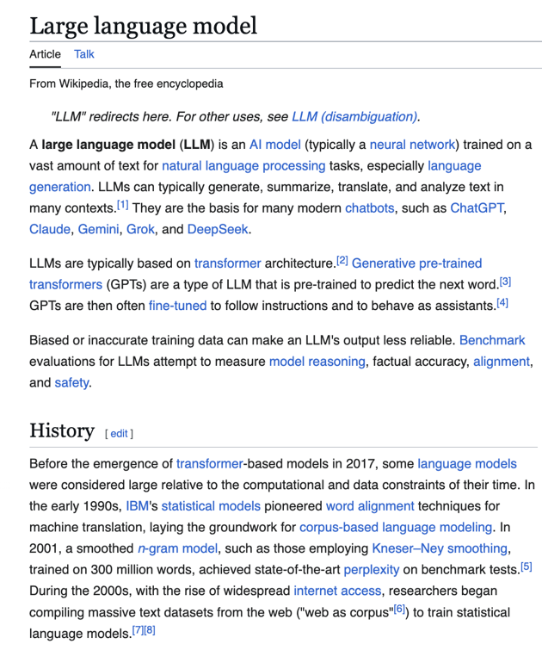
Neural networks for language
transformer network
Phuong & Hutter 2022

Slide 8
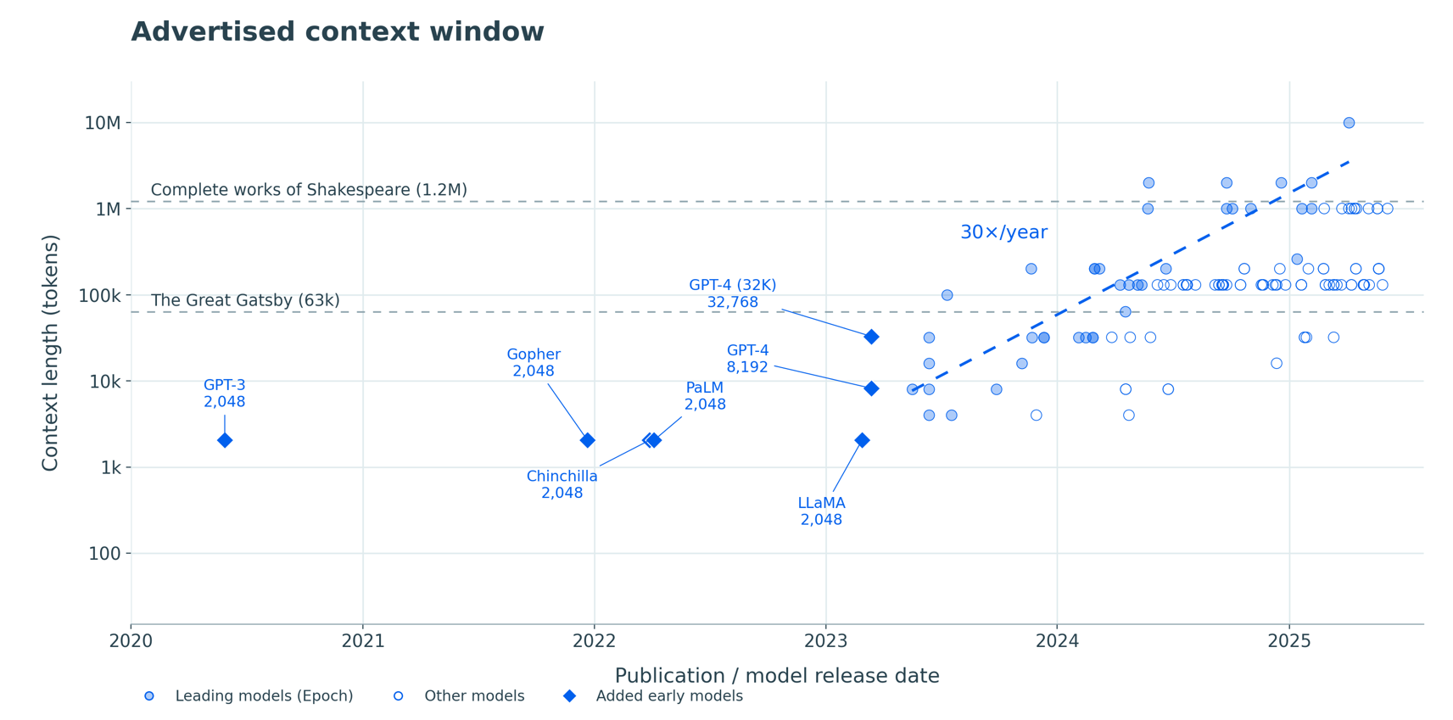
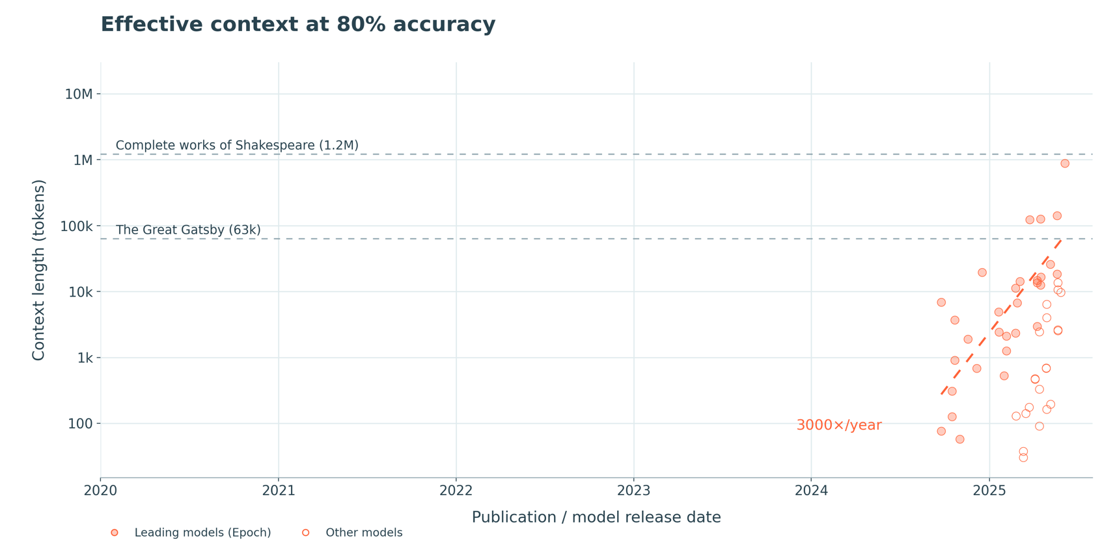
Long context

Slide 9
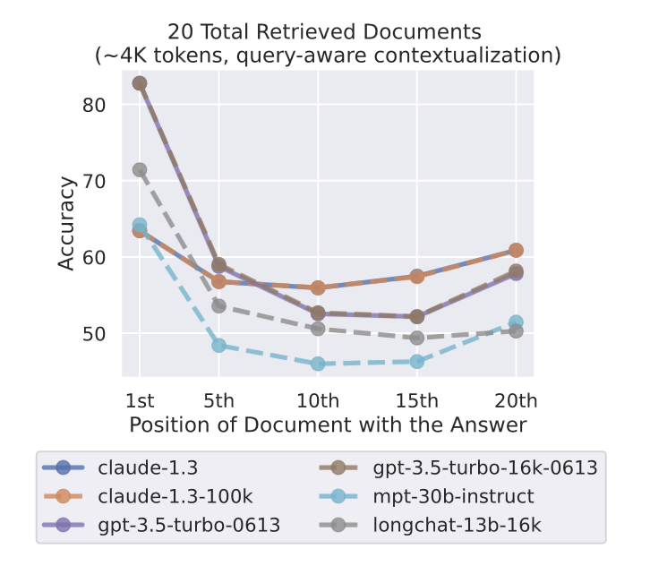
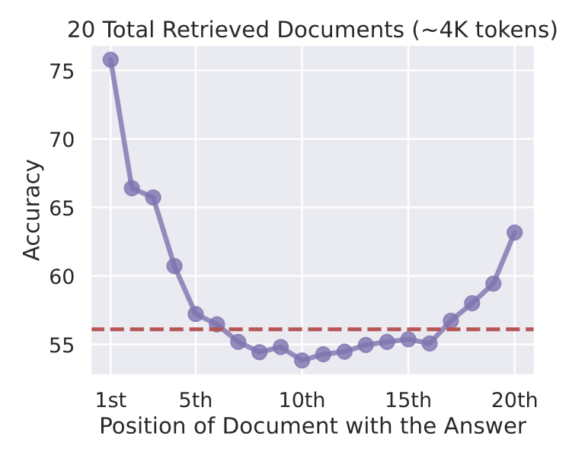
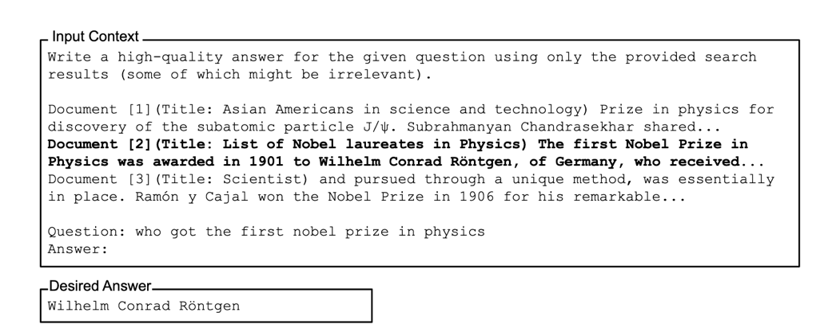

Long context
LLMs show both primacy and recency effects!
Liu 2023

Slide 10
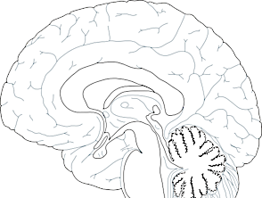
What components does a brain have?
working memory
motor control and tool use
multimodal perception
planning and reasoning
monitoring and control
social cognition

Slide 11
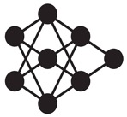
Retrieval augmented generation (RAG)
Sir Robert Walpole
query encoder
generator
motor output
who was the first British prime minister?
Sir Robert Walpole
visual input
semantic memory
who was the first British prime minister?
Lewis 2020

Slide 12
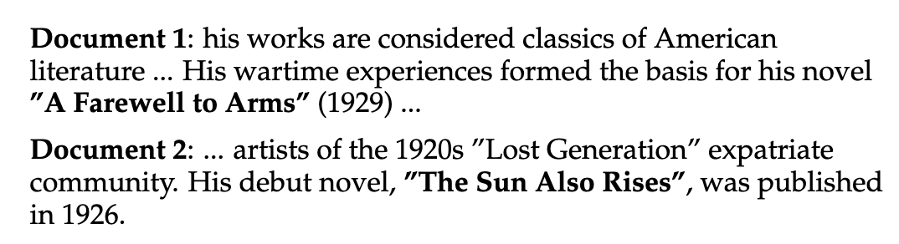
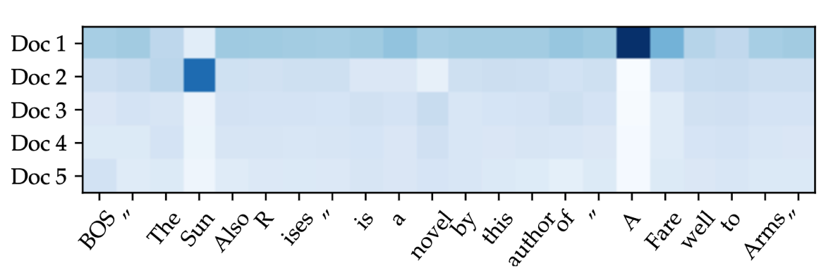


Retrieval augmented generation (RAG)
Sir Robert Walpole
query encoder
generator
motor output
working memory
“Hemingway”
$$z(doc)$$
doc 1
doc 2
matching
doc 3
…
doc $n$
visual input
semantic memory
who was the first British prime minister?
Lewis 2020

Slide 13
Structure
Scaling – making big AI models work
Memory – allowing the past to influence the present
Reasoning – using externalisation for search
Agents – moving from words to actions
What’s missing? – consolidation, metacognition, embodiment
?

Slide 14
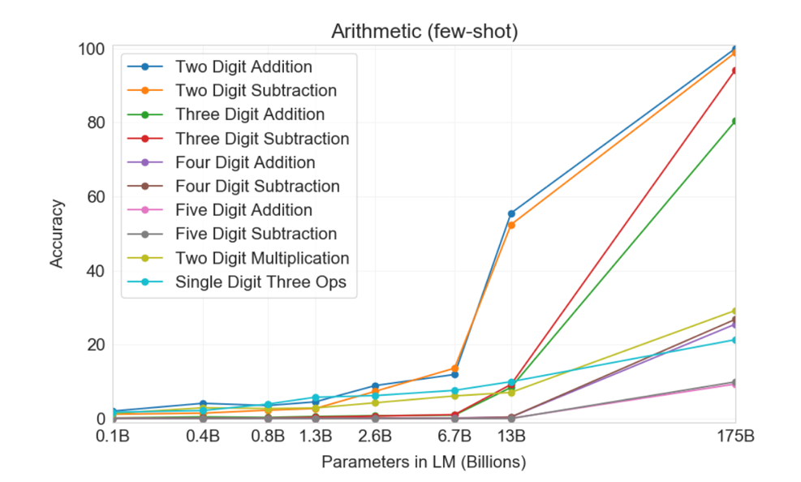
Planning and reasoning
action sequences
motor output
abstract plans
semantic memory
Arithmetic abilities of GPT-3 (Brown 2020)
LLMs naively struggle with complex computations
Koechlin & Summerfield 2007

Slide 15
Planning and reasoning
Arithmetic abilities of GPT-3 (Brown 2020)
LLMs naively struggle with complex computations
Koechlin & Summerfield 2007

Slide 16
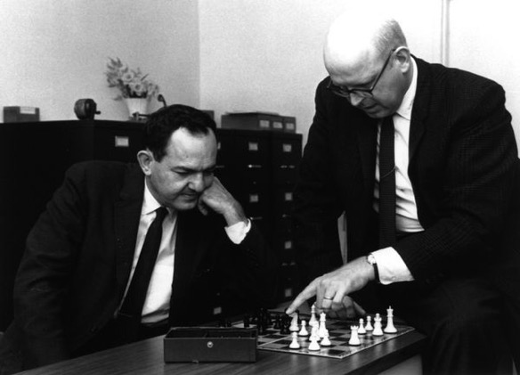
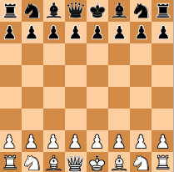
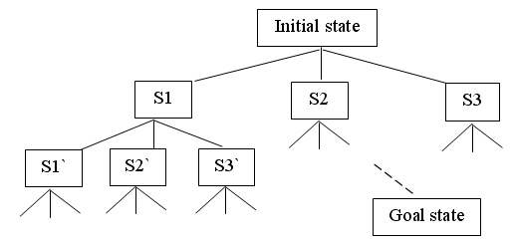

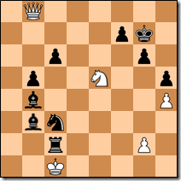
Large reasoning models
symbolic systems
…. and so on …
Many queries pose search problems
Early chess solvers (e.g. DeepBlue) used tree search for planning and inference
checkmate!!

Slide 17
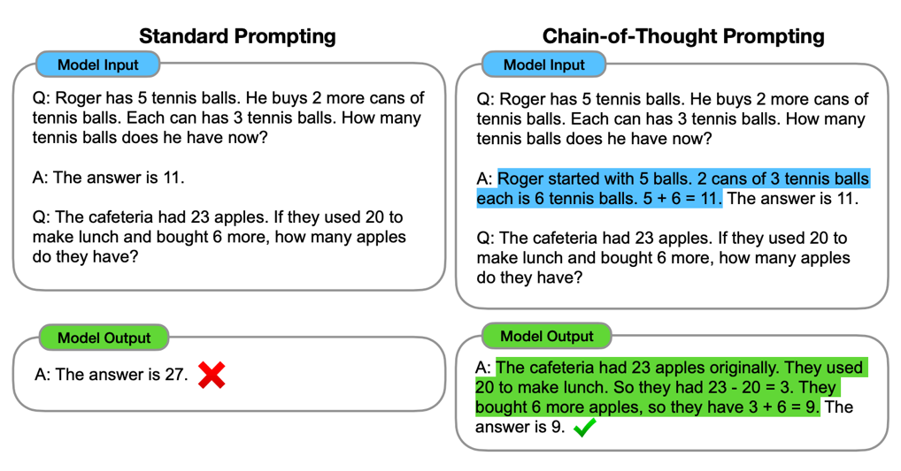
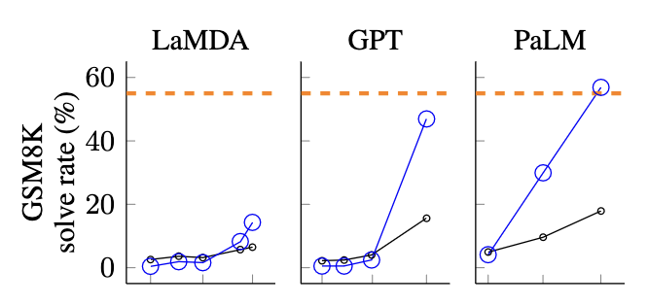
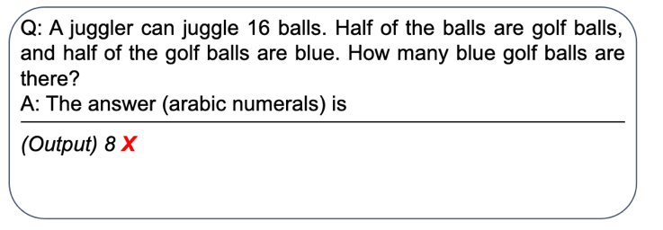
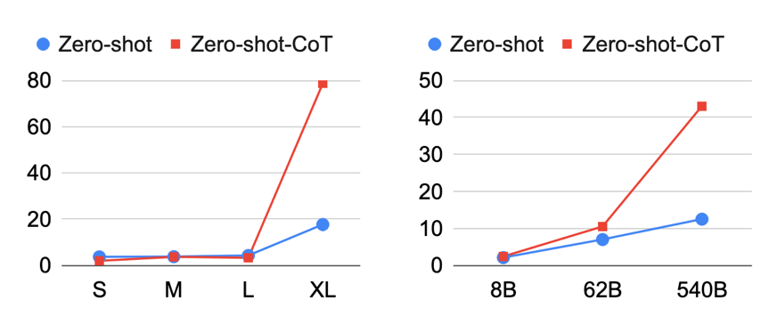
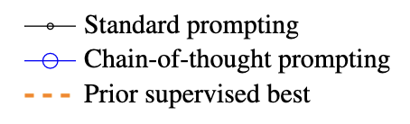
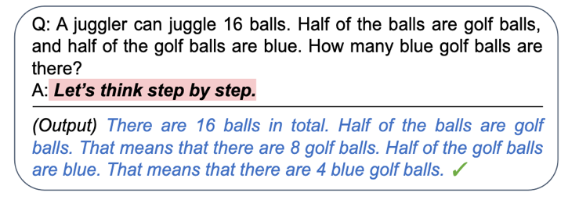
Large reasoning models
GPT-3
(Multi-Arith)
PALM
GSM-8K
Prompting models to decompose problems via in-context learning
Simply telling AI to reason has a similar effect!!
Koijma 2022; Wei 2022

Slide 18
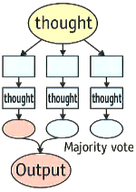
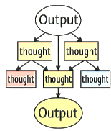

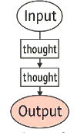
Large reasoning models
symbolic systems
Let’s think about it step by step!!
Many queries pose search problems
Allowing LLMs to generate (or explicitly search over) interim reasoning states greatly enhances performance

Slide 19
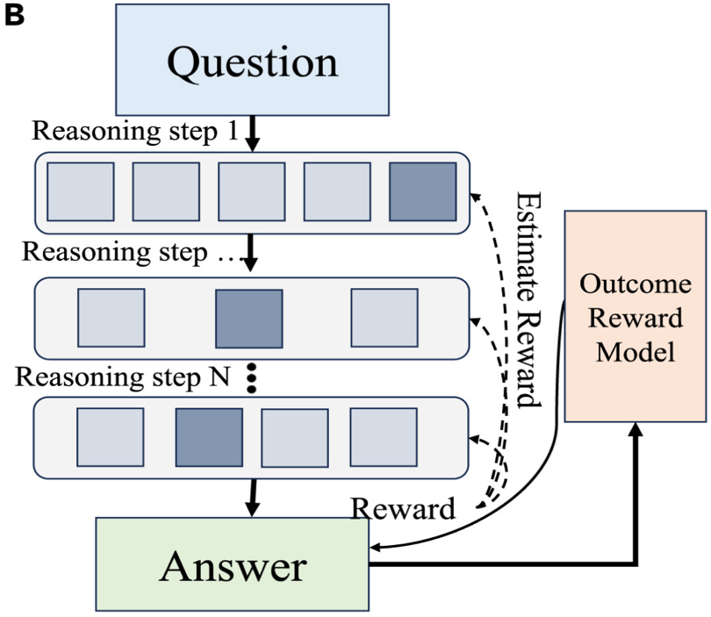
Large reasoning models
the most effective solutions train LLMs to search using RL
This is precomputation: rather than brute force search, models now learn to reason, conditional on the semantics of the problem (c.f. meta-skills, acquiring critical thinking)
Guo 2025

Slide 20
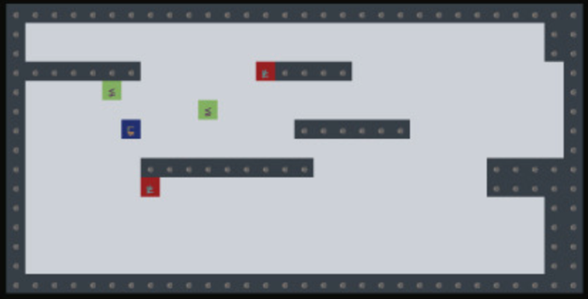
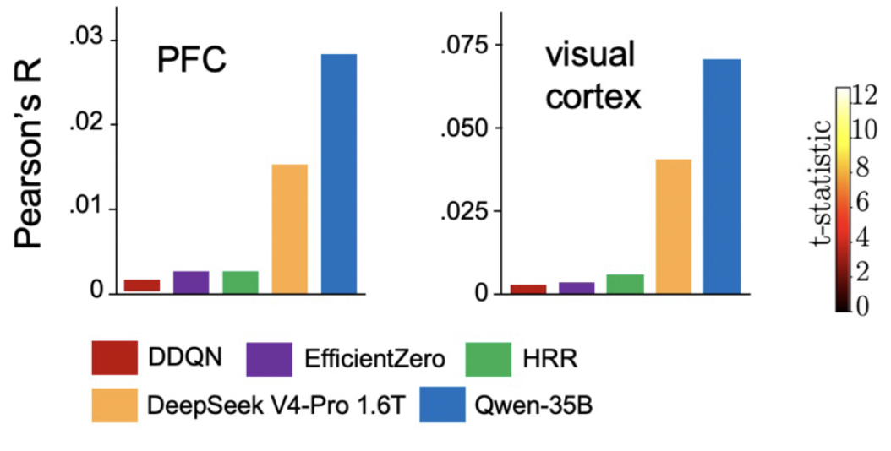
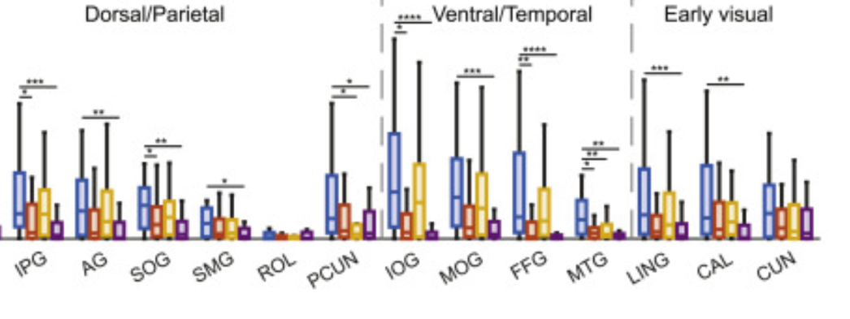

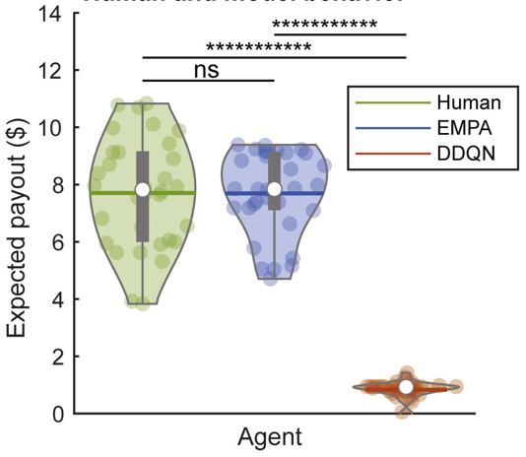
Large reasoning models
VGDL games
EMPA
Large reasoning models increase representational alignment with BOLD for complex environments
Tomov 2023
Csaba 2026

Slide 21
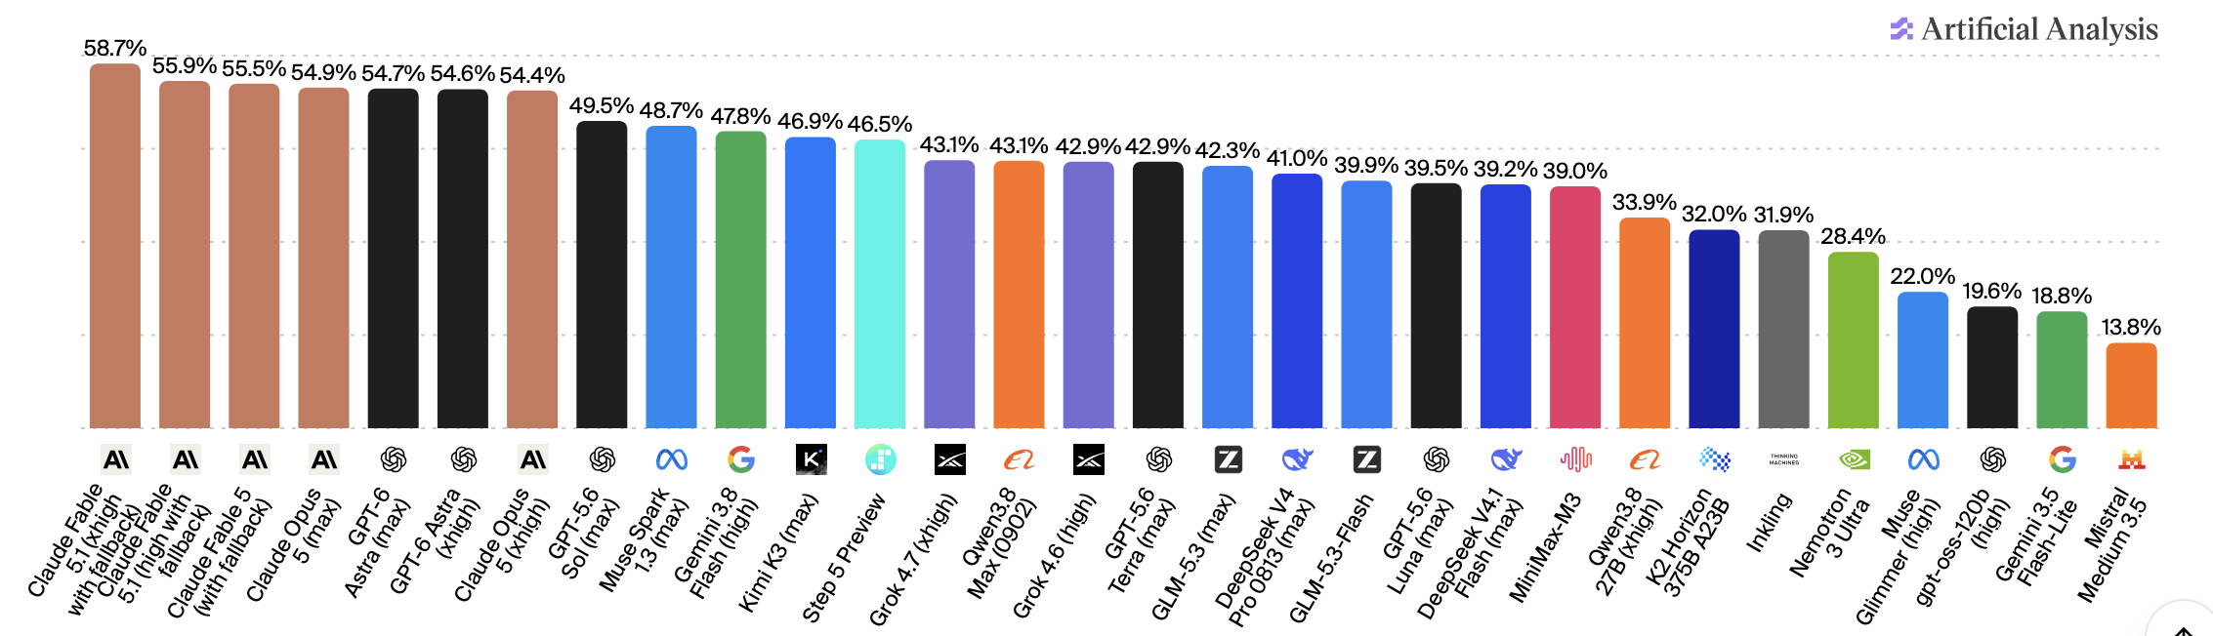
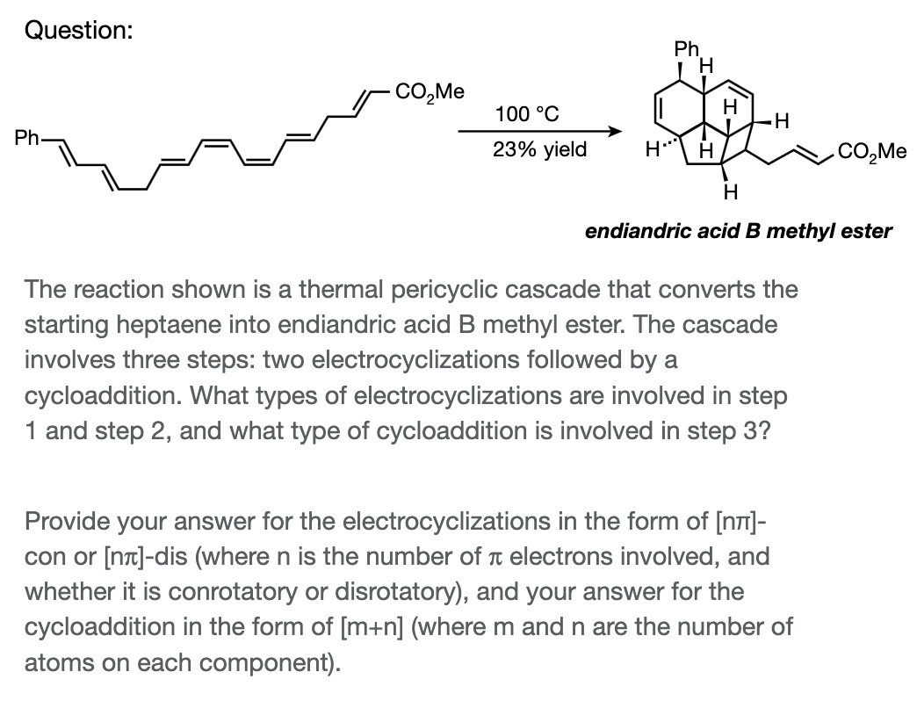

Humanity’s Last Exam
Humanity’s last exam involves >2,000 questions contributed by human academics, and has still not saturated
CAIS 2026

Slide 22
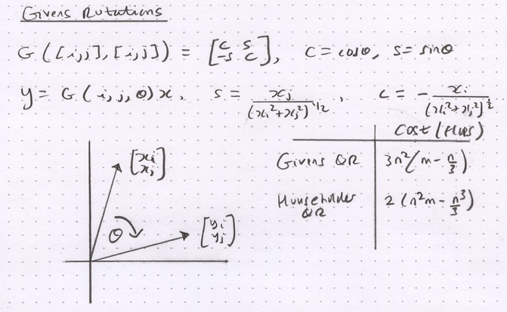
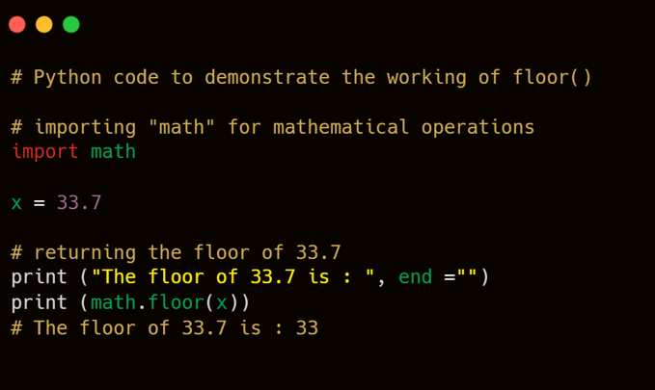
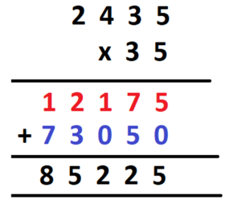

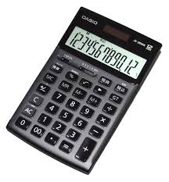
Externalisation
pencil and paper
coding tools
We use external tools to help us solve reasoning problems. So do AI agents
Code is almost a lingua franca for reasoning problems in the digital era
calculator

Slide 23






Tool use
query encoder
generator
Computer code can be used to communicate with an application programming interface (API)
This means that LLMs can emit tokens that control a browser (e.g. Bing API)
Allowing live web information to be incorporated into replies
Will it rain today?
No idea, check the BBC
$$z(doc)$$
doc 1
doc 2
BBC says it will be miserable
Will it rain today?
matching
doc 3
…
“Knowledge cutoff”
doc $n$
Nakano 2021

Slide 24










Claude Code
interrupt / amend query
prompt
Agentic Loop
output
Gather context
Take Action
Verify results
planning / reasoning
control / monitoring
In natural intelligence, executive function involves a loop between:
execution (lateral PFC)
monitoring (medial PFC)
Cloud, Web, Local Desktop, MCP servers
Terminal, Directories, Git, Sub-agents, Skills, Automemory

Slide 25

Agentic capabilities
Kwa 2025

Slide 26



ARC-AGI
Puzzle games involving human priors (mostly from old skool video games)
GPT-6 Astra recently saturated the full ARC-AGI 3 benchmark
Arc Prize Foundation 2026

Slide 27
Structure
Scaling – making big AI models work
Memory – allowing the past to influence the present
Reasoning – using externalisation for search
Agents – moving from words to actions
What’s missing? – consolidation, metacognition, embodiment
?

Slide 28
What remains to be solved?
Integated Memory. AI models do not consolidate ongoing experience into memory.
  Models cannot learn continually
  Persistence is very expensive (e.g. long context)
Self-monitoring. AI models do not explicitly monitor their own behaviours
  Overconfidence / poor calibration
  Goal drift over time
  No stable identity / shape shifting
Open-endedness. AI models deal poorly with uncertain / open-ended environments
  Robotics lags far behind
  Reliability lags far behind capability
  Models lack initiative / known HOW but not WHAT to do
Notes:
Note that it’s not that the network lacks the capacity to learn both tasks.
It’s easy to find a network paramaterisation that meets the objectives of both tasks A and B.
It can be found by training the network on an interleaved fashion, in which tasks A and B are mixed together.
However, life isn’t like that for humans. We usually perform tasks in an autocorrelated fashion. For example, I might play the violin in the morning and the piano in the afternoon, but rarely switch rapidly between them during a concert.

Slide 29




Continual learning
People learn continually over the lifespan
Memories are consolidated in the period after learning
This probably involves transfer of information from hippocampus to neocortex via experience-dependent replay
Brashers-Krug et al 1996
Notes:
Note that it’s not that the network lacks the capacity to learn both tasks.
It’s easy to find a network paramaterisation that meets the objectives of both tasks A and B.
It can be found by training the network on an interleaved fashion, in which tasks A and B are mixed together.
However, life isn’t like that for humans. We usually perform tasks in an autocorrelated fashion. For example, I might play the violin in the morning and the piano in the afternoon, but rarely switch rapidly between them during a concert.

Slide 30



Consolidation
People learn continually over the lifespan
hippocampus
z
z
z
In animals, information is consolidated to neocortex over time
place cell
LLMs cannot incorporate new experiences into their weights except by retraining
Notes:
Note that it’s not that the network lacks the capacity to learn both tasks.
It’s easy to find a network paramaterisation that meets the objectives of both tasks A and B.
It can be found by training the network on an interleaved fashion, in which tasks A and B are mixed together.
However, life isn’t like that for humans. We usually perform tasks in an autocorrelated fashion. For example, I might play the violin in the morning and the piano in the afternoon, but rarely switch rapidly between them during a concert.

Slide 31




Consolidation
CNN (ResNet) on CIfAR image recognition
Confidence measured in log probs
AI models are often poorly calibrated
“how confident are you”?
Sun 2025; Guo 2017
Notes:
Note that it’s not that the network lacks the capacity to learn both tasks.
It’s easy to find a network paramaterisation that meets the objectives of both tasks A and B.
It can be found by training the network on an interleaved fashion, in which tasks A and B are mixed together.
However, life isn’t like that for humans. We usually perform tasks in an autocorrelated fashion. For example, I might play the violin in the morning and the piano in the afternoon, but rarely switch rapidly between them during a concert.

Slide 32


Embodiment
Opus 5.5 generated this image by writing computer code
Truly embodied image generation..?
Notes:
Note that it’s not that the network lacks the capacity to learn both tasks.
It’s easy to find a network paramaterisation that meets the objectives of both tasks A and B.
It can be found by training the network on an interleaved fashion, in which tasks A and B are mixed together.
However, life isn’t like that for humans. We usually perform tasks in an autocorrelated fashion. For example, I might play the violin in the morning and the piano in the afternoon, but rarely switch rapidly between them during a concert.

Slide 33


Open-endedness
Probably not taking over the world any time soon
Notes:
Note that it’s not that the network lacks the capacity to learn both tasks.
It’s easy to find a network paramaterisation that meets the objectives of both tasks A and B.
It can be found by training the network on an interleaved fashion, in which tasks A and B are mixed together.
However, life isn’t like that for humans. We usually perform tasks in an autocorrelated fashion. For example, I might play the violin in the morning and the piano in the afternoon, but rarely switch rapidly between them during a concert.

Slide 34
Jagged frontier
general knowledge
The frontier is jagged – AI systems are superhuman in some domains, but still lag far behind in others
There is “cognitive dark matter” in intelligence
coding
writing poems
maths
composing music
reading clock
scientific research
playing tennis
persuading people
reviewing scientific articles
Mineault 2026

Slide 35



Jagged frontier
Saxena 2025

Slide 36

Large reasoning models
10K agents, allowed to discuss
They sent 2.7 million messages
Using 130B tokens
At a cost of $15m
Diversity helps!!
Millenium problem solved
Controversies over priority
Human mathematicians not happy

