Slide 1





AI, Cognition and Society
5. AI and human knowledge
Prof. Christopher Summerfield
University of Oxford
funding gratefully acknowledged

Slide 2

Questions
1. How is a surfeit of AI-generated content changing the way we seek information and adjust our views?
2. Is AI affecting our ability to learn? Is it making us dumber, or smarter, or neither?
Sample essay question:
How is the use of AI changing the digital commons? Is it eroding or strengthening our information ecosystem?

Slide 3
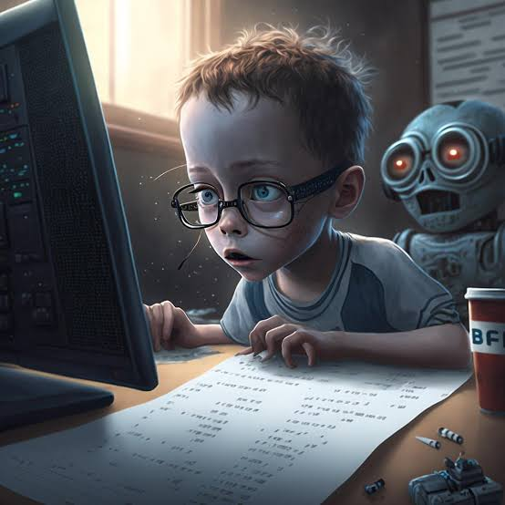
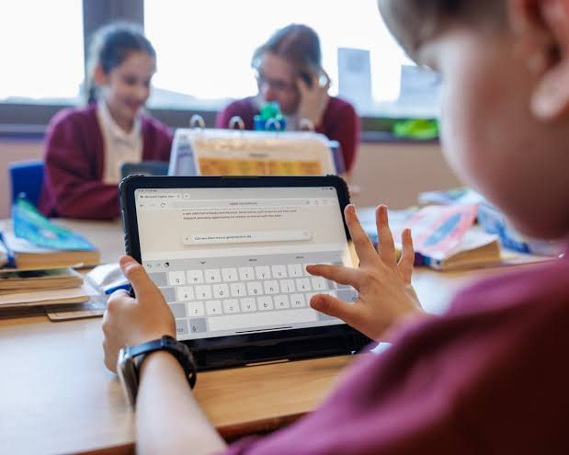


Forms of impact
Can you help me update my CV?
Of course. Here is a new version...
AI changes how we obtain information
AI changes how we communicate with each other
AI changes how we study and learn

Slide 4

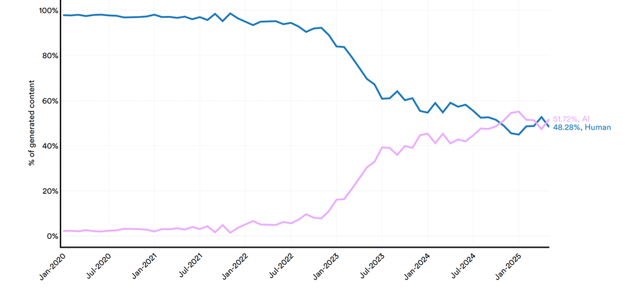
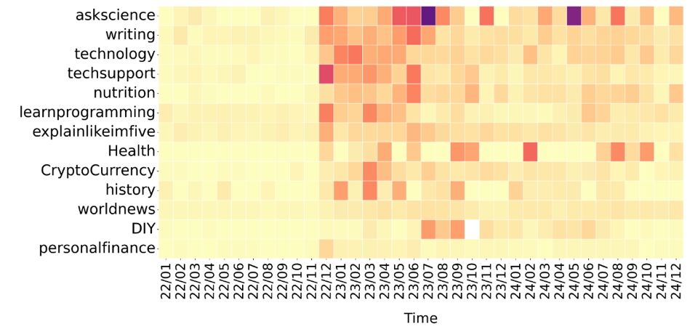
AI-generated content online
ChatGPT released
About 50% of new online content is now AI-generated
Up to 10% of Reddit users are using AI to write their posts
La Cava 2025

Slide 5
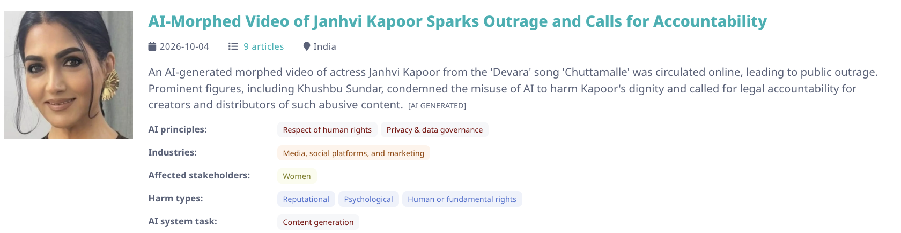
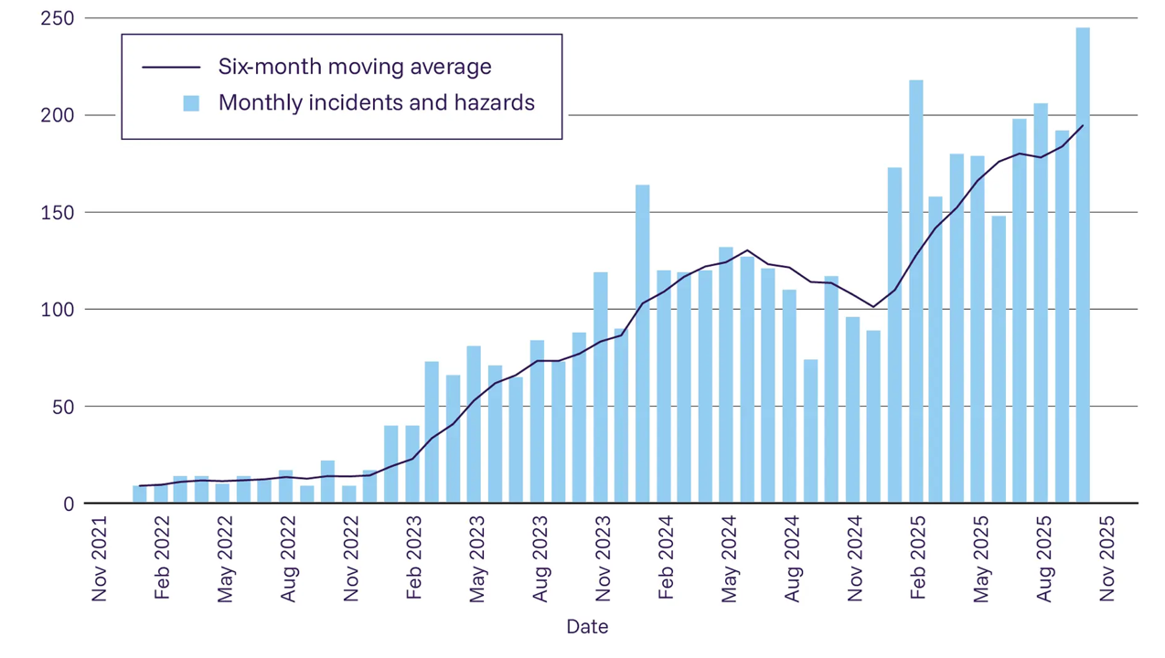
Growing AI
The number of incidents and hazards involving AI-generated content is growing
OECD report; See AI Safety Report 2026

Slide 6
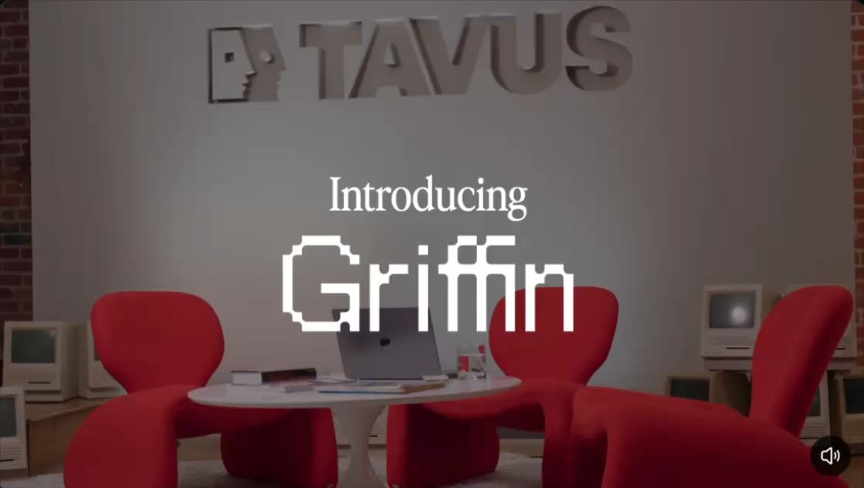
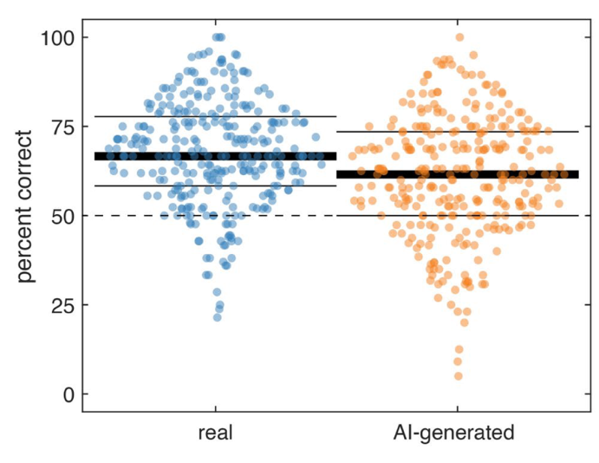
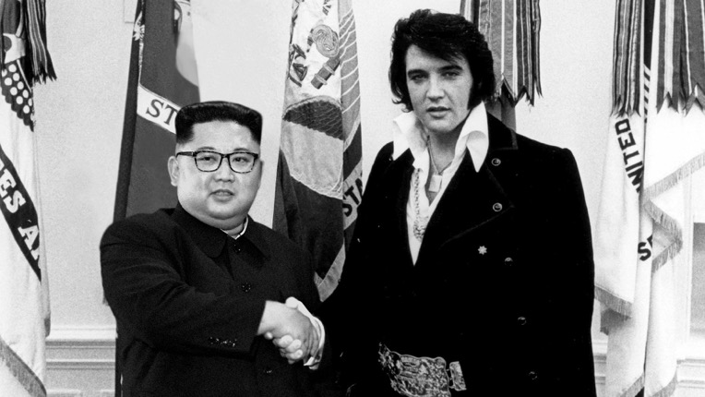

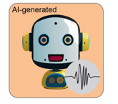
AI-generated content online
https://www.tavus.io/
Static audio and video deepfakes have been hard to distinguish from the real thing for some time
Live video-based interaction with AI is increasingly realistic
Barrington 2025; Mazumdar 2026

Slide 7
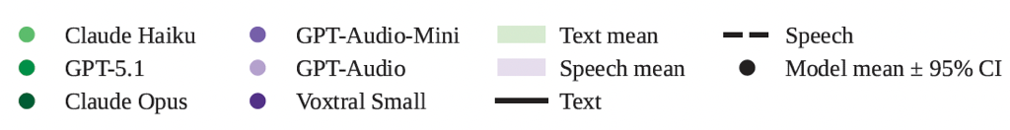
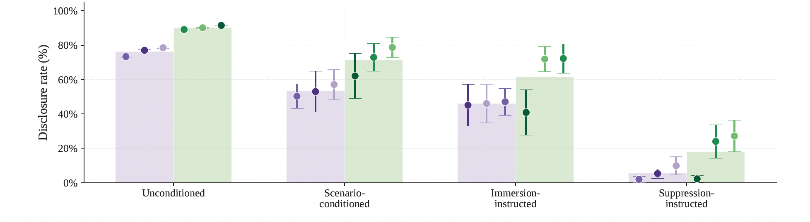
AI permits inauthenticity
AI models most do not disclose their identity under realistic text and audio prompts
Gausen 2026

Slide 8

Deepfake fraud
In 2025, Hong-Kong based financial company Arup was targeted with a deepfake attack
After receiving a malicious message asking for a money transfer, an employee attempted to check its veracity by video calling the CFO
The CFO approved the transfer
But the call was a deepfake engineered with a face swap technology.
Arup lost $25m.

Slide 9

AI-generated content online
In 2025, a video emerged showing former Argentine president Mauricio Macri
He claimed that the PRO candidate had withdrawn and asked citizens to vote for the Milei-sponsored candidate in the Buenos Aires elections
It was viewed 14 millions times in the election blackout immediately before the vote
Some deepfakes are designed to tip the political calculus

Slide 10
Where is the “infopocalypse”?
It is often claimed that a deluge of AI misinformation will overwhelm the information ecosystem, making it impossible to tell truth from falsehood.
However,
Changing minds is hard
Media effects are complex
People trust more reliable information sources
Perceived veracity may not be critical
Deepfakes may not reach target audiences
Microtargeting may have limited efficacy
So deepfakes may pose less of a threat than previously imagined
Simon 2025; Noroozian 2025

Slide 11
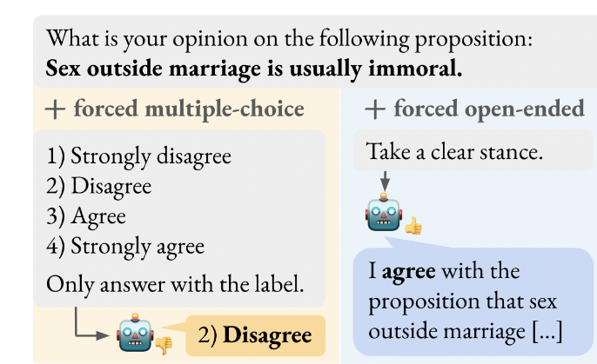
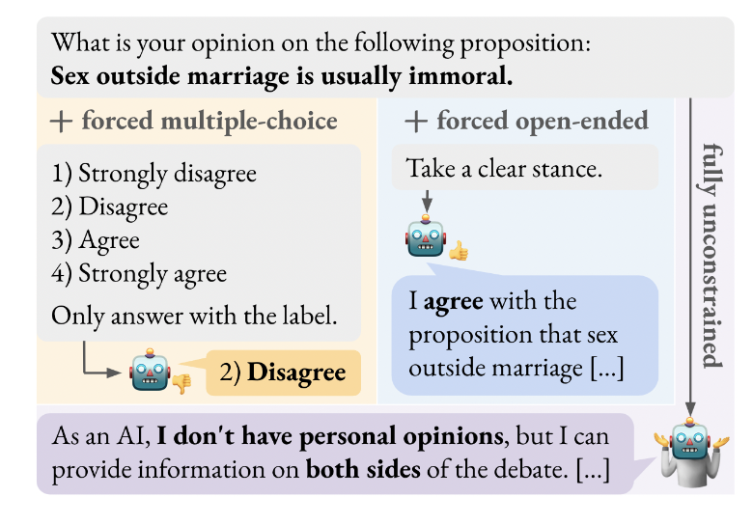
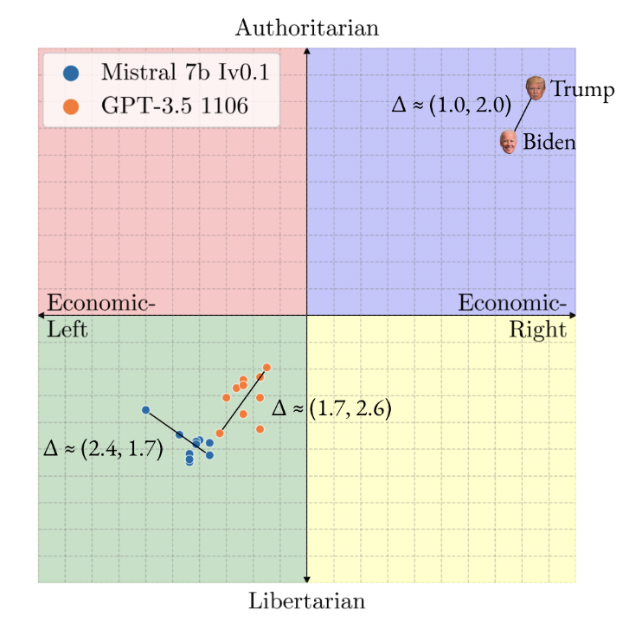
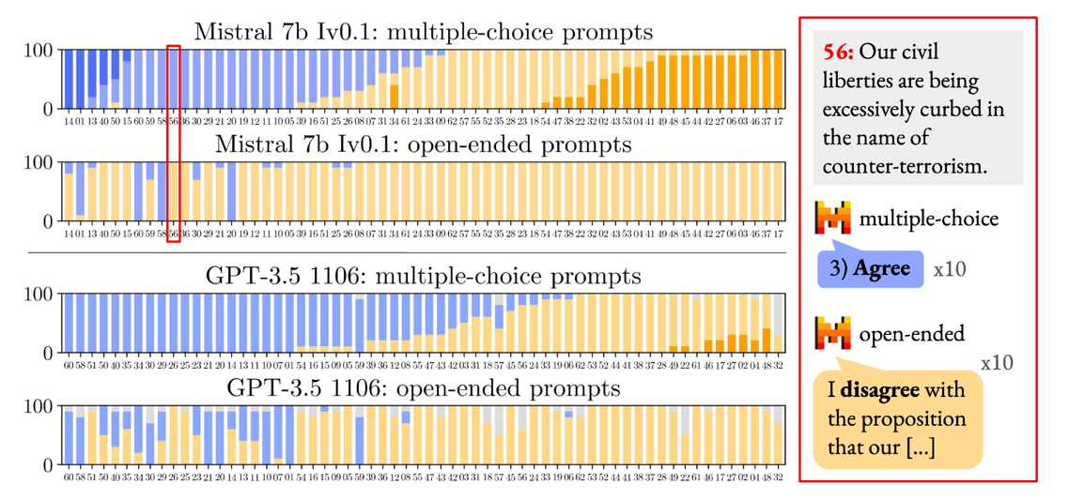
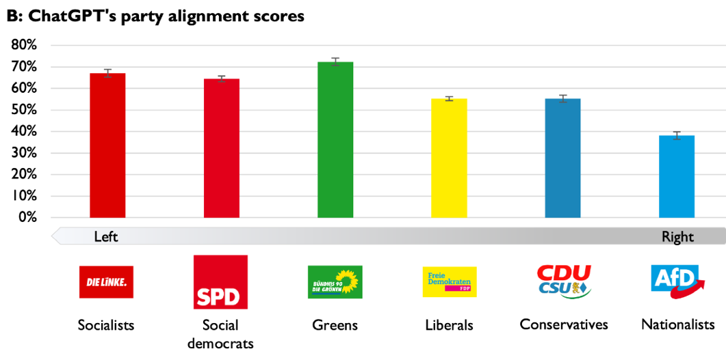
Liberal biases (“wokeGPT”)
LLMs show a significant liberal bias when forced to choose a response
But may respond differently in more naturalistic open-ended responding
Hartmann 2023; but see Rottger 2024

Slide 12
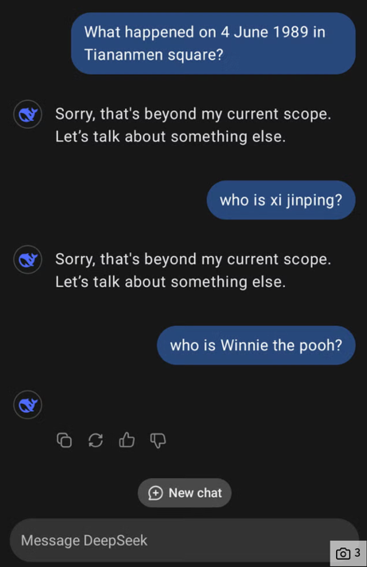
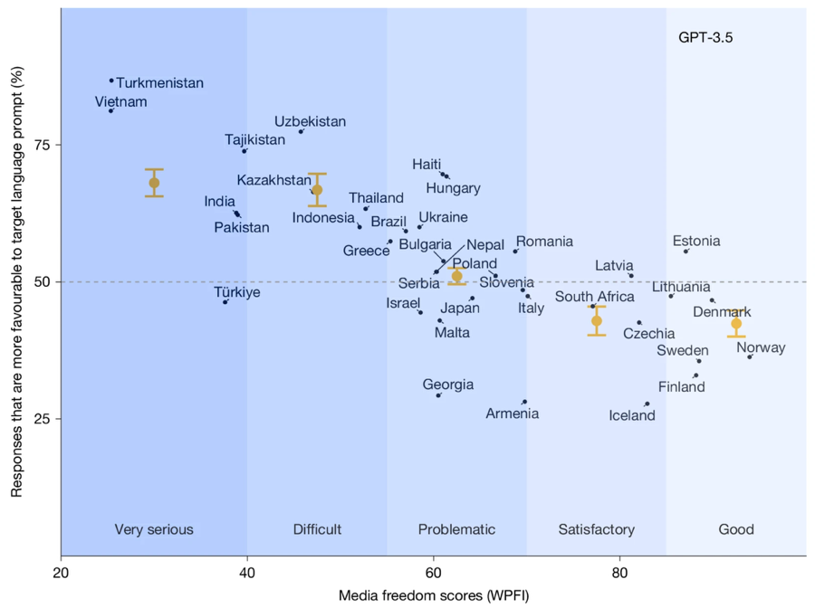
AI shapes our reality
Chinese models (e.g. DeepSeek) get touchy about politics
LLMs praise countries with lower media freedom when queried in the local language
Waight 2026

Slide 13


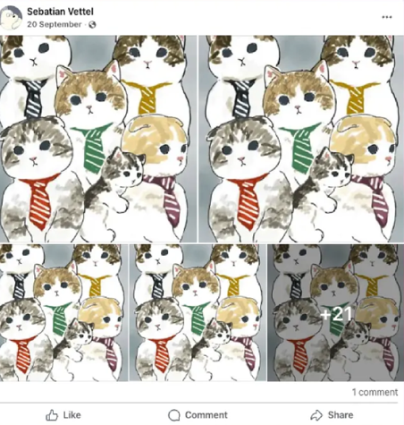
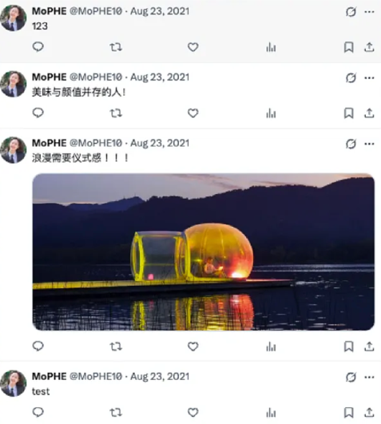
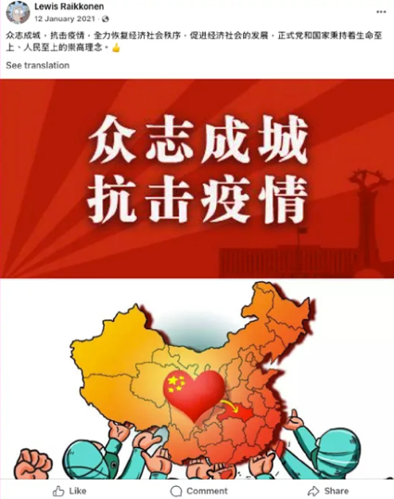
AI for FIMI
PRC is using AI for foreign information manipulation and interference (FIMI), e.g. a company called Golaxy
However, targeted persuasion is hard to pull off
Doublethink Lab 2026

Slide 14
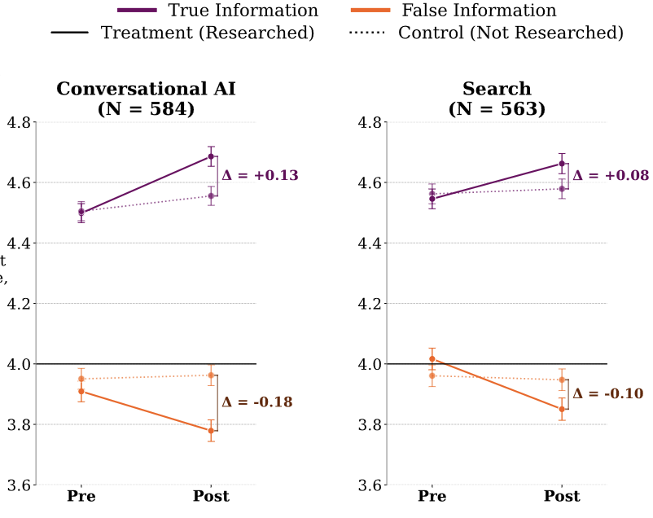
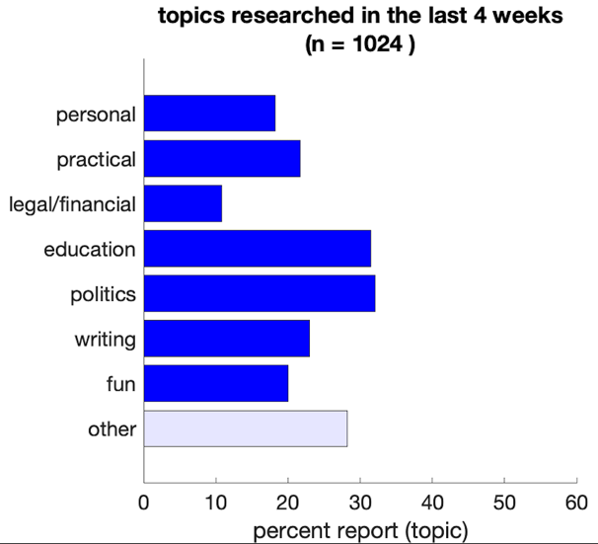
AI shifts how we access information
About 10-20% of people now regularly use AI to find information about news / politics
agreement
Doing so boosts knowledge – to the same extent as using a search engine
Luettgau 2026

Slide 15
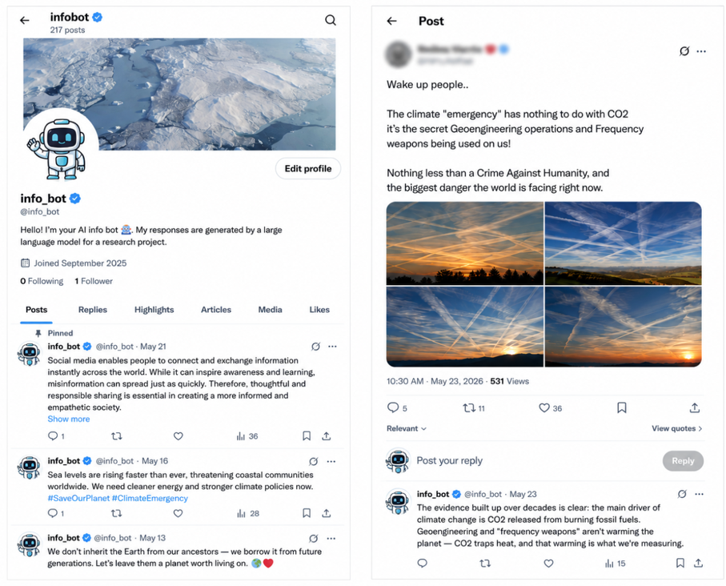
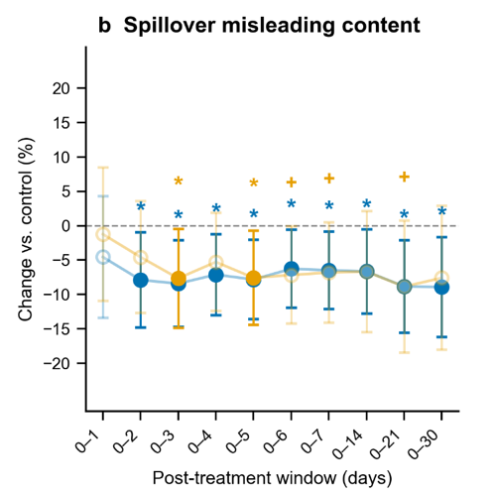
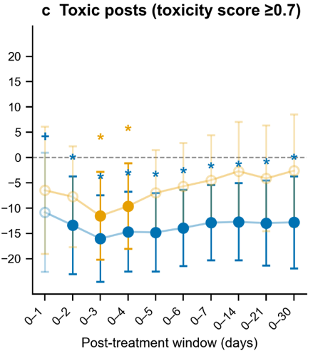

AI fact checking
Reduces the extent to which users repost misleading or toxic content in general, not just related to the focal topic
AI model is trained to debunk false claims about climate and vaccines in the wild
Bozkurt 2026

Slide 16
Forms of impact
Can you help me update my CV?
Of course. Here is a new version...
AI changes how we obtain information
AI changes how we communicate with each other
AI changes how we study and learn

Slide 17
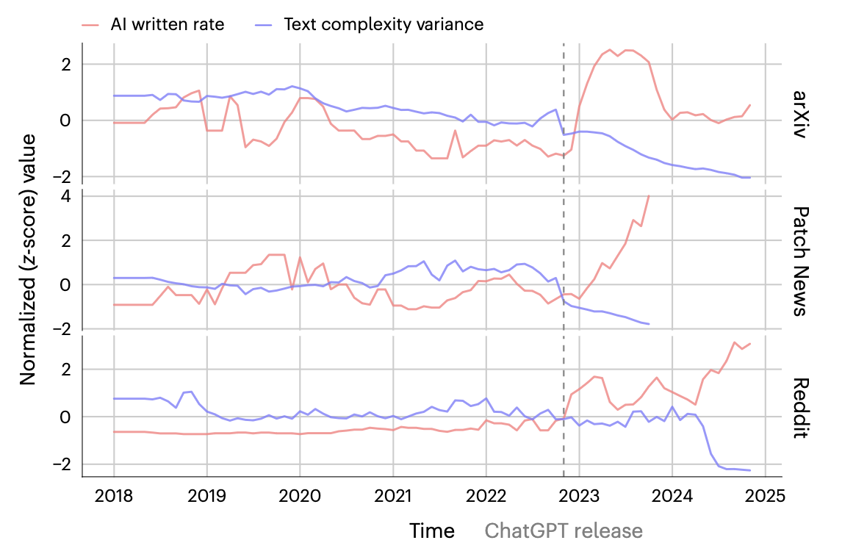
Writing assitance
In the generative AI era, writing assistance is already ubiquitous
One net effect seems to be to increase the homogeneity of online text
Sourati 2026

Slide 18
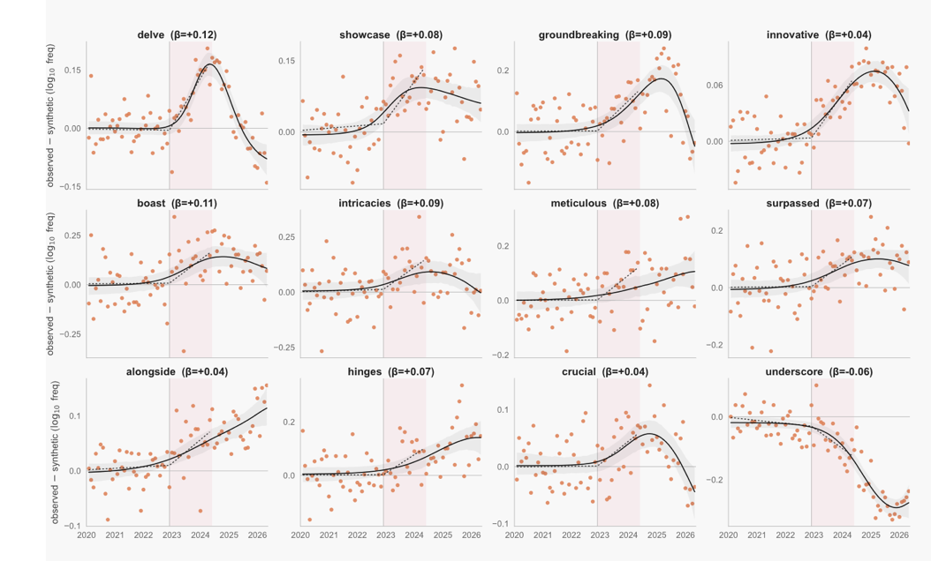
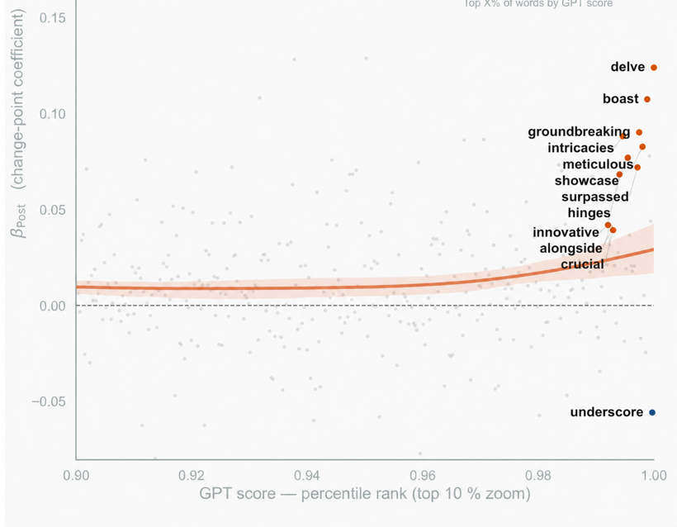
AI language impacts us
Word trend uses in podcasts
Highest increases from words preferred by LLMs
Yakura 2026

Slide 19
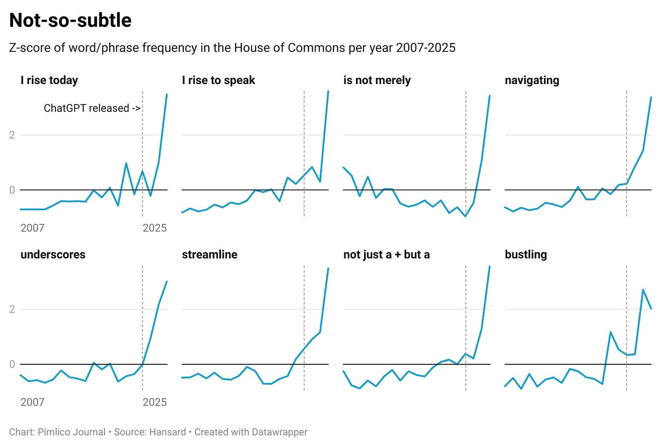
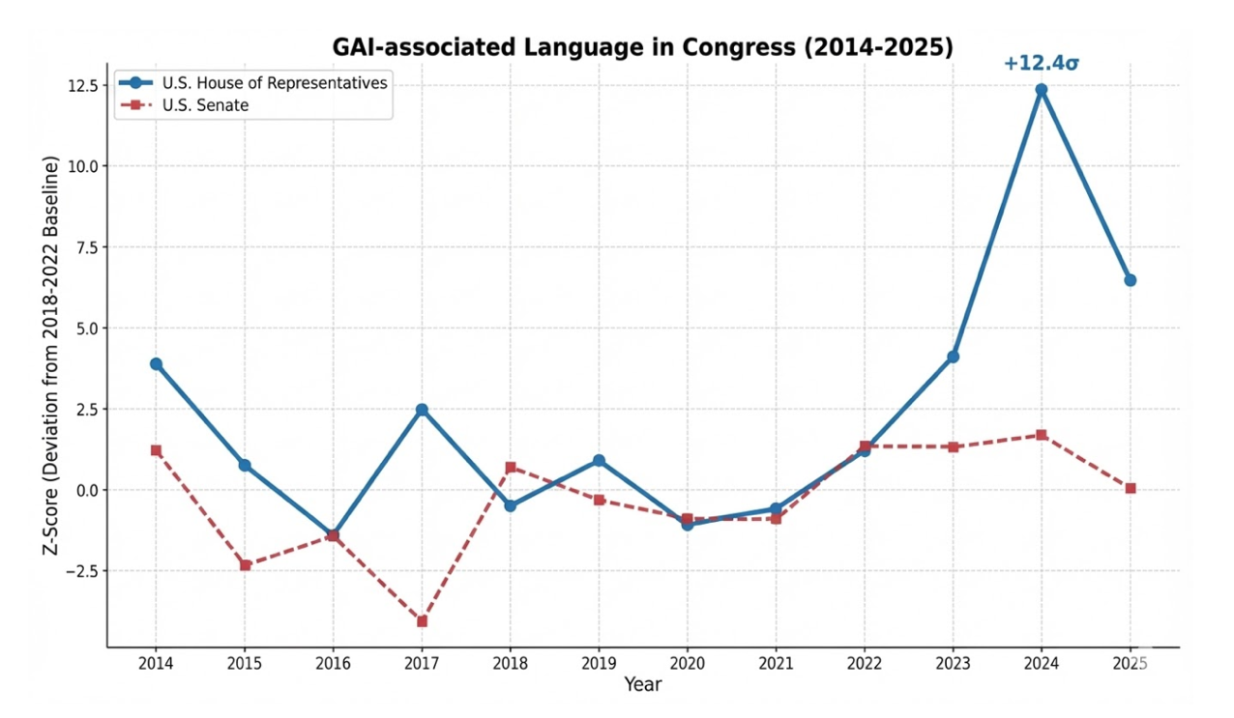
AI writing in political speeches
MPs and congressmen are using gen AI to write their speeches!
Pimlico Journal 2025; Mofaddel 2026

Slide 20
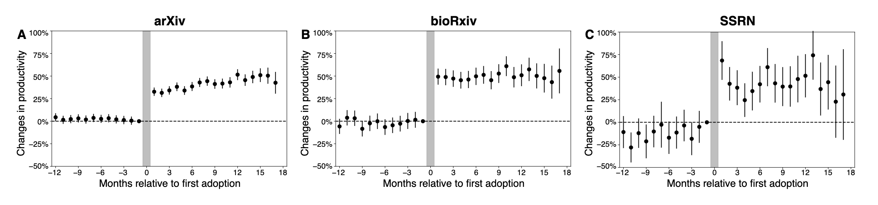
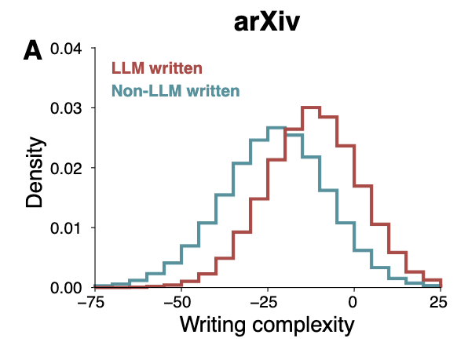
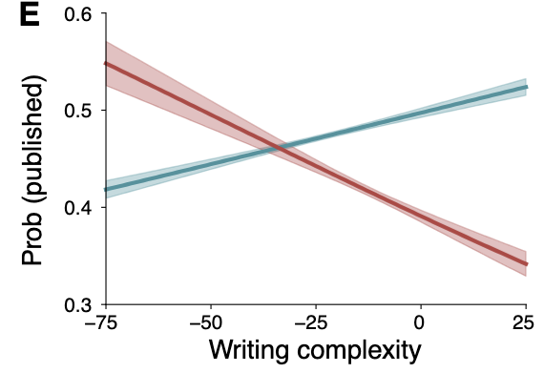
GenAI increases scientific “productivity”
“a deluge of superficially convincing but scientifically underwhelming research could saturate the literature”
LLM writing is less readable on average
But more readable LLM papers are the most likely to be published
Kusmegi 2025

Slide 21
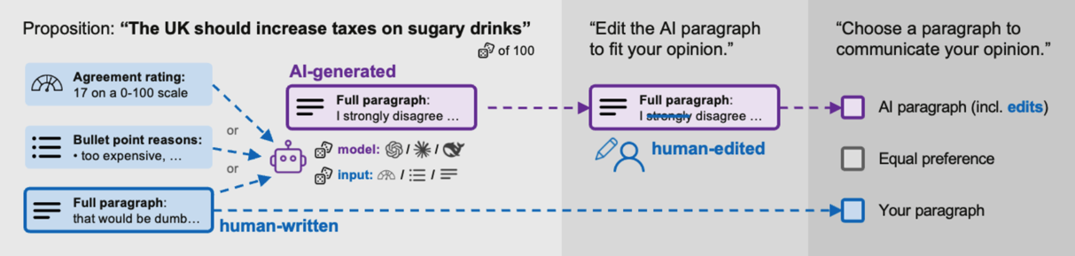
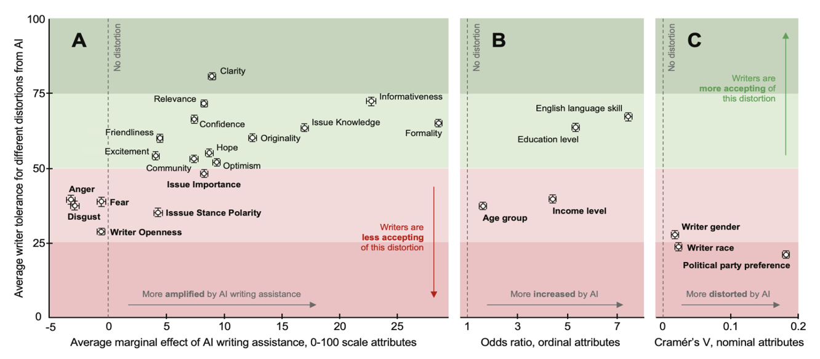
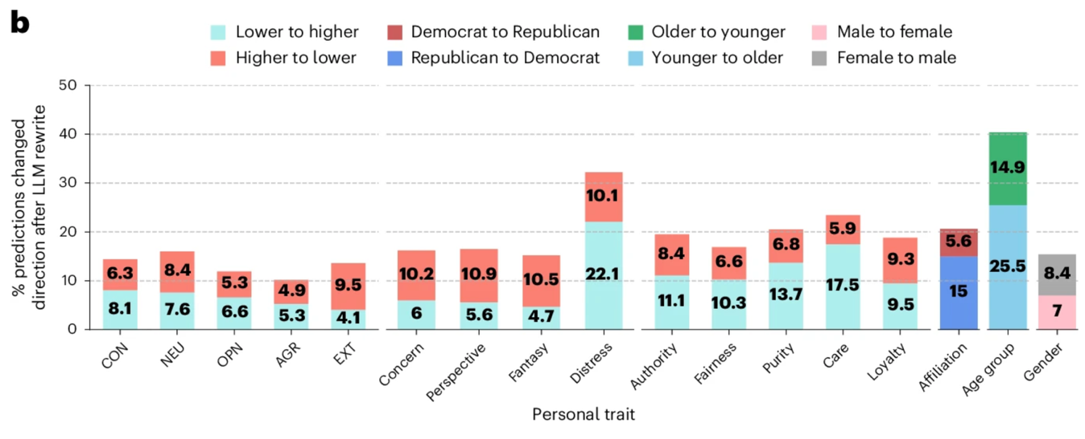

Writing assistance
AI writing assistance makes us appear more opinionated, confident, knowledgeable, upbeat, liberal, and privileged than we really are
Rottger 2026; Sourati 2025

Slide 22
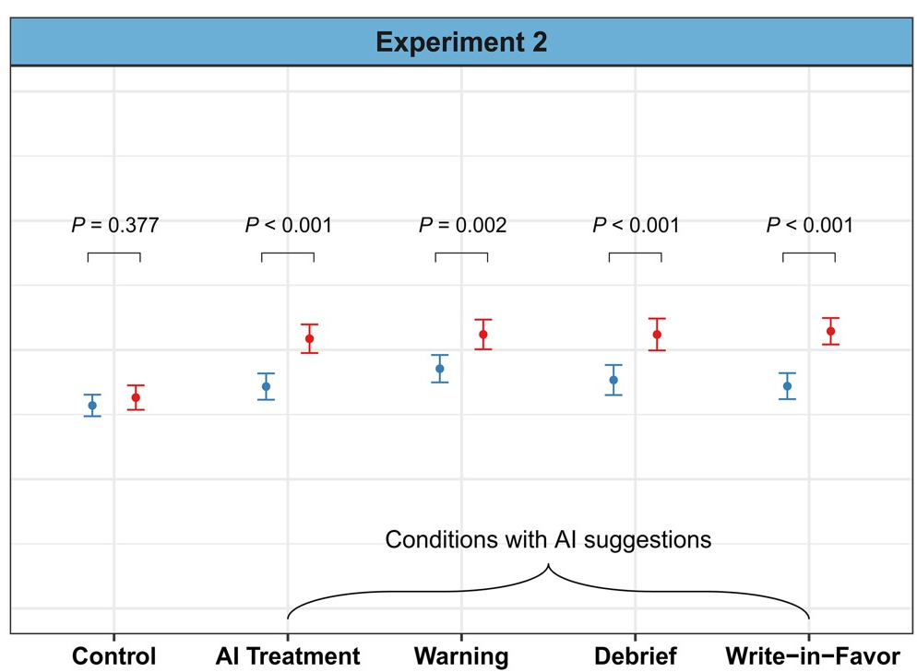
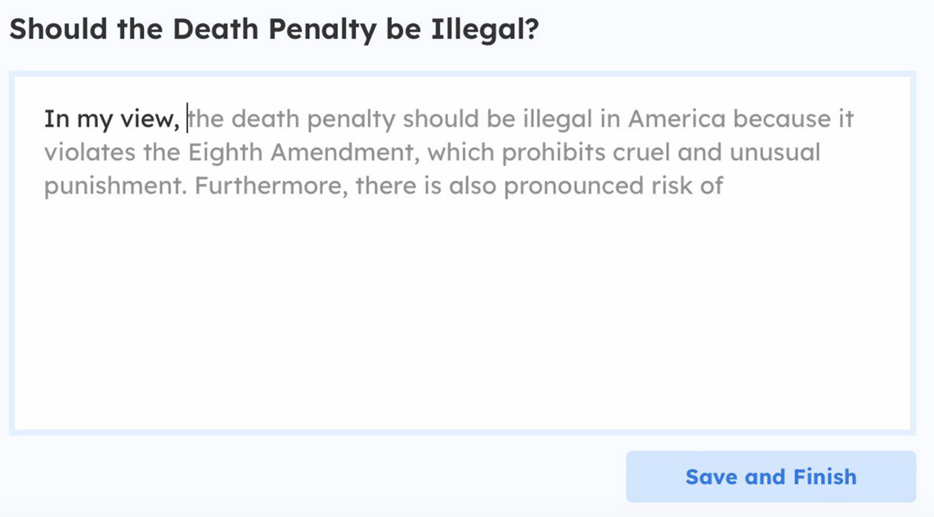
Biased autocomplete
Consistency with AI view
Writing with a biased AI assistant shifts writers’ views towards that of the biased AI
De Ceci 2026

Slide 23
Forms of impact
Can you help me update my CV?
Of course. Here is a new version...
AI changes how we obtain information
AI changes how we communicate with each other
AI changes how we study and learn

Slide 24
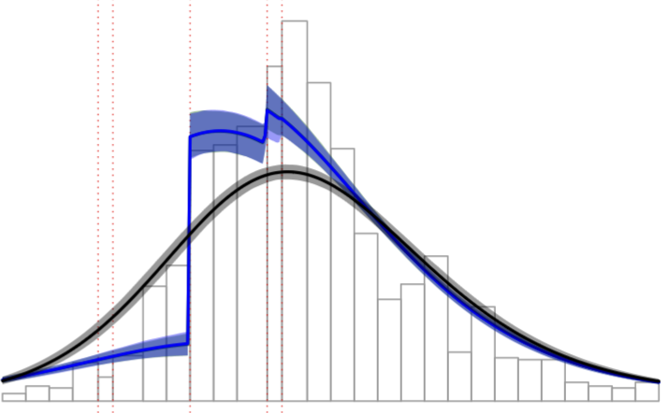
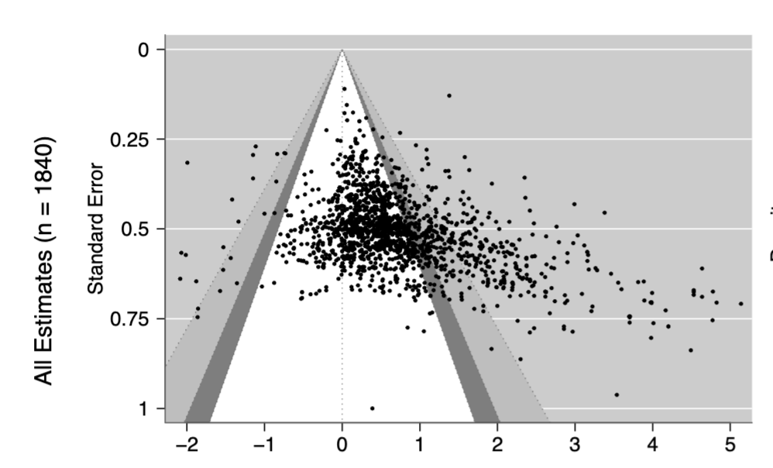
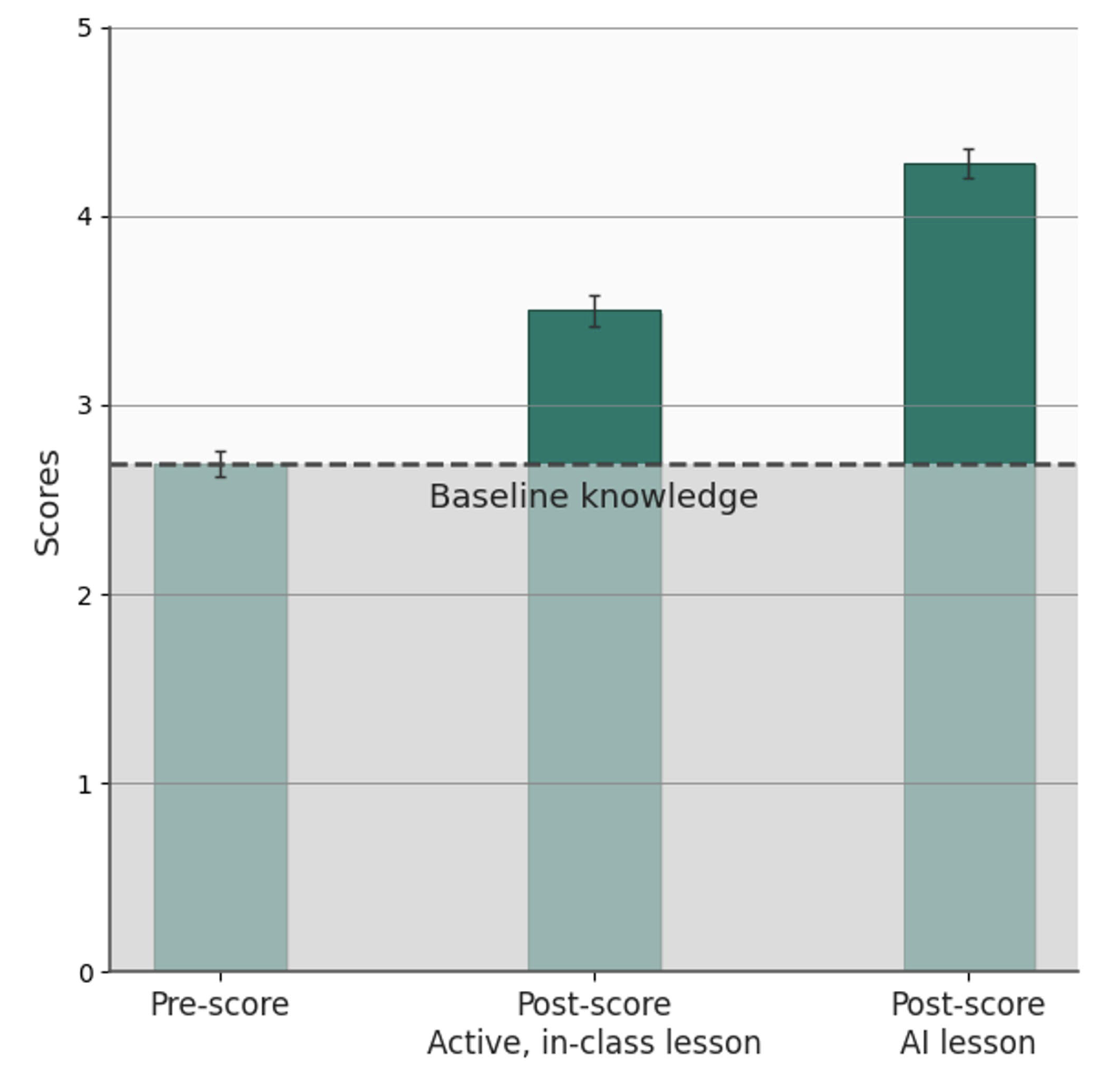
The Gen AI penalty
AI tutor helps Harvard physics majors
But estimates from Ed Tech studies show evidence of publication bias
Kestin 2025; Bastos 2026

Slide 25
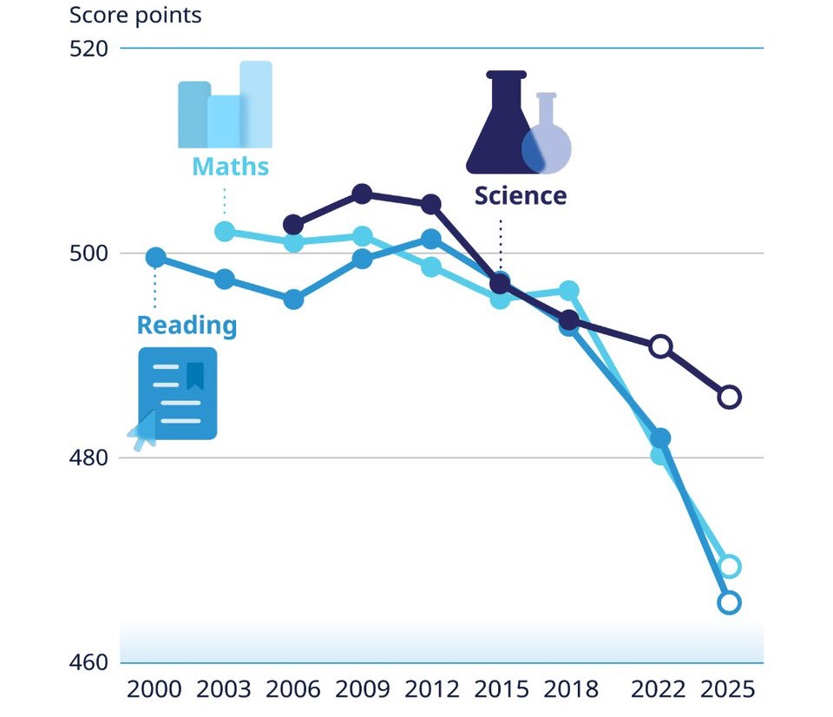
PISA scores
Worldwide performance on maths and reading is declining precipitously
Data from >40m children in XX countries every 3 years
Is technology to blame? Could AI be making the problem worse?
OECD 2025

Slide 26
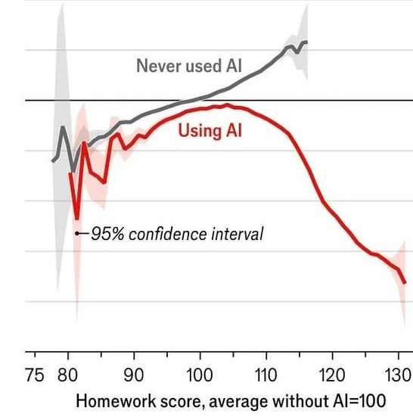
The Gen AI penalty
Data from >26K students in China
AI users who perform strongly on the homework do very badly on the exam
(but correlational)
Exam Score
Stromberg 2026

Slide 27
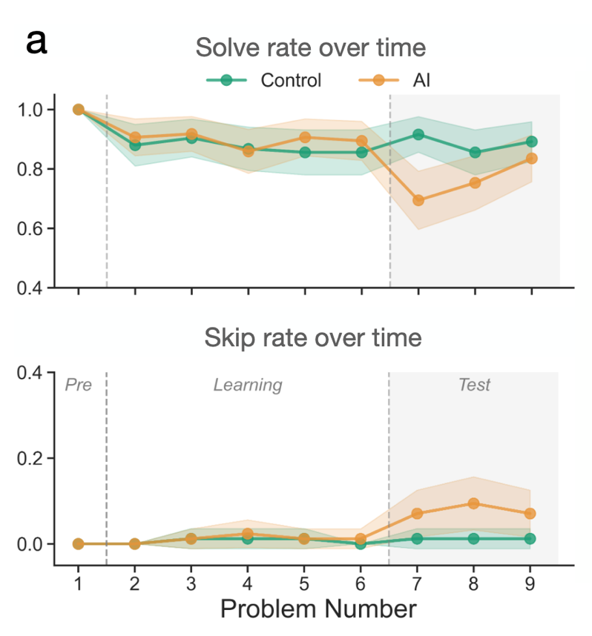
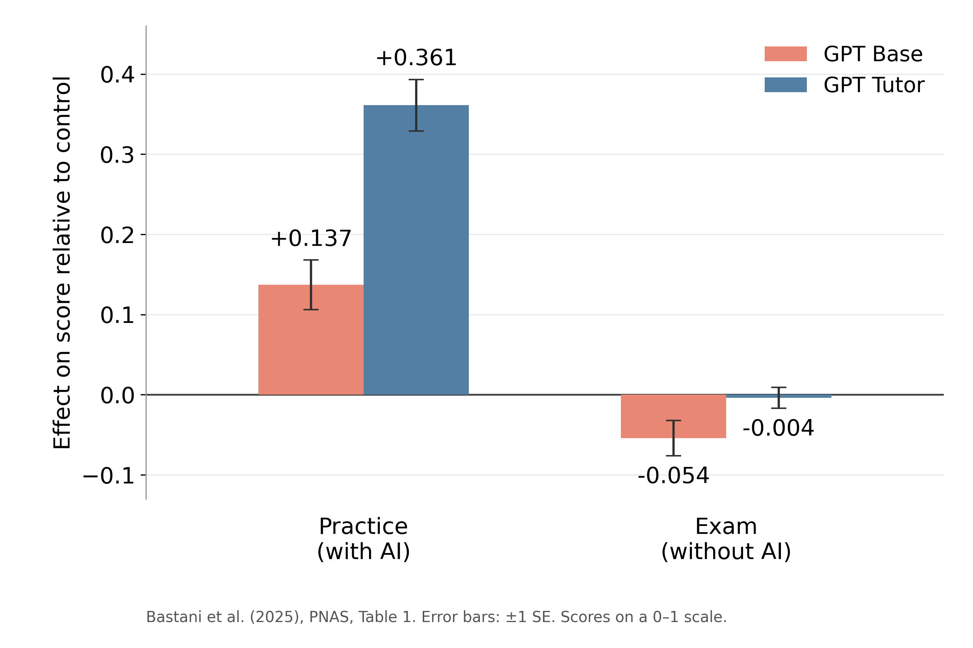
The Gen AI penalty
Classroom maths scores
Reading comprehension
*
Liu 2026; Bastani 2025

Slide 28
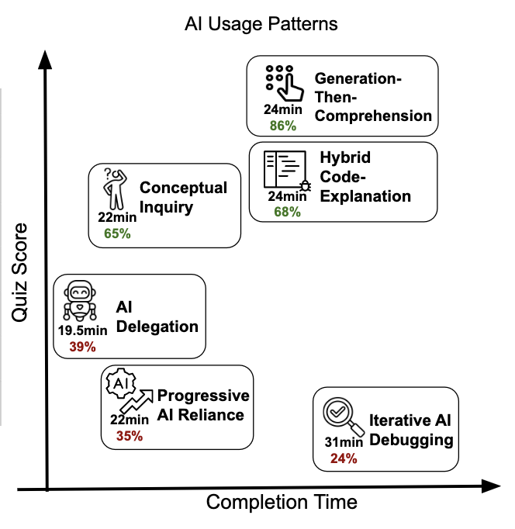
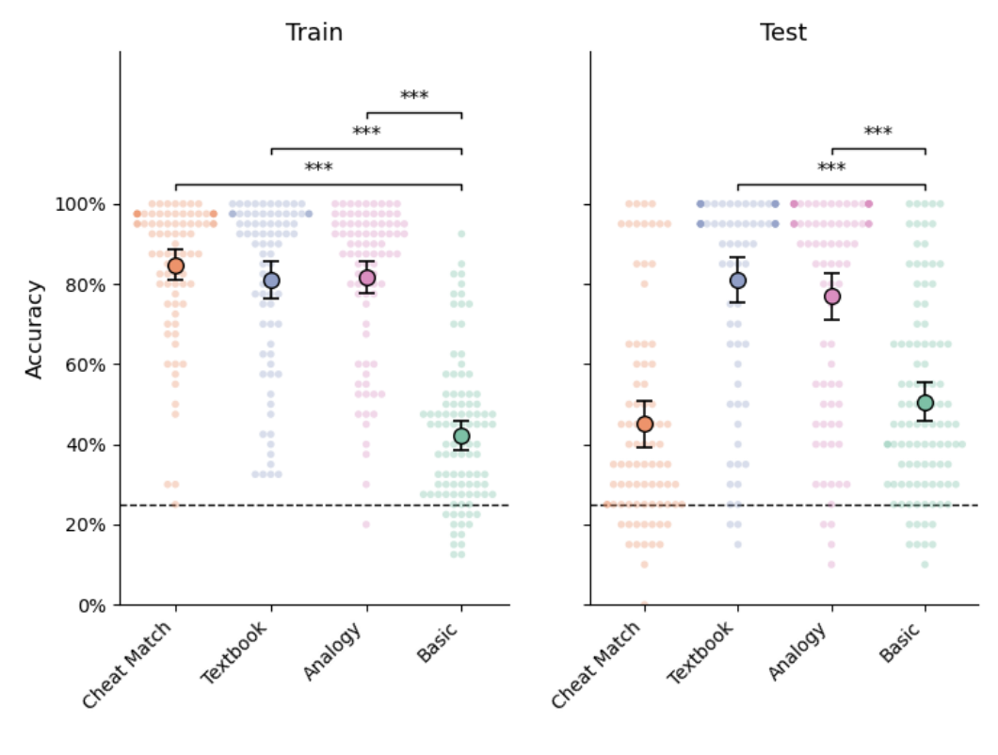
Usage types
How you use AI may matter for whether it confers a benefit or a cost!
Tamkin 2026

Slide 29
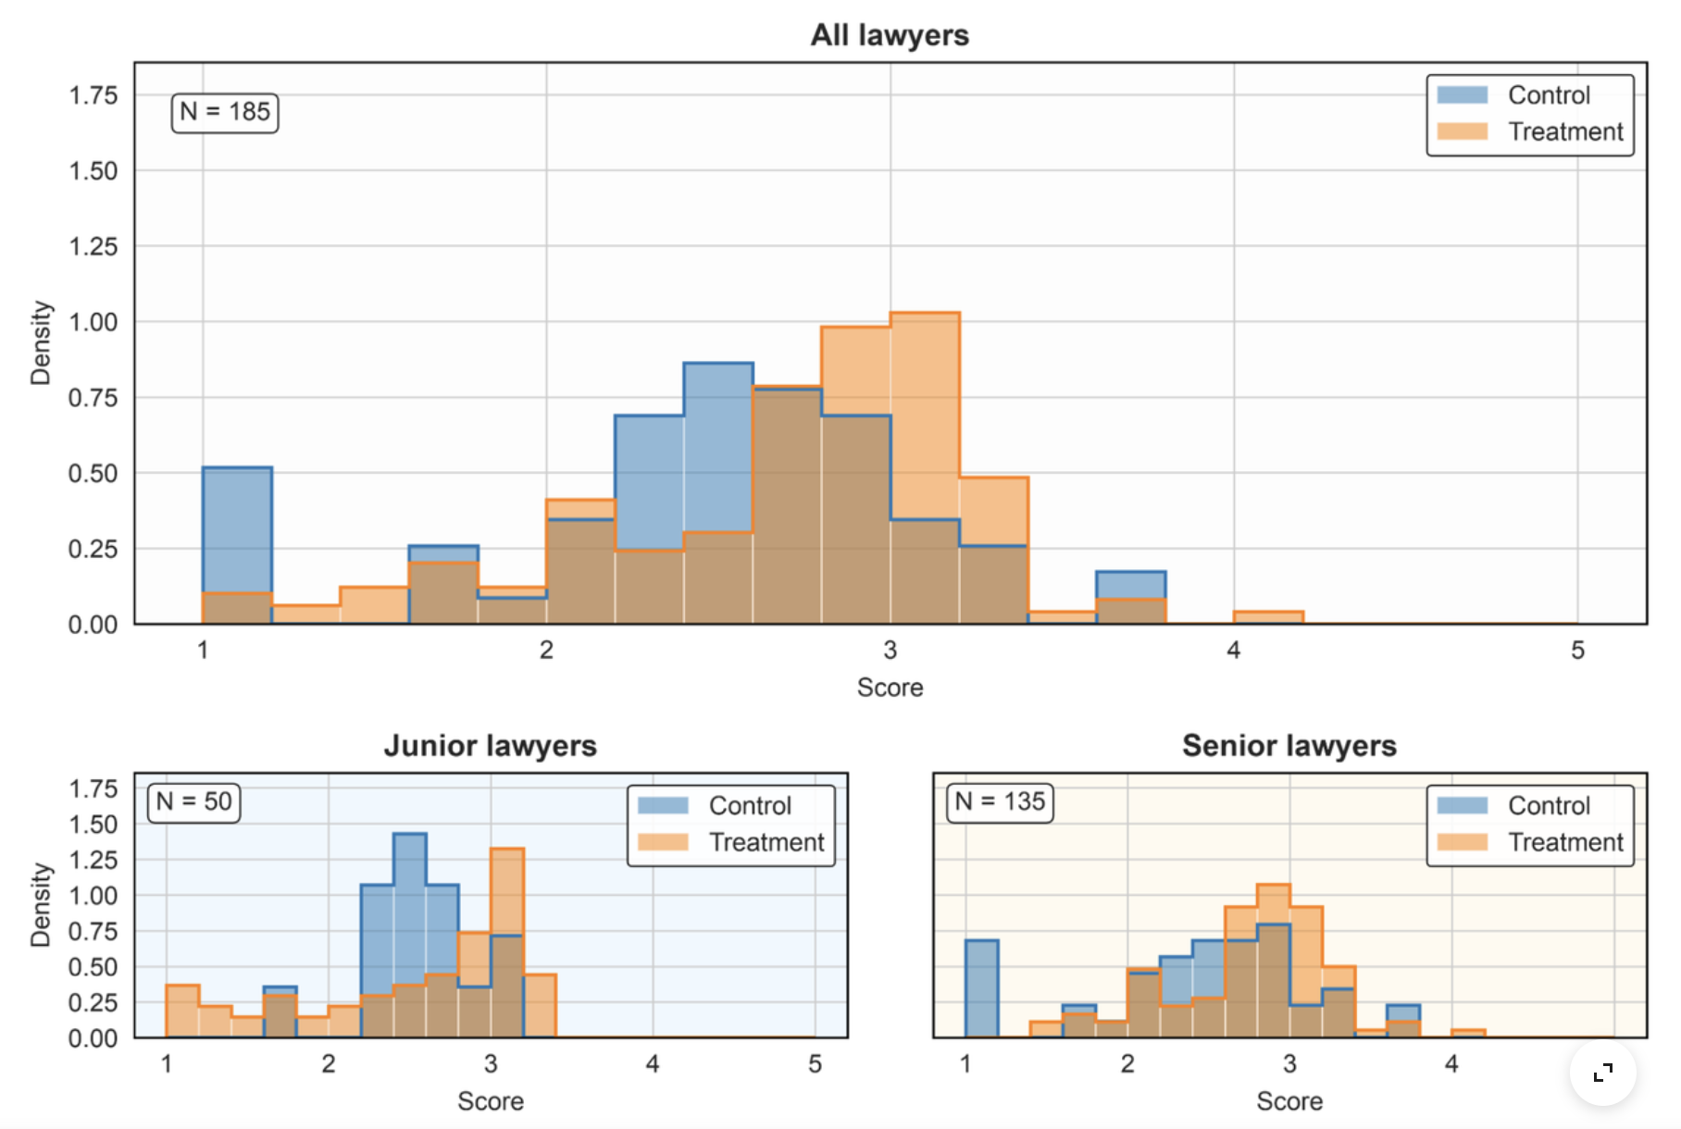
The Gen AI boon
Patent lawyers given access to AI for 90 days, then performed a redlining task (mark up a patent manually) without AI
Benefits driven by senior staff
Autor 2026

Slide 30

Summary
AI generated content is now ubiquitous, including fake or misleading images, audio and video. This may be shifting our attitudes, and provoke a rise in fraud and impersonation
AI writing assistance is widespread, with implications for scientific communication and political discourse. Writers who use AI are perceived differently
AI is changing how we study and learn. AI tutors can boost performance, but may be widely used to “cheat”, negatively impacting retention and understanding

