Slide 1
The empirical rule

Slide 2

Ever wanted to feel normal? Here’s your chance!

Slide 3
Demo: The empirical rule in Excel
Worksheet: empirical-rule.xlsx
Demo notes: demo-notes.pdf
Prerequisites
Absolute and relative references
Conditional logic
Descriptive statistics (central tendency, variability)
Normal distribution as “bell curve” (histogram)

Slide 4
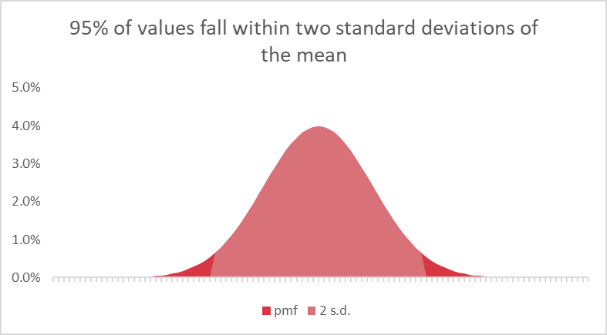
What does it matter?
Very common real-world distribution (heights.xlsx dataset)
We may not know a population’s “true value,” but we will roughly know what its distribution looks like

Slide 5
Questions about the empirical rule?

