Slide 1


First steps with Power Apps for Excel users

Slide 2

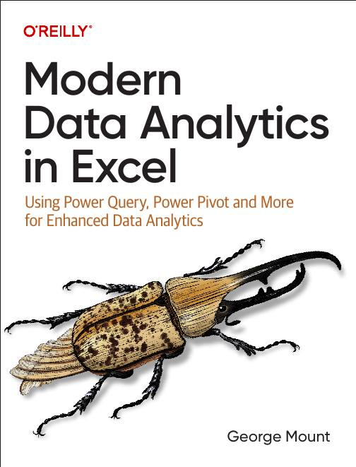



Hi, I’m George

Slide 3

Objectives for this session
Create a Power App using Excel as a data source
Customize Power App interface for better user experience
Deploy and share your Power App within an organization

Slide 4
Creating a Power App from Excel
Upload Excel table to Power Apps
Create basic three-screen app
Add and edit records
Preview app in development
File: first-power-app.xlsx
Notes:
False!
Function, Formula, Function
Argument

Slide 5
Modifying your Power App
Continuing with our example:
Adding required fields
Creating data validation dropdowns
Creating data validation on date ranges
Notes:
False!
Function, Formula, Function
Argument

Slide 6
Deploying your Power App
Continuing with our example:
Preparing Excel workbook for external use
Migrating our app from development to production via ZIP folder
Notes:
False!
Function, Formula, Function
Argument

Slide 7
Creating a Power App with images
File: power-apps-challenge.xlsx
Turn this into an app with photos!
Use image URLs to populate values
Notes:
False!
Function, Formula, Function
Argument

Slide 8
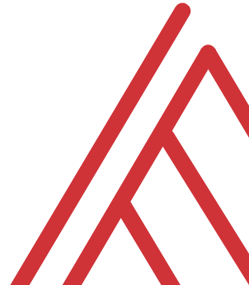
Questions?

Slide 9
Thank you

