Slide 1


Power Automate for Excel: Getting Started

Slide 2
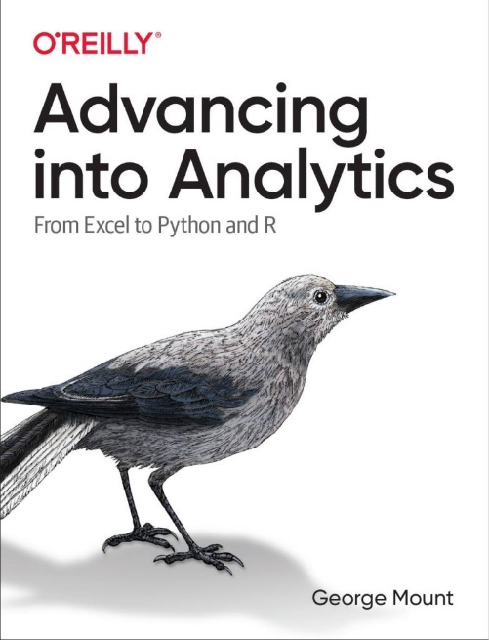
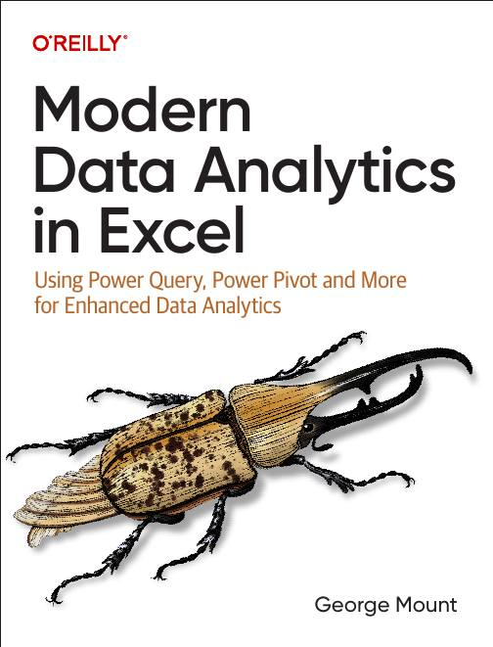



Hi, I’m George

Slide 3

Objectives for this session
Understand how Power Automate enhances Excel tasks and automation capabilities
Build, customize, and troubleshoot Power Automate workflows for Excel
Automate repetitive tasks, integrate conditional logic, and extract data into Excel
Gain insights into Power Automate's role within the Power Platform for further professional growth

Slide 4
Power Automate availability
Power Apps Developer Plan: https://www.microsoft.com/en-us/power-platform/products/power-apps/free
Office Scripts: Please see https://learn.microsoft.com/en-us/office/dev/scripts/testing/platform-limits?tabs=business

Slide 5
1. First Steps with Power Automate

Slide 6
First flow with Power Automate
Use Power Automate templates for Excel
Create clock in/clock out workflow
File: first-flow.xlsx
Notes:
False!
Function, Formula, Function
Argument

Slide 7
Customizing outputs with Power Fx
Continue with the previous example
How can we improve appearance of outputs in Excel?
Resource: https://stringfestanalytics.com/power-automate-for-excel-how-to-understand-the-power-fx-programming-language/
Notes:
False!
Function, Formula, Function
Argument

Slide 8
Building flows with Copilot
Get AI assistance to build a flow
Create a monthly email/post to Teams based on data in a workbook
File: power-automate-copilot.xlsx
Resource: https://stringfestanalytics.com/power-automate-for-excel-how-to-build-flows-with-copilot/
Notes:
False!
Function, Formula, Function
Argument

Slide 9
Exercises
Build on the clock in/clock out workflow
Task: Modify the flow to prompt users for comments when clocking in or out
Add the comment prompt where the in/out criteria is built with a yes/no checkbox
Save the clock in/out data, including comments, to the worksheet
Post an update to Teams with details (who clocked in/out, time, and comments)
File: first-steps-exercises.xlsx
Notes:
False!
Function, Formula, Function
Argument

Slide 10
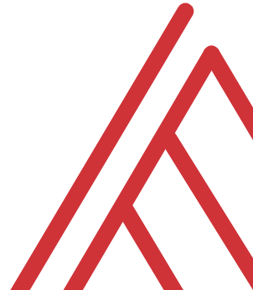
Questions?

Slide 11
2. Building and managing Excel-related flows

Slide 12
Automating Excel entry with Power Automate
Add summary of all incoming manager’s emails into a workbook
File: automate-excel-entry.xlsx
Resource: https://stringfestanalytics.com/how-to-track-incoming-emails-in-excel-with-power-automate/
Notes:
False!
Function, Formula, Function
Argument

Slide 13
Creating conditional flows
Create emails only when project is delayed
Test flow and put on schedule
File: conditional-logic.xlsx
Resource: https://stringfestanalytics.com/power-automate-for-excel-how-to-understand-conditional-flows/
Notes:
False!
Function, Formula, Function
Argument

Slide 14
Office Scripts + Power Automate, part 1
Run a TOC updater script on schedule
Files: power-automate-office-scripts.xlsx, add-toc.txt
Resource: https://stringfestanalytics.com/how-to-get-started-with-power-automate-for-excel/
Notes:
False!
Function, Formula, Function
Argument

Slide 15
Office Scripts + Power Automate, part 2
How can we apply the same script to multiple workbooks?
Use conditional logic to validate filetype
Folder: multiple-workbooks
Resource: https://stringfestanalytics.com/how-to-run-an-office-script-on-all-excel-workbooks-in-a-folder-with-power-automate/
Notes:
False!
Function, Formula, Function
Argument

Slide 16
Exercises
Folder: 02-challenge
Task: Create a log in file-log.xlsx every time a workbook is uploaded to incoming-files folder
Trigger: When a file is created (properties only)
Use conditional logic for file type
Consider using Power Fx to format upload date
Notes:
False!
Function, Formula, Function
Argument

Slide 17
3. Advanced Flow Configuration

Slide 18
Creating an expense approval process
Create and track expense approval process using Forms, Excel and Power Automate
File: expense-approval.xlsx
Resource: https://stringfestanalytics.com/power-automate-for-excel-how-to-create-an-approval-process-with-microsoft-forms/
Notes:
False!
Function, Formula, Function
Argument

Slide 19
Retrieving data from external sources
How can we check and collect data from outside sources, e.g. RSS feeds?
Power Automate vs Power Query for data collection
Fils: get-rss.xlsx, bbc-rss.txt
Resource: https://stringfestanalytics.com/power-automate-for-excel-how-to-work-with-rss-feeds/
Notes:
False!
Function, Formula, Function
Argument

Slide 20
Exercises
Create a customer feedback review process
Start with: “When a new response is submitted > Get response details”
Add a conditional operation: if the "Overall Experience" score is 4 stars and up, email the recipient thanking them for their business. If it's less, email the recipient apologizing and also send an email notification to a manager.
Use Power Automate to convert feedback score to text with INT() function
Feel free to use Copilot for help!
Notes:
False!
Function, Formula, Function
Argument

Slide 21
Questions?

Slide 22
Thank you

