Slide 1


Becoming a Citizen Developer with the Power Platform

Slide 2
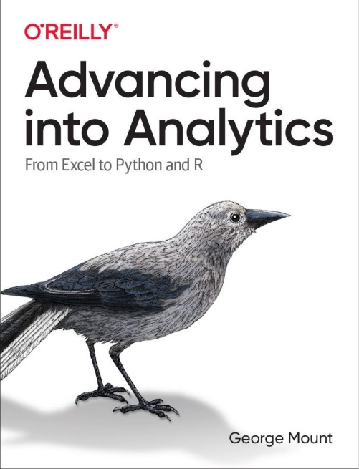
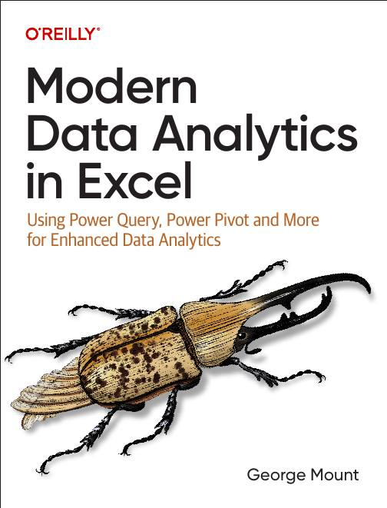



Hi, I’m George

Slide 3

Objectives for this course
Understand how Excel connects with Power Automate, Power Apps, Power BI, and Copilot Studio to create end-to-end workflows
Build trigger-based flows to automate common Excel tasks and send real-time notifications through Teams or Outlook
Create low-code dashboards and apps that update automatically and streamline reporting
Use Copilot Studio and Power Fx to add natural language automation and chatbot capabilities

Slide 4
Resources
Download at https://github.com/stringfestdata/gxls-power-platform/archive/refs/heads/main.zip

Slide 5
Automating tasks with Power Automate

Slide 6
First steps with Power Automate

Slide 7
First flow with Power Automate
Use Power Automate templates for Excel
Create clock in/clock out workflow
File: first-flow.xlsx
Notes:
False!
Function, Formula, Function
Argument

Slide 8
Customizing outputs with Power Fx
Continue with the previous example
How can we improve appearance of outputs in Excel?
Resource: https://stringfestanalytics.com/power-automate-for-excel-how-to-understand-the-power-fx-programming-language/
Notes:
False!
Function, Formula, Function
Argument

Slide 9
Building flows with Copilot
Get AI assistance to build a flow
Create a monthly email/post to Teams based on data in a workbook
File: power-automate-copilot.xlsx
Resource: https://stringfestanalytics.com/power-automate-for-excel-how-to-build-flows-with-copilot/
Notes:
False!
Function, Formula, Function
Argument

Slide 10
Exercises
Build on the clock in/clock out workflow
Task: Modify the flow to prompt users for comments when clocking in or out
Add the comment prompt where the in/out criteria is built with a yes/no checkbox
Save the clock in/out data, including comments, to the worksheet
Post an update to Teams with details (who clocked in/out, time, and comments)
File: first-steps-exercises.xlsx
Notes:
False!
Function, Formula, Function
Argument

Slide 11
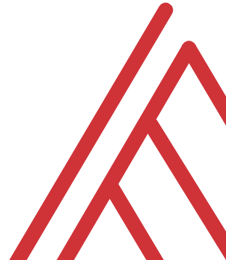
Questions?

Slide 12
Building and managing Excel-related flows

Slide 13
Automating Excel entry with Power Automate
Add summary of all incoming manager’s emails into a workbook
File: automate-excel-entry.xlsx
Resource: https://stringfestanalytics.com/how-to-track-incoming-emails-in-excel-with-power-automate/
Notes:
False!
Function, Formula, Function
Argument

Slide 14
Creating conditional flows
Create emails only when project is delayed
Test flow and put on schedule
File: conditional-logic.xlsx
Resource: https://stringfestanalytics.com/power-automate-for-excel-how-to-understand-conditional-flows/
Notes:
False!
Function, Formula, Function
Argument

Slide 15
Office Scripts + Power Automate, part 1
Run a TOC updater script on schedule
Files: power-automate-office-scripts.xlsx, add-toc.txt
Resource: https://stringfestanalytics.com/how-to-get-started-with-power-automate-for-excel/
Notes:
False!
Function, Formula, Function
Argument

Slide 16
Office Scripts + Power Automate, part 2
How can we apply the same script to multiple workbooks?
Use conditional logic to validate filetype
Folder: multiple-workbooks
Resource: https://stringfestanalytics.com/how-to-run-an-office-script-on-all-excel-workbooks-in-a-folder-with-power-automate/
Notes:
False!
Function, Formula, Function
Argument

Slide 17
Exercises
Folder: pa-challenge
Task: Create a log in file-log.xlsx every time a workbook is uploaded to incoming-files folder
Trigger: When a file is created (properties only)
Use conditional logic for file type
Consider using Power Fx to format upload date
Notes:
False!
Function, Formula, Function
Argument

Slide 18
Advanced Flow Configuration

Slide 19
Creating an expense approval process
Create and track expense approval process using Forms, Excel and Power Automate
File: expense-approval.xlsx
Resource: https://stringfestanalytics.com/power-automate-for-excel-how-to-create-an-approval-process-with-microsoft-forms/
Notes:
False!
Function, Formula, Function
Argument

Slide 20
Retrieving data from external sources
How can we check and collect data from outside sources, e.g. RSS feeds?
Power Automate vs Power Query for data collection
Fils: get-rss.xlsx, bbc-rss.txt
Resource: https://stringfestanalytics.com/power-automate-for-excel-how-to-work-with-rss-feeds/
Notes:
False!
Function, Formula, Function
Argument

Slide 21
Exercises
Create a customer feedback review process
Start with: “When a new response is submitted > Get response details”
Add a conditional operation: if the "Overall Experience" score is 4 stars and up, email the recipient thanking them for their business. If it's less, email the recipient apologizing and also send an email notification to a manager.
Use Power Automate to convert feedback score to text with INT() function
Feel free to use Copilot for help!
Notes:
False!
Function, Formula, Function
Argument

Slide 22
Questions?

Slide 23
Building interactive dashboards with Power BI

Slide 24
Loading, profiling and transforming data
Using Power Query in Power BI:
Read in workbook data
Profile, explore and transform the data via
Folder: 1-load-worksheet-to-power-bi
Notes:
False!
Function, Formula, Function
Argument

Slide 25
Load Excel data model to Power BI
Port a Power Pivot data model into Power BI
Strengths, weaknesses, limitations
Folder: 2-load-data-model-to-power-bi
Notes:
False!
Function, Formula, Function
Argument

Slide 26
Creating interactive dashboards and reports
Continue with penguins dataset
Creating interactive reports with Power BI
Slicers/Timelines
Cross filter functionality
Additional plot functionality vs Excel
Folder: 3-creating-interactive-visuals
Notes:
False!
Function, Formula, Function
Argument

Slide 27
Exercises
For all data since 1970:
Create stolen base percentage measure: SUM(SB) / (SUM(SB) + SUM(SC))
Compare SBP over time by league
Compare relationship between runs (R) and wins (W)
Add a timeline-based slicer to the report
Folder: 4-power-bi-challenge
Notes:
False!
Function, Formula, Function
Argument

Slide 28
Questions?

Slide 29
Designing simple business apps with Power Apps

Slide 30
Creating a Power App from Excel
Upload Excel table to Power Apps
Create basic three-screen app
Add and edit records
Preview app in development
File: first-power-app.xlsx
Notes:
False!
Function, Formula, Function
Argument

Slide 31
Modifying your Power App
Continuing with our example:
Adding required fields
Creating data validation dropdowns
Creating data validation on date ranges
Notes:
False!
Function, Formula, Function
Argument

Slide 32
Deploying your Power App
Continuing with our example:
Preparing Excel workbook for external use
Migrating our app from development to production via ZIP folder
Notes:
False!
Function, Formula, Function
Argument

Slide 33
Creating a Power App with images
Folder: power-apps-challenge
Turn this into an app with photos!
Use image URLs to populate values
Notes:
False!
Function, Formula, Function
Argument

Slide 34
Questions?

Slide 35
Creating chatbots with Copilot Studio

Slide 36
Creating an Excel MVP chatbot
Create a custom Copilot agent in Copilot Studio tailored for specific Excel-related use cases
Add and manage trusted knowledge sources (like MVP websites) to ensure high-quality, domain-specific responses
Test and publish the agent with simple topics added
File: mvp-knowledge-base-instructions.docx
Notes:
False!
Function, Formula, Function
Argument

Slide 37
Exercise: Create an Excel keyboard shortcut chatbot for Teams
Create a chatbot that helps users find Excel keyboard shortcuts, using only the provided “Excel keyboard shortcuts” cheat sheet as its knowledge base
Edit the “goodbye” topic to replace the default response (“okay, goodbye”) with a more engaging sign-off like “Keep on excelling,” then save and test
Publish the chatbot and launch it in Microsoft Teams to see it running inside an external app
Folder: copilot-studio-exercise
Notes:
False!
Function, Formula, Function
Argument

Slide 38
Questions?

Slide 39
THANK YOU

