Slide 2
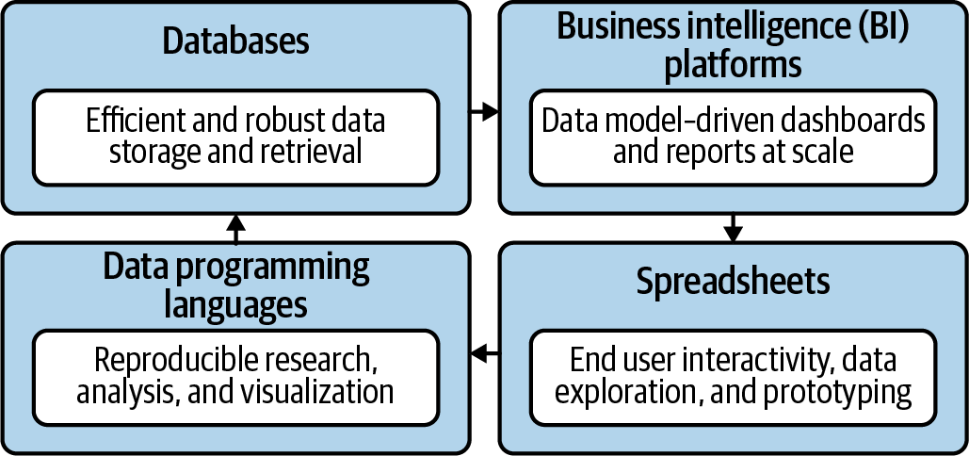
What is the data analytics stack (without Python)?
Mount, George. Advancing into Analytics: From Excel to Python and R. O’Reilly Media, 2021

Slide 3
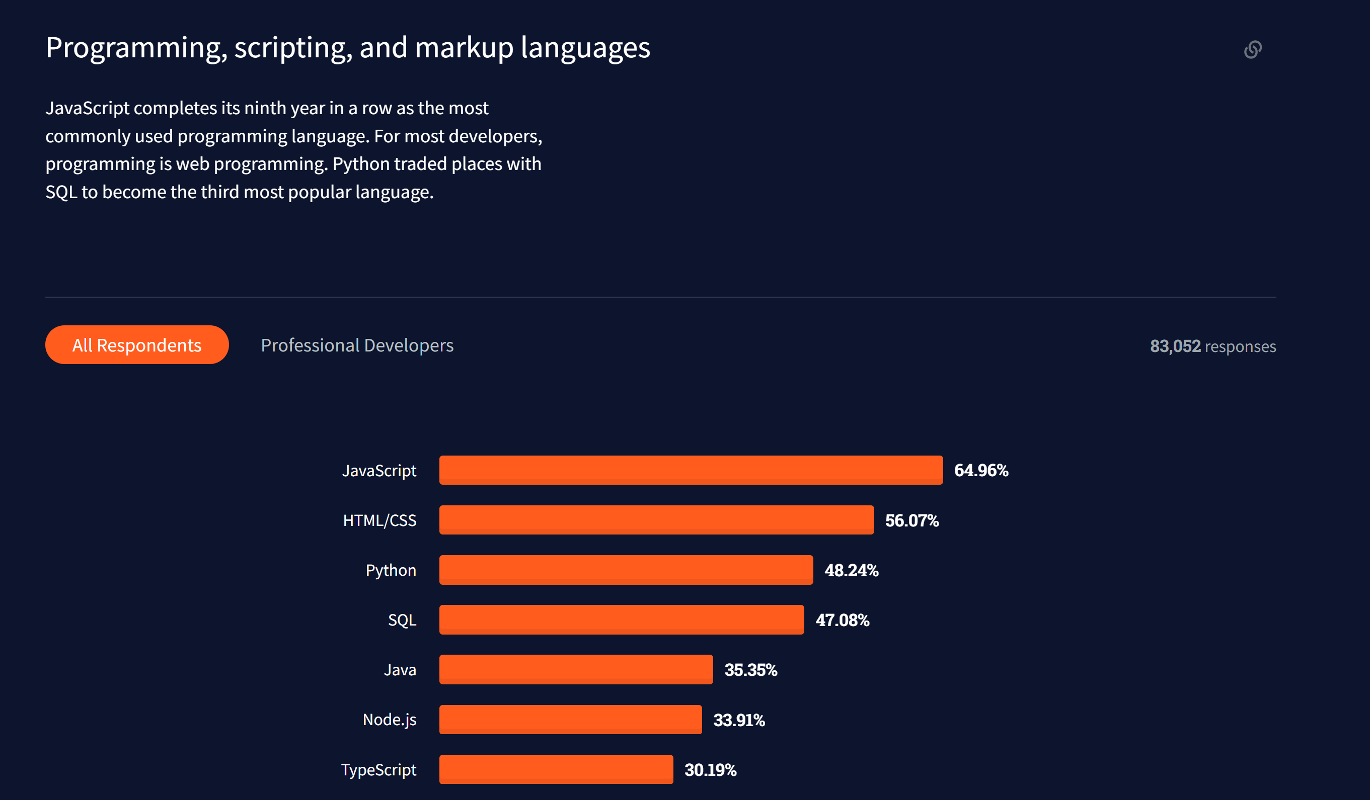
Python… the glue that binds
https://insights.stackoverflow.com/survey/2021#most-popular-technologies-language

Slide 4
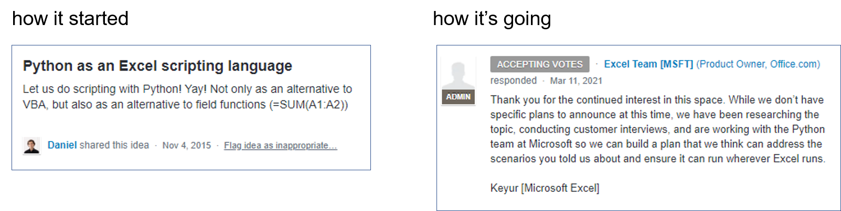
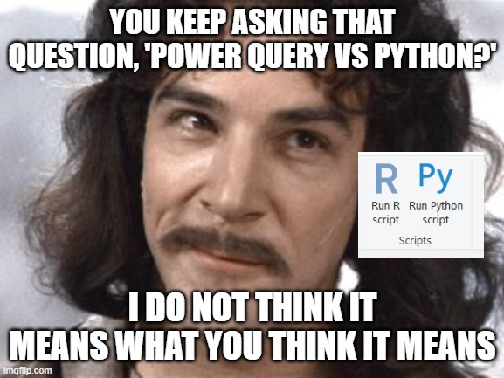
Insert Python here

Slide 5
The full stack analyst

Slide 6
Coding agenda
Read data in from a database
Manipulate and visualize the data
Send the data to Excel

Slide 7
Questions?

Slide 8
Conclusion
Python is the glue that binds analytics tools
Reproducible, readable data analysis
Infinite customization
The marginal cost to learn exceeds the marginal benefit!

