Slide 1
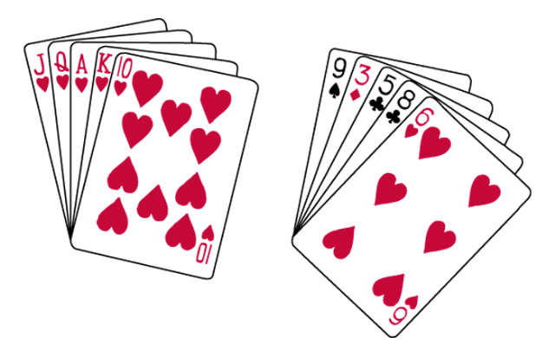
Order in Random Events
Given random data, we look for order and meaningful patterns.
Are your chances better for getting dealt hand
A or B?
A
B
Your chances of being dealt either of these hands is precisely the same: 1 in 2,598,960.

Slide 2
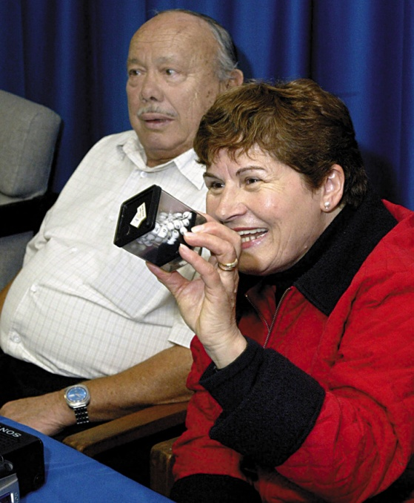
Order in Random Events
Given large numbers of random outcomes, a few are likely to express order.
Angelo and Maria Gallina won two California lottery games on the same day.
Notes:
OBJECTIVE 11| Explain the human tendency to perceive order in random events.

Slide 3
Extraordinary events may have chance related explanations.
A one in a million miracle happens 295 times a day in America
You hear strange things, like dreaming about the death of a person and then getting a phone call about the death of that person.
Suppose 10 people you know die a year
1 year contains 105,120 five minute intervals during which you might think about 1 of those 10 people
Yet there are 295 million Americans that makes it 1/10,512 x 295,000,000 = 28,063 or about 77 a day if a few make news this confirms our belief

Slide 4
It is human nature to find order/patterns
Superstitions
Water causes cramps
Getting cold makes someone sick
Weather changes cause arthritis pain

Slide 5
Think of a confounding variable
+ Correlation btw. Men with nice cars and wealth.
Conclusion: having a nice car makes you wealthy
+ Correlation btw. wearing bifocals and cancer.
Conclusion: wearing bifocals may lead to cancer
- Correlation btw. hours spent at the tutoring center and scores on college exams.
Conclusion: Studying is bad for exam scores
-Correlation btw. Length of marriage and cancer in men.
Conclusion: Woman cause cancer.

Slide 6
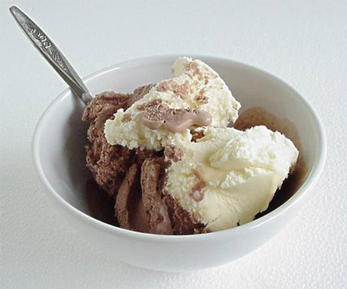
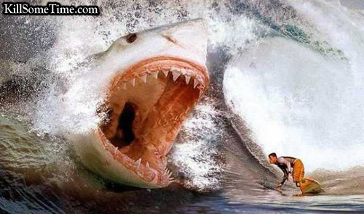
Correlational Research
Detects relationships between variables.
Does NOT say that one variable causes another.
Can be use to predict
There is a positive correlation between ice cream and shark attacks. Does that mean that ice cream causes shark attacks?

Slide 7

Measured using a correlation coefficient.
A statistical measure of the extent to which two factors relate to one another

Slide 8
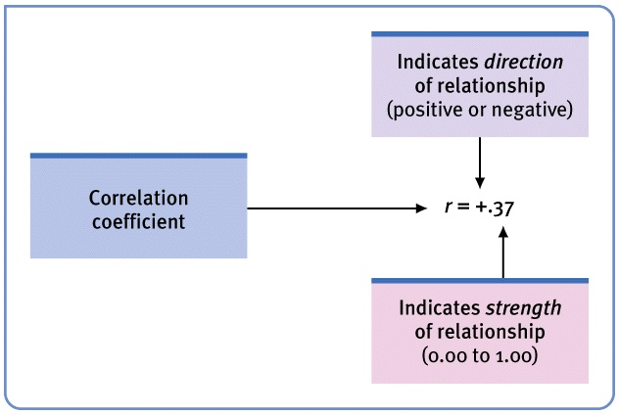
How to Read a Correlation Coefficient

Slide 9
Which of the following has the strongest relationship?
.5
-.5
-.98
-.75
.75
.005

Slide 10
Scatterplots
Perfect positive
correlation (+1.00)
Scatterplot is a graph comprised of points that are generated by values of two variables. The slope of the points depicts the direction, while the amount of scatter depicts the strength of the relationship.

Slide 11
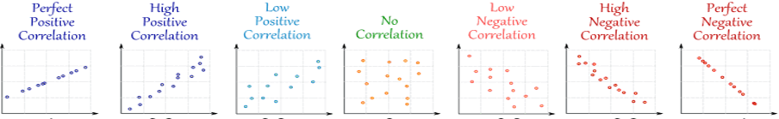
A
B
C
Pick from A, B, C
Relationship self-esteem and depression.
Relationship between pairs of shoes owned and IQ score.
Relationship between SAT score and first year college GPA.
Label the graph with the appropriate correlation coefficient.
0
+1
+.8
-.3
-.8
-1
+.3

Slide 12
Create a Scatterplot with the data:
Number of doors a car has
Average Driving Speed
2
3
4
5
6
7
8
73
75
60
55
50
48
45
What kind of correlation exists?
Relatively Strong Negative

Slide 13
Scatterplots
Perfect negative
correlation (-1.00)
No relationship (0.00)
The Scatterplot on the left shows a negative correlation, while the one on the right shows no relationship between the two variables.

Slide 14
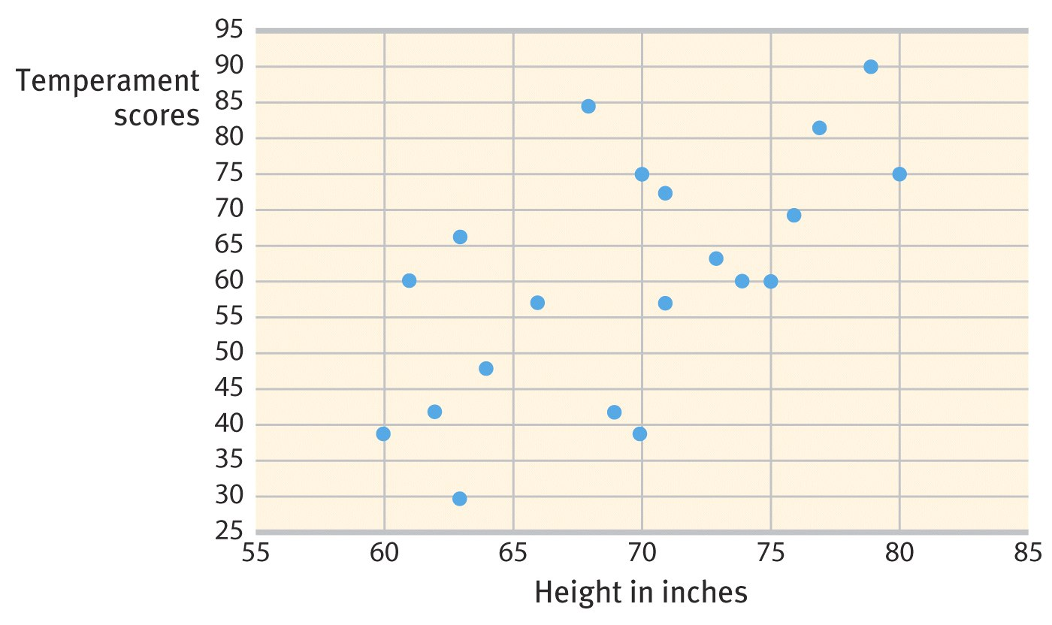
Scatterplot
The Scatterplot below shows the relationship between height and temperament in people.
There is a moderate positive correlation of +0.63.

Slide 15
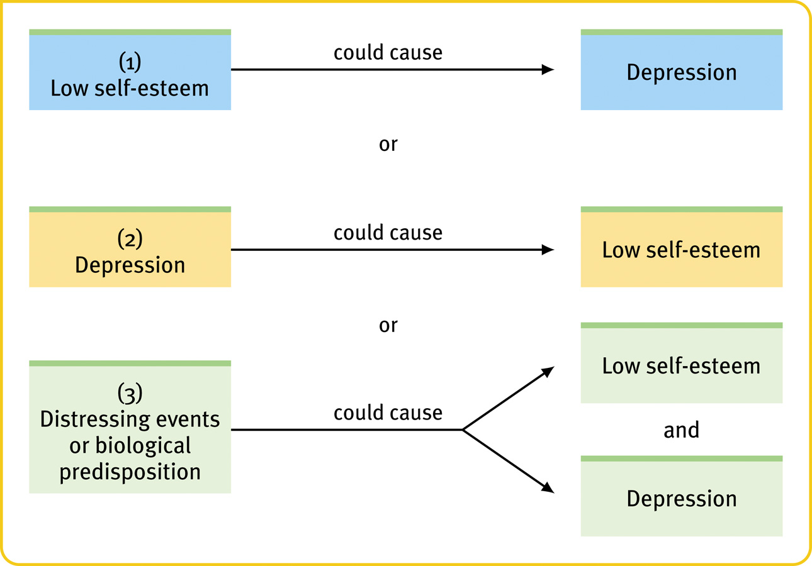
Correlation and Causation
or
Notes:
OBJECTIVE 9| Explain why correlational research fails to provide evidence of cause-effect relationships.

Slide 16
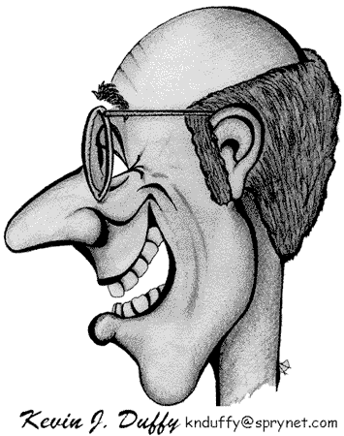
Confounding Variables
Length of a marriage has a positive correlation with hair loss in men.
Does marriage cause hair loss?
Do balding men make better husbands?
Does another factor underline this correlation?

Slide 17
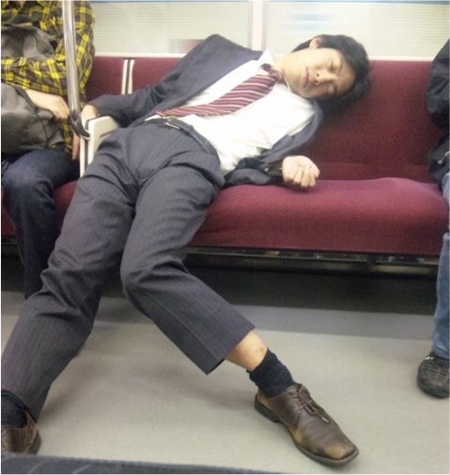
Positive correlation between sleeping with your shoes on and waking up with a headache.
Does wearing your shoes
to bed cause headaches?

Slide 18
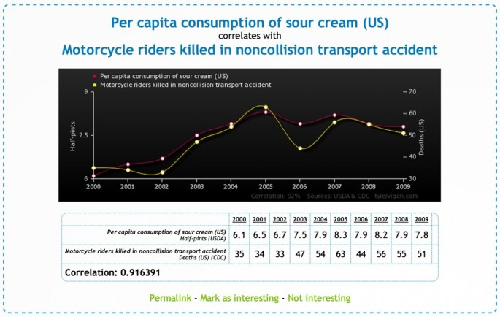

Slide 19
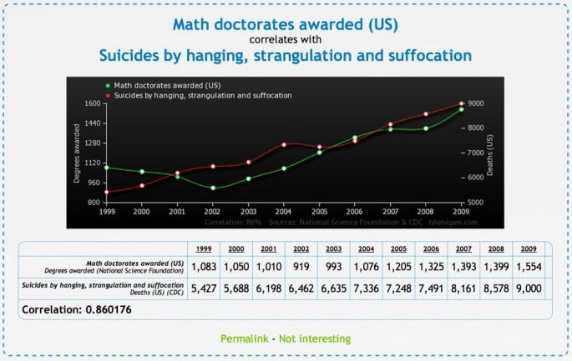

Slide 20
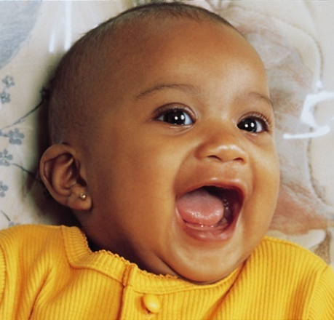
Illusory Correlation
The perception of a relationship where no relationship actually exists. Parents conceive children after adoption.
Do not conceive
Conceive
Adopt
Confirming evidence
Disconfirming evidence
Do not
adopt
Disconfirming evidence
Confirming evidence
Michael Newman Jr./ Photo Edit
Notes:
OBJECTIVE 10| Describe how people form illusory correlations.

Slide 21
Confounding Variables
There is a strong positive correlation between shoe size and reading skill
Reading Level
Shoe Size

Slide 22
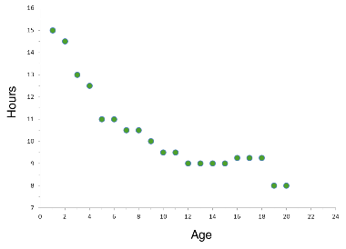
Describe the relationship

Slide 23
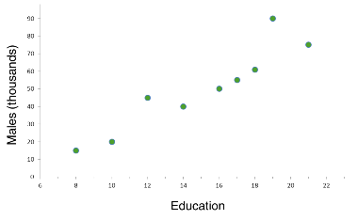
Describe the relationship.

Slide 24
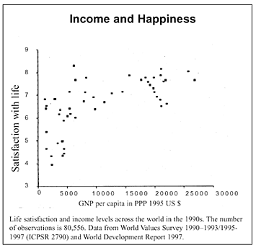
Correlational Research
Correlation is the relationship between two variables.
Positive correlation – both values increase
Negative correlation –
One variable increases, while the other decreases.
Correlational Coefficient – strength of the relationship
0= no relationship
+1 or – 1 = perfect relationship
Examples: SAT scores and success in college; Red wine and heart attacks; Prejudice and age; length of marriage and hair loss, etc.

