Slide 1




MODERN DATA ANALYTICS IN EXCEL
George Mount
Founder, Stringfest Analytics stringfestanalytics.com| @gjmount linkedin.com/in/gjmount george@stringfestanalytics.com

Slide 2
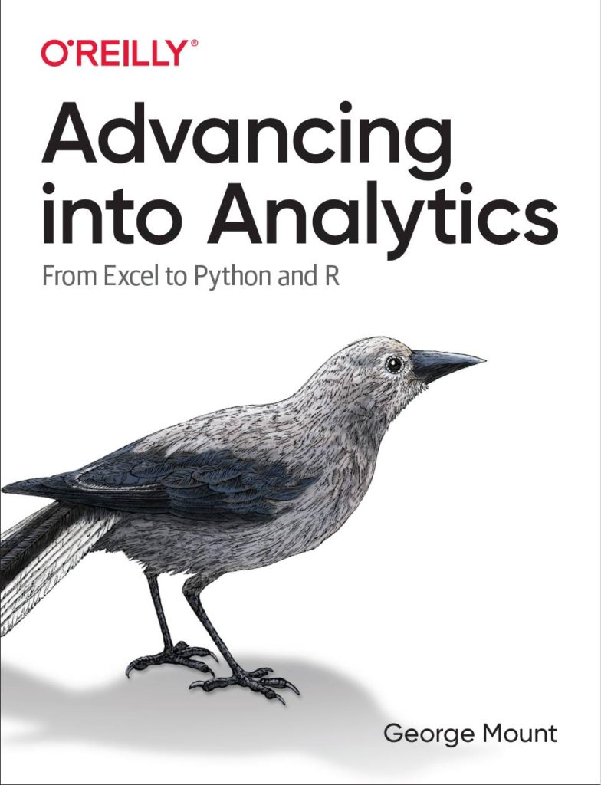



Hi, I’m George

Slide 3
Objectives
Make first impressions with the data using Power Query profiling
Conduct ad-hoc analysis with PivotTables
Pulling data fast with dynamic array functions

Slide 4
Follow along: https://swiy.co/HOfl

Slide 5
Ball tip porchetta lorem sed excepteur nostrud ham hock aliquip dolor fatback kielbasa
T-bone
Cow
Pork belly
Jerky
Ribeye
Bacon

Slide 6

What is modern Excel?
Historically:
Power Query
Power Pivot
Power View
We’ll substitute with dynamic array functions (and so much more!)

Slide 7
Data prep & profiling with Power Query
File: computers.xlsx
Profiling the data for potential issues
Adding an index column for slicing and dicing

Slide 8
Ad hoc analyzing with PivotCharts
Continue computers.xlsx
Compare distribution of computer price by category
We want to reshape without aggregating!

Slide 9
Pulling data fast with dynamic array functions
Continue computers.xlsx
Sort, filter and de-duplicate right from the spreadsheet

Slide 10
Color palette
0
0
0
255
255
255
69
166
73
231
230
230
69
166
73
138
138
138
Dark 1
Light 1
Dark 2
Light 2
Hyperlink
Followed Hyperlink
14
107
55
137
197
73
22
139
162
72
191
164
241
142
1
138
138
138
Accent 1
Accent 2
Accent 3
Accent 4
Accent 5
Accent 6

Slide 11
Conclusion

Slide 12
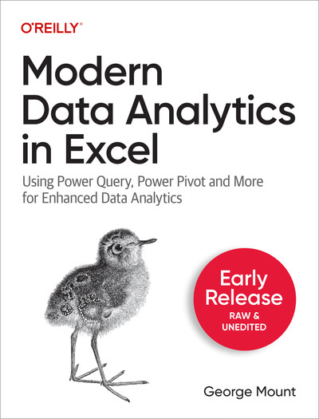
Modern Data Analytics in Excel
Available in early release: https://stringfestanalytics.com/maxl/
Raw, unedited manuscript
Send us feedback!
To publisher Q1 2024 (?)

Slide 13



Please provide feedback on this presentation using the below link or QR code
bit.ly/EVG2023feedback

Slide 15
THANK YOU
stringfestanalytics.com
linkedin.com/in/gjmount
george@stringfestanalytics.com

