Slide 1
硬體描述語言
Homework 02
班級：資工二
學號：S0754002
姓名：許雅竹
日期：2019/11/13

Slide 2
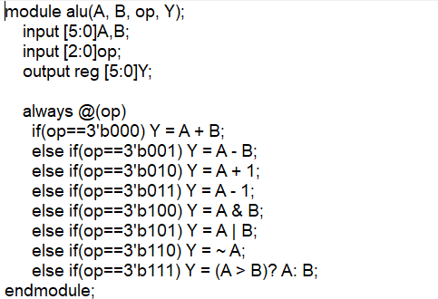
Verilog Code (alu.v)

Slide 3
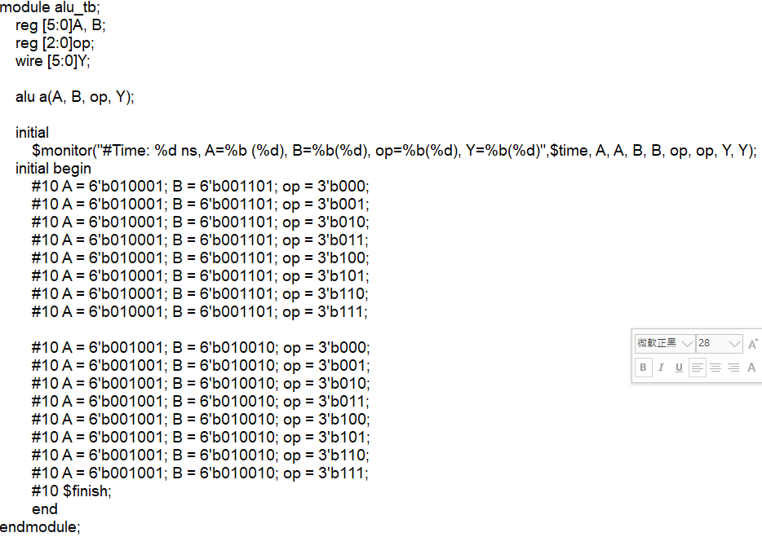
Verilog Code (alu_tb.v)

Slide 4
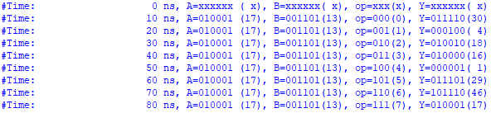
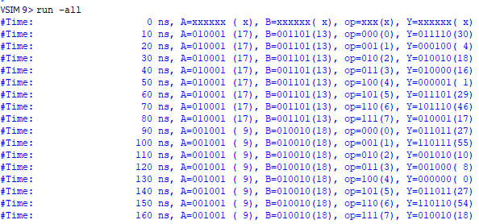
Text Message Output (1/2)
A=6’b010001 (6’d17), B=6’b001101 (6’d13), op=3’b000~3’b111

Slide 5
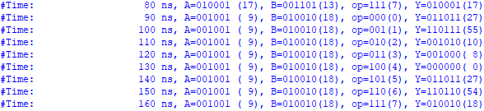
Text Message Output (2/2)
A=6’b001001 (6’d9), B=6’b010010 (6’d18), op=3’b000~3’

Slide 6
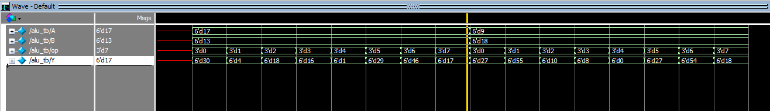
Simulation Waveform (1/2)
A=6’b010001 (6’d17), B=6’b001101 (6’d13), op=3’b000~3’b111
請清楚標示出信號之值

Slide 7

Simulation Waveform (2/2)
A=6’b001001 (6’d9), B=6’b010010 (6’d18), op=3’b000~3’b111
請清楚標示出信號之值

