Slide 1
硬體描述語言
Homework 04
班級：資工二
學號：S0754002
姓名：許雅竹
日期：2019/12/25

Slide 2
Design 1: Mealy Machine State Diagram
Target sequence: 10111
Input sequence: 11101111011101110111000
Detection output: 00000010000100010001000

Slide 3
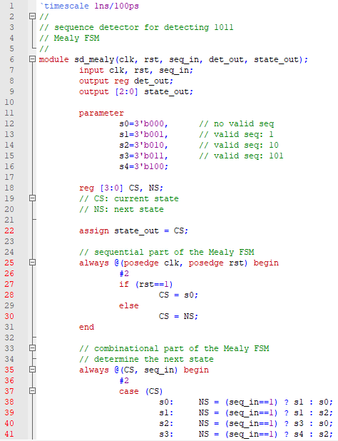
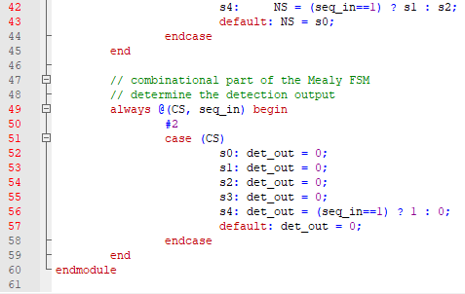
Design 1: Verilog Code

Slide 4
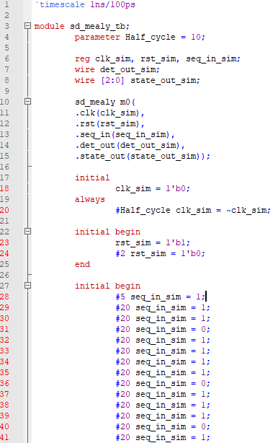
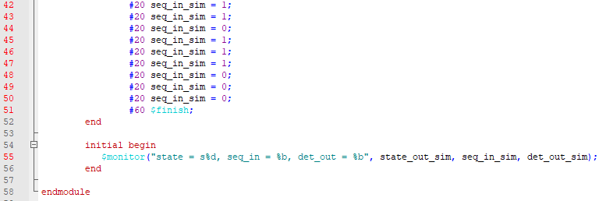
Test bench(Mealy Machine)

Slide 5
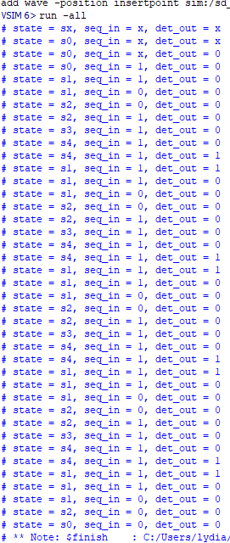
Design 1: Simulation Result
請標示出detection output

Slide 6



Wave(Mealy Machine)

Slide 7
Design 2: Moore Machine State Diagram
Target sequence: 10111
Input sequence: 11101111011101110111000
Detection output: 00000010000100010001000

Slide 8
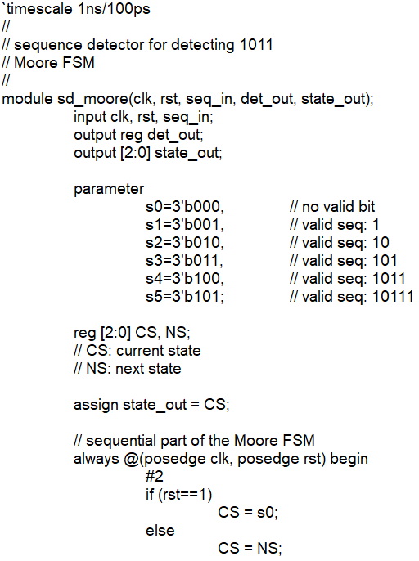
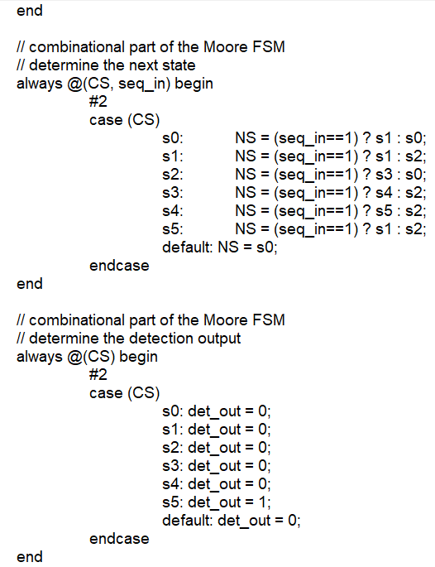
Design 2: Verilog Code

Slide 9
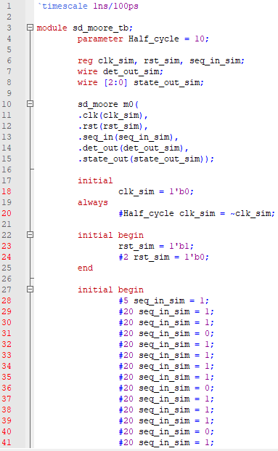
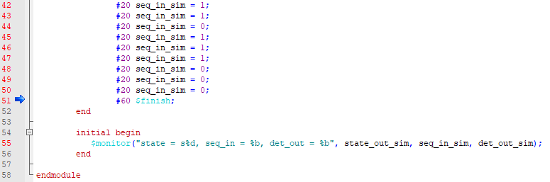
Test bench(Moore Machine)

Slide 10
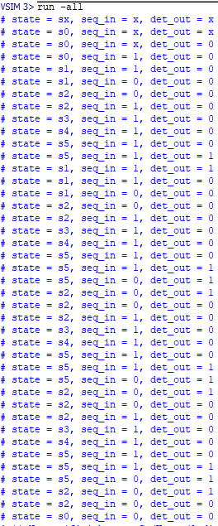
Design 2: Simulation Result
請標示出detection output

Slide 11



Wave(Moore Machine)

