Slide 1
ER model to relation schema

Slide 2
Example ER model

Slide 3
For Entity
每個strong/weak entity各自轉成一個relation
對特定的entity，如weak entity/subclass entity等，除了自己的attribute外，尚須加上其parent 的primary key
ex. Student (entity) is a Person (entity), 除了student 自己的attribute要轉成欄位名稱之外，需再加上Person的primary key

Slide 4
Entity to relation schema
Person (SSN, Name, Sex, Bdate)
Teacher (TID, Rank, Office, Salary, SSN)
Student (SID, Year, SSN)
Graduate (SID, Degree, Thesis)

Slide 5
For Relationship
(1) 若為ID所依賴的identifying relationship，如weak entity relationship或為is-a，則不需再轉換，因relationship已含入應有的entity中
(2) 若relationship有自己的attribute，使用separate relation approach
(3) 若為多元relationship (eg. ternary)，使用separate relation approach
PS. separate relation approach：將所有與該relationship有關係entity的primary key提出來，若relationship有自己的attribute，則再加上自己的attribute並與提出之primary key形成一個relation

Slide 6
For Relationship
(4) 兩個有relationship的entity ( A與B)。若只有其中一個entity A具有(1, 1) 或(0, 1)的cardinality，使用foreign key approach，將entity B的primary key加入至A的relation中
(5) 兩個有relationship的entity ( A與B)。若兩者皆是(1, 1)或(0, 1)的cardinality，使用foreign key approach，將任一entity的primary key加入至對方的relation中，如將entity A的primary key加入至B的relation；或將entity B的primary key加入至A的relation。但不可同時將彼此的primary key加入至對方的relation
(6) 不屬於上列情形者，皆使用separate relation approach

Slide 7
For Relationship – summary
看到有(1, 1) 或(0, 1)的cardinality，就是可以使用foreign key approach，把cardinality大的entity primary key加到對方的relation。
若兩邊cardinality一樣大，將任一entity的primary key加入至對方的relation中，但不要同時將彼此的primary key加到對方的relation。
其它情形都用separate relation approach

Slide 8
For Relationship – foreign key approach
Person (SSN, Name, Sex, Bdate)
Teacher (TID, Rank, Office, Salary, SSN)
Student (SID, Year, SSN)
Graduate (SID, Degree, Thesis, TID)
只有一邊的entity具有(1, 1) 或(0, 1)的cardinality

Slide 9
Practice

Slide 10
Entity to relation
Employee (ssn, name, sex, bdate, address, salary)
Department (number, name)
Project (number, name)
Location (name)
Dependent (ssn, name, sex, birthdate, relationship)

Slide 11
For Relationship
Employee (ssn, name, sex, bdate, address, salary, Supssn, number)
Department (number, name)
Project (number, name, Dnumber, Lname)
Location (name)
Dependent (ssn, name, sex, birthdate, relationship)
Manages (ssn, number, startdate)
Works_on (ssn, number, hours)
Is_located_on (number, name)

Slide 12
Function dependency & closure

Slide 13
Definition of function dependency
X → Y，X可以決定Y；Y功能相依於X
Ex.
SSN → Ename
Pnumber → {Pname, Plocation}
{SSN, Pnumber} → Hours
Ex.
身分證字號 → 姓名
學號→ {姓名、系所、級別}

Slide 14
Definitions of keys and attributes participating in keys
Person (SSN, Name, Sex, Bdate)
Key：用最少的屬性能決定其它所有屬性即是key，如SSN。
Superkey：Key加上任意數量的其它屬性即是superkey，如{SSN, Name}、{SSN, Sex}、{SSN, Name, Sex}…
Candidate key：若Key有一個以上，則稱這些key為candidate key
Prime attribute：屬於candidate key的屬性，都是prime attribute，如SSN
Nonprime attribute：不是prime attribute者，皆是nonprime attribute，如Name, Sex, Bdate

Slide 15
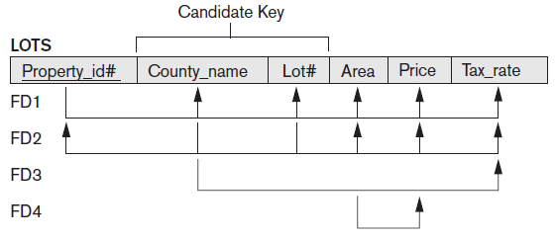
Example
Key：Property_id#, {Country_name, Lot#}
Superkey：包含property_id# 或{Country_name, Lot#}的任意組合
Candidate key： Property_id#, {Country_name, Lot#}
Prime attribute：Property_id#, Country_name, Lot#
Nonprime attribute：Area, Price, Tax_rate

Slide 16
Inference Rules for Function dependency
IR1：If X ⊇ Y, then X →Y
IR2：{X → Y} |= XZ → YZ
IR3：{X → Y, Y → Z} |= X → Z
簡化推理步驟
IR4：{X → YZ} |= X → Y, X → Z
IR5：{X → Y, X → Z} |= X → YZ
IR6：{X → Y, WY → Z} |= WX → Z

Slide 17
How to find key
只出現在功能相依的左手邊的屬性，一定是鍵的一部分
從來沒有出現在功能相依的左右兩邊的屬性，一定是鍵的一部分
同時出現在功能相依的左右兩邊的屬性，可能是鍵的一部分

Slide 18
Example
R(A, B, C, D, E, F)
FD1： {A, C} → B
FD2：C → B
FD3：{A, C} → D
FD4：{A, C}→ E, F
{C}⁺= {C, B}
{AC}⁺= {A, C, B, D, E, F} ＝> Key, candidate key
TIP.
只出現在功能相依的左手邊的屬性，一定是鍵的一部分
從來沒有出現在功能相依的左右兩邊的屬性，一定是鍵的一部分
同時出現在功能相依的左右兩邊的屬性，可能是鍵的一部分

Slide 19
Practice
CLASS (Classid, Course#, Instr_name, Credit_hrs, Text, Publisher, Classroom, Capacity)
FD1: Classid → Course#, Instr_name, Credit_hrs, Text, Publisher, Classroom, Capacity;
FD2: Course# → Credit_hrs;
FD3: {Course#, Instr_name} → Text, Classroom;
FD4: Text → Publisher
FD5: Classroom → Capacity
TIP.
只出現在功能相依的左手邊的屬性，一定是鍵的一部分
從來沒有出現在功能相依的左右兩邊的屬性，一定是鍵的一部分
同時出現在功能相依的左右兩邊的屬性，可能是鍵的一部分

Slide 20
Answer
{Classid}⁺ = {Classid ,Course#, Instr_name, Credit_hrs, Text, Publisher, Classroom, Capacity} ＝> Key, candidate key
{Course#}⁺ = {Course#, Credit_hrs}
{Text}⁺ = {Text, Publisher}
{Classroom}⁺ = {Classroom, Capacity}
{Course#, Instr_name}⁺ = {Course#, Instr_name, Credit_hrs, Text, Classroom, Publisher, Capacity}

Slide 21
Normalization

Slide 22
為何需要正規化
避免資料重複或相互矛盾(更新異常)的情形,
使資料庫在使用時能更有效率、更容易維護。

Slide 23
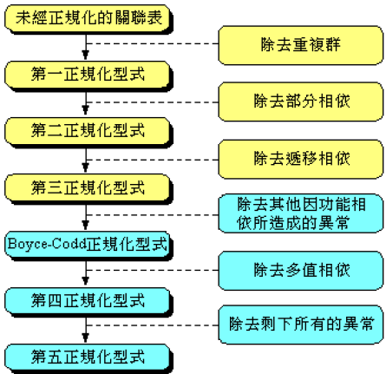
正規化步驟

Slide 24
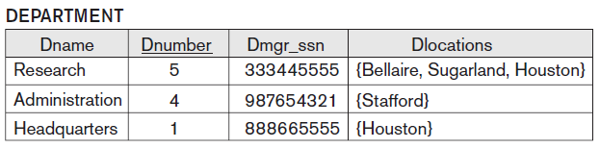
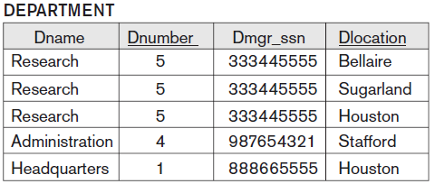
First Normal Form (1NF)
The value of any attribute in a tuple must be a single value
在資料表中的所有記錄之屬性值都是基元值(Atomic Value)
Normalize

Slide 25
Second Normal Form (2NF)
A relation schema R is in 2NF if every nonprime attribute A in R is not partially dependent on any key of R.
Key與非主要屬性間沒有部份相依的關係
部份相依

Slide 26
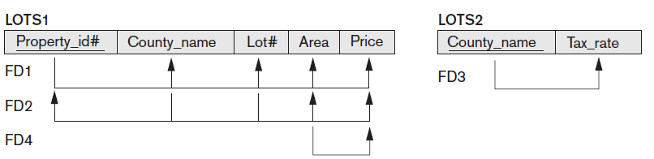
Second Normal Form (2NF)
部份相依
Normalize

Slide 27
Third Normal Form (3NF)
A relation schema R is in 3NF if every nonprime attribute of R meets both of the following conditions:
It is fully functionally dependent on every key of R. (2NF)
It nontransitively dependent on every key of R.
Key與非主要屬性間沒有部份相依的關係 (2NF)
非主要屬性間沒有間接相依的關係

Slide 28
Third Normal Form (3NF)
間接相依

Slide 29
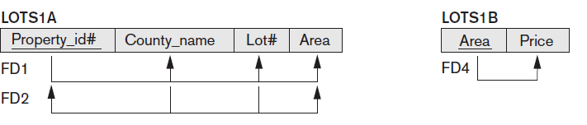
Third Normal Form (3NF)
間接相依
Normalize

Slide 30
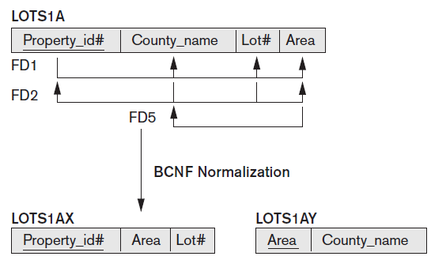
Boyce-Codd Normal Form (BCNF)
3NF allows FD having the RHS as a prime attribute, but is absent from BCNF
主要屬性不相依於非主要屬性

Slide 31
Function dependency
R (A, B, C, D, E, F)
FD1: A → B, C, D, E, F
FD2: {B, C} → A, D, E, F
FD3: B → F
FD4: D → E
FD5: D → B
部份相依
間接相依
主要屬性相依於非主要屬性

Slide 32
Function dependency – Find key
R (A, B, C, D, E, F)
FD1: A → B, C, D, E, F
FD2: {B, C} → A, D, E, F
FD3: B → F
FD4: D → E
FD5: D → B
{A}⁺ = {A, B, C, D, E, F}
{B}⁺ = {B, F}
{D}⁺ = {D, E, B, F}
{B, C}⁺ = {B, C, A, D, E, F}
Candidate key = A, {B, C}
Prime attribute = A, B, C
Nonprime attribute = D, E, F
TIP.
只出現在功能相依的左手邊的屬性，一定是鍵的一部分
從來沒有出現在功能相依的左右兩邊的屬性，一定是鍵的一部分
同時出現在功能相依的左右兩邊的屬性，可能是鍵的一部分

Slide 33
2NF
Candidate key = A, {B, C}
Prime attribute = A, B, C
Nonprime attribute = D, E, F
2NF: partially dependent
FD3: B → F;
PK = A
R1 (A, B, C, D, E)
R2 (B, F)
PK = {B, C}
R1 (A, B, C, D, E)
R2 (B, F)
R (A, B, C, D, E, F)
FD1: A → B, C, D, E, F
FD2: {B, C} → A, D, E, F
FD3: B → F
FD4: D → E
FD5: D → B

Slide 34
3NF
Candidate key = A, {B, C}
Prime attribute = A, B, C
Nonprime attribute = D, E, F
3NF: transitively dependent
FD4: D → E;
PK = A
R1 (A, B, C, D)
R2 (B, F)
R3 (D, E)
PK = {B, C}
R1 (A, B, C, D)
R2 (B, F)
R3 (D, E)
R (A, B, C, D, E, F)
FD1: A → B, C, D, E, F
FD2: {B, C} → A, D, E, F
FD3: B → F
FD4: D → E
FD5: D → B

Slide 35
BCNF
Candidate key = A, {B, C}
Prime attribute = A, B, C
Nonprime attribute = D, E, F
BCNF: Prime attribute depends on nonprime attribute
FD5: D → B;
PK = A
R1 (A, C, D)
R2 (B, F)
R3 (D, E)
R4 (D, B)
PK = {B, C}
R1 (A, B, C, D)
R2 (B, F)
R3 (D, E)
R (A, B, C, D, E, F)
FD1: A → B, C, D, E, F
FD2: {B, C} → A, D, E, F
FD3: B → F
FD4: D → E
FD5: D → B

