Slide 1
Project Management – Structures & Charts
Whilst I answer any individual questions about feedback, your first task is to investigate what a Work Breakdown Structure is, and find suitable software to make one of these!

Slide 2
Objectives…
Explain the purpose and the core elements of a work breakdown structure.
Explain the purpose and core elements of a GANTT chart.
Compare and contrast the WBS and GANTT Charts.

Slide 3
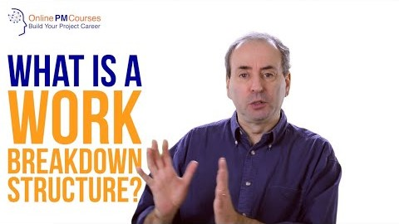
What is a Work Breakdown Structure?

Slide 4
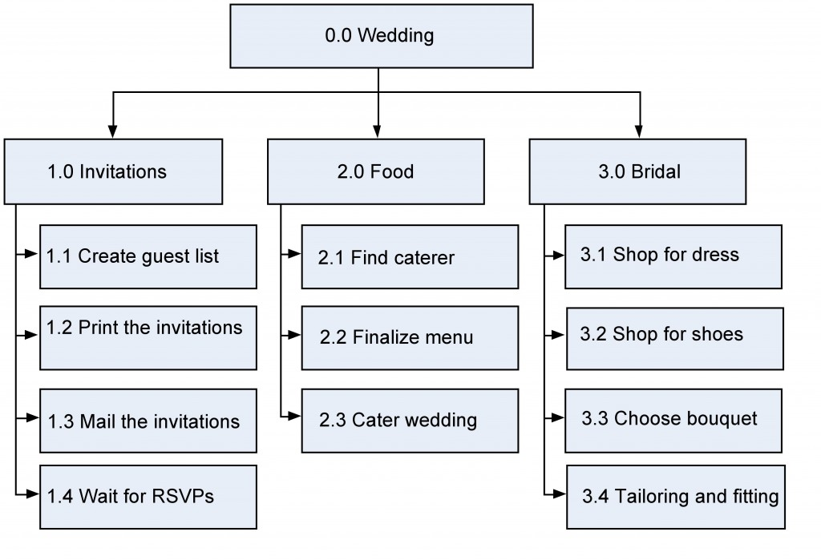
Quick Paired Task…
(5 mins) with the person next to you:
Compare your understanding of what a WBS is, and what it should include.
Looking at the assignment brief, what are you going to need this information for?
What software could you use to make one of these?
This Photo by Unknown Author is licensed under CC BY

Slide 5
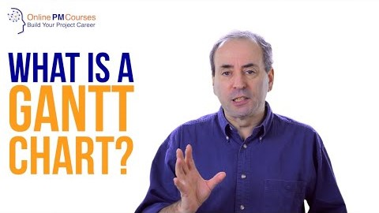
From this, we should be able to make a GANTT…

Slide 6
Quick Paired Task…
(5 mins) with the person next to you:
Explain why a WBS is different to a GANTT chart? And why do we need both?
Why should the WBS be made before the GANTT?
What information will need to be shown on your GANTT chart?
Useful Info!
MS Project is the best software for GANTT Charts.
This is available on Azure DevTools for Teaching (see slack or Moodle for the link).

Slide 7

For when you are ready to make a GANTT… Here are some Project 2016 Tutorial Videos!
DISCLAIMER: there are loads of resources out there if you don’t like these ones!

Slide 8
Before we move on…

Slide 9
Part 2: Searching for Academic Journals

Slide 10
Objectives…
Be able to gain access to 3 Academic Journal Databases.
Be able to demonstrate the use of effective searching of at least one journal database.
Be able to apply the previously taught techniques for summarising an academic paper.

Slide 11
There are 3 Journal Databases…
GALE Database
https://www.openathens.net/ > Login using O365 credentials > GALE Database
Further info can be found here: https://vle.mkcollege.ac.uk/mod/resource/view.php?id=24525&redirect=1
Jstor
https://www.openathens.net/ > Login using O365 credentials > ITHAKA
Google Scholar
https://scholar.google.com/ (No login required)

Slide 12
Activity…
Using each of the databases, search for something related to your chosen project title. Find an academic paper from each...
Apply the same summarising techniques taught in Week 1 to the papers you decide to look at.
Write this up for me to check!
(I have uploaded one of my old research summary documents for you to look at on Moodle)

Slide 13
The current roadmap…
You should now have enough knowledge and skills to complete task 1 of the project.
Your half term work is to now tackle Task 1 head on, ready for review/sign-off after half term.
REMEMBER! I need to sign off your project planning documentation prior to me looking at any other project work.

Slide 14
Any final questions? If not – over to you to make progress with your project!

