Slide 1

IFIS Presents

Slide 2
Machine Learning and Artificial Intelligence
2nd Annual
Cyber Security & Risk Management
Conference
Imperial Royale Hotel Kampala 17th - 19^{h} Oct’18
A cybersecurity perspective
www.forensicsinstitute.org
Forensics. Advisory. Security

Slide 3
Agenda
ML and AI, a novel intro
Machine Learning 101
Artificial Intelligence Applications
ML and Cyber Security
Summary and conclusion

Slide 4
Introduction
﻿AI vs ML vs DL
AI - Science of making things smart
ML – Approach of achieving AI through a system
DL – Techniques for implementing machine learning
Notes:
Fraud and theft have a lot in common. Both are criminal acts, and both are forcibly taking something from others without asking permission. Both are all about stealing and both are bad things.
The damage they can inflict may be big or small but it’s taking from someone nonetheless. People should be careful with thieves and fraudsters, that is why knowing the differences between these two criminals is very important. First let us know the definition of the two.

Slide 5
ML 101
Tasks
- Classification
- Regression
- Clustering
- Dimensionality Reduction
Methods
- supervised (learn by labeled data)
- unsupervised (learn by unlabeled data)
- semi supervised (somewhere inbetween)
- reinforcement (trial and error)
Notes:
Fraud and theft have a lot in common. Both are criminal acts, and both are forcibly taking something from others without asking permission. Both are all about stealing and both are bad things.
The damage they can inflict may be big or small but it’s taking from someone nonetheless. People should be careful with thieves and fraudsters, that is why knowing the differences between these two criminals is very important. First let us know the definition of the two.

Slide 6
Artificial Intelligence Applications
Computer vision (image recognition, face detection)
Natural Language Processing (Google translate, search engines)
Cyber Security (threat hunting, UEBA)

Slide 7
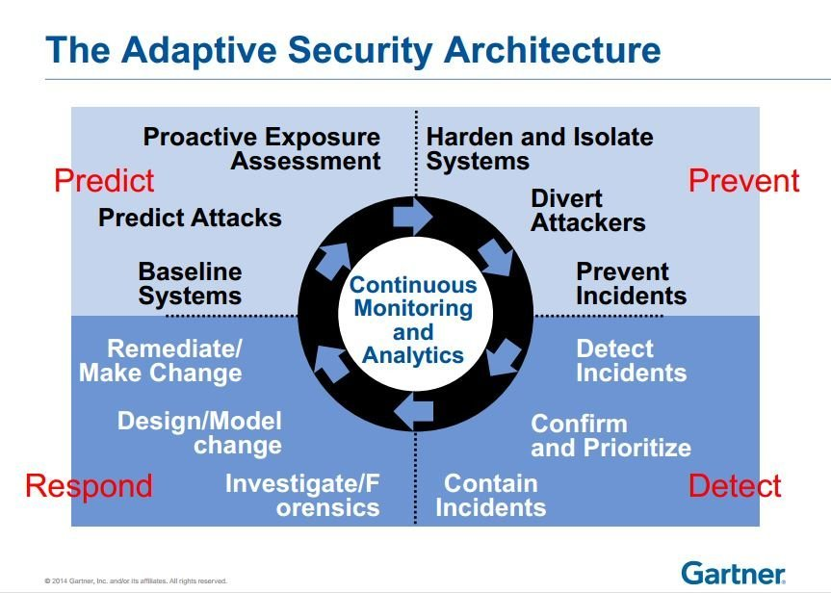
ML and Cyber Security

Slide 8
ML and Cyber Security cont …
Levels
- Network (ethernet, wireless, SCADA, cloud)
- Endpoint (server, workstation, mobile)
- Application (database, ERP, webapp)
- User (domain, application, cloud, social)
- Process (various)
Notes:
Fraud is a deceit or trickery over another to gain profit and an untruthful advantage. Fraud is an intentional deception so that the one doing the act may gain advantage or may profit from it. This is also done so that another individual may be damaged. The main purpose of fraud is to take money or other valuable things from other people.

Slide 9
ML and Cyber Security cont …
AI for Network Protection (IDS/NTA)
- Regression to predict packet parameters from baseline
- Classification to identify different classes of network attacks
- Clustering for forensics analysis. We are unaware of what happened so we cluster events to spot outliers
AI for End Point Protection (EDR/EPP)
- regression to predict the next action and compare with the real ones
- Classification, dividing programs into classes like malware, ransomware, spyware
- clustering for malicious software at gateways – filtering legal files from outliers
Notes:
Fraud is a deceit or trickery over another to gain profit and an untruthful advantage. Fraud is an intentional deception so that the one doing the act may gain advantage or may profit from it. This is also done so that another individual may be damaged. The main purpose of fraud is to take money or other valuable things from other people.

Slide 10
ML and Cyber Security cont …
AI for Application Protection (WAF/ static code analysis)
- regression to detect anomalies in HTTP requests
- classification to detect know types of attacks
- clustering application activity to detect abuse or exploitation
AI for User level security (UEBA, SIEM, IAM)
- regression to detect anomalies in user actions
- classification to divide users into group for group analysis
- clustering to separate groups of users and detect outliers
Notes:
Fraud is a deceit or trickery over another to gain profit and an untruthful advantage. Fraud is an intentional deception so that the one doing the act may gain advantage or may profit from it. This is also done so that another individual may be damaged. The main purpose of fraud is to take money or other valuable things from other people.

Slide 11
ML and Cyber Security cont …
AI for Process level security (anti-fraud, business Intelligence)
- regression to predict next actions and detect fraud transactions
- classification to detect known types of fraud
- clustering for comparison of business processes and detecting outliers
Notes:
Fraud is a deceit or trickery over another to gain profit and an untruthful advantage. Fraud is an intentional deception so that the one doing the act may gain advantage or may profit from it. This is also done so that another individual may be damaged. The main purpose of fraud is to take money or other valuable things from other people.

Slide 12
Case Study: User Entity Behaviour Analytics (UEBA)
Why?
- Legacy Threat models (users are the easiest attack vector)
- Legacy incident monitoring (infrastructure security focused analysis)
- Legacy security alerts analysis (no business context enrichment)
What ?
- User security monitoring
- User focused alert prioritization
- Advanced context enrichment
- User Behaviour vs. Fraud analysis
Notes:
Fraud is a deceit or trickery over another to gain profit and an untruthful advantage. Fraud is an intentional deception so that the one doing the act may gain advantage or may profit from it. This is also done so that another individual may be damaged. The main purpose of fraud is to take money or other valuable things from other people.

Slide 13
Case Study cont …
How ?
- Create a user centered threat model
- Identify user related data sources (this is key)
- Build a user Behaviour baseline (privacy violations, IANA, consult with the legal team)
- Scale, Context and Alerts (framework creation)
Data Preparation (sources, formats)
- log files, databases, security monitoring tools, log archives, log management tools
- syslog, proprietary formats, csv, text files, evtx
Notes:
Fraud is a deceit or trickery over another to gain profit and an untruthful advantage. Fraud is an intentional deception so that the one doing the act may gain advantage or may profit from it. This is also done so that another individual may be damaged. The main purpose of fraud is to take money or other valuable things from other people.

Slide 14
Case Study cont …
Data Normalisation
- Understand the data (when, who, did what, from where, where to, on what)
- Bringing all data to the same format and under unified event storage (SIEM)
- Find duplications and missing fields (data mangling)
Notes:
Fraud is a deceit or trickery over another to gain profit and an untruthful advantage. Fraud is an intentional deception so that the one doing the act may gain advantage or may profit from it. This is also done so that another individual may be damaged. The main purpose of fraud is to take money or other valuable things from other people.

Slide 15
Case Study cont …
Threat Modeling
- Categories (data exfil, account compromise, regular access abuse, privileged access abuse)
- Classes ( data transfer, account sharing, password attacks, privilege escalation, lateral movement)
- Scenarios (login from multiple hosts, user upgrades own privileges, cover tracks via deletion)
Anomalies
- Static anomalies (unusual action, new/rare event, unusual context, server/device)
- Temporal anomalies ( unusual time, unexpected event, high volume of events)
Notes:
Fraud is a deceit or trickery over another to gain profit and an untruthful advantage. Fraud is an intentional deception so that the one doing the act may gain advantage or may profit from it. This is also done so that another individual may be damaged. The main purpose of fraud is to take money or other valuable things from other people.

Slide 16
Case Study cont …
Anomalies vs. Threats
- Most anomalies are not malicious
- Anomalies are statistical deviations
- Big infrastructure always has anomalies
Notes:
Fraud is a deceit or trickery over another to gain profit and an untruthful advantage. Fraud is an intentional deception so that the one doing the act may gain advantage or may profit from it. This is also done so that another individual may be damaged. The main purpose of fraud is to take money or other valuable things from other people.

Slide 17
Anomalies vs. Threats, the matrix
Threat Model |  | Temporal Anomalies |  |  | Static Anomalies
Category | Class | Unusual Action | Unusual Time | Unusual Volume | New Action | New Server | New Device
Regular Access Abuse | Unauthorised access | High | Medium | Low | High | Medium | Low
 | Account sharing | Low | Medium | High | Low | Medium | High
Account Compromise | Password Attack | Medium | Low | High | Low | High | High
 | Privilege Escalation | High | Medium | Low | High | Medium | Low
 | Access Enumeration | High | Low | Medium | High | Medium | Low
Data Exfiltration | Data Transfer | Low | Medium | High | Low | Medium | High
Notes:
Fraud is a deceit or trickery over another to gain profit and an untruthful advantage. Fraud is an intentional deception so that the one doing the act may gain advantage or may profit from it. This is also done so that another individual may be damaged. The main purpose of fraud is to take money or other valuable things from other people.

Slide 18
Summary and Conclusion
Security analytics/data science is import to machine learning
ML implementations/models should help analysts and not replace them
Adjust tolerance and accuracy to false positives for your environment
ML and AI are not silver bullets
With growing amount of data and less expert analysts, its becoming the viable solution
Notes:
Fraud is a deceit or trickery over another to gain profit and an untruthful advantage. Fraud is an intentional deception so that the one doing the act may gain advantage or may profit from it. This is also done so that another individual may be damaged. The main purpose of fraud is to take money or other valuable things from other people.

Slide 19
Talk and work with us
Security as a Service
Penetration Testing
Vulnerability Assessments
Security Training
Security analytics
Tailor-Made security solutions for all industries
Forensics and Incident Response
Research and Development for Cyber Security Innovation
Notes:
Fraud is a deceit or trickery over another to gain profit and an untruthful advantage. Fraud is an intentional deception so that the one doing the act may gain advantage or may profit from it. This is also done so that another individual may be damaged. The main purpose of fraud is to take money or other valuable things from other people.

Slide 20


Our values for your success
Thank you!

