Slide 1
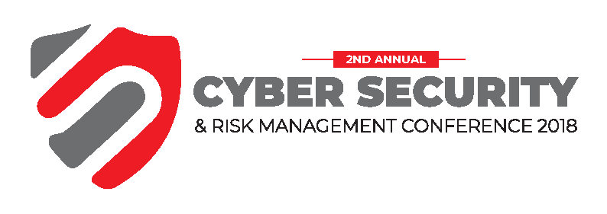
IFIS Presents

Slide 2
Threat Intelligence and Cyber Hygiene
2nd Annual
Cyber Security & Risk Management
Conference
Imperial Royale Hotel Kampala 17th - 19^{h} Oct’18
Intelligence driven security
www.forensicsinstitute.org
Forensics. Advisory. Security

Slide 3
Agenda
Introduction (What have you heard about TI)
Phases of TI life cycle
Tools and People
Threat Intelligence field case studies
Summary and conclusion

Slide 4
Introduction
Reducing Time Spent investigating security threats
Information and analysis from a rich array of sources, presented in ways that make it easy to understand and use.
Immensely valuable to all the major teams in any cyber security organisation
Can be handled mostly by existing security staff (with the right tools and support)
Notes:
Fraud and theft have a lot in common. Both are criminal acts, and both are forcibly taking something from others without asking permission. Both are all about stealing and both are bad things.
The damage they can inflict may be big or small but it’s taking from someone nonetheless. People should be careful with thieves and fraudsters, that is why knowing the differences between these two criminals is very important. First let us know the definition of the two.

Slide 5
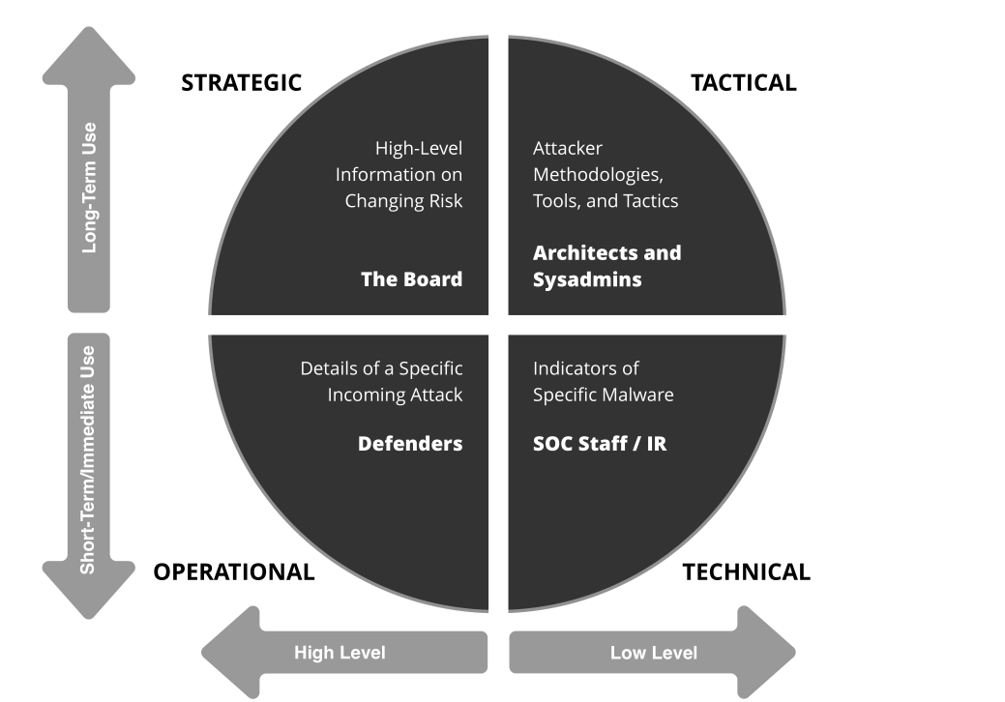
Types
Notes:
Fraud and theft have a lot in common. Both are criminal acts, and both are forcibly taking something from others without asking permission. Both are all about stealing and both are bad things.
The damage they can inflict may be big or small but it’s taking from someone nonetheless. People should be careful with thieves and fraudsters, that is why knowing the differences between these two criminals is very important. First let us know the definition of the two.

Slide 6
Phases of TI life cycle
Direction (assets, business processes, impact, threat modelling, priority)
Collection (internal data, external feeds, OSINT data, external expertise engagement)
Processing (SIEM, human processing)
Analysis (Human Process)
Dissemination (distribution of TI to the right team)
Feedback (keeping inline)
Notes:
Fraud and theft have a lot in common. Both are criminal acts, and both are forcibly taking something from others without asking permission. Both are all about stealing and both are bad things.
The damage they can inflict may be big or small but it’s taking from someone nonetheless. People should be careful with thieves and fraudsters, that is why knowing the differences between these two criminals is very important. First let us know the definition of the two.

Slide 7
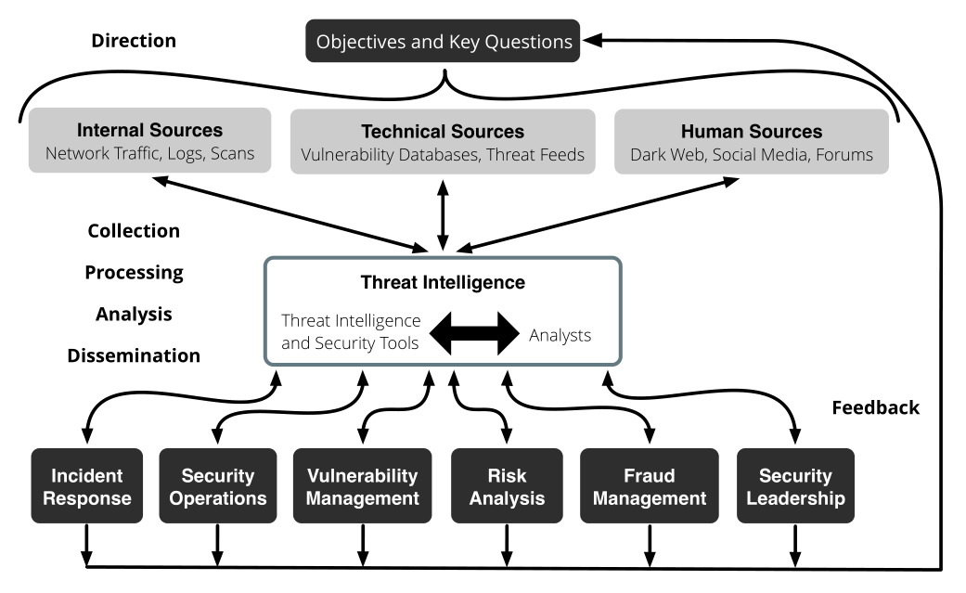
Phases of TI life cycle

Slide 8
Tools and People
Threat intelligence solutions that are designed to collect, process, and analyze all types of threat data from internal, technical, and human sources
Existing security tools, such as SIEMs and security analytics tools, which collect and correlate security events and log data
Two questions will arise:
1. Should there be a dedicated threat intelligence team?
2. Should it be independent, or can it live inside another cybersecurity group?
The answers are: yes, and it depends.

Slide 9
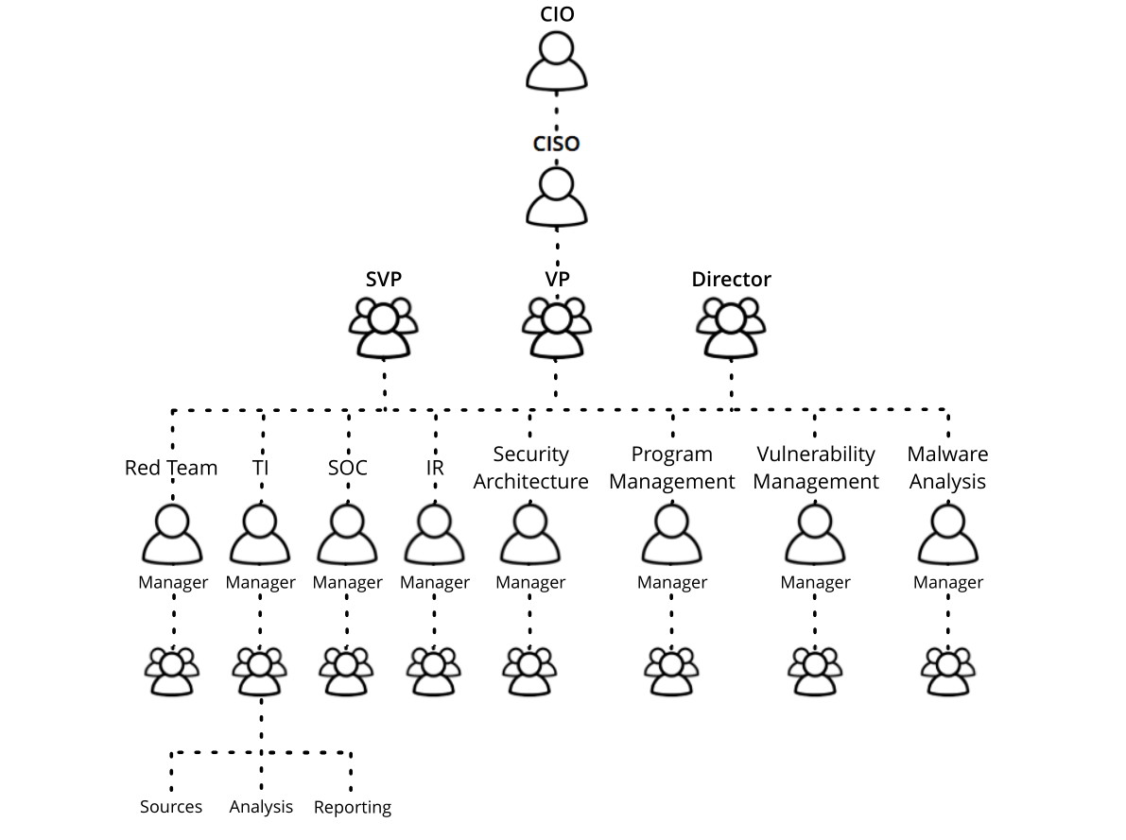
Tools and People (Structure)

Slide 10
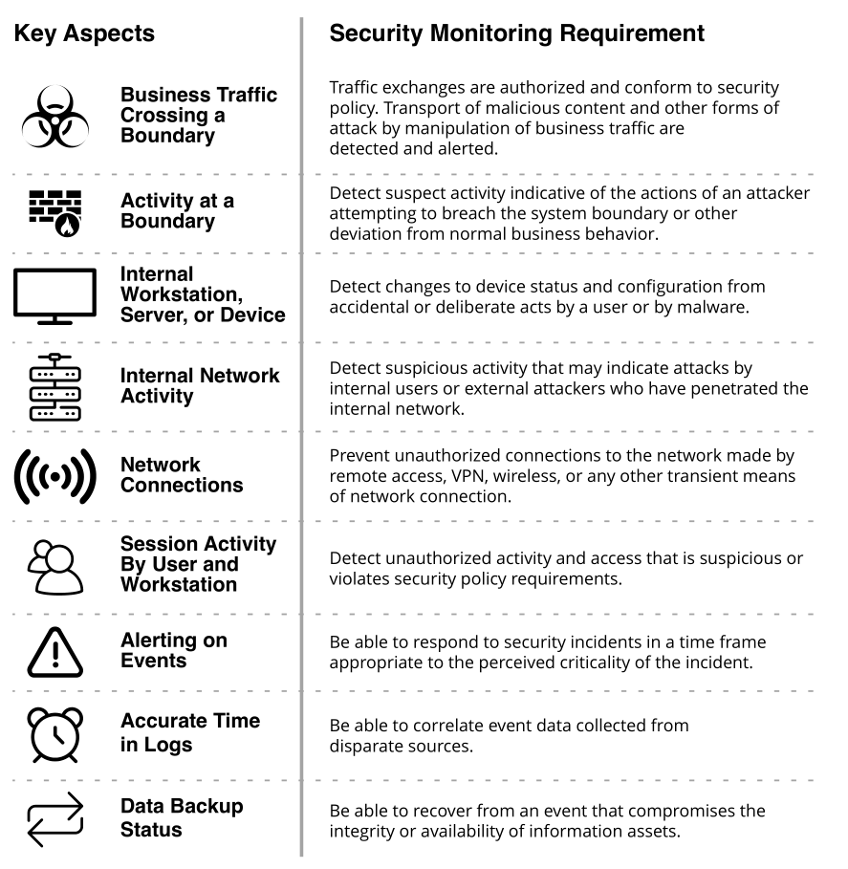
Case Study 1 : SOC Team

Slide 11
SOC – Correlating and enriching alerts
Raw IP addresses to ASN data, ip reputation, geo location
As an example of upskilling relatively junior analysts, suppose an alert is generated when an unknown external IP address attempts to connect over TCP port 445. Experienced analysts might know that a recent exploit for SMB has been used by ransomware to propagate itself and would identify the IP as likely compromised based on the owner, location, and open source data.

Slide 12
Case Study 2: Vulnerability Management
Time is of the essence
This has two implications:
1. You have roughly two weeks to patch or remediate your systems against a new exploit.
2. If you can’t patch in that timeframe, you should have a plan to mitigate the damage.

Slide 13
Vulnerability Management
Assess Risk Based on Exploitability
- Let’s use a metaphor: if patching vulnerabilities to keep your network safe is like getting vaccines to protect yourself from disease, then you need to decide which vaccinations are priorities and which are unnecessary. You may need a flu shot every season to stay healthy, but there’s no need to stay vaccinated against yellow fever or malaria unless you will be exposed to them.
- That’s why you have to do your research: one of the greatest values of a threat intelligence solution is that it identifies the specific vulnerabilities that represent risk to your organization and gives you visibility into their likelihood of exploitation.
- There are thousands in your environment, and hundreds are being exploited at any one time. But the only ones you really need to worry about are those that form the intersection of those two categories. (see figure on slide below)
- A common mistake in managing vulnerabilities is to focus on ranking threats in terms of severity. Ranking and classification systems like Common Vulnerabilities and Exposures (CVE)
naming and Common Vulnerability Scoring Systems (CVSSs) don’t take into account whether threat actors are actually exploiting vulnerabilities right now in your industry or locations.

Slide 14
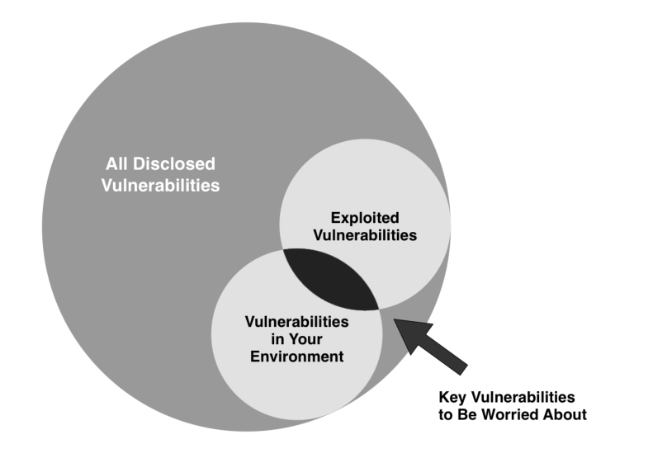
Vulnerability Management

Slide 15
Vulnerability Management
Threat Intelligence and Real Risk
The most effective way to assess the true risk of a vulnerability to your organization is to combine:
Internal vulnerability scanning data
External intelligence from a breadth of sources
An understanding of why threat actors are targeting
certain vulnerabilities and ignoring others

Slide 16
Case Study 3: Risk Management
The greatest responsibility of the modern CISO is risk management: taking the resources and budget available and allocating them in a way that most efficiently mitigates the threat of cyber incidents and attacks.
Sharpening the focus
1. Which types of attacks are becoming more (or less) frequent
2. Which types of attacks are most costly to the victims
3. What new kinds of threat actors are coming forward, and which assets and enterprises are they targeting
4. The security practices and technologies that have proven the most (or least) successful in stopping or mitigating these attacks

Slide 17
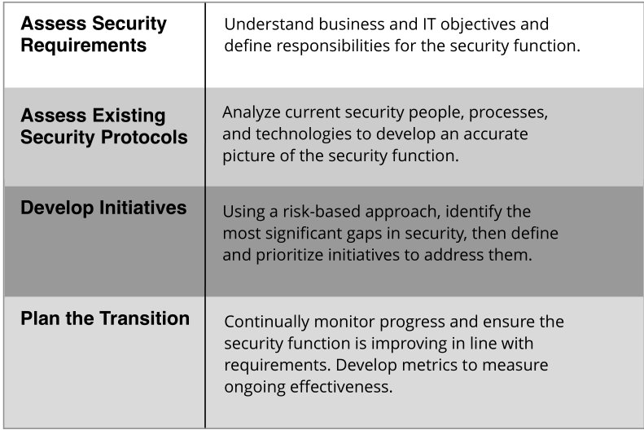
Risk Management

Slide 18
Threat Management and Risk
Contextualized external threat intelligence can go much further, enabling security groups to assess whether an emerging threat is likely to affect their specific enterprise based on factors like:
1. Industry: Is the threat affecting other businesses in our vertical?
2. Technology: Does the threat involve compromising software, hardware, or other technologies used in our enterprise?
3. Geography: Does the threat target facilities in regions where we have operations?
4. Attack method: Have techniques used in the attack, including social engineering and technical methods, been used successfully against our company or similar ones?

Slide 19
Threat Intelligence and Risk
Mitigation: People, Processes, and Tools
- Vulnerability scans and techniques such as penetration testing and red teaming can help security organizations understand where gaps exist in their defenses.
- Today’s enterprises have far more technical vulnerabilities, more weaknesses in security processes and policies, and more employees susceptible to social engineering techniques than they can possibly patch, harden, and train in the immediate future.
Communication
Investiment
Support from Above
Security Skills Gap

Slide 20
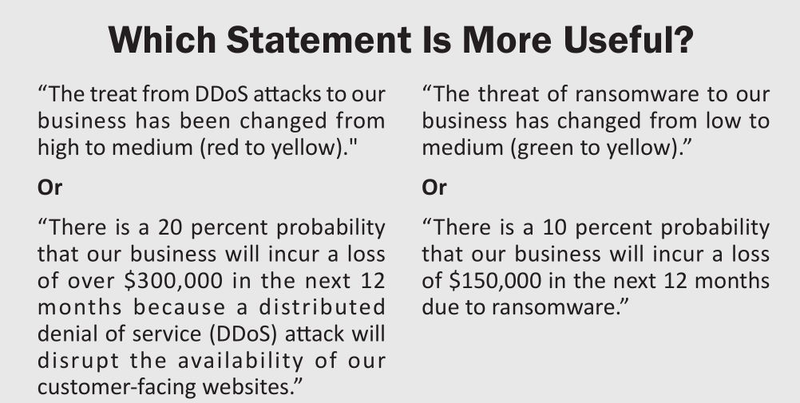
Threat Intelligence and Risk

Slide 21
Case Study 4: Fraud Prevention
Know Your Enemy
More than 78% of breaches are attributed to organized crime
Information Sharing
Techniques, Tactics and Procedures being used by attackers
Documentation of industry specific breaches
Techniques, Tactics and Procedures being used by attackers

Slide 22
Connecting the Dots for Fraud Prevention
The following contextual information might be used to turn news about a new technique variant into intelligence:
Evidence that criminal groups are using a type of information stealing malware in the wild
Reports that the malware can be easily available or accessed by even non-technical entities
Confirmation that vulnerabilities/weaknesses targeted by the malware kits are present in your enterprise

Slide 23
Fraud Prevention: Use case: Compromised data
Compromised personal information and corporate intellectual property has enormous intrinsic value. (breach data)
Threat intelligence can provide early warning of upcoming attacks related to fraud due to compromised credentials.

Slide 24
Fraud Prevention: Use case: OSINT Visualisation
Monitoring Phishing domains
Monitoring an organisation’s SSL/TLS certificates, domains and subdomains in near-real time
Creating dashboards using public datasets to gain insights into an organisation’s external posture

Slide 25
Summary and Conclusion
Two Key Takeaways
A focus on relevant risk. It is accepted wisdom that there is no such thing as being “one hundred percent secure.” This highlights the importance of relevance when it comes to identifying and responding to threats.
Increased efficiency makes for better security. Making the best use of the highly skilled individuals that comprise your security teams is also critical for mounting an effective defense. Integrated threat intelligence is proven to help security teams identify threats earlier and resolve incidents faster.
Notes:
Fraud is a deceit or trickery over another to gain profit and an untruthful advantage. Fraud is an intentional deception so that the one doing the act may gain advantage or may profit from it. This is also done so that another individual may be damaged. The main purpose of fraud is to take money or other valuable things from other people.

Slide 26
Talk and work with us
Security as a Service
Penetration Testing
Vulnerability Assessments
Security Training
Tailor-Made security solutions for all industries
Forensics and Incident Response
Research and Development Labs for Cyber Security Innovation
Notes:
Fraud is a deceit or trickery over another to gain profit and an untruthful advantage. Fraud is an intentional deception so that the one doing the act may gain advantage or may profit from it. This is also done so that another individual may be damaged. The main purpose of fraud is to take money or other valuable things from other people.

Slide 27


Our values for your success
Thank you!

