Slide 1
LITHOS
Group – 22
Aravind Achanta
Yonathan Gordon
Spoorthi Pendyala
Sai Priya Jyothula
Sumanth Reddy Pandugula
Vakkalanka V S S Dilip Raju

Slide 2
Contents
Project Overview
Game Rationale
Goals
Stakeholders
Context of work
Working of the Game
Sample Strategies
Competitiveness
Key Definitions
Facts
Assumptions

Slide 3
Project Overview
What is the game about?
Pre Historic Humans
What is the Game objective?
Uncivilized Tribe → Civilization
What does it do?
Educates user about the Early Human Lifestyle

Slide 4
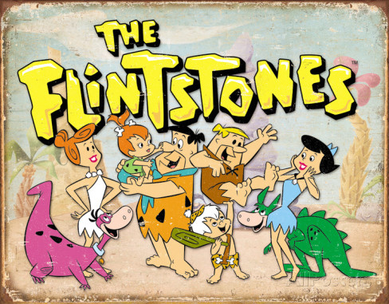

Game Rationale
Existing ones mislead the user

Slide 5
Goals of the Project
Historical accuracy
Engaging and informative
Measured by:
Student performance in quizzes
Leaderboards
Customer Ratings & Reviews

Slide 6
Stakeholders
The client – Lithos INC.
Customers and Hands-on users:
High school students – target audience
Teachers and parents
Interested individuals
Administrators, developers

Slide 7
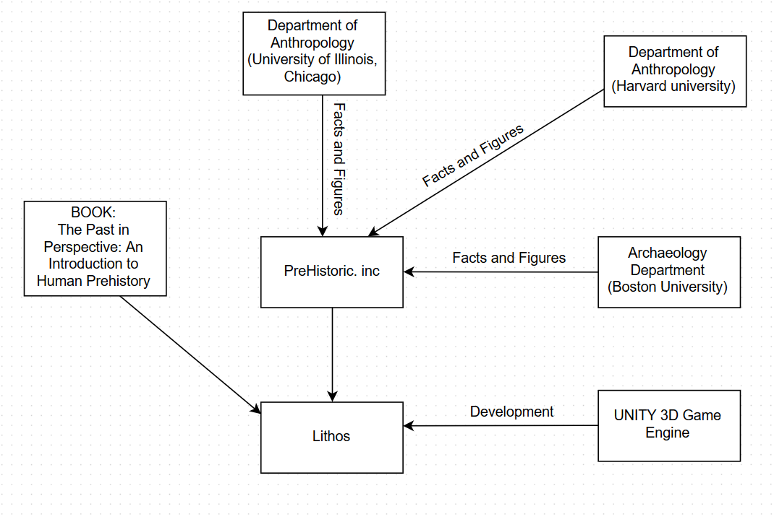
Context of the Work

Slide 8
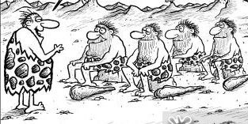
Working of the Game
Game starts as the PLAYER leads an UNCIVILIZED TRIBE solely focused on survival.

Slide 9
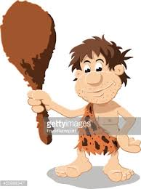

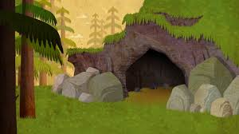
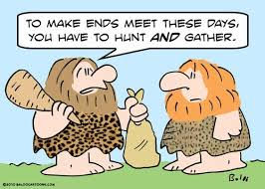

Gather Food
You are at Level 0.
To go to the next level you have to,
Find a safe shelter
Answer the quiz
LEVEL 1

Slide 10
Working of the Game contd...
The timeline of Prehistory is evenly spread as levels starting from Paleolithic Age, continuing through Iron Age and finally emerging as a civilization.
Employ strategies for a ‘smart’ play
Game ends with the tribe settling down as a sophisticated civilization.
Hints and corrections that pop up when the player deviates from the intended goals or takes more time.

Slide 11
Sample Strategies
Two meters:
Food meter
Safety meter
Monitor the meters and make sure they do not go down a level.
Choosing the right set of people from the tribe to perform the specified task
After entering the multiplayer mode:
Deciding which clans to ally with and which ones to fight against.

Slide 12
Competitiveness
User competes against the computer and other online players.
Artificial Intelligence Engine
Analyses the skillset of all tribes
Pits them with respect to skillset
Deploys counter game strategies

Slide 13
Key Definitions
Stone Age
Paleolithic Age
Lower Paleolithic- Food & Shelter
Middle Paleolithic- Fire and Clothing
Upper Paleolithic
Mesolithic Age- Tool Carving
Neolithic Age- Agriculture
Bronze Age
Iron Age

Slide 14
Facts
Stone Age is the earliest known age.
Lower Paleolithic age dealt only with humans searching for food and shelter.
Middle Paleolithic age is where humans have little knowledge about clothing.
Fire was discovered in the middle Paleolithic age due to natural lightning.
The first metal, Copper was known to humans in early Bronze Age.
Humans learnt about alloys in middle Bronze Age.

Slide 15
Assumptions
Targets the PC platform
Attract both dedicated gamers and casual gamers from all age groups.
Available for all Desktop platforms (Windows, Mac, Linux)
Programmed using the game development engine "UNITY 3D”.
User data will be confidential

Slide 16
THANK Y☺U

