Slide 1
LITHOS
Group – 22
Aravind Achanta
Yonathan Gordon
Spoorthi Pendyala
Sai Priya Jyothula
Sumanth Reddy Pandugula
Vakkalanka V S S Dilip Raju

Slide 2
Contents
Project Overview
Game Rationale
Goals
Stakeholders
Context of work
Working of the Game
Sample Strategies
Competitiveness
Use Case Diagram
Functional Requirements
Test Plans

Slide 3
Project Overview
What is the game about?
Pre Historic Humans
What is the Game objective?
Uncivilized Tribe → Civilization
What does it do?
Educates user about the Early Human Lifestyle

Slide 4
Goals of the Project
Historical accuracy
Engaging and informative
Measured by:
Student performance in quizzes
Leaderboards
Customer Ratings & Reviews

Slide 5
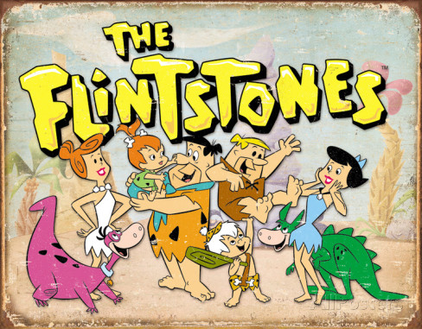
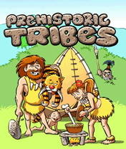
Game Rationale
Existing ones mislead the user

Slide 6
Stakeholders
The client – Lithos INC.
Customers and Hands-on users:
High school students – target audience
Teachers and parents
Interested individuals
Administrators, developers

Slide 7
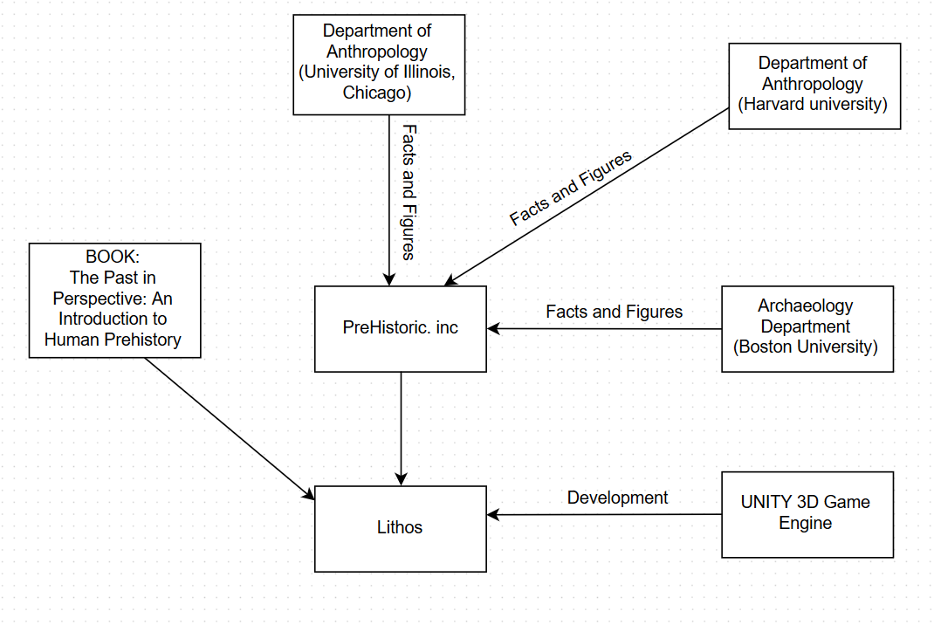
Context of the Work

Slide 8
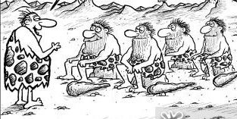
Working of the Game
Game starts as the PLAYER leads an UNCIVILIZED TRIBE solely focused on survival.

Slide 9
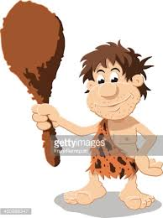

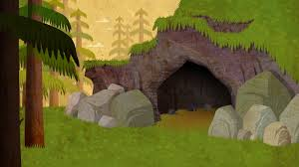
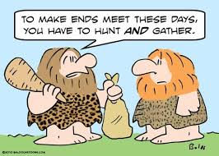

Gather Food
You are at Level 0.
To go to the next level you have to,
Find a safe shelter
Answer the quiz
LEVEL 1

Slide 10
Working of the Game contd...
The timeline of Prehistory is evenly spread as levels starting from Paleolithic Age, continuing through Iron Age and finally emerging as a civilization.
Employ strategies for a ‘smart’ play
Game ends with the tribe settling down as a sophisticated civilization.
Hints and corrections that pop up when the player deviates from the intended goals or takes more time.

Slide 11
Sample Strategies
Two meters:
Food meter
Safety meter
Monitor the meters and make sure they do not go down a level.
Choosing the right set of people from the tribe to perform the specified task
After entering the multiplayer mode:
Deciding which clans to ally with and which ones to fight against.

Slide 12
Competitiveness
User competes against the computer and other online players.
Artificial Intelligence Engine
Analyses the skillset of all tribes
Pits them with respect to skillset
Deploys counter game strategies

Slide 13
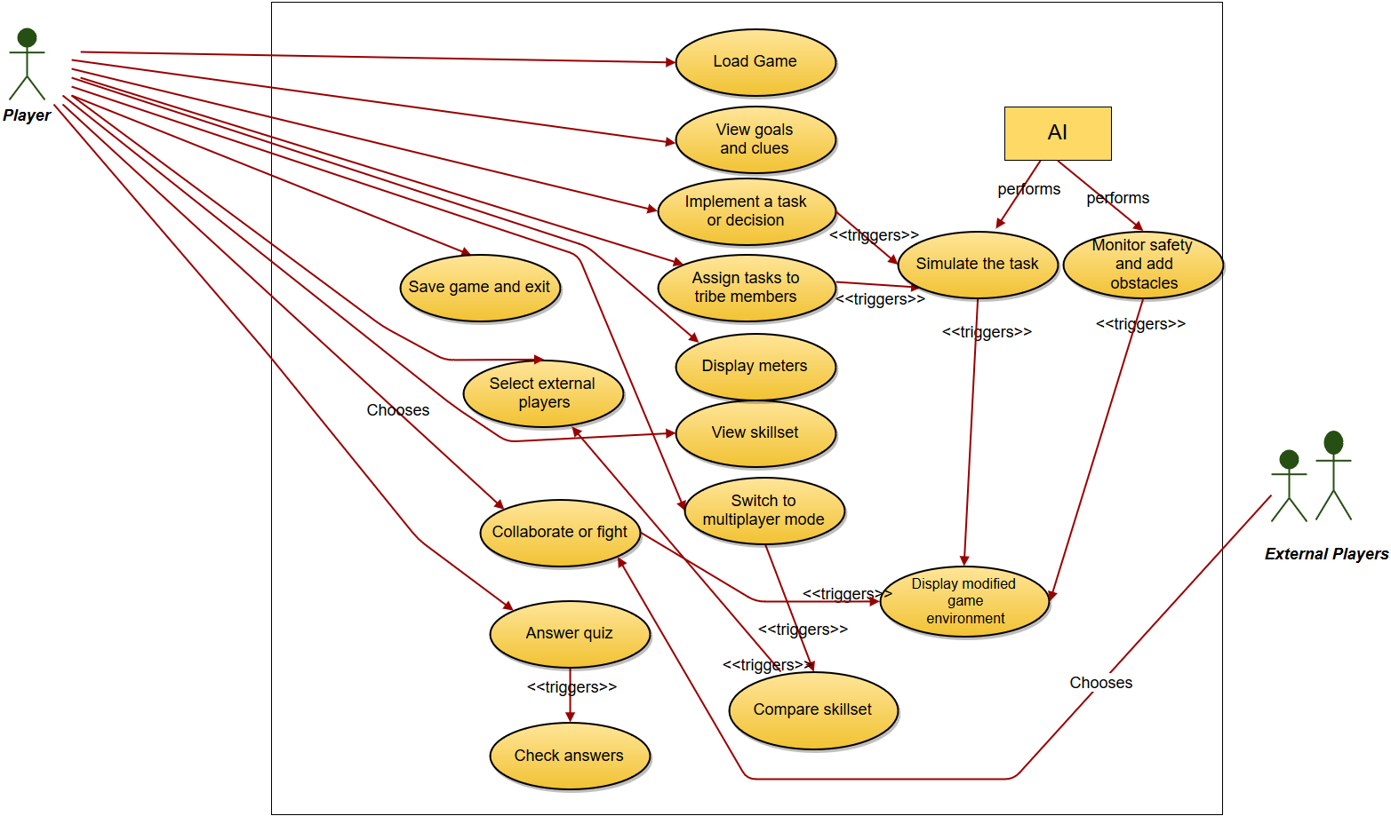
Use Case Diagram

Slide 14
Functional Requirements
Load and Save Game
load a pre-existing game or a new game.
Information Screens
show game info: goals, clues, meters and skillset
Implementing and assigning tasks
means to view skillset and choose tribe members, implement and assign tasks
Artificial Intelligence
simulation reports, add challenges
End-of-level Quiz
means to answer quiz, check answers and compute score
Multiplayer mode
search for compatible external players, send invites, monitor responses, means to choose between collaborate and fight.

Slide 15
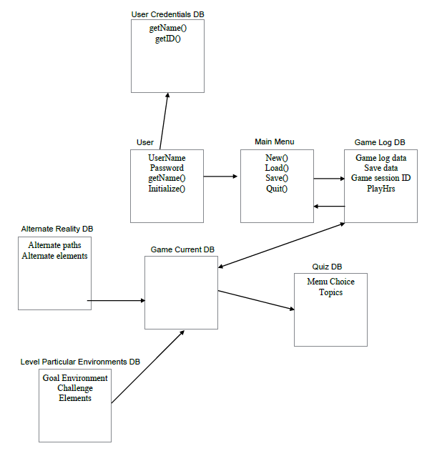
Data Requirements

Slide 16
Look and feel Requirements
Appearance Requirements
Intuitive UI elements for an engaging game play
Color coordination according to ages
Style Requirements
3D Realistic characters
Fonts- ancient gothic style
Menus - manuscript type
Fonts, colors, sounds must correspond to the historical age

Slide 17
Test Plans
Features
Single, multiplayer, UI of game - Black Box Testing
Unit Testing, Integration Testing - White Box Testing
Data storage (User ID) Testing
Pass/Fail Criteria
White Box/Black Box testing passed or failed?
Small team for testing

Slide 18
THANK Y☺U

