Slide 1
LITHOS
Group – 22
Aravind Achanta
Yonathan Gordon
Spoorthi Pendyala
Sai Priya Jyothula
Sumanth Reddy Pandugula
Vakkalanka V S S Dilip Raju

Slide 2
Contents
Project Overview
Use Case Diagram
Functional Requirements
Non-functional Requirements
Test Plans

Slide 3

Project Overview
Lithos is an interactive multiplayer strategy game in which the user plays the role of a tribal leader who tries to overcome various obstacles in Prehistoric Age.

Slide 4
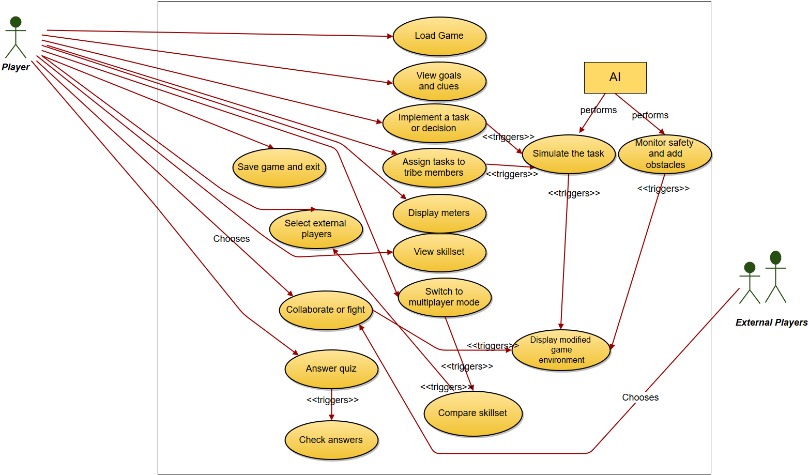
Use Case Diagram

Slide 5
Use case ID: 10 Name: SelectExternalPlayers pre-conditions: The player is in multiplayer mode and the system has the list of compatible external players. post-conditions: The system sends invites from the player to the selected external players to join the multiplayer game. Initiated by: Player Triggering Event: The player selects the ‘Select External Players’ option. Supporting use cases: CompareSkillset (Use Case ID: 9) Additional Actors: Not Applicable
Sequence of Events: 1. The player selects the ‘Select External Players’ option. 2.The system displays the list of compatible external players and provides the player with the option to know more about each of them. 3. The player selects the option to know more about a particular external player. 4. The system displays the detailed information (such as the highest played level, skillset, number of tribe members, scores) of the particular external player. 5. The system provides a means for the player to send an invite to the external player to join the multiplayer game. 6. The player chooses to send an invite to the external player. 7. The system notifies the external player of the invite. 8. The system provides the player with the option to go back to the list again (Step 2).
Alternatives: One of the external players sends an invite for the player to join the multiplayer game. Exceptions: 1. The external player does not have comparable skillset. 2. The communication system that sends the invite is down. 3. The detailed information about one of the other external players is unavailable.

Slide 6
Functional Requirements
Load and Save Game
load a pre-existing game or a new game.
Information Screens
show game info: goals, clues, meters and skillset
Implementing and assigning tasks
means to view skillset and choose tribe members, implement and assign tasks
Artificial Intelligence
simulation reports, add challenges
End-of-level Quiz
means to answer quiz, check answers and compute score
Multiplayer mode
search for compatible external players, send invites, monitor responses, means to choose between collaborate and fight.

Slide 7
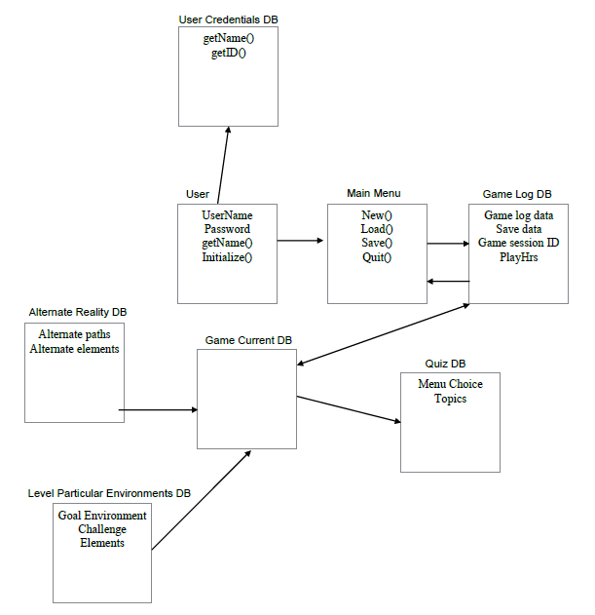
Data Requirements

Slide 8
Non-functional Requirements

Slide 9
Performance Requirements
Speed and Latency
  24 FPS 90% of time
  Low bandwidth speed
  CPU utilization < 10%
  GPU < 75 %
Precision
  Health bar to represent starvation level and relative safety using percentages
  Correct Spelling of names and historical events
Capacity requirements
  Handle up to 1 million users without crashing
  Performance should stay constant regardless of number of users logged in to the system.

Slide 10
Dependability Requirements
Reliability Requirements
  Should not crash
  Trigger Data recovery mechanism in case of an unexpected fault
Availability Requirements
  Game Server up 24/7
  Resume functionality within 15 minutes
  In case of maintenance/repair, notify via email
Safety
  gamma correction and brightness set according to the norms and standards with the corresponding regulations.

Slide 11
Maintainability and Supportability Requirements
Maintainability requirements
  Release updates on a 6 month basis
  Depends on problem severity and customer feedback
Supportability requirements
  Allow plugins to be added easily
  Easily comprehensible tutorials
Adaptability requirements
  Run on all major operating systems
  Updates should be easily patched

Slide 12
Security Requirements
Access Requirements
  Validating credentials through a database
  End to End encryption
Integrity/ Privacy Requirements
  Fault tolerance mechanism
  Encryption must be free of potential exploits
Audit requirements
  Store user credentials in the database for 3 years after account deactivation
Immunity Requirements
  Appropriate anti-virus software to reduce risk of malicious attacks
  Secure networking mechanism to
  Reduce the possibility of counterfeit data

Slide 13
Usability Requirements
Ease of use requirements
  Low learning curve as target audience are students
Personalization
  GUI customization, Personal profile, language customization
Learning requirements
  Minimal computer literacy is required
  Ability to follow tutorials and instructions
Accessibility requirements
  Features to aid visually or hearing impaired
    Audio Cues
    Closed Captioning
    No patterned backgrounds

Slide 14
Look and feel Requirements
Appearance Requirements
  Intuitive UI elements for an engaging game play
  Color coordination according to ages
Style Requirements
  3D Realistic characters
  Fonts- ancient gothic style
  Menus - manuscript type
  Fonts, colors, sounds must correspond to the historical age

Slide 15
Operational and Environmental Requirements
Expected Physical environment
  Computer labs in schools, Personal Computers
  Windows 7 and higher, Linux 12.4 and higher, Mac OS X 10.8 and higher
Production requirements
  Download file from Lithos webpage
  Less than 2MB of RAM to be used

Slide 16
Cultural and Political Requirements
Cultural requirements
  Historically accurate
  Non-offensive to any culture
  Support multiple languages
Political requirements
  Represent the values of Lithos inc
  Preserve the real purpose while stressing on the game events’ accuracy

Slide 17
Legal Requirements
Compliance Requirements
  Avoid Copyright infringement
  User data must not be confiscated
  Internal development knowledge must not be leaked to outsiders
Standard Requirements
  Comply with Milspec standards
  Comply with ESRB’s standards
  Marketing and distribution must comply with FTC standards

Slide 18
Test Plans
Features
    Single, multiplayer, UI of game - Black Box Testing
    Unit Testing, Integration Testing - White Box Testing
    Data storage (User ID) Testing
Pass/Fail Criteria
    White Box/Black Box testing passed or failed?
    Small team for testing

Slide 19
Test Plans
Approach
    Black Box Testing – Unity Game Engine
    White Box Testing – C++/ C# platform
    Full Configuration testing – Windows, Mac OS X, Linux
Suspension/Resumption
    Fail safe mechanism
    Test for recovery in every case
Testing Materials
    Black Box Testing- Windows operable Workstation
    White Box Testing –visual Studio operable Windows Machine
    Full Configuration Testing – Windows, Mac OS X, Linux

Slide 20
Test Cases I
Test Case Name | Description | Expected Results
LITHOS-DOWNLOAD GAME | User visits the Lithos INC. website and downloads the latest version of the game. | User successfully downloads the software to his local system.
LITHOS-VIEW GAME | User clicks on the “view goals and clues” option in the game screen. | System displays the goals of the current level and provides the player with relevant clues according to the challenges of the level in a window.
LITHOS-LEVEL COMPLETION | User achieves the level specific goals and clicks on continue game. | System should display corresponding quiz questions for that level.
LITHOS-SIMULATE TASKS | User assigns tasks to different tribe members in his team. | Skillset of the tribe members changes as the game advances.

Slide 21
Test Cases II
Test Case Name | Description | Expected Results
LITHOS-MULTIPLAYER TEST | User selects the multiplayer mode option. | System must display a message that the user has entered into the multiplayer mode.
LITHOS-COLLABORATE OR FIGHT OPTION | System displays a list of external players who have accepted the requests sent by the player and the requests accepted by the player himself. | Systems must show the options to fight or collaborate.
LITHOS-COMPARE SKILL SET | User clicks on select external players in multiplayer mode. | System must populate a list of players with matching skill set.

Slide 22
Testing Schedule
Unit Testing | Duration: 2 days Begins: After each sprint is completed
Integration testing | Duration: 7 days Begins: 3 weeks before each release
Usability testing | Duration: 2 weeks Begins: 3 weeks before each release
Inspection Testing | During the entire development phase.

Slide 23
THANK Y☺U

