Slide 1
LITHOS
Group – 22
Aravind Achanta
Yonathan Gordon
Spoorthi Pendyala
Sai Priya Jyothula
Sumanth Reddy Pandugula
Vakkalanka V S S Dilip Raju

Slide 2
Contents
Project Overview
Use Case Diagram
Functional Requirements
Non-functional Requirements
Test Plans

Slide 3
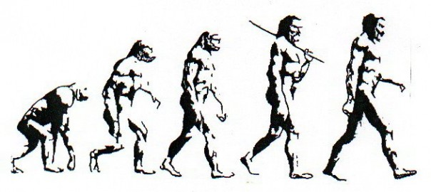
Project Overview
Lithos is an interactive multiplayer strategy game in which the user plays the role of a tribal leader who tries to overcome various obstacles in Prehistoric Age.

Slide 4
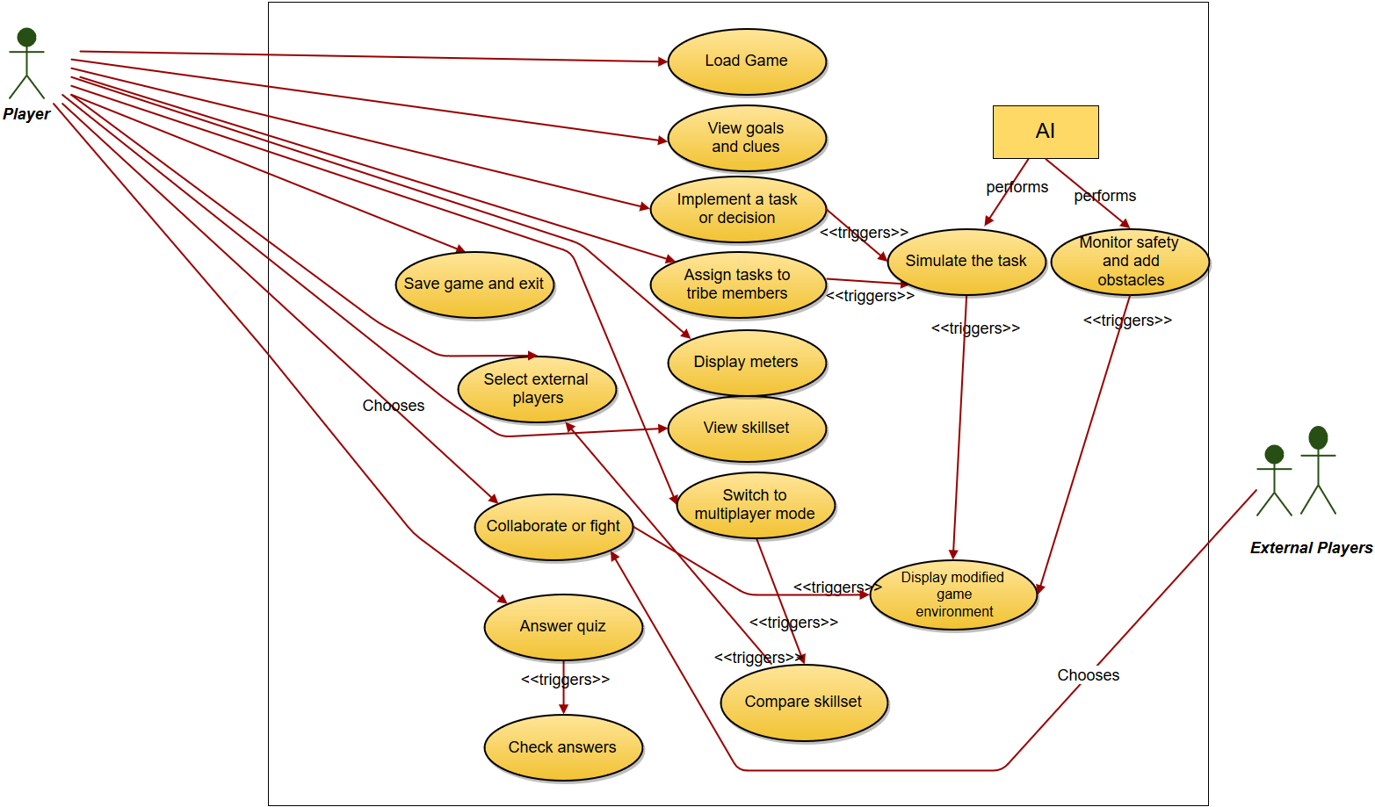
Use Case Diagram

Slide 5
Use case ID: 10 Name: SelectExternalPlayers pre-conditions: The player is in multiplayer mode and the system has the list of compatible external players. post-conditions: The system sends invites from the player to the selected external players to join the multiplayer game. Initiated by: Player Triggering Event: The player selects the ‘Select External Players’ option. Supporting use cases: CompareSkillset (Use Case ID: 9) Additional Actors: Not Applicable
Sequence of Events: 1. The player selects the ‘Select External Players’ option. 2.The system displays the list of compatible external players and provides the player with the option to know more about each of them. 3. The player selects the option to know more about a particular external player. 4. The system displays the detailed information (such as the highest played level, skillset, number of tribe members, scores) of the particular external player. 5. The system provides a means for the player to send an invite to the external player to join the multiplayer game. 6. The player chooses to send an invite to the external player. 7. The system notifies the external player of the invite. 8. The system provides the player with the option to go back to the list again (Step 2).
Alternatives: One of the external players sends an invite for the player to join the multiplayer game. Exceptions: 1. The external player does not have comparable skillset. 2. The communication system that sends the invite is down. 3. The detailed information about one of the other external players is unavailable.

Slide 6
Functional Requirements
Load and Save Game
load a pre-existing game or a new game.
Information Screens
show game info: goals, clues, meters and skillset
Implementing and assigning tasks
means to view skillset and choose tribe members, implement and assign tasks
Artificial Intelligence
simulation reports, add challenges
End-of-level Quiz
means to answer quiz, check answers and compute score
Multiplayer mode
search for compatible external players, send invites, monitor responses, means to choose between collaborate and fight.

Slide 7
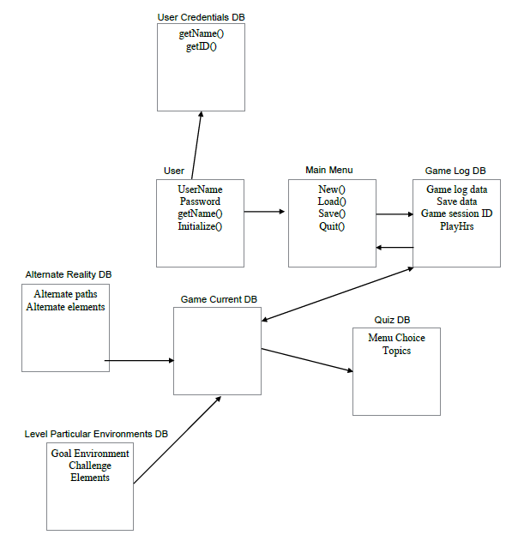
Data Requirements

Slide 8
Non-functional Requirements

Slide 9
Performance Requirements
Speed and Latency
24 FPS 90% of time
Low bandwidth speed
CPU utilization < 10%
GPU < 75 %
Precision
Health bar to represent starvation level and relative safety using percentages
Correct Spelling of names and historical events
Capacity requirements
Handle up to 1 million users without crashing
Performance should stay constant regardless of number of users logged in to the system.

Slide 10
Dependability Requirements
Reliability Requirements
Should not crash
Trigger Data recovery mechanism in case of an unexpected fault
Availability Requirements
Game Server up 24/7
Resume functionality within 15 minutes
In case of maintenance/repair, notify via email
Safety
gamma correction and brightness set according to the norms and standards with the corresponding regulations.

Slide 11
Maintainability and Supportability Requirements
Maintainability requirements
Release updates on a 6 month basis
Depends on problem severity and customer feedback
Supportability requirements
Allow plugins to be added easily
Easily comprehensible tutorials
Adaptability requirements
Run on all major operating systems
Updates should be easily patched

Slide 12
Security Requirements
Access Requirements
Validating credentials through a database
End to End encryption
Integrity/ Privacy Requirements
Fault tolerance mechanism
Encryption must be free of potential exploits
Audit requirements
Store user credentials in the database for 3 years after account deactivation
Immunity Requirements
Appropriate anti-virus software to reduce risk of malicious attacks
Secure networking mechanism to
Reduce the possibility of counterfeit data

Slide 13
Usability Requirements
Ease of use requirements
Low learning curve as target audience are students
Personalization
GUI customization, Personal profile, language customization
Learning requirements
Minimal computer literacy is required
Ability to follow tutorials and instructions
Accessibility requirements
Features to aid visually or hearing impaired
Audio Cues
Closed Captioning
No patterned backgrounds

Slide 14
Look and feel Requirements
Appearance Requirements
Intuitive UI elements for an engaging game play
Color coordination according to ages
Style Requirements
3D Realistic characters
Fonts- ancient gothic style
Menus - manuscript type
Fonts, colors, sounds must correspond to the historical age

Slide 15
Operational and Environmental Requirements
Expected Physical environment
Computer labs in schools, Personal Computers
Windows 7 and higher, Linux 12.4 and higher, Mac OS X 10.8 and higher
Production requirements
Download file from Lithos webpage
Less than 2MB of RAM to be used

Slide 16
Cultural and Political Requirements
Cultural requirements
Historically accurate
Non-offensive to any culture
Support multiple languages
Political requirements
Represent the values of Lithos inc
Preserve the real purpose while stressing on the game events’ accuracy

Slide 17
Legal Requirements
Compliance Requirements
Avoid Copyright infringement
User data must not be confiscated
Internal development knowledge must not be leaked to outsiders
Standard Requirements
Comply with Milspec standards
Comply with ESRB’s standards
Marketing and distribution must comply with FTC standards

Slide 18
Test Plans
Features
Single, multiplayer, UI of game - Black Box Testing
Unit Testing, Integration Testing - White Box Testing
Data storage (User ID) Testing
Pass/Fail Criteria
White Box/Black Box testing passed or failed?
Small team for testing

Slide 19
Test Plans
Approach
Black Box Testing – Unity Game Engine
White Box Testing – C++/ C# platform
Full Configuration testing – Windows, Mac OS X, Linux
Suspension/Resumption
Fail safe mechanism
Test for recovery in every case
Testing Materials
Black Box Testing- Windows operable Workstation
White Box Testing –visual Studio operable Windows Machine
Full Configuration Testing – Windows, Mac OS X, Linux

Slide 20
Test Cases I
Test Case Name | Description | Expected Results
LITHOS-DOWNLOAD GAME | User visits the Lithos INC. website and downloads the latest version of the game. | User successfully downloads the software to his local system.
LITHOS-VIEW GAME | User clicks on the “view goals and clues” option in the game screen. | System displays the goals of the current level and provides the player with relevant clues according to the challenges of the level in a window.
LITHOS-LEVEL COMPLETION | User achieves the level specific goals and clicks on continue game. | System should display corresponding quiz questions for that level.
LITHOS-SIMULATE TASKS | User assigns tasks to different tribe members in his team. | Skillset of the tribe members changes as the game advances.

Slide 21
Test Cases II
Test Case Name | Description | Expected Results
LITHOS-MULTIPLAYER TEST | User selects the multiplayer mode option. | System must display a message that the user has entered into the multiplayer mode.
LITHOS-COLLABORATE OR FIGHT OPTION | System displays a list of external players who have accepted the requests sent by the player and the requests accepted by the player himself. | Systems must show the options to fight or collaborate.
LITHOS-COMPARE SKILL SET | User clicks on select external players in multiplayer mode. | System must populate a list of players with matching skill set.

Slide 22
Testing Schedule
Unit Testing | Duration: 2 days Begins: After each sprint is completed
Integration testing | Duration: 7 days Begins: 3 weeks before each release
Usability testing | Duration: 2 weeks Begins: 3 weeks before each release
Inspection Testing | During the entire development phase.

Slide 23
THANK Y☺U

