Slide 1
Welcome to EPICS!
Week 1, Studio Day 1

Slide 2

Are you in the right room?
Section U –
Engineering Annex
Roll Call
Notes:
Make this announcement twice – once at beginning, and once 20 minutes in

Slide 3

A lot of Firsts!
First time in college?
First time in eating dorm food?
First time living in a new place?
Other firsts?
Education and a Degree
Awareness Training Exercise
Notes:
Make this announcement twice – once at beginning, and once 20 minutes in

Slide 4
TODAY
Roll call
Mentor introduction
A week in the life of an EPICS student
Design cycle
Mini team exercises
Next up

Slide 5
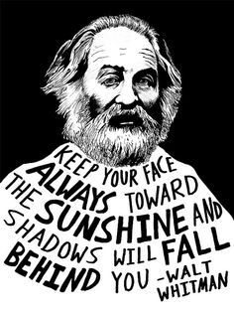
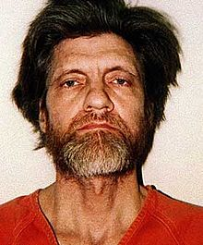
Mentor Introduction
Apologies for the Beard!
Me

Slide 6


Mentor Introduction
Graduated from Mines in 1997
Took EPICS as Freshman
Met my wife at Mines
Got the worst grades of my life here
Love this place
Two daughters (ages 14 and 12)

Slide 7


Mentor Introduction
Career Continuum
Designed Power Delivery Systems
Masters of Engineering
Designed Water & Wastewater Plants
Masters of Business Administration
Director of O&M at the NTP
Adjunct EPICS Professor at Mines.
More Firsts to Come!

Slide 8
Mentor Introduction
This is how quick I am able to respond
This is not my Primary Job
Email me at my work address
Instant Messaging
Fred Flintstone

Slide 9
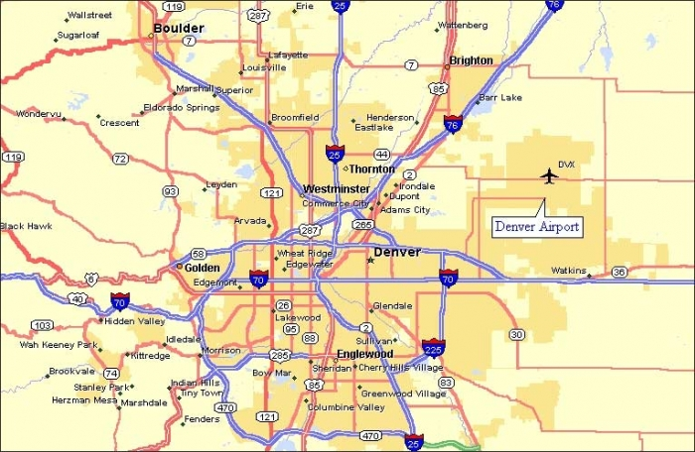
Mentor Introduction
6:00 am - Brighton
I want to be here – Let’s Make this Semester Productive!
3:30 am - Golden
4:30 am - Parker

Slide 10
TODAY
Roll call
Mentor introduction
A week in the life of an EPICS student
Design cycle
Mini team exercises
Next up

Slide 11
A week in the Life
Project Day 1
TUES 3:30 pm
Graphics Lab
Varies by student (W,Th,F)
With graphics instructors
Project Day 2
Thurs 3:30 pm
ANNEX
ANNEX
With your mentor(s)
CTLM 129
With your mentor(s)
All the rest of your classes, fun stuff, people, experiences
Remember Education and Degree and Awareness Training!

Slide 12
EPICS 151 and course deliverables
Notes:
ALWAYS REFER TO CURRENT COPY ONLINE!!!

Slide 13
TODAY
Roll call
Mentor introduction
A week in the life of an EPICS student
Design cycle
Mini team exercises
Next up

Slide 14
Creative problem solving process
Test
Problem Definition
Exploration
Analysis
Implementation
Stakeholder engagement, Presentation/ Documentation, Project Management
Refine
Test
Test
Test
Test
Iterate
Refine
Refine
Refine
Refine
Iterate
Iterate
Iterate
Iterate

Slide 15
EPICS 151 and course content
Team time and Project work
Problem Definition
Exploration
Analysis
Implementation
Content and Process work
Stakeholder engagement, Presentation/ Documentation, Project Management
(Design Log- wk 13, Hand-sketching- wk 7, and SolidWorks homework & exam)
Project Plan / Team contract
(wk 11)
Test
Refine
Iterate
Design Report, presentation, works-like prototype
(wk 16)
Client (251) / Mentor (151)
Time →

Slide 16
TODAY
Roll call
Mentor introduction
A week in the life of an EPICS student
Design cycle
Mini team exercises
Next up

Slide 17
TODAY’s objectives
3 - Design solutions through cycle of testing, refining, iterating, and feedback.
4 - Determine equivalency and equitably contribute to team efforts from start to end on a collaborative project, and participate in learning activities and coaching activities in the team.

Slide 18
The Marshmallow Challenge
Build the tallest free-standing tower you can, with a marshmallow at the top in 18 minutes
Materials:
20 sticks of spaghetti
1 yard of tape
1 yard of string
1 marshmallow

Slide 19

Mini team exercise
On a sheet of paper, write two lists:
Attributes of a high functioning team
Include things you’ve experienced on a team that you’ve liked
Attributes of a dysfunctional team
Include things you’ve experienced on a team that you don’t like
4-5 minutes

Slide 20
The Marshmallow Challenge
Build the tallest free-standing tower you can, with a marshmallow at the top in 18 minutes
Materials:
20 sticks of spaghetti
1 yard of tape
1 yard of string
1 marshmallow
20 minutes

Slide 21
The Marshmallow Challenge: Take aways
Ideas? What was the point of all this?
http://marshmallowchallenge.com/TED_Talk.html
Notes:
They’ll no doubt talk about team work.
Make sure to emphasize failing early, often, when you can still do something about it.

Slide 22
What was the point? …TODAY’s objectives
3 - Design solutions through cycle of testing, refining, iterating, and feedback.
4 - Determine equivalency and equitably contribute to team efforts from start to end on a collaborative project, and participate in learning activities and coaching activities in the team.

Slide 23
That Problem Solving Process
Test
Problem Definition
Exploration
Analysis
Implementation
Stakeholder engagement, Presentation/ Documentation, Project Management
Test
Test
Test
Test
Refine
Refine
Refine
Refine
Refine
Iterate
Iterate
Iterate
Iterate
Iterate
The longer you resist those round-about arrows, the bigger your failures will be. Really.
(….umm…. not just in EPICS…)

Slide 24
Finally,
On that sheet of paper, add to your 2 lists:
Attributes of a high functioning team
Include things you’ve experienced on a team that you’ve liked
Attributes of a dysfunctional team
Include things you’ve experienced on a team that you don’t like
1-2 minutes

Slide 25
notice where you’re sitting
Sit with the same folks in Day 2 and next week.
Your official project teams will be determined late week 2. But this group is your initial, 2-week team.

Slide 26

Next class: bring your Design Log (notebook)
Purpose:
Documentation of your process throughout this class (1st half of book)
Major project decisions
Conceptual sketches
Notes from testing, interviews, discussions, lectures, observations
Bug lists
Sketching practice (2nd half of book - stay tuned…)
The Campus Bookstore sells composition notebooks
(blank, grids, lines: your choice)
** Tape your 2 lists of team function into it.
Notes:
Emphasize that these habits are workplace standards, and that often patent disputes go to Design Logs and data books just like these to determine who had an idea first.

Slide 27
Next class: bring your Design Log (notebook)
Format:
Informal document (internal use)
Bound book, NOT spiral/perforated
FRONT COVER: Write your name, semester, and EPICS project and lab section
FIRST PAGE: Write your name, contact info, and team name
NO loose papers tucked inside
Staple or tape in extra sketches, class information, project plan, etc
Some folks number pages of the Design Log
And include a basic Table of Contents (for 8-15 key pages)
Use pencil or pen but CROSS OUT your work instead of ERASING
Graphics instructors will talk about additional use of your Design log
Notes:
Emphasize that these habits are workplace standards, and that often patent disputes go to Design Logs and data books just like these to determine who had an idea first.

Slide 28
Lastly, Student Information Card
Purpose: to help us place you in teams
How: we’ll work to create teams with a breadth of skills
Why: it won’t ensure your team experience is heavenly, but it’s how things are done in the workplace
Return at the end of class, or bring beginning of day 2.

Slide 29
Coming up next!
Project Day 2:
Sit with your 2-week team again.
Assignments:
1- Bring your design log! (buy at bookstore)
2- Tape today’s paper in it. Yes, the one with the 2 lists.
3- Read course outcomes, highlight, and bring questions
4- Watch IDEO design video: https://youtu.be/taJOV-YCieI
Write in your design log:
- Two things you liked from the video
- Two things that left you wondering, or that you didn’t like about the video
Graphics Day 1:
Conceptualization and visualization, and perspective sketching

