Slide 1
Presentation on Multithreading
Sumon Karmakar

Slide 2
Multi Threading
Multithreading in java is a process of executing multiple threads simultaneously.
Thread is basically a lightweight sub-process, a smallest unit of processing. Multiprocessing and multithreading, both are used to achieve multitasking.
Advantages of Java Multithreading
1) It doesn't block the user because threads are independent and you can perform multiple operations at same time.
2) You can perform many operations together so it saves time.
3) Threads are independent so it doesn't affect other threads if exception occur in a single thread.

Slide 3
Multi Threading
Multitasking:-
Multitasking is a process of executing multiple tasks simultaneously. We use multitasking to utilize the CPU. Multitasking can be achieved by two ways:
Process-based Multitasking(Multiprocessing)
Thread-based Multitasking(Multithreading)

Slide 4
Multi Threading
Processor-Based Multitasking:-
Each process have its own address in memory i.e. each process allocates separate memory area.
Process is heavyweight.
Cost of communication between the process is high.
Switching from one process to another require some time for saving and loading registers, memory maps, updating lists etc.

Slide 5
Multi Threading
Thread-Based Multitasking:-
Threads share the same address space.
Thread is lightweight.
Cost of communication between the thread is low.

Slide 6
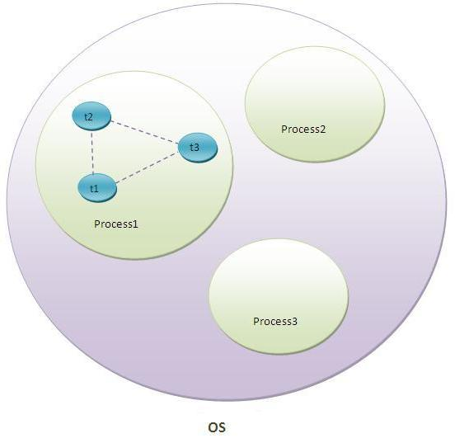
Multi Threading
Definition of Thread:-
A thread is a lightweight sub process, a smallest unit of processing. It is a separate path of execution.
Threads are independent, if there occurs exception in one thread, it doesn't affect other threads. It shares a common memory area.

Slide 7
Multi Threading
Lifecycle of a Thread:-
A thread can be in one of the five states. According to sun, there is only 4 states in thread life cycle in java new, runnable, non-runnable and terminated. There is no running state.
The life cycle of the thread in java is controlled by JVM. The java thread states are as follows:
New
Runnable
Running
Non-Runnable (Blocked)
Terminated

Slide 8
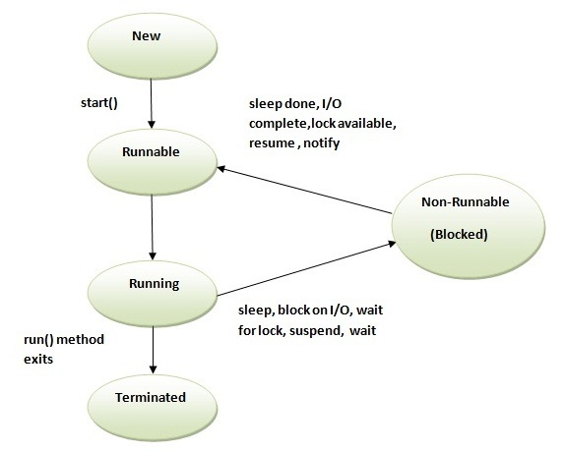
Multi Threading
Lifecycle of a Thread:-

Slide 9
Multi Threading
Lifecycle of a Thread:-
1) New:- The Thread is in the new state if you create an instance of Thread class but before the invocation of the thread class.
2) Runnable:- The thread is in runnable state after invocation of start() method, but the thread scheduler has not selected it to be the running thread.
3) Running:- The thread is in running state if the thread scheduler has selected it.
4) Non-Runnable (Blocked):- This is the state when the thread is still alive, but is currently not eligible to run.
5) Terminated:- A thread is in terminated or dead state when its run() method exits.

Slide 10
Multi Threading
Process of creating a Thread:-
There are two ways to create a thread:
By extending Thread class
By implementing Runnable interface.

Slide 11
Multi Threading
Thread Class :-
Thread class provide constructors and methods to create and perform operations on a thread.Thread class extends Object class and implements Runnable interface.
Commonly Used Constructor of Thread Class :-
Thread() Thread(String name) Thread(Runnable r) Thread(Runnable r,String name)

Slide 12
Multi Threading
Commonly Used Methods of Thread Class :-
public void start()
public void run()
public void sleep(long milliseconds)
Public void join()
Public void join(long milliseconds)
Public int getPriority()
Public int setPriority(long milliseconds)
Public void suspend()
Public void resume()

Slide 13
Multi Threading
Joining a thread :- The join() method waits for a thread to die. In other words, it causes the currently running threads to stop executing until the thread it joins with completes its task.
Syntax:-
public void join()throws InterruptedException
public void join(long milliseconds)throws InterruptedException

Slide 14
Multi Threading
Naming Thread & Current Thread:-
Naming Thread:- The Thread class provides methods to change and get the name of a thread. By default, each thread has a name i.e. thread-0, thread-1 and so on. By we can change the name of the thread by using setName() method. The syntax of setName() and getName() methods are given below:
public String getName(): is used to return the name of a thread.
public void setName(String name): is used to change the name of a thread.

Slide 15
Multi Threading
Naming Thread & Current Thread:-
Naming Thread Example:-
class TestMultiNaming1 extends Thread{
public void run(){ System.out.println("running...");
} public static void main(String args[]){
TestMultiNaming1 t1=new TestMultiNaming1();
TestMultiNaming1 t2=new TestMultiNaming1();
System.out.println("Name of t1:"+t1.getName());
System.out.println("Name of t2:"+t2.getName());
t1.start();
t2.start();
t1.setName("Sonoo Jaiswal");
System.out.println("After changing name of t1:"+t1.getName()); } }
Output:- Name of t1:Thread-0
Name of t2:Thread-1
id of t1:8
running...
After changeling name of t1:Sonoo Jaiswal
running...

Slide 16
Multi Threading
Naming Thread & Current Thread:-
Current Thread:- The currentThread() method returns a reference of currently executing thread.
public static Thread currentThread()

Slide 17
Multi Threading
Naming Thread & Current Thread:-
Example of Current Thread:-
class TestMultiNaming2 extends Thread{
public void run(){
System.out.println(Thread.currentThread().getName()); }
public static void main(String args[]){
TestMultiNaming2 t1=new TestMultiNaming2();
TestMultiNaming2 t2=new TestMultiNaming2();
t1.start();
t2.start();
} }
Output:- Thread-0
Thread-1

Slide 18
Multi Threading
Thread Priority:- Each thread have a priority. Priorities are represented by a number between 1 and 10. In most cases, thread schedular schedules the threads according to their priority (known as preemptive scheduling). But it is not guaranteed because it depends on JVM specification that which scheduling it chooses.
3 Constants defined in the Thread Class:
public static int MIN_PRIORITY
public static int NORM_PRIORITY
public static int MAX_PRIORITY

Slide 19
Multi Threading
Example of Thread Priority:-
class TestMultiPriority1 extends Thread{
public void run(){
System.out.println("running thread name is:"+Thread.currentThread().getName());
System.out.println("running thread priority is:"+Thread.currentThread().getPriority());
} public static void main(String args[]){
TestMultiPriority1 m1=new TestMultiPriority1();
TestMultiPriority1 m2=new TestMultiPriority1();
m1.setPriority(Thread.MIN_PRIORITY);
m2.setPriority(Thread.MAX_PRIORITY);
m1.start();
m2.start();
} }
Output:-
running thread name is:Thread-0
running thread priority is:10
running thread name is:Thread-1
running thread priority is:1

Slide 20
Multi Threading
Daemon Thread:- Daemon thread in java is a service provider thread that provides services to the user thread. Its life depend on the mercy of user threads i.e. when all the user threads dies, JVM terminates this thread automatically.
There are many java daemon threads running automatically e.g. gc, finalizer etc.
It provides services to user threads for background supporting tasks. It has no role in life than to serve user threads.
Its life depends on user threads.
It is a low priority thread.
Why JVM terminates Daemon thread if there is no longer use?
The sole purpose of the daemon thread is that it provides services to user thread for background supporting task. If there is no user thread, why should JVM keep running this thread. That is why JVM terminates the daemon thread if there is no user thread.

Slide 21
Multi Threading
Daemon Thread Methods:-
No. | Method | Description
1) | public void setDaemon(boolean status) | is used to mark the current thread as daemon thread or user thread.
2) | public boolean isDaemon() | is used to check that current is daemon.

Slide 22
Multi Threading
Daemon Thread Example:- public class TestDaemonThread1 extends Thread{
public void run(){ if(Thread.currentThread().isDaemon()){//checking for daemon thread
System.out.println("daemon thread work");}
else{ System.out.println("user thread work");
}}
public static void main(String[] args){
TestDaemonThread1 t1=new TestDaemonThread1();//creating thread
TestDaemonThread1 t2=new TestDaemonThread1();
TestDaemonThread1 t3=new TestDaemonThread1();
t1.setDaemon(true);//now t1 is daemon thread
t1.start();//starting threads
t2.start();
t3.start();
}}
Output:- daemon thread work
user thread work
user thread work

Slide 23
Multi Threading
Garbage Collection:- In java, garbage means unreferenced objects.
Garbage Collection is process of reclaiming the runtime unused memory automatically. In other words, it is a way to destroy the unused objects.
Advantages:-
It makes java memory efficient because garbage collector removes the unreferenced objects from heap memory.
It is automatically done by the garbage collector(a part of JVM) so we don't need to make extra efforts.

Slide 24
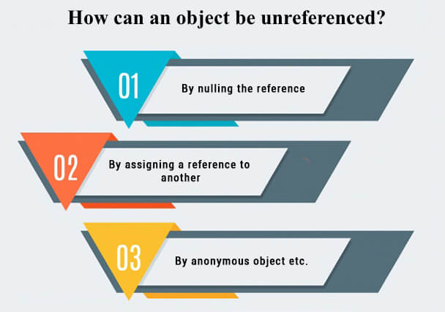
Multi Threading
How a object can be unreferenced:-

Slide 25
Thank You.

