Slide 1


Yoga pose classification from images using transfer learning approach. Presented by (Sumon Singh, Deepali Handgar) Co-Authors – (Dr. Harshali Patil, Dr. Jyotshna Dongardive)
International Conference on
Emerging Trends in Digital Technologies-2023
(ICETDT-2023)
organized by
SVKM's Usha Pravin Gandhi College of Arts, Science and Commerce
Paper ID: (ICETDT#1002)

Slide 2
INTRODUCTION
Yoga is a type of physical activity that consists of postures (also called ‘asanas’) in continuous sequence along with regulated breathing. Yoga originated in ancient India.
In this paper, various pre-trained deep-learning CNN models were used to classify the yoga pose in each image.
Their results are compared and analyzed.
The models used were VGG16, VGG19, InceptionV3, DenseNet201, ResNet50V2, ResNet152V2, ResNet101V2, MobileNet, MobileNetV2 and InceptionResNetV2.

Slide 3
PROBLEM STATEMENT
Aim:
To use transfer learning to classify the yoga pose from the given images and compare the results.

Slide 4
LITERATURE REVIEW
Authors | Paper Title | Key Takeaways
Debabrata Swain et al. | Yoga Pose Monitoring System using Deep Learning | CNN – to extract features LSTM – to understand the occurrence of sequence of frames on videos.
S. Abarna et al | Skeleton Pose Estimation Features-based Classification of Yoga Asana using Deep Learning Techniques | 1D CNN and RNN- for classification and feature selection, OpenPose and CenterNet pre-trained models were used. Better results were obtained with 1D CNN & OpenPose

Slide 5
LITERATURE REVIEW
Authors | Paper Title | Key Takeaways
Josvin Jose et al | Yoga Asana Identification: A Deep Learning Approach | CNN & Transfer learning on images. Of all models VGG16 gave highest accuracy of 85%.
C. Long et al | Development of a yoga posture coaching system using an interactive display based on transfer learning | Transfer learning on images taken from RGB camera. MobileNet-DA was best performing model with accuracy of 98.43%.

Slide 6
METHODOLOGY/PROCESS-FLOW
Dataset
The dataset used for this research paper was taken from Kaggle and uploaded by Niharika Pandit.
The dataset used consists of 1551 images of 5 different yoga asanas.
The 5 asanas are the ‘downward dog pose’, the ‘goddess pose’, the ‘plank pose’, the ‘tree pose’, and the ‘warrior pose’.
The images were resized from 1280x720 pixels to 100x100 pixels for ease of computing using the PIL library in python.
A dataset of 1000 images of 100x100 pixels was also generated using the ‘ImageDataGenerator’ from the tensorflow library.

Slide 7
METHODOLOGY/PROCESS-FLOW
Layers
Input Layer:
A simple preprocessing step normalized the input image (100 × 100 × 3 pixels) to the interval [0, 1].
Next, split the 5-class image dataset into categories for training and testing. The training images were the input to the pretrained model layers and features were extracted.
The pretrained models were able to classify yoga poses based on the class labels assigned to the training data set.

Slide 8
METHODOLOGY/PROCESS-FLOW
Pre-trained model layers:
Each pre-trained model is constructed using two parts: a convolutional basis and a classifier. The convolutional foundation consists of convolutional layers and pooling layers.
The convolutional layers transform the image and extract features from it and the pooling layers reduce the dimensions of the features without losing any important information.
Classifiers are responsible for classifying images based on their characteristics.

Slide 9
METHODOLOGY/PROCESS-FLOW
In the pre-trained model layers, the convolution base used the weights/bias from the ImageNet dataset and the classifier was removed.
Extra layers were added to the model and the classifier was replaced with another for yoga pose image classification.

Slide 10
METHODOLOGY/PROCESS-FLOW
Additional Layers: Additional layers were added to one of the pre-trained models. Flatten layer was used to make the multidimensional output into 1D so that it could go through the next dense layers.
The first layer - 256 nodes,
the second layer - 128 nodes,
the third layer - 64 nodes,
the fourth layer - 32,
the fifth layer - 16 nodes.

Slide 11
METHODOLOGY/PROCESS-FLOW
The ‘ReLU activation’ function was used in the dense layers.
Dropout layers were added to avoid overfitting. On the final layer, the softmax activation function was used.
These layers are then stacked sequentially to form an entire connected network.
The loss function used was the cross entropy loss function and the optimizer used was the Adam optimizer. ‘Early stopping’ was also used to avoid overfitting.

Slide 12
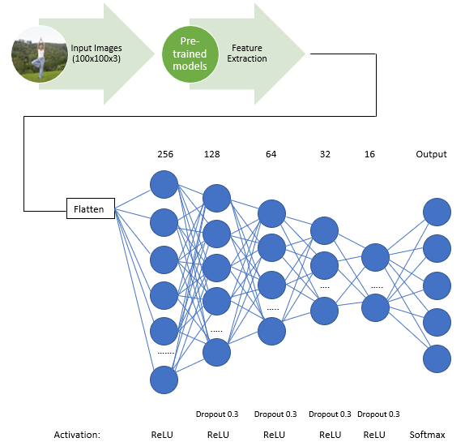
ARCHITECHTURE OF MODEL

Slide 13
RESULTS AND DISCUSSION
Models | Time (ms/step) [Unaugmented Data] | Time (ms/step) [Augmented Data]
ResNet152V2 | 3393 | 5325
ResNet101V2 | 2271 | 4213
VGG19 | 3365 | 5302
VGG16 | 3300 | 4248
DenseNet201 | 2213 | 3160
InceptionResNetV2 | 1169 | 2135
ResNet50V2 | 1146 | 2118
InceptionV3 | 1088 | 1067
MobileNetV2 | 1064 | 1053
MobileNet | 56 | 1040
Time taken:
MobileNet took the least time to
train the data for augmented as well
as un-augmented data. Whereas, the
ResNet152V2 took the most time to
train the data for both datsets.

Slide 14
RESULTS AND DISCUSSION
Model | Accuracy (Unaugmented Data) | Accuracy (Augmented Data)
ResNet152V2 | 91.49 % | 78.94 %
ResNet101V2 | 93.83 % | 93.83 %
VGG19 | 93.19 % | 94.47 %
VGG16 | 94.47 % | 95.74 %
DenseNet201 | 93.26 % | 91.06 %
InceptionResNetV2 | 85.74 % | 87.66 %
ResNet50V2 | 93.83 % | 93.83 %
InceptionV3 | 86.38 % | 84.47 %
MobileNetV2 | 93.40 % | 92.55 %
MobileNet | 92.55 % | 91.70 %
Comparison of Accuracy:
As we can see that the
VGG16 gives the highest value
Of accuracy for both datasets.

Slide 15
RESULTS AND DISCUSSION
A comparison of the evaluation metrics observed.
Metric | Highest Score (Augmented) | Model (Augmented) | Highest Score (Un-augmented) | Model (Un-augmented)
Precision | 0.96 | VGG16 | 0.95 | VGG16
Recall | 0.96 | VGG16 | 0.94 | ResNet101V2, VGG16, DenseNet201, and ResNet50V2
F-Score | 0.96 | VGG16 | 0.94 | ResNet101V2, VGG16, DenseNet201, and ResNet50V2

Slide 16
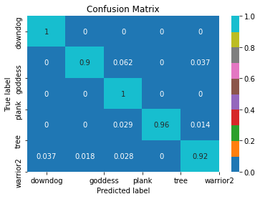
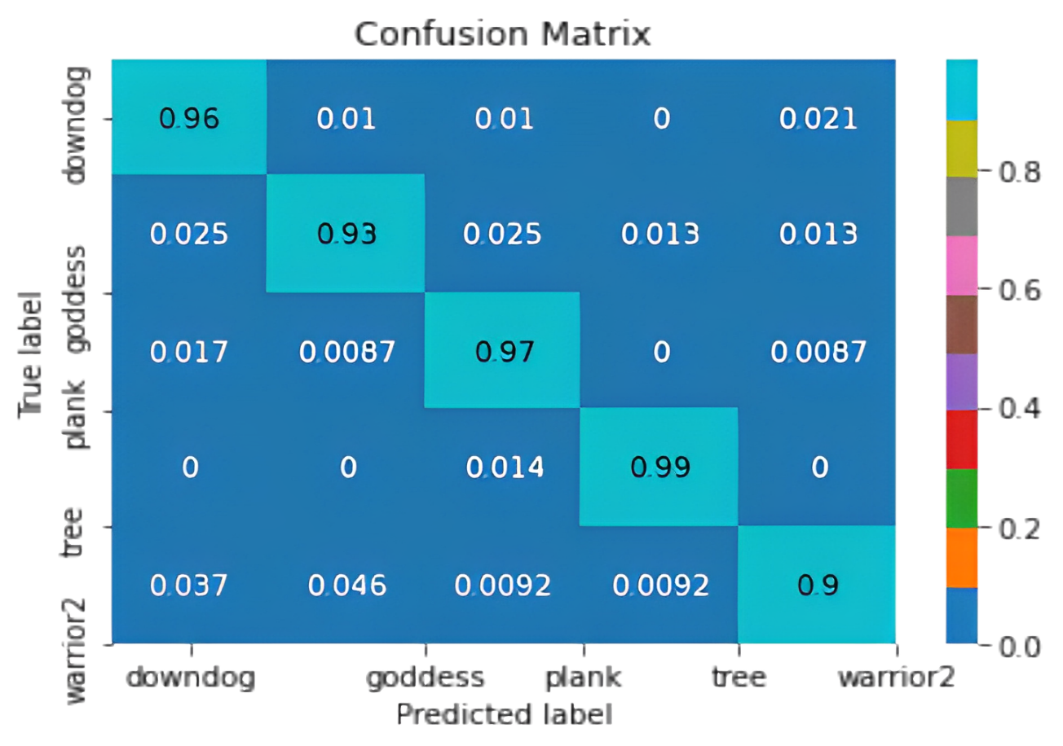
RESULTS AND DISCUSSION
Fig. 4 Confusion matrix of VGG16 on augmented data. Fig.7 Confusion matrix of VGG16 on unaugmented data.

Slide 17
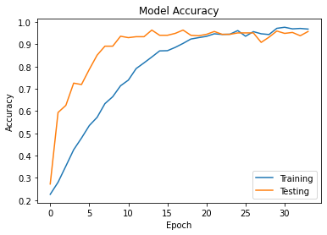
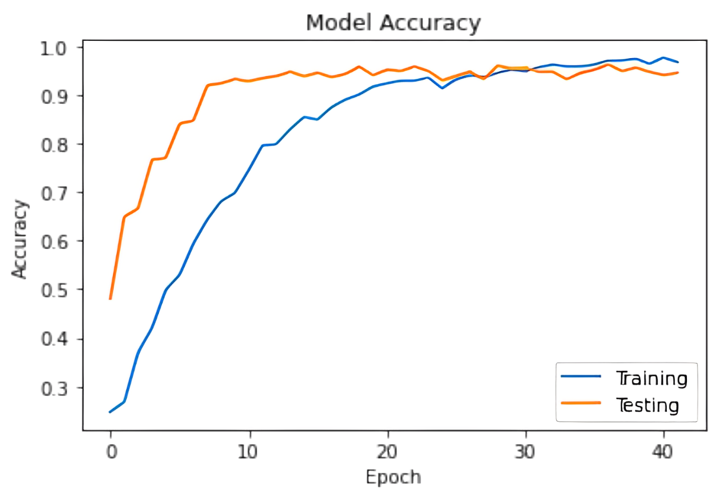
RESULTS AND DISCUSSION
Fig.5 Model accuracy [For VGG16 on augmented data]. Fig. 8 Model accuracy [For VGG16 on unaugmented data].

Slide 18
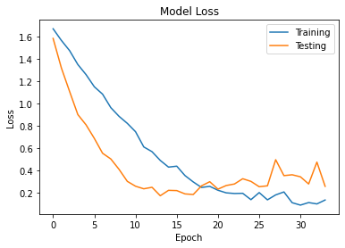
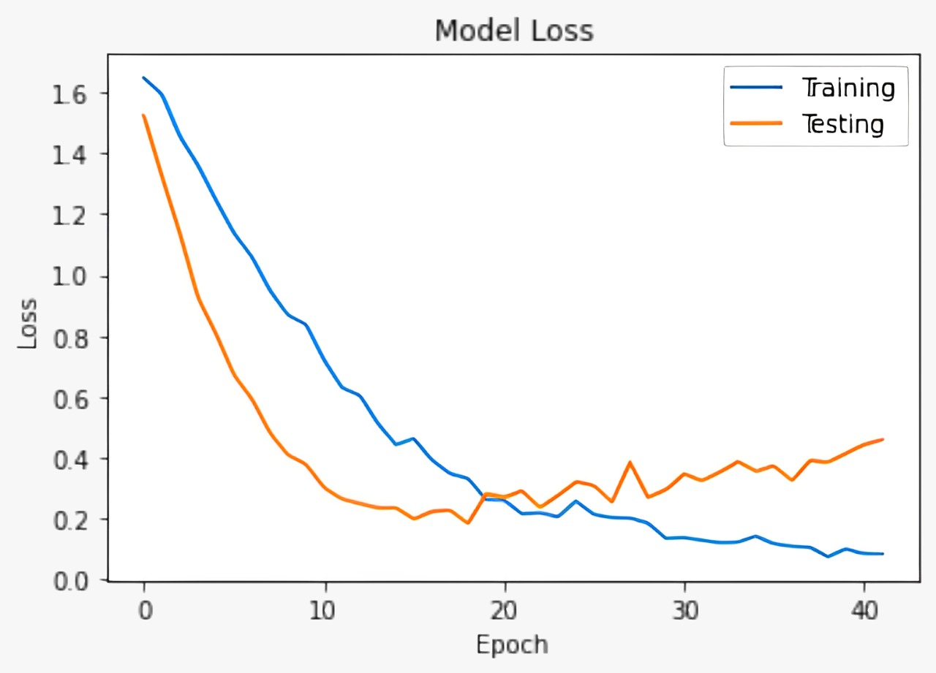
RESULTS AND DISCUSSION
Fig. Loss plot [For VGG16 on augmented data]. Fig. Loss incurred [For VGG16 on unaugmented data].

Slide 19
CONCLUSION
In our paper, VGG16 gave the best performance. VGG16 is a 16 layer deep convolutional neural network. It is mostly used for classification and object detection. It is one of the popular choices for classification, as it achieves high accuracy. Several variants of ResNetV2 model have been used due to the difference in their architecture and extracting features based on it. Several variants of the model were used to test whether the model produced significant differences.
It can also be seen that augmented data does not give us much different results as compared to unaugmented.

Slide 20
FUTURE ENHANCEMENT
During the 2019 Covid pandemic, people were forced to stay isolated in their homes. This limited their physical movement and exercises were then done indoors. During this time, online applications which provide guidance for exercise and yoga proved to be extremely beneficial. Technologies like these can be used which provide and guide users with the means to identify the correct postures of yoga asanas. Instead of using images, we can also use videos to analyse yoga postures. Deep-pose estimators, LSTM, etc are compatible with video analysis.

Slide 21
REFERENCES
[1]. Kaggle.com, ‘Yoga Poses Dataset’, 2022. [Online]. Available: https://www.kaggle.com/datasets/niharika41298/yoga-poses-dataset [Accessed: Sep-2022]
[2]. wikipedia.com, ‘Yoga’, 2022. [Online]. Available: https://en.wikipedia.org/wiki/Yoga [Accessed: Sep-2022]
[3]. hopkinsmedicine.org,,‘9 benefits of Yoga’, 2022. [Online]. Available:
https://www.hopkinsmedicine.org/health/wellness-and-prevention/9-benefits-of-yoga [Accessed: Sep-2022]
[4]. Long, C., et al., “Development of a yoga posture coaching system using an interactive display based on transfer learning.” https://rdcu.be/cYKjv

Slide 22
REFERENCES
[5]. Debabrata Swain., et al, ‘Yoga Pose Monitoring System using Deep Learning’,Research Square, June 2022
https://assets.researchsquare.com/files/rs-1774107/v1/c134f9a8-c453-45b5-a16a-541b34fde471.pdf?c=1656926080
[6]. S. Abarna., et al, ‘Skeleton Pose Estimation Features-based Classification of Yoga Asana using Deep Learning Techniques’, International Journal of Mechanical Engineering, vol.7,Feb 2022
https://kalaharijournals.com/resources/FebV7_I2_281.pdf
[7]. J. Jose., et al, ‘Yoga Asana Identification: A Deep Learning Approach’, IOP Conference Series: Materials Science and Engineering, 2021 https://iopscience.iop.org/article/10.1088/1757-899X/1110/1/012002/pdf

Slide 23
REFERENCES
[8]. L. Torrey, ‘Transfer Learning’, University of Wisconsin, Madison WI, USA
https://ftp.cs.wisc.edu/machine-learning/shavlik-group/torrey.handbook09.pdf
[9]. wikipedia.com ‘Softmax activation function’,2022.[Online]. Available:
https://en.wikipedia.org/wiki/Softmax_function [Accessed: Sep-2022]
[10]. oreilly.com, ‘Multi-class cross entropy loss’, 2022. [Online]. Available: https://www.oreilly.com/library/view/hands-on-convolutional-neural/9781789130331/7f34b72e-f571-49d2-a37a-4ed6f8011c93.xhtml [Accessed: Sep-2022]

Slide 24
REFERENCES
[11]. machinelearningmastery.com, ‘How to Calculate Precision, Recall, and F-Measure for Imbalanced Classification’, 2022.[Online]. Available: https://machinelearningmastery.com/precision-recall-and-f-measure-for-imbalanced-classification/ [Accessed: Sep-2022]
[12]. S. Gupta, et al., ‘Yoga Pose Detection Using Deep Learning’, International Journal of Innovative Research in Engineering, Volume 3, Issue 6 (November-December 2022), PP: 92-94.
https://theijire.com/assets/pdf/archives/1668833195_78987abdde335ec66914.pdf
[13]. S. K. Yadav, et al, ‘Real-time Yoga recognition using deep learning’, Neural Computing and Applications (2019) 31:9349–9361
https://link.springer.com/article/10.1007/s00521-019-04232-7

Slide 25
REFERENCES
[14]. J. Kutalek, ‘Detection of Yoga Poses in Image and Video’, BRNO University of Technology, Excel@FIT2021
https://excel.fit.vutbr.cz/submissions/2021/024/24.pdf
[15]. U. Bahukhandi, et al, ‘Yoga Pose Detection and Classification using Machine Learning Techniques’, International Research Journal of Modernization in Engineering Technology and Science ( Peer-Reviewed, Open Access, Fully Refereed International Journal ) Volume:03/Issue:12/December-2021 https://www.irjmets.com/uploadedfiles/paper/volume_3/issue_12_december_2021/17486/final/fin_irjmets1638881020.pdf
[16]. Y. Agarwal, et al, ‘Implementation of Machine Learning Technique for Identification of Yoga Poses’, 9th IEEE International Conference on Communication Systems and Network Technologies
https://ieeexplore.ieee.org/abstract/document/9115758

Slide 26
QUESTIONS AND ANSWERS

