Slide 2
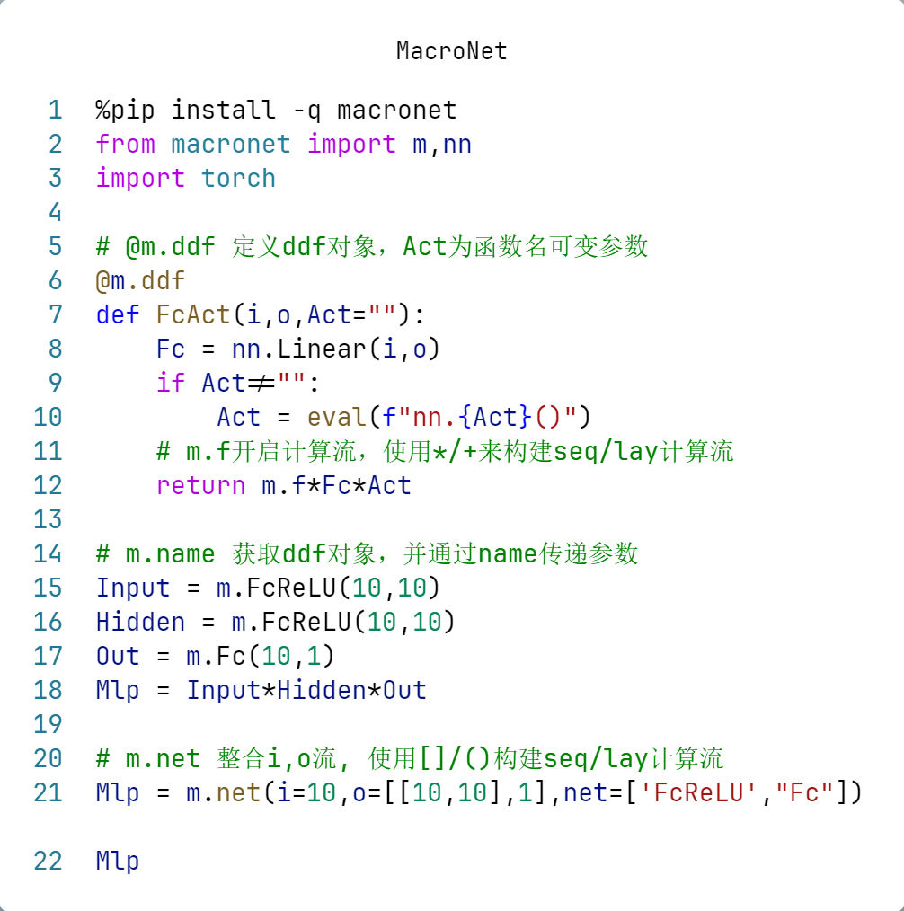
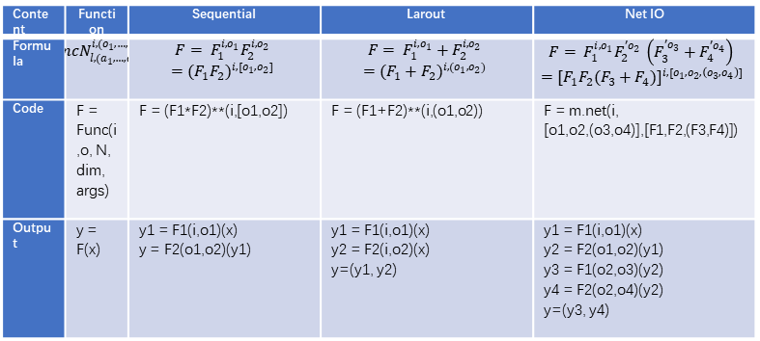
A
C
(o₁,…,o_{n})
o: output size list：
[ ] for sequence(seq) structrue
( ) for layout(lay) structrue
i: input size
i
,
[o₁,…,o_{n}]
Func
N
a: args of func：
ai is blank for setting default
l
,
(a₁,…,a_{n})
N: dim
l: label
B
$$Mlp = {\left(FcReLU\right)}^{10,\left[10,10\right]}{Fc}_{ }^{[1]}$$
from macronet import m
m.FcRMlp = m.FcReLU**(10,[10,10])*m.Fc**[1]
Mlp = m.net(i=10,o=[[10,10],1],net=['FcReLU',"Fc"])
Content | Function | Sequential | Larout | Net IO
Formula | $${FuncN}_{l,(a_{1},…,a_{n})}^{i,(o_{1},…,o_{n})}$$ | $$F= F_{1}^{i,o_{1}}F_{2}^{i,o_{2}}$$ $$={(F_{1}F_{2})}^{i,[o_{1},o_{2}]}$$ | $$F= F_{1}^{i,o_{1}}+F_{2}^{i,o_{2}}$$ $$={(F_{1}+F_{2})}^{i,(o_{1},o_{2})}$$ | $$F= F_{1}^{i,o_{1}}F_{2}^{{′o}_{2}} \left(F_{3}^{{′o}_{3}}+F_{4}^{{′o}_{4}}\right)$$ $$={[F_{1}F_{2}(F_{3}+F_{4})]}^{i,[o_{1},o_{2},\left(o_{3},o_{4}\right)]}$$
Code | F = Func(i,o, N, dim, args) | F = (F1*F2)**(i,[o1,o2]) | F = (F1+F2)**(i,(o1,o2)) | F = m.net(i, [o1,o2,(o3,o4)],[F1,F2,(F3,F4)])
Output | y = F(x) | y1 = F1(i,o1)(x) y = F2(o1,o2)(y1) | y1 = F1(i,o1)(x) y2 = F2(i,o2)(x) y=(y1, y2) | y1 = F1(i,o1)(x) y2 = F2(o1,o2)(y1) y3 = F1(o2,o3)(y2) y4 = F2(o2,o4)(y2) y=(y3, y4)

