Slide 1
SMART_MART APPLICATION
Smart_Mart Application is a CLI based record keeping software that makes the processes like stock checking, billing and sales tracking easy for the store workers.
The process of record keeping, billing, sales tracking, etc take alot of time and are tedious if done manullay. This Smart_Mart application helps in performing all these processes easily and comparatively fast. For example if a customer buys some product, and the bill is generated, the sales data and stock data are automatically updated.
This application is developed in Python following the Object Oriented Programming priciples.

Slide 2
Hardware and Software Requriemnts
Minimum Hardware requriements
1. Computer/Laptop
2. 1 GB Ram
Software requriements
1. Windows OS/Linux/MacOS
2. Python3

Slide 3
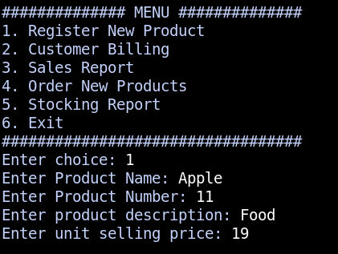
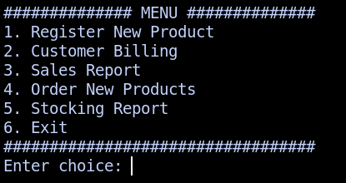
SMART_MART APPLICATION
Main Menu : User Navigates the application using this menu.
Register New Product: Each product that the system will be dealing with must be registered.

Slide 4
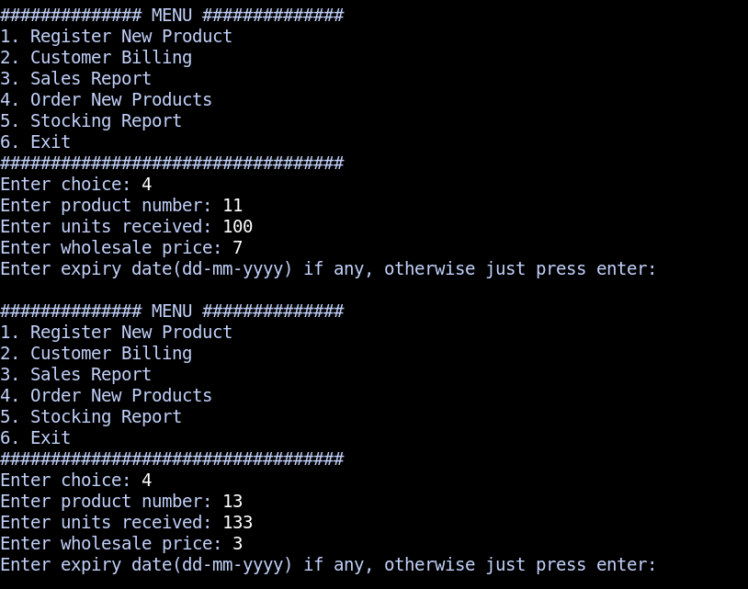
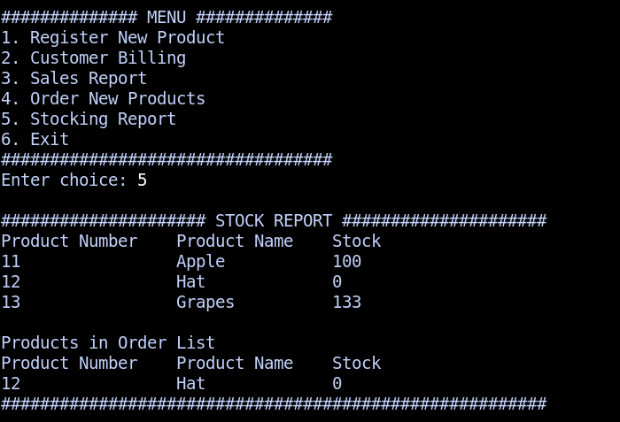
Receiving Shipment: User can order products in wholesale for the store.
Stock Report: The report will show the products that are about to finish. The minimum number of the product that should be in store is 10., otherwise, system will put the product on order list

Slide 5
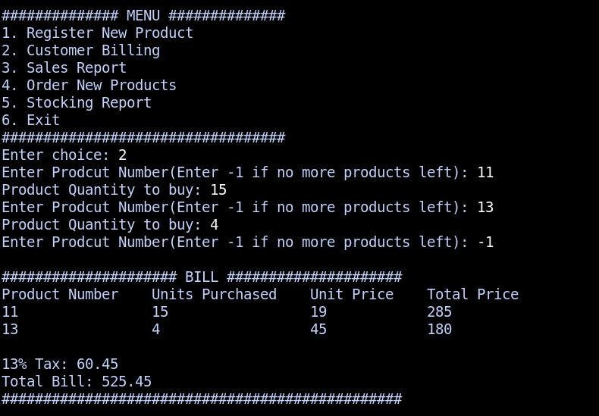
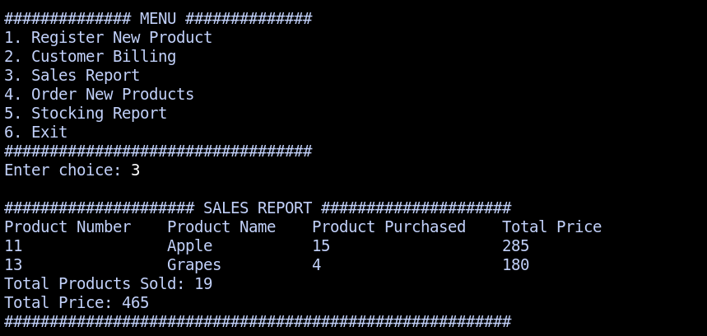
Individual Billing: When a person shops in the convenient store, a bill will be generated.
Sales Report: At end of the day or when requested, the system will create a sales report.

