Slide 1
Agenda
Common Programming Languages
Web development - Front end, back end, full stack
About
Difference
Cover about python, flask, Django
Databases – SQL, MySQL?
Other applications of python
Pytest
Testing framework in retail industries
Automotive
DevOps
About
Git, docker, CI/CD
CI/CD tools – Gitlab, Jenkins, Bitbucket
Agile / Scrum

Slide 2
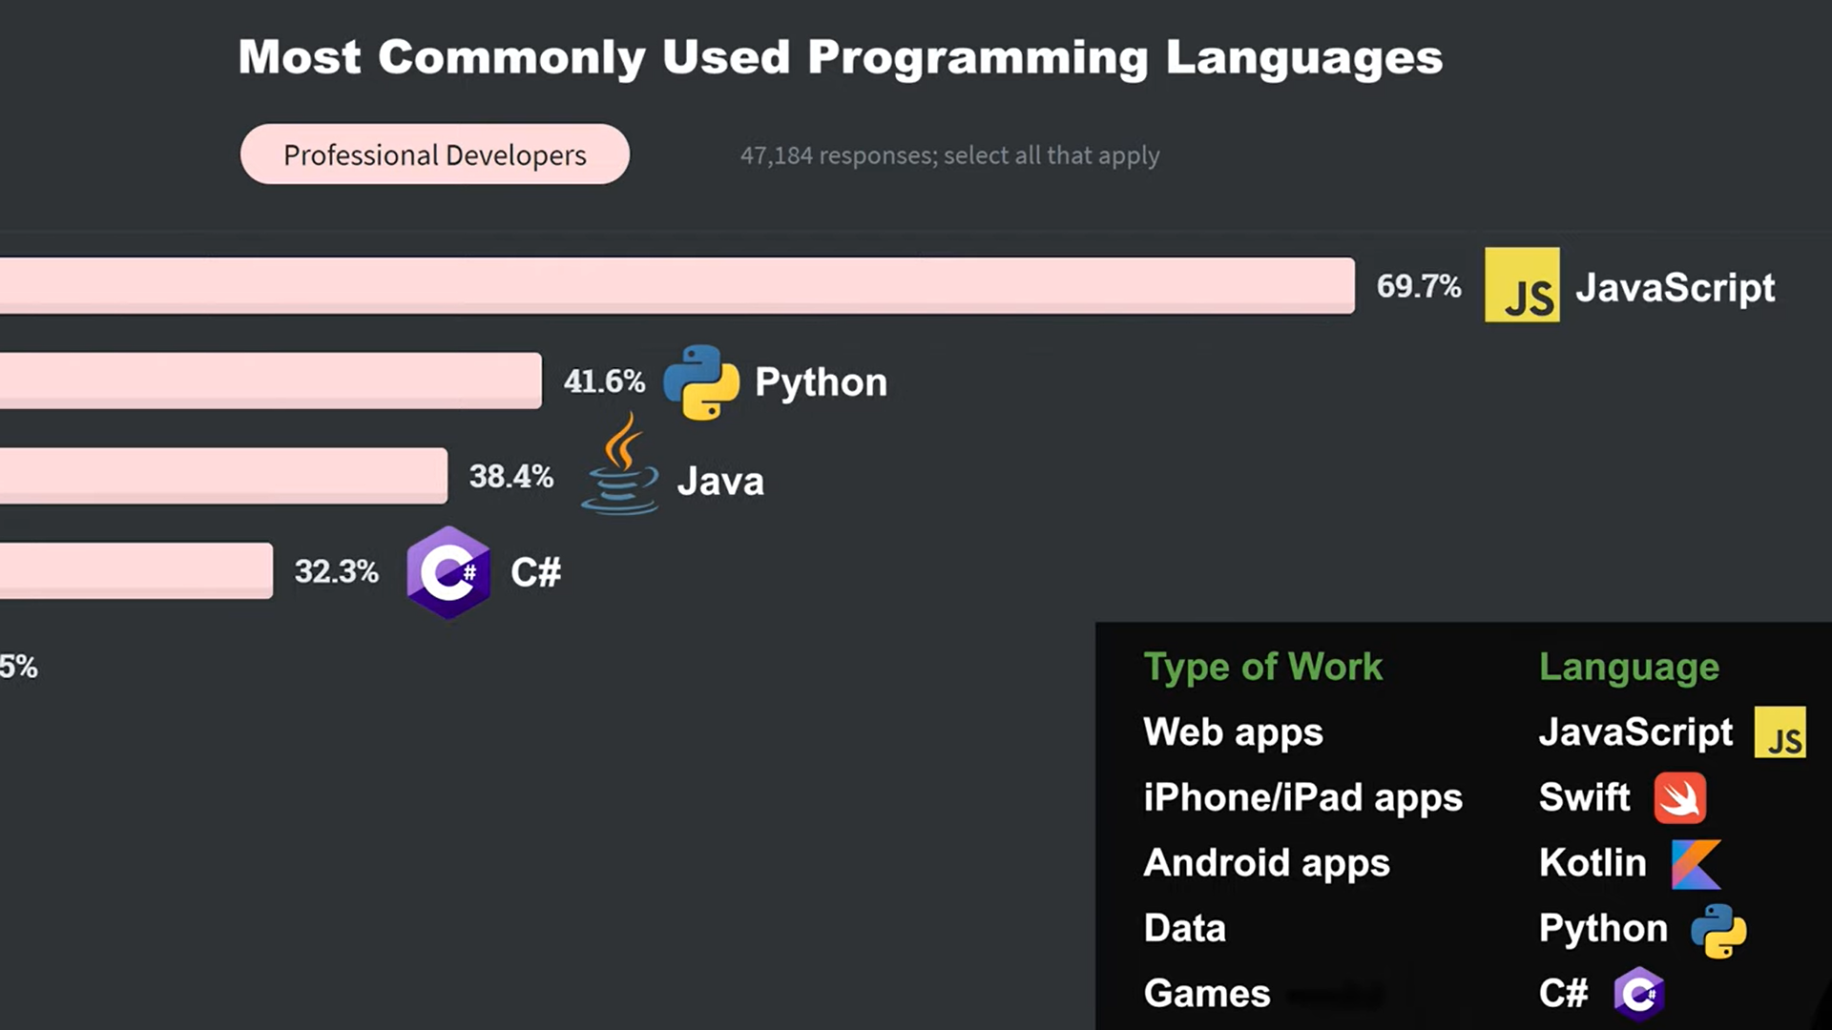
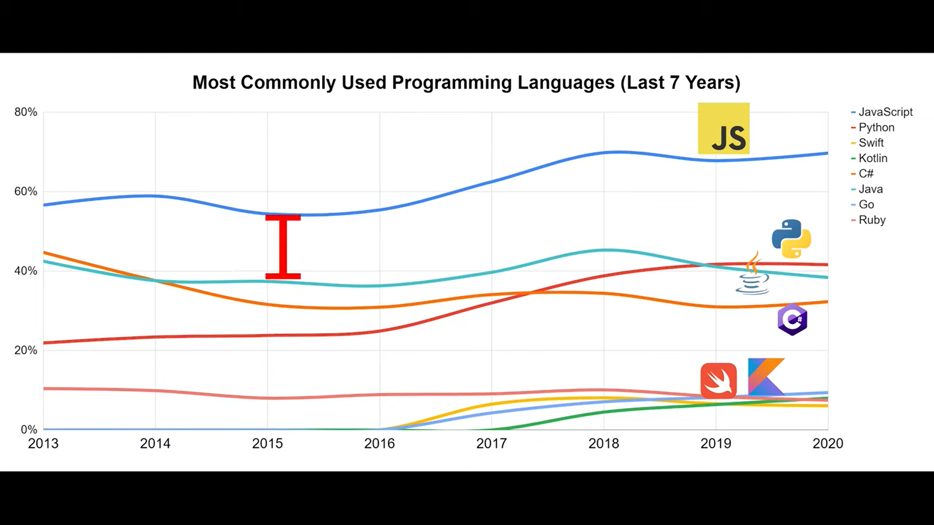
Programming Languages
Type of Work | Language
Web apps | JavaScript
iPhone/iPad apps | Swift
Android apps | Kotlin
Data | Python
Games | C#
https://www.youtube.com/watch?v=FhrJAi-eHwI

Slide 3
Front end web development
Visual stuff
HTML – adding content to webpage
CSS – styles the webpage. Colors, size, spaces, etc.,
Can’t organize code into different files
Missing useful features
Bundler + Transpiler = CSS Preprocessor
SASS – organize CSS into different files, lets us write enhanced CSS
Bundles into one CSS, transforms back to normal CSS
CSS Framework
Bootstrap
Only displays content

Slide 4
Front end web development
JavaScript – makes webpage interactive
Document Object Model (DOM) – feature that allows JS to change the webpage
Repetitive, hard to manage
JavaScript Framework
ReactJS, Angular, VueJS
JS missing a lot of features. Ex: splitting the code into different files, organizing
Bundler
Webpack – splits up JS code, bundles all of the files when putting on website
Transpiler
TypeScript – adds extra features to JS
Lets us write enhanced version of JS, finally transforms back to normal JS
Communication with backend
JS – XMLHttpRequest
Tools – axios-http, fetch API
Ref:
https://www.youtube.com/watch?v=WG5ikvJ2TKA

Slide 5
Back end web development
Managing and saving data
https://www.youtube.com/watch?v=XBu54nfzxAQ

Slide 6
Applications of python
Web development
Backend web framework – Django, flask
AI / Machine Learning
Data Science & Processing
Software Development
Testing framework – Automotive, Retail,..
Audio, Visual applications
Game development
Desktop GUIs
CAD applications
Web scraping
Robotics, Automation, Image Processing
Virtual env
Ref:
https://www.geeksforgeeks.org/top-10-python-applications-in-real-world/
Projects:
https://www.youtube.com/watch?v=8ext9G7xspg

Slide 7
DevOps
Set of practices to place focus on collaboration, communication and integration between development and operations teams
Development team – writing code, creating new features
Operations team – maintaining infrastructure, ensure SW runs smoothly
Creates shared responsibility, automating processes to achieve faster, more reliable SW
Key principles
Collaboration
Throughout SDLC
SW not only functional, but also easy to deploy & maintain
Automation
Repetitive tasks such as building, deploying, testing,..
Reduces errors, speeds up processes, increases efficiency

Slide 8
DevOps
Key principles
CI / CD
Continuous Integration & Continuous Deployment
CI – automatically integration code changes into shared repository and running automated tests
CD – automatically deploying code changes to production environments after passing tests
Ref:
https://www.linkedin.com/pulse/devops-bridging-gap-between-development-operations/
https://about.gitlab.com/topics/devops/

Slide 9
Git, GitHub, Docker
Git
Version control software
Open source
DevOps Platforms / Tools
GitHub
Gitlab
Bitbucket
Docker ?

Slide 10
Agile SW development
Agile delivery
Iterative approach to software delivery
Teams build software incrementally
Nonlinear workflow that changes during development process, as opposed to traditional waterfall methodologies
Key principles:
Collaboration – Team members interaction over processes and tools
Customer focus – Satisfy customer with early, continuous delivery of valuable SW
Value-based prioritization (core of Scrum methodology)
Iterative development – breaking down to small deliverables
Agile methodology elements:
Small teams, short iterations
Fast feedback from customers
Value-based business priorities
Users engaged in refining end-of-product requirements

Slide 11
Agile SW development
Benefits
Speed to market
Higher quality
Transparency
Agile delivery frameworks
Scrum
Kanban
Ref
https://about.gitlab.com/topics/agile-delivery/

