Slide 1
Video Name
Module name
Notes:
On video/lesson title slides
Let's use title case for the main lesson/video title (above the horizontal line)
And sentence case for the subtitle (below the horizontal line)

Slide 2
Notes:
On video/lesson title slides
Let's use title case for the main lesson/video title (above the horizontal line)
And sentence case for the subtitle (below the horizontal line)

Slide 3
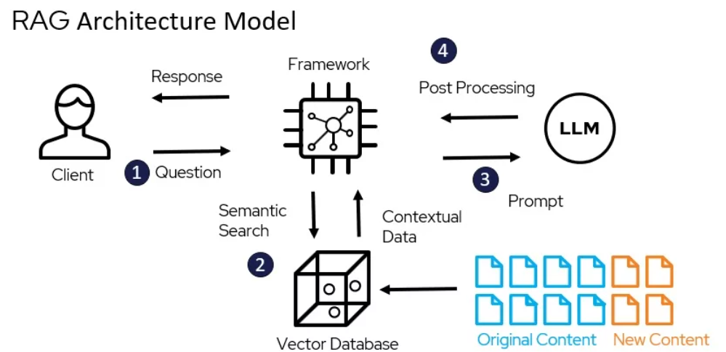
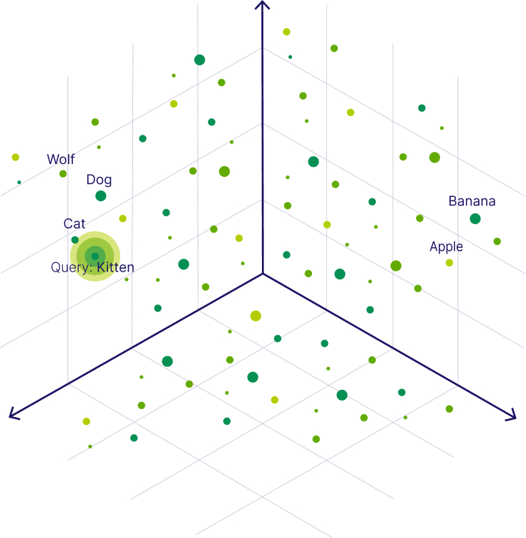
What is RAG?
Explanatory text about a concept
Bulleted list item 1
Bulleted list item 2
  Sub-bullet 1
  Sub-bullet 2
include link to image source in speaker notes
Notes:
If you are comfortable drafting video scripts here in the speaker notes feel free to do so. If you prefer to write in a document, template video script documents are also available.
[Click] Include this notation if you intend to animate in a bullet, an image, etc. You can also just accomplish this by copy-pasting this slide, and adding the new image or text to the second slide
For regular lecture slides:
Use sentence case for titles (just capitalize the first word and any proper nouns)

Slide 4
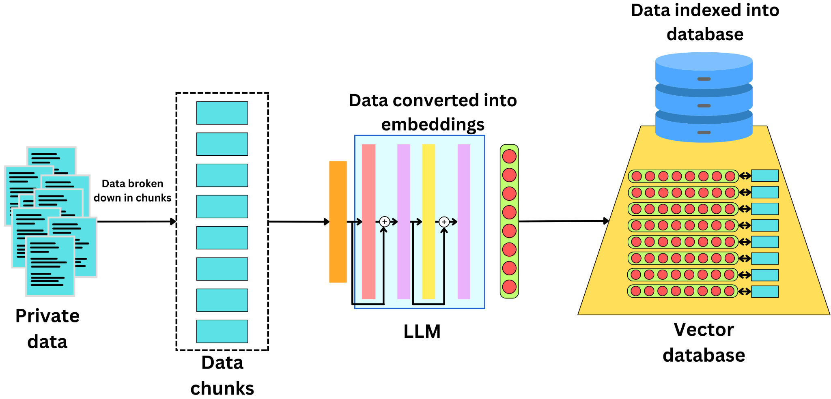
Diagram or image focused slide
include link to image source in speaker notes
Notes:
For regular lecture slides:
Use sentence case for titles (just capitalize the first word and any proper nouns)

Slide 5
from together import Together
query = "What are 'skip-level' meetings?" # we keep the same query - can change if we want
def rerank(query: str, chunks: List[str], top_k = 3) -> List[int]:
response = client.rerank.create(
model = "Salesforce/Llama-Rank-V1",
query = query,
documents = chunks,
top_n = top_k
)
return result.index
for result in response.results:
print(f"Document: {top_k_chunks[result.index]}")
print(f"Relevance Score: {result.relevance_score}\n\n")
Notes:
Don’t worry about syntax highlighting if that’s proving challenging, much of this may also be addressed with screen capture

Slide 6
Comparing two approaches
RAG
Thing 1
Thing 2
Fine-tuning
Thing 1
Thing 2
Notes:
For regular lecture slides:
Use sentence case for titles (just capitalize the first word and any proper nouns)

Slide 7
Notes:
On video/lesson title slides
Let's use title case for the main lesson/video title (above the horizontal line)
And sentence case for the subtitle (below the horizontal line)

Slide 8
Notes:
For regular lecture slides:
Use sentence case for titles (just capitalize the first word and any proper nouns)

