Slide 1
Disk Organizer
Group Members
Abdul Rafay
Asad Ali
Shayan Khurram

Slide 2
Problem Statement
Lack of accessible tools for organizing
monitoring, and cleaning disk space.

Slide 3
Challenges
Time-consuming file management and cleanup.
Inefficient navigation through directories.

Slide 4
Solution
Disk Organizer

Slide 5
Methodology
Directory Selection and Initialization:
User selects a directory to begin the analysis or management process.
The system initializes by scanning the selected directory to retrieve metadata such as file and folder names, types, and sizes.
File Exploration:
The Explorer module displays the contents of the selected directory in a structured format.
Users can navigate through the directory, search for specific files or folders, and view details like type and size.

Slide 6
Methodology
File Organization:
Users select files or folders within the Organizer module.
Contextual actions such as renaming, deleting, or reorganizing files are performed via a right-click menu, ensuring seamless file management.
Temporary File Identification
The Junk Cleaner module scans the system for temporary files, cache, or other redundant data that can be safely deleted.

Slide 7
Features
Explorer
Simplifies directory browsing with file details (name, type, size).
Includes a search feature for quick navigation.
Organizer
Allows renaming, deleting, and moving files effortlessly.
Keeps storage clean and organized.
Junk Cleaner
Removes unnecessary files in one click.
Displays deleted item sizes for better storage tracking.

Slide 8
Methodology
Junk Cleaning Execution:
The user initiates the cleaning process by clicking the "Clean" button.
Temporary files are removed, and a detailed report showing the size of the deleted files is displayed.

Slide 9
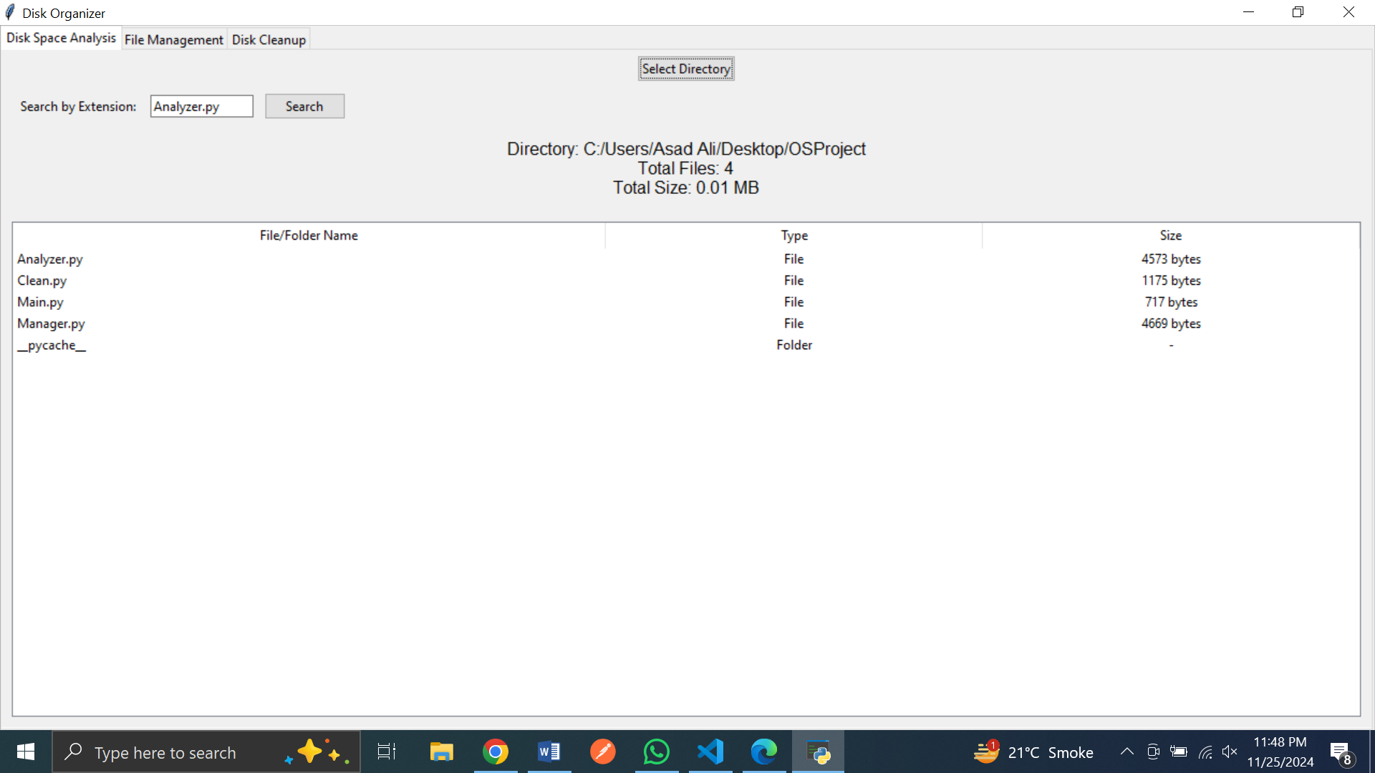
Result

Slide 10
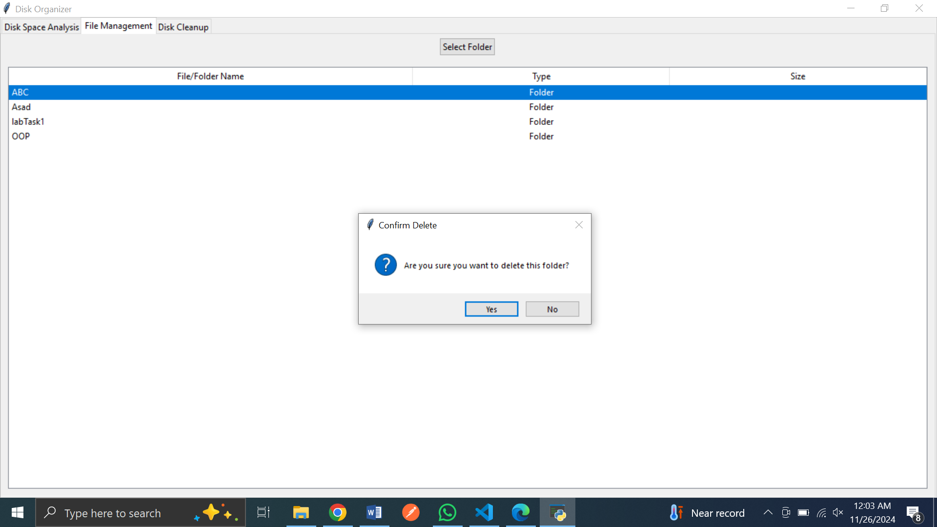
Result

