Slide 1

EMAIL SPAM CLASSIFIER
Project Guide :- Prof. Yogesh Sahu
Team Member:- Yash Patidar
Yash Sahu
Sumit Kumar

Slide 2
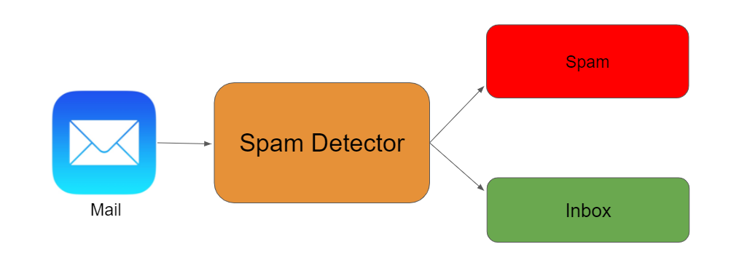
Email Spam Classification
Email spam refers to unsolicited, unwanted, and often malicious messages sent in bulk. It includes various forms of scams, advertisements, and phishing attempts.
Email spam classification is crucial to protect users from unwanted content, fraudulent activities, and identity theft. It enhances email security and improves productivity.

Slide 3
Objective
Accurate classification: The primary goal is to accurately categorize incoming emails as either spam or ham (legitimate). This means minimizing both false positives (legitimate emails classified as spam) and false negatives (spam emails classified as legitimate).
Adaptability: Spammers constantly evolve their tactics, so the classifier needs to be adaptable and able to learn from new data to maintain high accuracy.
Efficiency: Ideally, the classification process should be efficient, consuming minimal resources and allowing for fast email processing.
False positive minimization: False positives can be particularly frustrating for users, so minimizing them is crucial for user experience and trust in the system.
False negative mitigation: While important, some false negatives are inevitable

Slide 4
Problem Statement
Spam emails are unsolicited, bulk emails sent for commercial or deceptive purposes.
They clog our inboxes, waste our time, and pose security threats like phishing attacks.
The volume of spam is immense, accounting for a significant portion of all email traffic.
They consume valuable storage space, waste our time sorting through them, and can even be dangerous.
Phishing emails, a common type of spam, try to trick us into revealing sensitive information like passwords or credit card numbers.

Slide 5
How Does an Email Spam Classifier Work?
A spam classifier is a machine learning algorithm trained to identify and filter spam emails.
It analyzes emails based on various features, including:
Sender address and domain
Subject line content
Email body content and keywords
Presence of attachments
Formatting and punctuation
Based on these features, the classifier predicts whether an email is spam or legitimate.

Slide 6
Techniques Used in Spam Classifiers
Natural Language Processing:-
NLP helps computers decode human language: text and speech. It uses AI to understand meaning, context, and intent behind words.
Random Forest Classifier:-
Imagine a forest of decision trees, each predicting independently. A Random Forest Classifier combines their votes for powerful classification! It randomly samples training data, uses subsets of features in each tree, and grows them fully to capture complex patterns. It's accurate, resists overfitting, but can be computationally heavy and less interpretable compared to single decision trees.

Slide 7
Conclusion
Summary of Email Spam Classification Techniques
We explored various techniques, from data preprocessing to classification algorithms, to effectively classify email spam.
Future Directions
Continued research on deep learning methods, incorporating natural language processing techniques, and adapting to evolving spam strategies.

Slide 8
The Future of Email
The fight against spam is a continuous journey. Research and development in machine learning algorithms will further refine spam detection, offering even greater accuracy and adaptability. User education and awareness remain crucial aspects of staying vigilant against evolving phishing tactics.

Slide 9
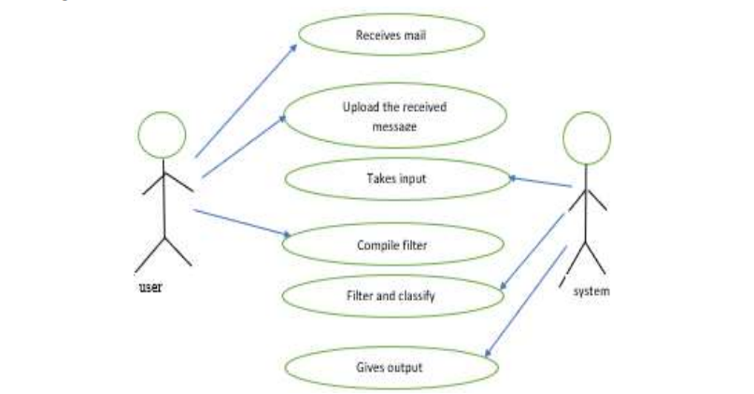
Use Case

Slide 10
References
https://www.sciencedirect.com/science/article/pii/S1877050921007493
https://papers.ssrn.com/sol3/papers.cfm?abstract_id=4145123

Slide 11
THANK YOU

