Slide 1
Determining Interesting Stories
Improving Efficiency for Analysts via Automation
Summer Long
08-14-2023

Slide 2
Agenda
Introduction of DIPS
Motivation for Project
Process
Program Demonstration

Slide 3
Introduction of DIPS
The Division of Industry Productivity Studies produces annual measures for detailed industries, including but not limited to:
Productivity
Output
Hours
Labor compensation
Organized by groups of industries and released once a year
(Credit: Eugene Yum)

Slide 4
Motivation for Project
Analysis packets are prepared for the Associate Commissioner
However, they prove to be laborious on analysts
Potential solution: automate part of the materials in the decision process
Notes:
Lots of time is spent determining what to write about, resulting in the manual generation of materials that are not used
Analysts are unable to focus more time on the specifics of chosen industries

Slide 5
Process

Slide 6
1. Reviewing Existing Analysis Packets
Common visualizations from analysis packets were identified
Select visualizations were chosen for automation
An interest score was devised to emulate analyst selection which is a weighted score including output index, hours index, output per hour index, and employment
End goal of generation: a table displaying commonly used measures, and sorted labor productivity graphs

Slide 7
2. Familiarizing With Database and Measures
Database was accessed through SQLAlchemy
Crash-coursed in commonly leveraged measures, such as:
Output index
Hours index
Output per hour
Unit labor cost
Notes:
Microsoft sql server

Slide 8
3. Figure Generation
Figures were generated with Matplotlib
Description of parameters and figures were imported on Word for easy use of analysts using docx package
508 compliance was prioritized to incorporate into generation
Notes:
Emphasis on replicating how figures were displayed in prior analysis
Avoids the burden of copy and pasting figures, enables easy annotation

Slide 9
4. User Interface Creation
Tkinter was leveraged to create a user interface with user selected parameters
More user-friendly than running code from the command line
Currently accessed by running main_window.py on an IDE, but will be packaged into a program that is ran in the future

Slide 10
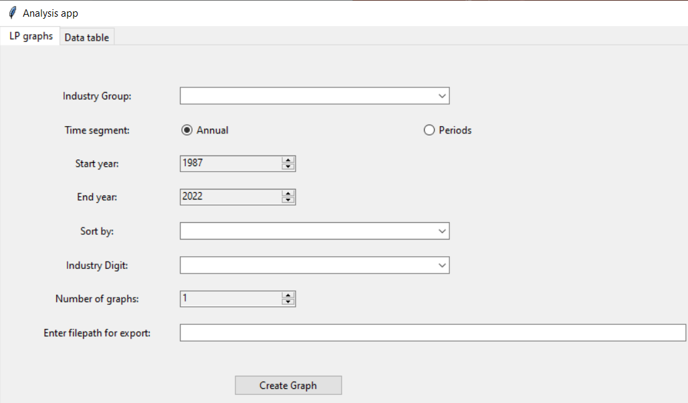
User Interface

Slide 11
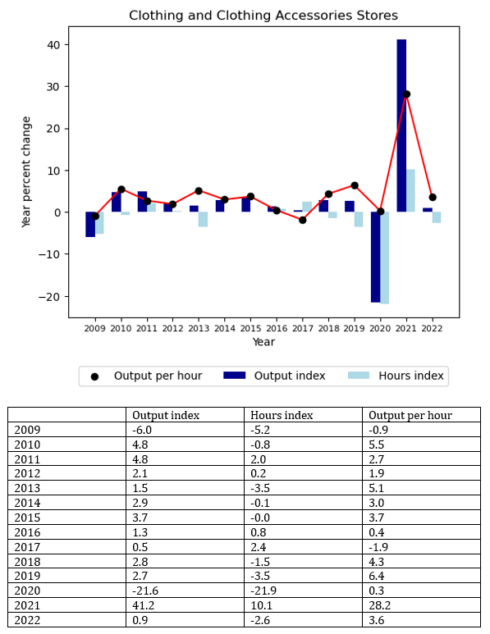
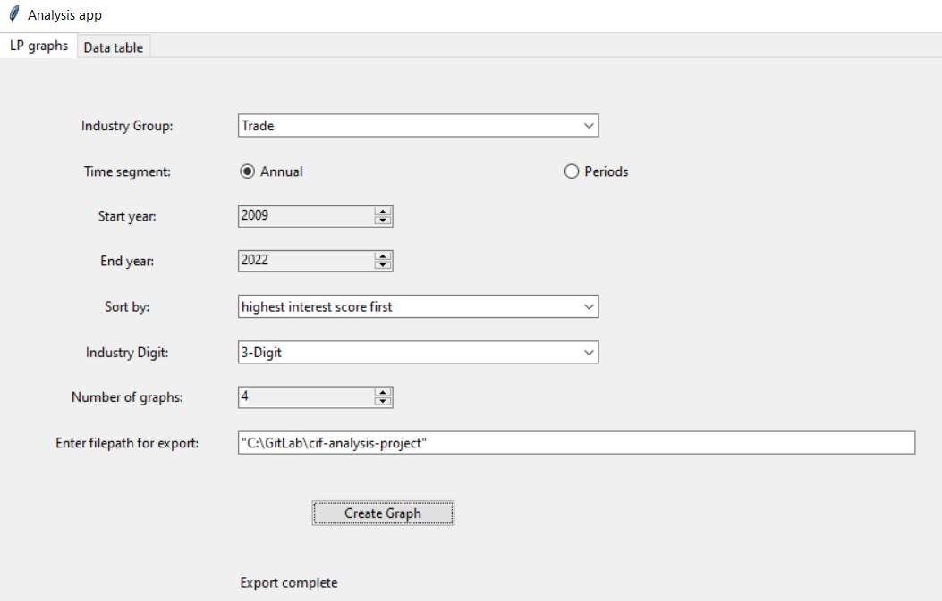
“Most interesting chart” generated from the input displayed above

Slide 12
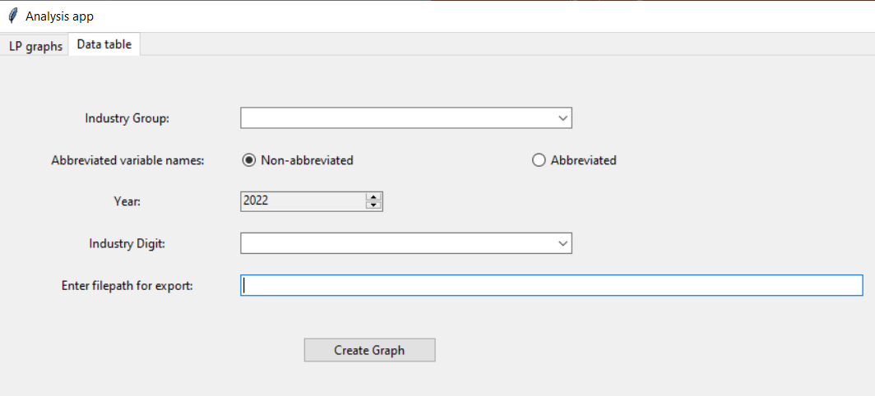

Slide 13
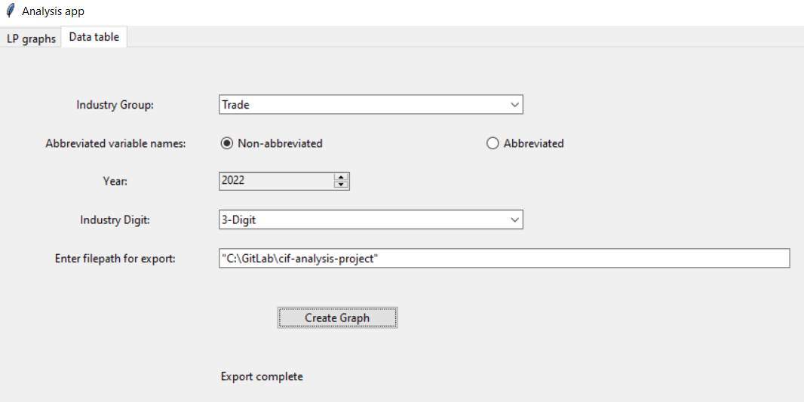
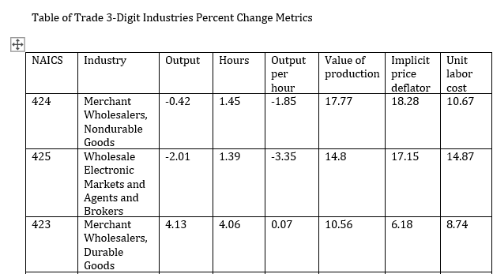
Abridged sample of table generation from input displayed above

Slide 14
Program Demonstration

Slide 15
Contact Information
Summer Long
Data Science Intern
University of Chicago B.A. ‘23, M.S. ’24
https://www.linkedin.com/in/summer-long-
salong@uchicago.edu

Slide 16
Appendix: Interest Score Calculation
(|.2x| + |.2y| + |.6z|) * b
x is the difference between the percent change in the output index for the 2 most recent datapoints recorded
y is the difference between the percent change in the hours index for the 2 most recent datapoints recorded
z is the difference between the percent change in the output per hour index for the 2 most recent datapoints recorded,
b is the number of employees in the most recent datapoint recorded

