Slide 1
Predicting the most popular and trending locations within the localities of twelve boroughs in the city of Berlin
Sumudu R Samarasinghe 25th June 2019

Slide 2
Introduction
Background
Berlin city is one of the German’s federal states and it consists of twelve boroughs each with its own local government
Each borough is made up of neighborhoods/localities.
It is beneficial for each borough council to have an effective plan on improving the infrastructure of its localities within a year. This will also help the city government to allocate funds appropriately and ultimately improve the living standards and well-being of the inhabitants.
To achieve this predicting and identifying the behavior of inhabitants within localities of each borough, most popular areas, venues, activities etc. is important.
Interest
The project findings will directly be beneficial for local governments of each borough in their planning, designing strategies and fund management processes. It will also provide valuable insights on future planning of the borough infrastructure and decision making as well. The findings of the project will also benefit inhabitants of each borough localities ensuring them an easy, healthy, comfortable, safe life style.
Problem
Usually each borough’s local government is allocated funds to improve living standards and general well-being of its inhabitants
It is important that these funds are utilized in a way that the population receives the maximum benefits every year.
It is critical for the local government of each borough to identify the most effective ways, such as on what, where and how to utilize the allocated funds.

Slide 3
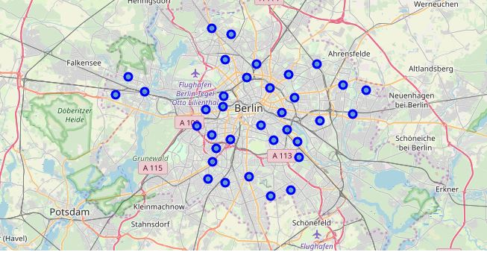
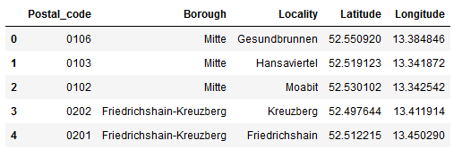
Data
Data Sources – Boroughs of Berlin city and each of its locality were scraped from the wiki web https://en.wikipedia.org/wiki/Boroughs_and_neighborhoods_of_Berlin
Foursquare API was also used to get data about popular/ trending venues, venue categories etc. for each locality.

Slide 4
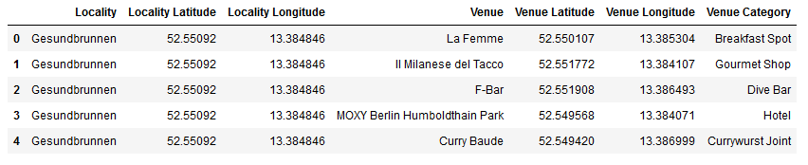
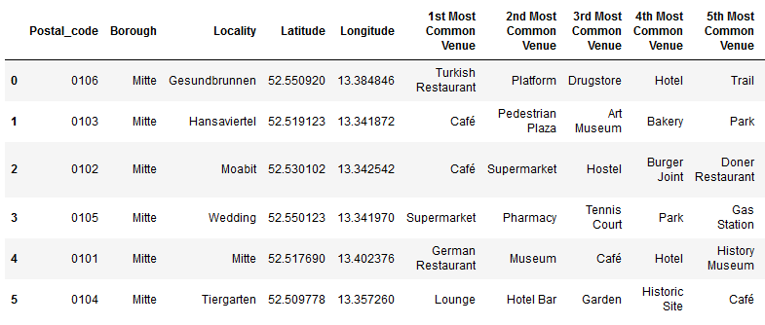
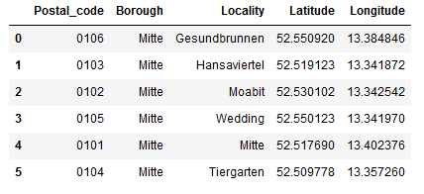
Results
Two boroughs Mitte and Friedrichshain-Kreuzberg were chosen to analyze
Borough Mitte has 6 localities. We obtained postal code, latitude and longitude data for all
Foursquare API used to retrieve venue data per each locality with a maximum limit of 100 venues within a radius of 500m

Slide 5
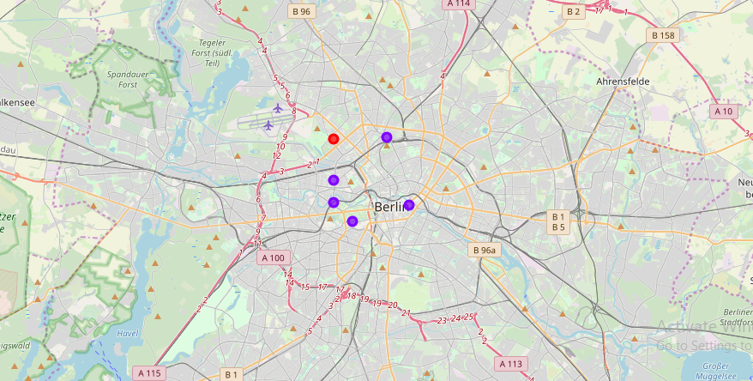
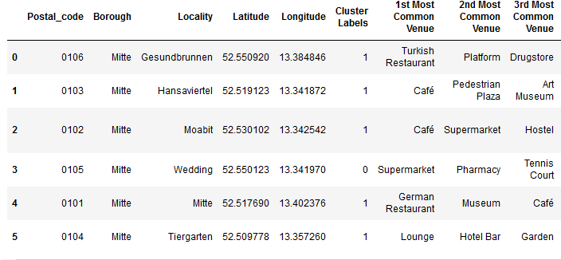
Results contd.
Within the borough Mitte, the top popular venues of all localities include restaurants/hotels, cafes and museums
Clustering of localities within the Mitte borough based on top venues shows that five of the six localities have high similarity to each other while one locality within Mitte (Wedding) shows less similarity to the rest of the 5 localities
Most popular venues within the localities of Mitte borough are identified as restaurants, cafes, bakery, drugstore, bar, bookstore, metro station etc.

Slide 6
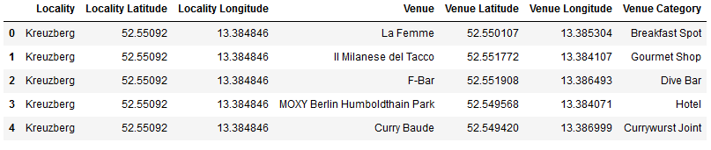
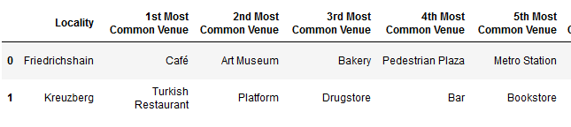
Results contd.
Results of the analysis of Friedrichshain-Kreuzberg borough localities show that restaurants, cafes, drugstore, bar, metro station, book store etc. are the most popular venues among its inhabitants

Slide 7
Discussion
Mitte borough localities suggests that this borough is likely to be historically important and probably a local and foreign tourist attraction site
Restaurants, hotels and cafes are similarly popular within almost all the localities in Mitte borough as well as some of the other outdoor locations of leisure such as park, trail, and tennis court providing supporting evidence
Cluster analysis results of Mitte borough localities shows, the most popular venues within the cluster with 5 localities are probably tourist attraction sites with historical value
Single locality that clustered outside the rest seems to be a domestic area/ residential area since the popular venues include supermarket, pharmacy, gas station etc unlike localities in other cluster
Analysis of Friedrichshain-Kreuzberg borough localities suggest that it is mostly a domestic/ residential area and among the most popular venues, restaurants/cafes, backery, drugstore,bar,metro station, book store were seen supporting the suggestion
The above partial analysis results of borough localities and their popular venues using location data clearly shows that this type of analysis is beneficial in identifying which regions/ places to be given the highest priority, what measures to be taken and how they should be implemented in terms of allocating and managing funds to improve the underlying infrastructure of a borough

Slide 8
Conclusion
A complete analysis of all localities per each and every borough in the Berlin city will ultimately help to understand the most popular places/ venues/ locations among the people and also their popular activities/ behavioral patterns. This information can then be effectively used by the local government bodies of boroughs in their decision making/ designing strategies and processes to improve the underlying infrastructure facilities to enhance living standards of mainly its inhabitants as well as its local/ foreign tourists. These measures may include ensuring safety of pedestrians by proper walking tracks/ pavements, pedestrian crossings, improving facilities for dis-able individuals, ample parking spaces with cheap and easy access, beautify the surroundings with trees, plants, ponds etc. Proper disposal facilities of garbage, take measures to ensure that restaurants/hotels/cafes specially in popular regions provide healthy, clean food etc.

Slide 9
Thank You
(Click the arrow when in Slide Show mode)
Notes:
In Slide Show mode, click the arrow to enter the PowerPoint Getting Started Center.

