Slide 1
Noodles Crypto Analytics Platform
END-TO-END DATA ENGINEERING • ANALYTICS • POWER BI
From raw JSON to actionable
social engagement intelligence
Industry Connect | Final Portfolio Presentation
October 2026
NOODLES / INDUSTRY CONNECT
01 / 12

Slide 2
Executive summary
THE SOLUTION AT A GLANCE
The challenge
The solution
The outcome
Fragmented cryptocurrency metadata and social engagement across JSON sources.
Python / pandas ETL → MySQL star schema → reporting views → interactive Power BI.
Reusable analytical model with engagement KPIs, token rankings and platform comparisons.
NOODLES / INDUSTRY CONNECT
02 / 12

Slide 3
Business problem & objectives
DESIGNED FOR MORE CONSISTENT ANALYSIS
Before
After
Manual inspection of different JSON structures
Inconsistent token and platform fields
Difficult cross-platform comparisons
Standardized transformations and validation
Relational data warehouse and reusable SQL views
Interactive executive reporting in Power BI
NOODLES / INDUSTRY CONNECT
03 / 12

Slide 4
End-to-end architecture
SOURCE → TRANSFORM → MODEL → SERVE → VISUALIZE
01 SOURCE
02 ETL
03 WAREHOUSE
04 REPORTING
05 ANALYTICS
Token / Twitter / Reddit JSON
→
Python • pandas • validation
→
MySQL noodles_dw • star schema
→
Aggregations • four SQL views
→
Power BI • DAX • dashboards
CONTROL / Jupyter notebooks • QA checks • error handling
NOODLES / INDUSTRY CONNECT
04 / 12

Slide 5
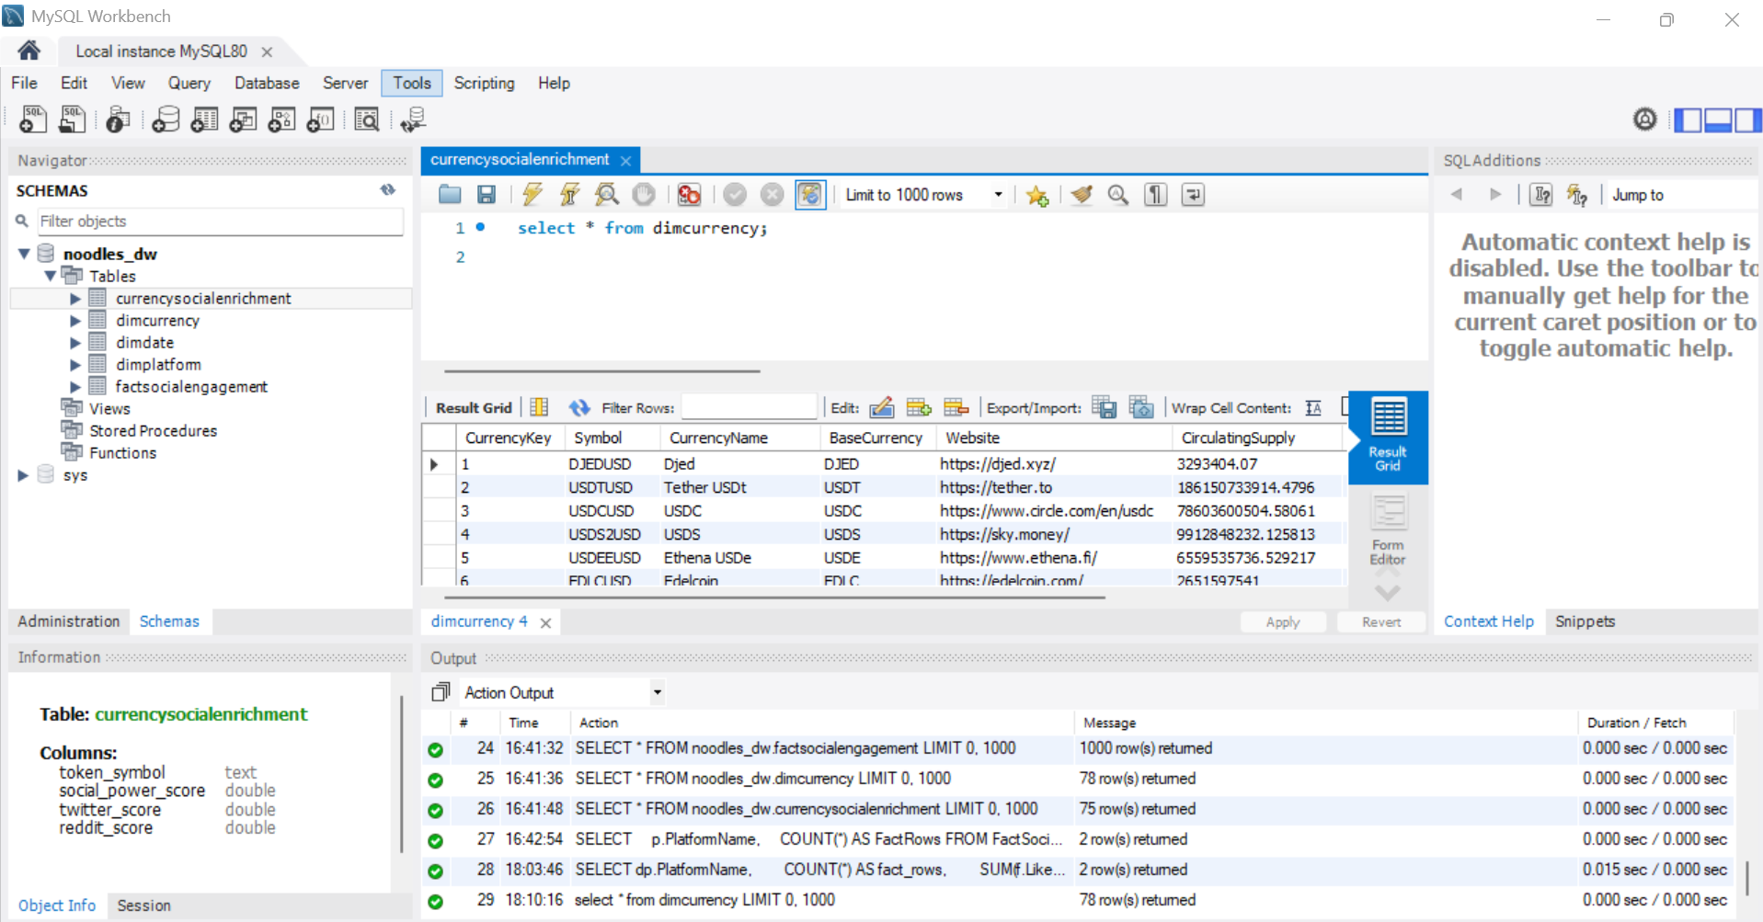
Data warehouse design
RELATIONAL FOUNDATION FOR ENGAGEMENT ANALYTICS
Star schema
DimCurrency
DimDate
DimPlatform
FactSocialEngagement
Fact grain: one social engagement record
NOODLES / INDUSTRY CONNECT
05 / 12

Slide 6
Python ETL & reporting preparation
JUPYTER + PANDAS + SQLALCHEMY
01 Extract
02 Transform
Read JSON currency and social-platform records
Normalize symbols, types and missing fields
03 Load
04 Serve
Populate MySQL warehouse objects
Build aggregations and vw_* reporting views
NOODLES / INDUSTRY CONNECT
06 / 12

Slide 7
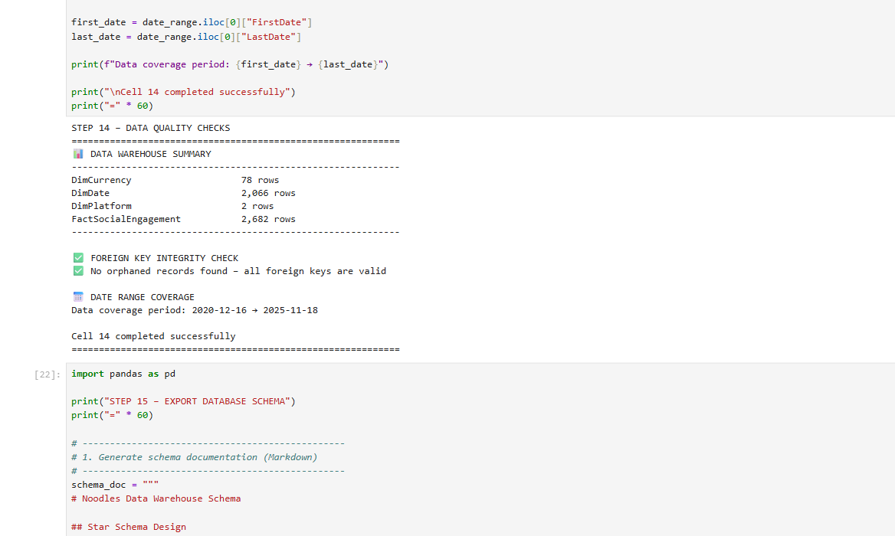
Data quality & validation
CHECKS BEFORE REPORTING
Validation approach
Inspect missing metrics and duplicate identifiers
Check foreign-key integrity
Review row counts and reporting-view outputs
Investigate rejected records
NOODLES / INDUSTRY CONNECT
07 / 12

Slide 8
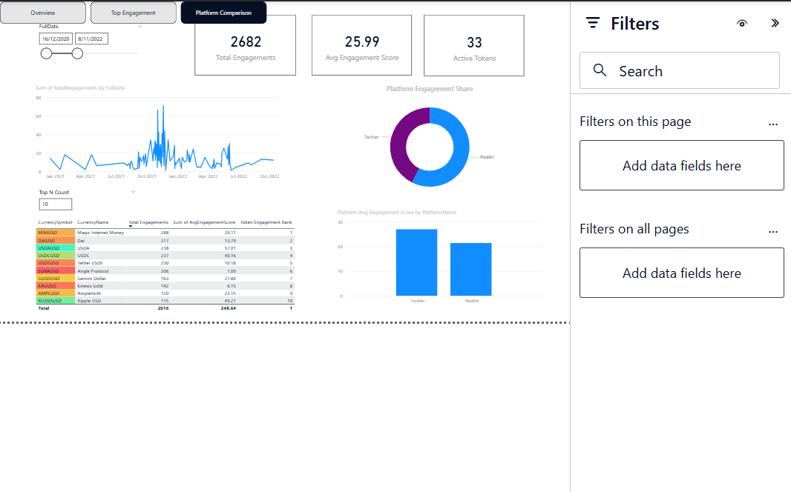
Executive Overview
TASK 8 / MANAGEMENT REPORTING
Executive capabilities
Total Engagements
Average Engagement Score
Active Tokens
Engagement trends
Dynamic Top N token ranking
NOODLES / INDUSTRY CONNECT
08 / 12

Slide 9
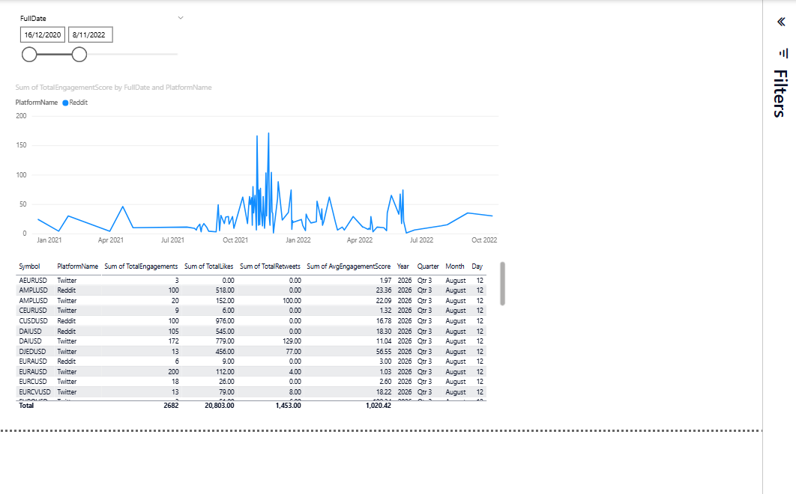
Platform Performance Analysis
TASK 8 / TWITTER/X VS REDDIT
Compare platforms
Daily engagement trend
Likes, comments and retweets
Average engagement score
Date-based exploration
NOODLES / INDUSTRY CONNECT
09 / 12

Slide 10
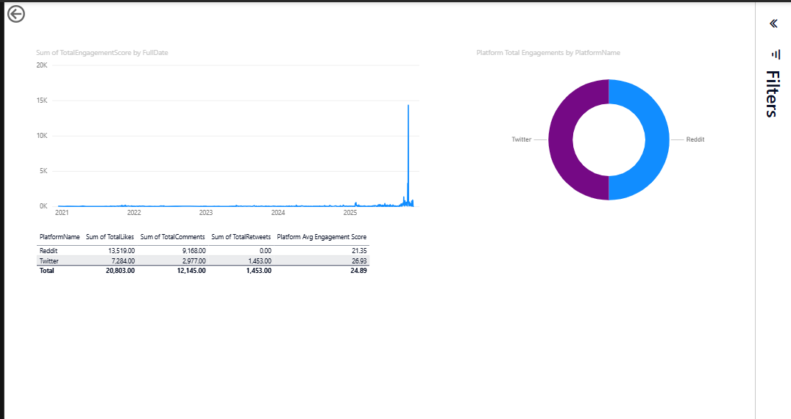
Token drill-through
TASK 8 / DETAILED EXPLORATION
Interaction design
Right-click a token from the overview
Navigate to its detail page
Inspect platform breakdown
Return using the back button
Verify token-specific filters during final QA
NOODLES / INDUSTRY CONNECT
10 / 12

Slide 11
Key outcomes & technical skills
EVIDENCE-BASED PROJECT HIGHLIGHTS
2,682
4 views
3 pages
Social engagement fact records in the Task 5 schema export; not a live count.
vw_ExecutiveDashboard
vw_TimeSeries
vw_SocialAnalytics
vw_PlatformDaily
Executive Overview
Platform Performance
Token Drill-through
Capabilities: Python ETL • MySQL modeling • DAX • Power BI • data quality
NOODLES / INDUSTRY CONNECT
11 / 12

Slide 12
Thank you
QUESTIONS & DISCUSSION
From fragmented data to
clear executive insights.
Industry Connect | Noodles Crypto Analytics
Portfolio: add verified GitHub repository URL before presenting
NOODLES / INDUSTRY CONNECT
12 / 12

